Slide 1
BYU Student Alumni Association
BYU MPA Class
BYU Student Family Housing
Life is Good:
10 Things You Should Do
to Improve your Personal Finances
February 29, 2020
Bryan Sudweeks, Ph.D., CFA
From the BYU Marriott School of Management website on
Personal Finance
at http://personalfinance.byu.edu

Slide 2
Abstract
The phrase “Life is Good ” is a wonderful acronym to help you remember what we believe you should be doing financially. This presentation will help you understand this phrase and the 10 things it represents. In this presentation we have imbedded a number of readings, PowerPoints and other materials to help you learn to become more financially wise. As you work to put Christ more at the center of your lives and finances, you will realize that “becoming self-reliant in providing for ourselves and families, both spiritually and temporally” is simply living the gospel of Jesus Christ. Moreover, it takes personal finance from being an unfortunate necessity to an important shared spiritual experience for you and your family! (see General Handbook, section 1.2.1)
2

Slide 3

Remember “Life is Good”
What do I want you to remember from today?
  L Love God and put and pay Him first
  I Invest wisely, consistent with your risk level
  F Find happiness in your spouse and family
  E Enjoy the journey and give back
  I Invest in yourself & family for education/missions
  S Save 20%, build a reserve and save 15% for retirement
  G Get and stay out of debt
  O Organize yourself, know your vision, goals & plans
  O Operate on a budget and protect yourself
  D Do good, be good, and become more like Christ
3

Slide 4
L1. Love the Lord, and Put and Pay Him First
How do we put and pay God first?
  We do this as we live His gospel and bring Christ more into our lives and finances
    We increase our love for and faith in the Savior and His atonement
    We strive to change daily and become a more converted disciple
    We apply His words and create our lives and values more closely with Him
    We always remember Him
L
Life is Good
4

Slide 5
L1. Love the Lord, and Put and Pay Him First
  1. We increase our love for and faith in the Savior and His atonement
  We study, pray, learn more about Him, and act on His amazing atonement
  We understand that He has prepared a “customized curriculum” called life for each of His children
  We realize that Personal Finance is simply part of living the gospel of Jesus Christ and is provided to help us live meaningful and happy lives and to return with our families to Him
L
Life is Good
5

Slide 6
Love the Lord (continued)
  2. We strive to change daily and become a more converted disciple
    Boyd K. Packer said: “True doctrine, understood, changes attitudes and behavior. The study of the doctrines of the gospel will improve behavior quicker than a study of behavior will improve behavior. (“Little Children,” Ensign, Nov. 1986, 17.)
    David A. Bednar added, “President Packer did not teach that simply knowing true doctrine changes us. Rather, doctrine must be understood. . . Thus, true doctrine confirmed in the heart as true by the witness of the Holy Ghost changes attitudes and behavior. (Increase in Learning, Deseret Book, 2011, p. 154.)
Life is Good
6

Slide 7
Love the Lord (continued)
Doctrines and principles, confirmed by the Spirit, change behavior
  What are the key doctrines of Finance?
    Spiritual:
      To bring us to Jesus Christ
    Temporal:
      To help us be wiser stewards
    Family:
      To return with our families back to God
    Individual:
        To accomplish our divine missions
Life is Good
7

Slide 8
Love the Lord (continued)
What are the key principles of Finance?
  Ownership:
    We do not own the things we have and are
  Stewardship:
    We are stewards over all God has blessed us with
  Agency:
    The right to choose is one or God’s greatest gifts to his children
  Accountability:
    We will be held accountable for all our choices, including our financial ones
Life is Good
8

Slide 9
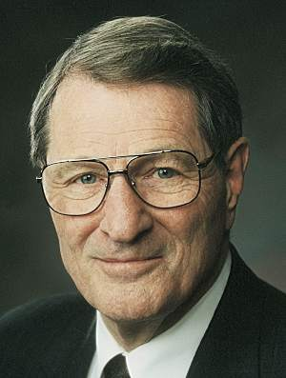
Love the Lord (continued)
  On the questions of what is really ours, Elder Neal A. Maxwell stated:
    The submission of one’s will is really the only uniquely personal thing we have to place on God’s altar. The many other things we “give,” brothers and sisters, are actually the things He has already given or loaned to us. However, when you and I finally submit ourselves, by letting our individual wills be swallowed up in God’s will, then we are really giving something to Him! It is the only possession which is truly ours to give! (italics added, “Swallowed Up in the Will of the Father,” Ensign, Nov. 1995, 22).
Life is Good
9

Slide 10
Love the Lord (continued)
3. We apply His words and create our lives and values more closely with Him
  Application (or the creative process) is an invitation to learn, prepare, plan and create. We:
    Catch our vision. “Where there is no vision, the people perish” (Proverbs 29:18)
    Develop our goals. Goals are tools to help us keep us focused on our vision
    Make our plans. Plans are how we reach our goals
    Determine constraints. What will hold us back?
    Become accountable. Who will help us?
Life is Good
10

Slide 11
Love the Lord (continued)
How important are vision, goals and plans?
  M. Russell Ballard said:
    Over the years, I have observed that those who accomplish the most in this world are those with a vision for their lives, with goals to keep them focused on their vision and tactical plans for how to achieve them. Knowing where you are going and how you expect to get there can bring meaning, purpose, and accomplishment to life. (“Return and Receive,” Ensign, May 2017.)
Life is Good
11

Slide 12
Love the Lord (continued)
  4. We always remember Him
    We remember:
      His death and atonement save us
      All things, including ourselves, are His
      We are His stewards, and
      We are all unprofitable servants
      Our conduct on our journey is as important as our destination
    What we do right now is as important as where we are going
Life is Good
12
Notes:
As such, turning to the Lord and our daily conduct will takes us from the flawed people we are now to becoming more like our Savior

Slide 13
I2. Invest Wisely, Consistent with Your Risk
Investing isn’t rocket science (and it isn’t as difficult as those who are trying to get your money make it out to be)
  If we understand the principles of successful investing, investing is understandable and doable
LIfe is Good
13

Slide 14
Invest Wisely (continued)
How have most equity investors done?
  Each year, DALBAR puts out an annual book on Quantitative Analysis of Investor Behavior. It discusses how average equity fund investors have done versus benchmarks over the past 20 years.
  Investor Index
  Year Period Returns* Returns Difference
  2015 1995-2014 5.2% 9.9% -4.7%
  2016 1996-2015 4.7% 8.2% -3.5%
  2017 1997-2016 4.8% 7.7% -2.9%
  2018 1998-2017 5.3% 7.2% -1.9%
  2019 1999-2018 3.9% 5.6% -1.7%
  * Dalbar 2013-2019
LIfe is Good
14

Slide 15
Invest Wisely (continued)
How have most bond investors done?
  According to DALBAR, bond investors have done equally poorly versus the bond benchmark over the past 20 years.
  Investor Index
  Year Period Returns* Returns Difference
  2015 1995-2014 0.8% 6.2% -5.4%
  2016 1996-2015 0.5% 5.3% -4.8%
  2017 1997-2016 0.5% 5.0% -4.5%
  2018 1998-2017 0.4% 4.6% -4.2%
  2019 1999-2018 0.2% 4.6% -4.4%
  * Dalbar QAIB 2013-2019, www.dalbar.com, ** Estimate
LIfe is Good
15

Slide 16
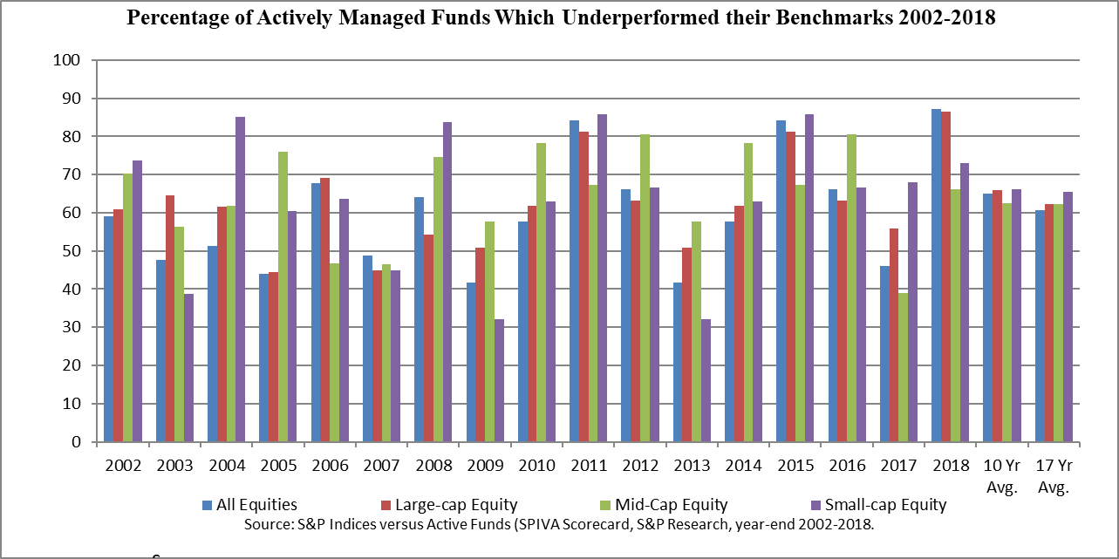
Invest Wisely (continued)
Have most actively managed funds outperformed their benchmarks?
NO!
LIfe is Good
16

Slide 17
Invest Wisely: The Hourglass Top
1. Are your priorities in order and are you “square” with the Lord?
2. Do you have adequate auto, health and life insurance?
3. Are you out of high-interest rate credit card and consumer debt?
4. Have you written down your personal vision and goals, do you live on a budget, and do you have a well-written investment plan?
LIfe is Good
If you can answer these affirmatively, you are ready to invest!
17

Slide 18
Invest Wisely: The Hourglass Bottom
Taxable Assets
Retirement Assets
4. Opportunistic: Individual Stocks, Bonds and Sector Funds
3. Diversify: Broaden and Deepen your Asset Classes
2. Core: Broad Market (Large Cap) Index Funds/ETFs, or Core
1. Basics: Emergency Fund and Food Storage
LIfe is Good
18

Slide 19
Invest Wisely (continued)
The key to investing is to know yourself, your vision and your goals. Then do 5 key things:
  1. Know what to do before you invest, and understand the principles of successful investing
  2. Know the factors you control, assets, asset classes and investment vehicles
  3. Understand your risk level, and determine an asset allocation consistent with your level of risk
  4. Understand what makes a good mutual/index fund, and write your investment plan
        5. Choose good mutual/index funds, rebalance tax-efficiently, and hold them for 40 years
LIfe is Good
19

Slide 20
F3. Find happiness where it is to be found
Don’t be fooled by the “deceitfulness of riches”
  You can’t buy happiness, so don’t even try
    Use money to do what it can do, to buy security for you and your family
      Then find happiness where it is to be found, in your:
        Spouse
        Family
        Service to God and our fellowman
LiFe is Good
20

Slide 21
E4. Enjoy the Journey and Give Back
We are but temporary travelers in this world, so make it a better place because you were here
  Decide now how you will follow Christ’s example and give back
    Develop a “Giving Plan” on how you will give
      Remember giving is a state of mind, not your pocketbook
      If you can’t give when you are poor, it will be much harder when you have money
LifE is Good
21

Slide 22
I5. Invest in yourself and family
The glory of God is intelligence
  Make it your glory as well.
    Save, if you choose, for your own and your children’s missions and education, and make it a priority
      Put together mission and education plans for you and your children, and work to follow these plans
Life Is Good
22

Slide 23
S6. Save 20% of Everything You Earn
How much should I save each month?
  You cannot spend your way into financial security, and you cannot depend on others
    Save 20% of every dollar you earn, build a reserve, and save 15% (75%) for retirement
    Always get the company match—it is free money
    Use the remaining 5% for your other long-term goals, i.e., saving for children’s missions, education, etc.
Life iS Good
23

Slide 24
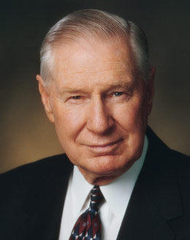
G7. Get and Stay Out of Debt
Consumer debt slows growth and savings, and is expensive, both economically and spiritually
  James E. Faust stated:
    Over the years the wise counsel of our leaders has been to avoid debt except for the purchase of a home or to pay for an education. I have not heard any of the prophets change this counsel (“Doing the Best Things in the Worst Times,” Ensign, Aug. 1984, 41).
        Sadly, consumer, auto, and credit card debt not paid off monthly are not included in that short list of acceptable debt
Life is Good
24

Slide 25

Get out of Debt (continued)
Be consistent in your thinking
  Debt is an after-tax amount, and what you earn is a before-tax amount.
  If you are in the 28% federal marginal tax, 10% state tax, pay 10% tithing and 7.65% Social Security/Medicare, you will need to earn $2.25 to spend or pay back $1 of principle or interest
  See Loan Amounts (LT34)
Life is Good
25

Slide 26
O8. Organize your Life
Organize your life and have a plan
  Know and write down your vision, goals, plans, constraints and accountability
  What is the importance of vision?
    What is your vision for your life?
      What is your mission in life?
      What goals do you want to accomplish before you die?
      What are your plans and strategies, constraints and your accountability partners (see Planning Your Life: (LT38))?
Life is GOod
26

Slide 27
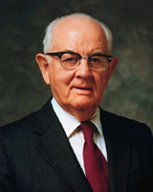
O9. Operate on a Budget and Protect Yourself
Spencer W. Kimball counseled:
  Every family should have a budget. Why, we would not think of going one day without a budget in this Church or our businesses. We have to know approximately what we may receive, and we certainly must know what we are going to spend. And one of the successes of the Church would have to be that the Brethren watch these things very carefully, and we do not spend that which we do not have (Conference Report, April 1975, pp. 166-167).
Life is GoOd
27

Slide 28
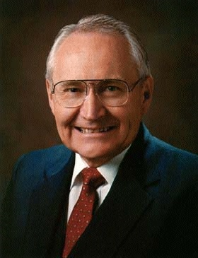
Operate on a Budget (continued)
Make saving a part of every budget
  L. Tom Perry taught:
    After paying your tithing of 10 percent to the Lord, you pay yourself a predetermined amount directly into savings. That leaves you a balance of your income to budget for taxes, food, clothing, shelter, transportation, etc. It is amazing to me that so many people work all of their lives for the grocer, the landlord, the power company, the automobile salesman, and the bank, and yet think so little of their own efforts that they pay themselves nothing (“Becoming Self-Reliant,” Ensign, Nov. 1991, 64).
Life is GoOd
28

Slide 29

Operate on a Budget (continued)
What is a Budget (we call it a saving, income and expense plan)?
  It is the single most important tool in helping us attain our personal goals.
    It is the process of planning our spending
    It’s making sure our resources are used for the things that matter most—our personal goals
    It gives every dollar a name and a purpose
    See a Simple Budget Spreadsheet (LT4C)
Life is GoOd
29

Slide 30

Budgeting: The Old Way
Income
Tithing
Expenses
Available for Savings
Personal Goals
Life is GoOd
30

Slide 31

Budgeting: The Better Way
Income
Pay the
Lord First
Pay
Yourself
Expenses
Other
Savings
Personal Goals
Life is GoOd
31

Slide 32
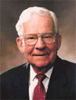
Operate on a Budget (continued)
Marvin J. Ashton stated:
  Some claim living within a budget takes the fun out of life and is too restrictive. But those who avoid the inconvenience of a budget must suffer the pains of living outside of it. The Church operates within a budget. Successful business functions within a budget. Families free of crushing debt have a budget. Budget guidelines encourage better performance and management (italics added, “It’s No Fun Being Poor,” Ensign, Sept. 1982, 72).
Life is GoOd
32

Slide 33
Protect Yourself with Insurance
Have adequate auto, homeowners/renters, health and life insurance
  Generally, auto coverage of 100/300/100 is a good starting point for students (you will likely need higher limits)
  Get renter’s insurance from your auto insurance company—its really cheap
  Get health insurance that meets your needs/budget
  Get adequate life insurance (but be careful of those wanting to sell you cash value and indexed universal life policies when you likely can do better with cheaper term policies)
Life is GoOd
33

Slide 34
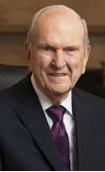
D10. Do Good, Be Good, and Get Better
Russell M. Nelson reminds us:
  “We can do better and be better. . . We need to do better and be better because we are in a battle. The battle with sin is real. . . I bless you with the courage to repent daily and learn how to exercise full priesthood power. I bless you to communicate the love of the Savior to your wife and children and to all who know you. I bless you to do better and to be better. And I bless you that as you make these efforts, you will experience miracles in your life.” (“We can Do Better and Be Better,” Ensign, May 2019).
Life is GooD
34

Slide 35

Do Good, Be Good and Get Better (continued)
Part of being getting better is to be more financially wise.
  Average per household debt in the U.S. is $14,500 excluding mortgage debt in 2007
  Credit card users pay 12-20% more than cash users
  40% of American families spend more than they earn
  The typical family pays $1,200 per year in interest
  About 60% of all active credit card accounts are not paid off monthly
  Most couples indicate that finances are a major stress on their marriages
  Sources: available upon request
Life is GooD
35

Slide 36
Do Good, Be Good and Get Better (continued)
How do to you get better in your finances?
  There are many sources of good information
  Let me add three other sources to your list:
    1. The Personal Finances for Self-Reliance program (part of Self Reliance Services)
      Personal Finances for Self-Reliance Program
    2. The LDS Provident Living Website
      www.providentliving.org, then Family Finances
    3. The BYU Marriott School of Management’s Personal Finance website
      http://personalfinance.byu.net
Life is GooD
36

Slide 37

Do Good, Be Good and Get Better (continued)
1. Personal Finances for Self-Reliance Program
Take the Personal Finances for Self-Reliance course offered by your Ward. It is an amazing program that EVERYONE should take carefully and prayerfully. Start here!
37

Slide 38
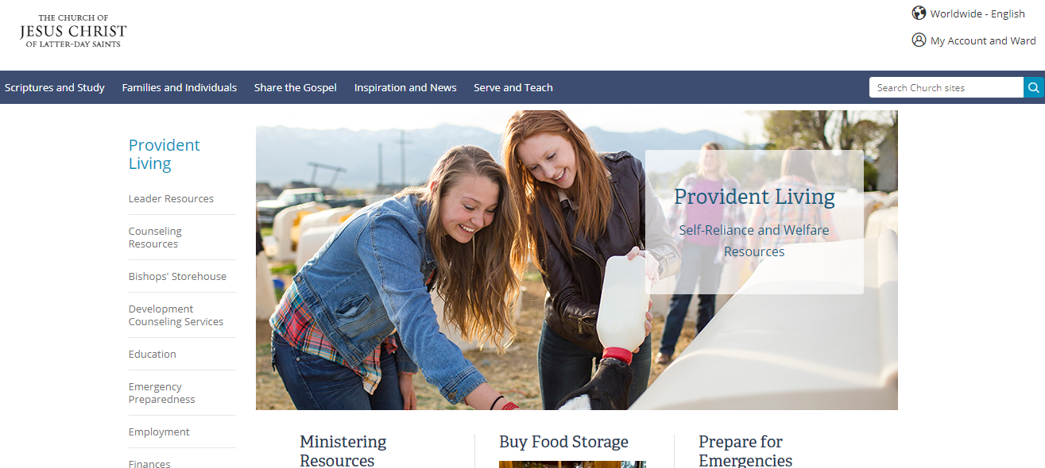
Do Good, Be Good and Get Better (continued)
2. LDS Provident Living Website
There is lots of inspired counsel for each of us
This is good for guidelines and general finance information
38

Slide 39
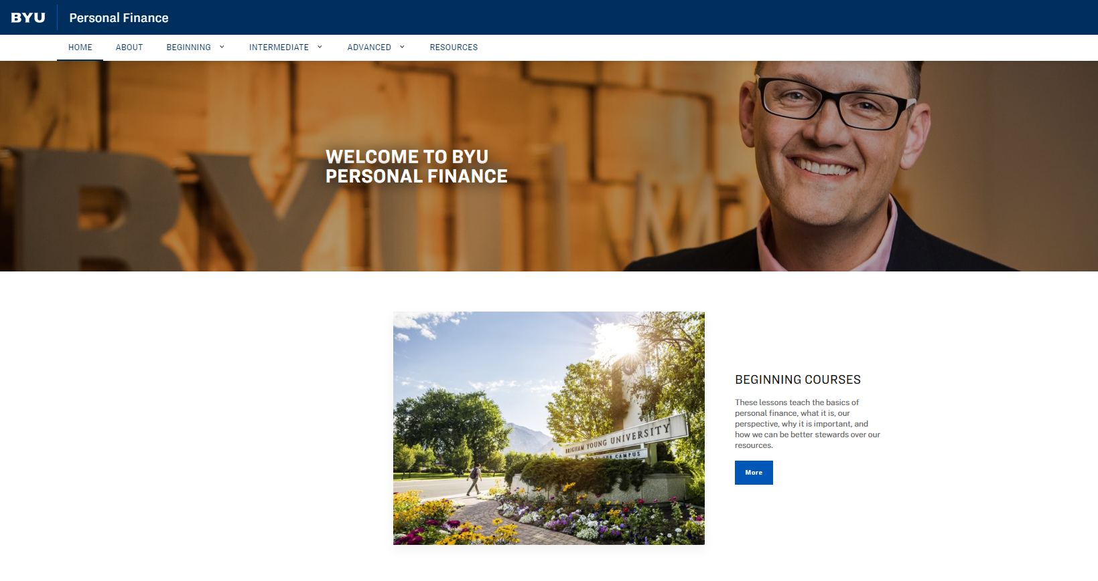
Do Good, Be Good and Get Better (continued)
3. BYU MSB Personal Finance Website
This is for those who want to go beyond Personal Finance basics into the areas discussed today. Its free and can help!
39

Slide 40
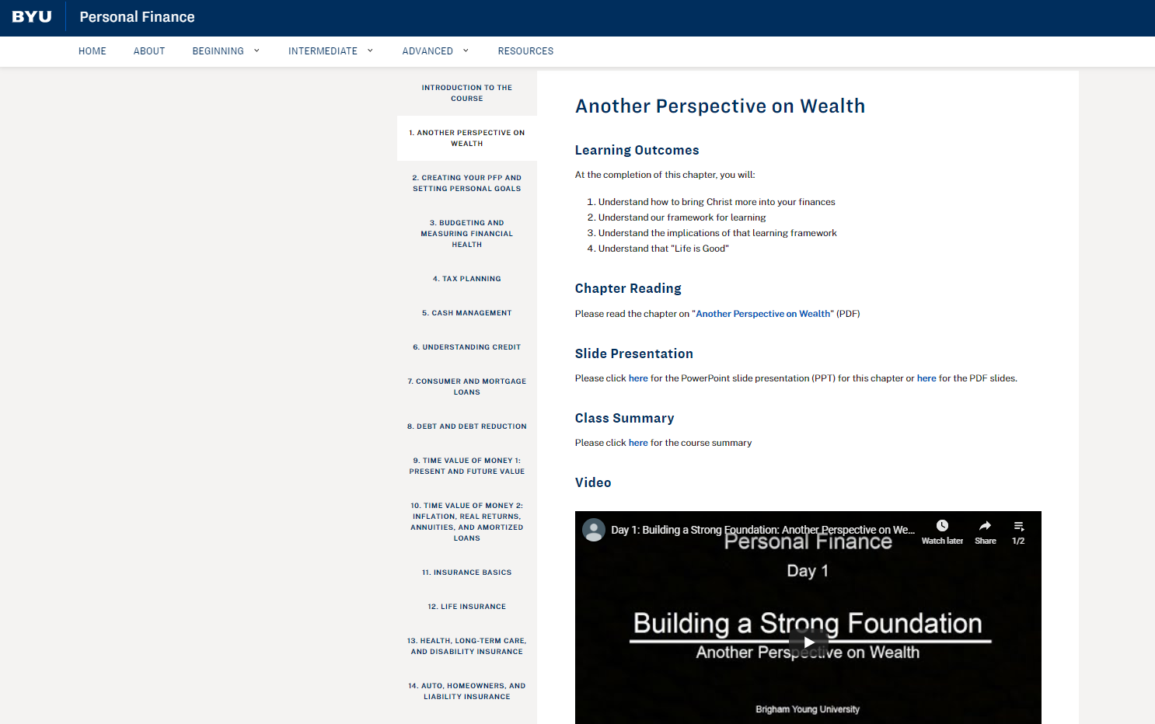
Do Good, Be Good and Get Better (continued)
Each section contains Learning Outcomes, Readings, PowerPoints, Videos, and Assignments and Learning Tools
40

Slide 41
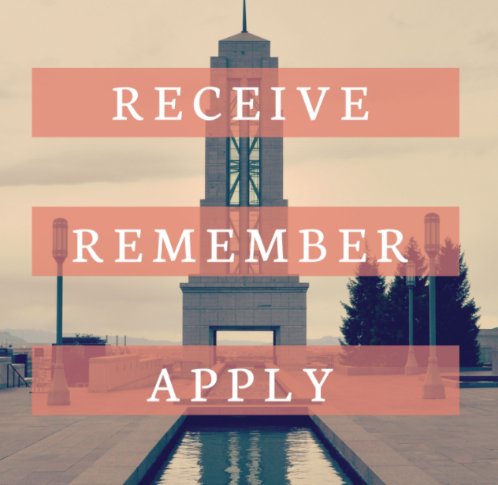
Do Good, Be Good and Get Better (continued)
To be and get better, we must remember the “ifs ”
  These are not just the things we must know, but things we must do!
Life is GooD
41

Slide 42
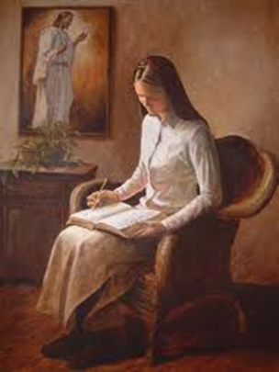
Do Good, Be Good and Get Better (continued)
a. The scriptures make us wise . . . if we learn from them and obey the commandments
  It is not enough to read the scriptures—we must read, think, ponder, pray and obey the commandments
    O remember, my son, and learn wisdom in thy youth; yea, learn in thy youth to keep the commandments of God (Alma 37:35).
Life is GooD

Slide 43
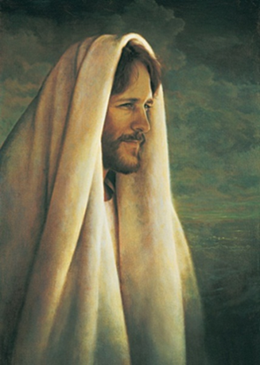
Do Good, Be Good and Get Better (continued)
b. The Savior makes us holy . . . if we repent and apply the atonement in our lives
  It is not enough to have a Savior—we must repent and take advantage of His amazing atonement
    For, behold, the Lord your Redeemer suffered death in the flesh; wherefore he suffered the pain of all men, that all men might repent and come unto him. And he hath risen again from the dead, that he might bring all men unto him, on conditions of repentance (D&C 18:11-12).
Life is GooD
43

Slide 44
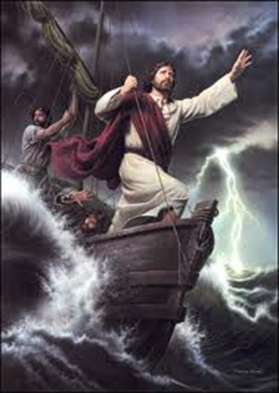
Do Good, Be Good and Get Better (continued)
c. The storms make us strong . . . if we learn the lessons God wants us to learn from them
    Nevertheless, . . . thou knowest the greatness of God; and he shall consecrate thine afflictions for thy gain (2 Nephi 2:2).
    And if men come unto me I will show unto them their weakness. I give unto men weakness that they may be humble; and my grace is sufficient for all men that humble themselves before me; for if they humble themselves before me, and have faith in me, then will I make weak things become strong unto them (Ether 12:27).
Life is GooD
44

Slide 45
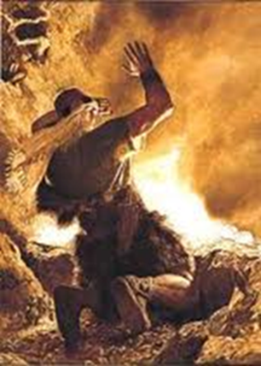
Do Good, Be Good and Get Better (continued)
The Brother of Jared knew about storms
  When the brother of Jared came to the ocean on his way to the “promised land,” he had three problems, and the Lord helped the brother of Jared with each
    The Lord instructed him to put in holes for air
      He will instruct us in our lives as well
    The Lord touched the stones, which gave light
      He will touch us and give us “light” as well
    The Lord sent the storms to take Jared and his family toward the “promised land”
        Likewise, the storms which He sends us today will take us to our “promised land” as well
Life is GooD
45

Slide 46
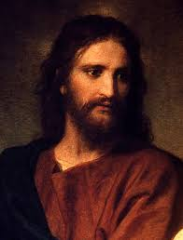
Do Good, Be Good and Get Better (continued)
The Lord is in our storms
  He is trying to teach us those things which will take us to our “promised land,” to return to His presence
    If we learn the lessons He is trying to teach us, we will become stronger, more valiant in the testimony of Christ, more willing and able to serve, and more ready for the next storm
Life is GooD
46

Slide 47
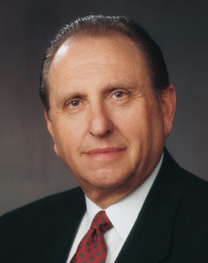
Do Good, Be Good and Get Better (continued)
d. We can “be of good cheer”. . . IF we heed Christ and His prophet’s counsel
  I testify to you that our promised blessings are beyond measure. Though the storm clouds may gather, though the rains may pour down upon us, our knowledge of the gospel and our love of our Heavenly Father and of our Savior will comfort and sustain us and bring joy to our hearts as we walk uprightly and keep the commandments. There will be nothing in this world that can defeat us. My beloved brothers and sisters, fear not. Be of good cheer. The future is as bright as your faith (italics added, Thomas S. Monson, “Be of Good
        Cheer,” Ensign, May 2009, 92).
Life is GooD
47

Slide 48
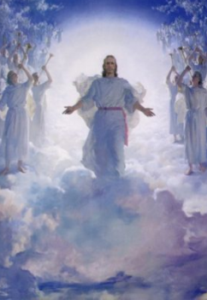
Do Good, Be Good and Get Better (continued)
I know that if we strive to obey the Lord’s commandments and seek to be like our Savior, we will all come to know, in spite of all the storms, that:
      For verily, I say unto you, that great things await you (D&C 45:62).
        For great things truly await you as you remember and follow that “Life is Good!”
Life is Good
48

Slide 49
Appendix
  L Love the Lord and put and pay Him first
  I Invest wisely, consistent with your risk
  F Find happiness in your spouse and family
  E Enjoy the journey and give back
  I Invest in yourself/family for education/missions
  S Save 20%, build a reserve and save 15% for retirement
  G Get and stay out of debt
  O Organize yourself, know vision, goals & plans
  O Operate on a budget and protect yourself
  D Do good, be good, and become more like Christ
49

Slide 50
Sources
Slides and hyperlinks are from the BYU Marriott School Personal Finance website at http://personalfinance.byu.edu
Please feel free to use this resource and to share it with others
There is no advertising, no paid pages, and we receive nothing from putting this resource together. Our only goal is to help you get your financial houses more in order as
Life is Good
50

Slide 51
Helpful Learning Tools
PFP Table of Contents (LT01)
Completed PFP (LT02A)
Simple Budget (LT04C)
Simple Balance Sheet and Ratios (LT04B)
Investment Plan Example Template (LT05A)
Retirement Planning Needs (LT06)
Using Morningstar to Select Funds (LT07)
Maximum Mortgage Payments for LDS (LT11)
Excel Financial Calculator (LT12)
Life is Good
51

