Slide 1
Time Value of Money 2:
Inflation, Real Returns, Annuities, and Amortized Loans
2019/07/08
Personal Finance: Another Perspective

Slide 2
Objectives
A. Understand the impact of inflation on investing
B. Understand how to calculate real returns
C. Know how to solve problems relating to Annuities, Future Value of an annuity, and Present Value of an annuity
D. Know how to solve problems relating to amortized loans

Slide 3
Understand the Impact of Inflation on Investing
What is inflation?
  Inflation is the increase in the volume of money and credit relative to available goods and services resulting in a continuing rise in the general price level
    In other words, your money can buy less goods and services than it could before.
    To compensate, you must pay more money (for the same amount of goods)

Slide 4
Inflation (continued)
What is the impact of inflation on investing?
  Inflation has a negative impact on your investments
    You have the same amount of money but your money can buy less
      Inflation forces us to save more, because our dollars will be worth less in the future.

Slide 5
Investment Problem #1
Inflation
40 years ago a five stick pack of gum was 5 cents a pack. Today it is 75 cents per pack.
  Assuming no change in the size of the gum, at what rate has inflation increased over each of those 50 years?

Slide 6
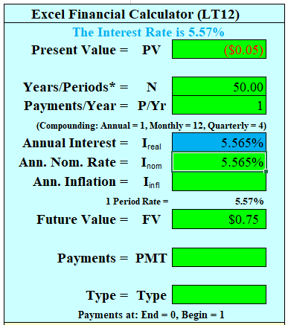
Answer #1:
Inflation
Clear registers, set your calculator to 1 payment year, and set your payments to end mode, i.e. end of the period payments.
  -.05 = PV .75 = FV 50 = N and solve for I
    I% = 5.56% per year
  Inflation on gum has
  averaged 5.56% per year
  for the last 50 years!

Slide 7
Investment Problem #2:
The Future Value of a Wedding (inflation)
I have six wonderful daughters (and one son). Assume the average wedding costs $23,000 this year.
  Assuming 4% inflation, what will it cost in 15 years for all six weddings for my six daughters?

Slide 8
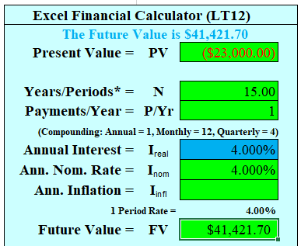
Answer #2:
Future Costs of Weddings and Inflation
Clear registers, set to end of period, 1 payment per year
    -23,000 = PV, 15 = N, 4 = I
    Solve for FV ?
    FV = $41,422 per wedding
  Total Cost = $41,422 x 6 = ?
    Total costs = $248,530
      I need to save now
      Inflation will raise
      my costs by 80%!!!!

Slide 9
Understand the Concept of Real Returns and how to calculate them
Real Returns are your return on investments after the impact of inflation
  Inflation has a negative impact on your investments, i.e. your money will buy less
To keep your buying power constant (or your real returns constant) you must actually earn more money in nominal terms to maintain your purchasing power
  The formula for Real Returns is: (1 + return) -1
  (1 + inflation)

Slide 10
Real Return Methodology
While some have argued that it is OK to just subtract inflation (π) from your nominal return (r_{nom}).
  However, this overstates your real return (r_{real}).
The correct formula links (1+r_{real}) * (1+π) = (1 + r_{nom})
  Multiplied out and simplified the answer is:
    r_{real}+ π + r_{real} π = r_{nom}
  Assuming the cross term r_{real} π is small, the formula condenses to: r_{real}+ π = r_{nom} or r_{real}= r_{nom} - π
The correct method is to divide both sides by (1+π) and subtract 1 to give: r_{real} = [(1 + r_{nom})/ (1+π)] - 1

Slide 11
Investment Problem #3:
Real Returns (returns after inflation)
Paul just graduated from college and landed a “real” job that pays $35,000 per year.
  A. What nominal rate will he need to earn in the future to maintain a 2% real return assuming inflation averages 1.96%?
  B. What will his salary be in 10 years in nominal terms?
  C. What will his salary be in 10 years in real terms?

Slide 12
Answer #3:
Real Returns
A. What nominal rate is needed to maintain a 2% real return?
  Real Return = (1 + nominal return)/(1 + inflation) – 1
  To make a real return of 2%, he will need to make a nominal return of 4% assuming inflation of 1.96%
    1 + .02 = (1 + x%)/(1.0196) Solve for x?
    His nominal return must be 4%

Slide 13
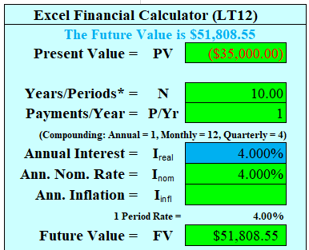

Answer #3:
Real Returns (continued)
B. What will his salary be in 10 years in nominal terms?
  Nominal return: -$35,000 = PV,
  4 = I%, 10 = N, P/Yr = 1,
  solve for FV ?
  FV = $51,809
What will his salary be
in 10 years in real terms?
  Real Return: -35,000 = PV
  2 = I%, P/Yr = 1, 10 = N
  Solve for FV ?
  FV = $42,665

Slide 14
C. Know How to Solve Problems
Relating to Annuities
What is an Annuity?
  A series of equal dollar payments coming at the end of each time period for a specified number of time periods, generally months or years.
What is a Compound Annuity?
  An investment that involved depositing an equal sum of money at the end of each year for a certain number of year and allowing it to grow
Can you find the Present and Future Value of each of these types?
  Yes!

Slide 15
Solving Problems
Relating to Annuities
Problem:
  You want to determine the value of a series of equal dollar payments either currently or at some point in the future
Problem Statement:
  What will be the future (present) value of a series of annual (monthly) payments x years in the future if my interest rate is y%?
Key Information Needed:
  Amounts, years in the future and the interest rate

Slide 16
Investment Problem #4:
Annuities
When you retire at age 60, you plan to have $750,000 saved. Assuming an interest rate of 7% and that you will need payments for 30 years (you expect to die at age 90), how much could you receive each year for your $750,000?

Slide 17
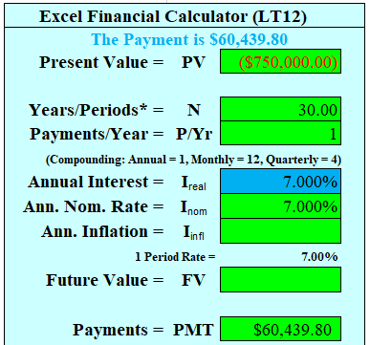
Answer #4:
Annuities
Assuming you need payments for 30 years and interest rates are 7%, you can receive:
  -750,000= PV, 30 = N,
  7 = I%, P/Yr = 1
  Solve for Payment?
  PV of Annuity = $60,440
Start saving for retirement the
month you graduate. It will
make a big difference on what
you will be able to retire with!

Slide 18

Investment Problem #5:
Compound Annuities
You are looking to buy a new Polaris 700 quad or four wheeler to clean the snow from your driveway (ha!). Instead of borrowing the $7,000 for the quad, you want to save for it each month. How much will you need to save each month, assuming you can get 7% on your investments and you want to buy the quad in 50 months? How much if you can get 7% and want it in 24 months?

Slide 19
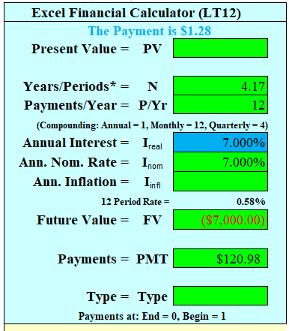
Answer #5:
Compound Annuities
50 Months:
  Clear memories, set payments to 12 (monthly), set to end mode
  -7,000 = FV, 50/12 = N, 7 = I%, P/Yr = 12, Solve for PMT = ?
  Note that for N, it needs to be an annual number, or 50/12
  You will need to save
  $120.98 each month to
  have it in 50 months

Slide 20
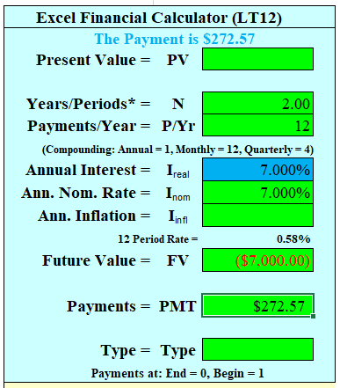
Answer #5:
Compound Annuities
24 months:
  Clear memories, set payments to 12 (monthly), set to end mode
  -7,000 = FV, 24/12 = N,
  P/Yr = 12, 7 = I%,
  Solve for PMT = ?
  You will need to save
  $272.57 each month to
  have it in 24 months

Slide 21
Investment Problem #6:
Present Value of an Annuity
Two people wish to buy your house. The first offers you $200,000 today, while the second offers you 25 annual payments of $14,200 each.
  What is the present value of each offer, assuming a 5% discount rate?
  Who would you sell it to?

Slide 22
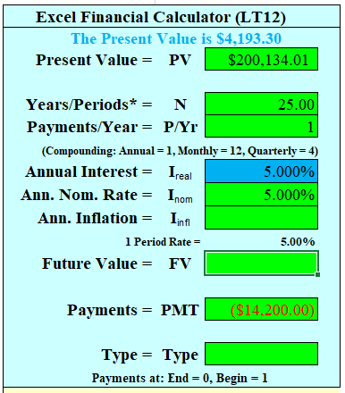
Answer #6:
Present Value of Annuities
A. What is the Present Value of each offer:
  Offer 1: Present value = $200,000
  Offer 2: Clear memories, set 1 payment year and end of period
    -14,200 = PMT, 25 = N, 5 = I%, Solve for PV?
    Present Value of Offer 2 = $200,134
B. Which is the better offer?
  Offer 1 and Offer 2 are roughly the same
  Take either one (one is more certain)
  Know how to evaluate
  different cash flows!

Slide 23
Investment Problem #7:
FV of an Annuity
Josephine, age 22, started working full time and plans to deposit $3,000 annually into an IRA earning 6%. How much will he have (FV) in:
    20 years?
    30 Years?
    40 Years?
If she increased her investment return to 8%, how much would he have after each of the three time periods?

Slide 24
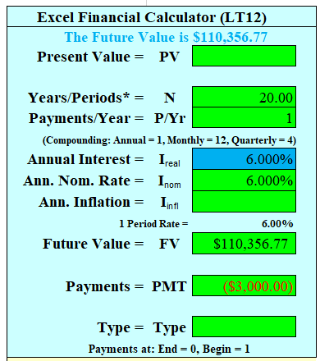
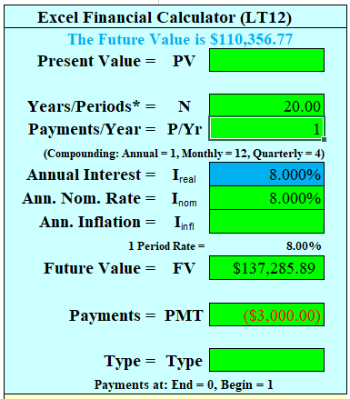
Answer #7:
Present Value of an Annuity
6% interest, $3,000 PMT
  20 Years = $110,357
  30 Years = $237,175
  40 Years = $464,286
8% Interest
  20 Years = $137,286 ($26,929 more)
  30 Years = $339,850 ($10,675 more)
  40 Years = $777,170 ($312,884 more)
Your rate of return and time make
a big difference!

Slide 25
D. Know how to solve problems relating to Amortized Loans
What is an Amortized Loan?
  A loan paid off in equal installments, both principle and interest
    With an amortized loan the interest payment declines as your outstanding principal declines; therefore, with each payment you will be paying an increasing amount towards the principal of the loan.
      Examples -- car loans or home mortgages

Slide 26
Solving Amortized Loan Problems
Problem:
  You want to determine either the payment, time or interest rate necessary for a loan
Problem Statement:
  If I want to borrow z amount for x years at y% interest, what will be my p or payment?
Key Information Needed:
  Borrowed amount, years, interest rates, and payments

Slide 27

Investment Problem #8:
Buying a Car (With Four “Easy” Payments)
What are the annual payments to borrow $36,000 at 15% interest for a new Suburban SUV with four annual payments? How much interest will you have paid for the SUV?

Slide 28
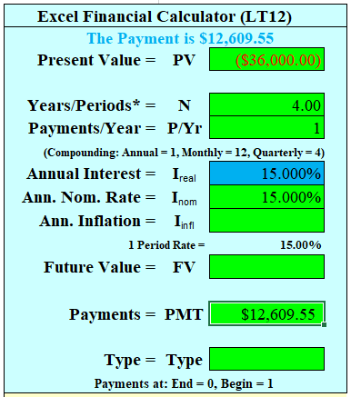
Answer #8:
Buying that SUV
A. Clear memories, set payments to annual and to end mode
  PV = -36,000, N = 4, I = 15, P/Yr =1
  Solve for PMT = ?
  PMT = $12,609.55
Interest Paid = 12,609.55 * 4 =
$50,438.2 – $36,000 = $14,438.21
(that is the cost of another car!)
  Buy the car, but not on credit.
  Save for it!

Slide 29
Investment Problem #9:
Buying a House
Calculate the monthly payments for a $250,000 mortgage loaned in each of the following ways:
  30 year fixed at 4.5%
  15 year fixed at 3.75%
  20 year fixed at 4.125%
  What are the total payments on each loan and which is the best option for a homeowner who, after reviewing his budget, can afford $1,550 per month?
Note: some calculators require you to set the payments to 12 (for monthly payments) and also require you to take the interest rate and divide by 12. Others just require you to set the payments to 12. Determine what your calculator requires before solving problems requiring monthly data!

Slide 30
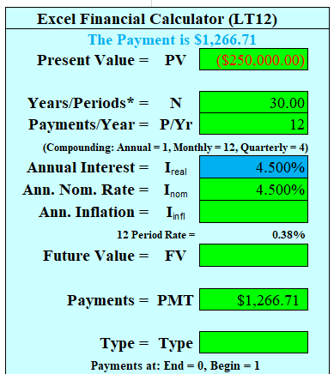
Answer #9:
The House
30 year at 4.5%
  Clear memories, set to monthly payments, and set to end mode
  -250,000 = PV, 30 = N,
  4.5% = I, P/Yr = 12
  Solve for PMT?
  PMT = $1,267

Slide 31
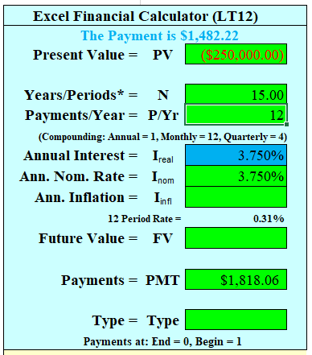
Answer #9:
The House
15 year at 3.75%
  Clear memories, set to monthly payments, and end mode
  -250,000 = PV 15 = N
  3.75% = I, P/Yr = 12
  Solve for PMT?
  PMT = $1,818

Slide 32
Answer #9:
The House (continued)
20 year at 4.125%
  Clear memories, set to monthly payments, and end mode
  -250,000 = PV 20 = N
  4.125% = I, P/Yr = 12
  Solve for PMT?
  PMT = $1,531
The safest option would be the 20-year fixed rate mortgage at 4.125 percent. It allows the homebuyer to pay off the home in ten less years than the 30 year loan and to save $77,250 in interest costs versus the 30 year loan.

Slide 33
Investment Problem #10:
Becoming a Millionaire
Your buddy thinks that to become a millionaire is totally beyond his earning abilities. You, the financial wizard that you are, plan to show her otherwise. Assuming your friend is 25 years old, and will retire at age 65, and assuming an 6% interest rate, how much will she have to save each month to reach her goal of becoming a millionaire when she retires?
How much each month if she earns 8% on her investments?

Slide 34
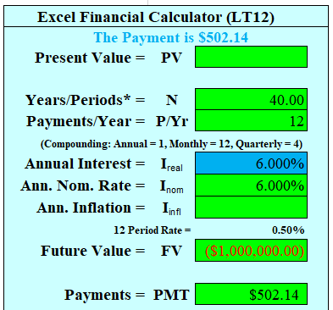
Answer #10: the Millionaire
At 6% interest:
  Clear your memory and set payments to monthly. FV = 1,000,000 N = 40,
  P/Yr = 12, I = 6%,
  Solve for Payment (PMT)
  PMT = $502.14

Slide 35
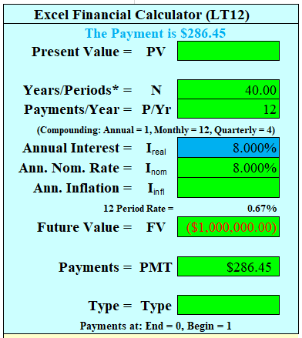
Answer #10: the Millionaire
At 8% interest:
  Clear your memory and set payments to monthly. FV = 1,000,000 N = 40,
  P/Yr = 12, I = 8%,
  Solve for Payment (PMT)
  PMT = $286.45
Its not that hard to become a millionaire if you will invest a specific amount every month!

Slide 36
Questions
Are you comfortable with solving amortized loan problems?

Slide 37
Review of Objectives
A. Do you understand the impact of inflation on investing?
B. Do you know how to calculate real returns?
C. Can you solve problems relating to Annuities, Future Value of an annuity, and Present Value of an annuity?
D. Do you know how to solve problems relating to amortized loans?

Slide 38
Case Study #1
Data
Lee is thirty-five years old and makes a $4,000 payment every year into a Roth Individual Retirement Account (IRA) (this is an annuity) for thirty years.
Calculations
Assuming the discount, or interest, rate Lee will earn is 6%, what will be the value of his Roth IRA investment when he retires in 30 years (this is future value)?
Note: The math formula is a bit tricky. The formula is:
FVn = Payment * (FVIFAi,n)

Slide 39
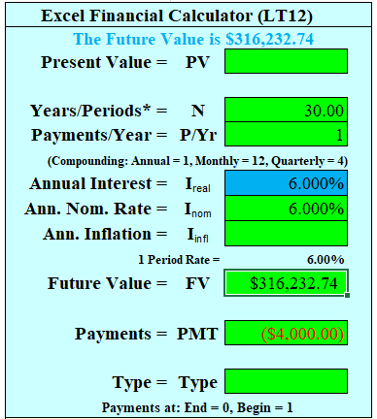
Case Study #1 Answers
There are two ways for Lee to solve the problem. Using the math formula, the problem is solved:
FV_{n,i} = Payment * [(1 + i)^{n} –1] /i = FV = $4,000 * [(1.06)30 –1]/.06 = $316,232.74
Using a financial calculator, clear the calculator’s memory and solve the problem this way:
1 = P/Y (payments per year)
4,000 = PMT (payment)
6 = I (interest rate)
30 = N (number of years)
Solve for FV = $316,232.74

Slide 40
Case Study #2
Data
Janice will make a yearly $2,000 payment (this is an annuity) for forty years into a traditional IRA account.
Calculations
Given that the discount, or interest, rate is 6 percent, what is the current value (that is, the present value) of Janice’s investment in today’s dollars? The math formula is:
PV_{n,i} = Payment * (PVIFA_{n,i})

Slide 41
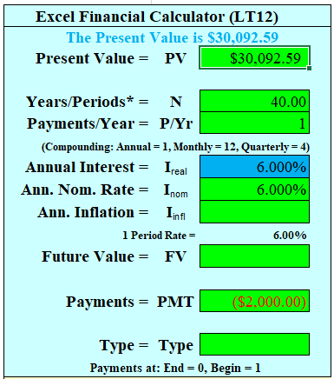
Case Study #2 Answer
Using the math formula, the calculation is:
PV_{n,i} = Payment * [ 1–( 1/(1 + i)^{n} )]/i = PV = 2,000 * [1–(1/(1.06)40] /.06 = $30,092.59
Using the financial calculator, the calculation is:
Clear memories and use the following:
1 = P/Y (payments per year)
2,000 = PMT (payment)
6 = I (interest rate)
40 = N (number of years)
Solve for PV = $30,092.59

Slide 42
Case Study #3
Data
Brady wants to borrow $20,000 dollars for a new car at 13 percent interest.
Calculations
He wants to repay the loan in five annual payments (this is an annuity). How much will he have to pay each year (this indicates present value)? The math formula is the formula that was used in the previous problem, i.e.:
PV_{n} = Payment * (PVIFA_{i,n})

Slide 43

Case Study #3 Answer
Using the math formula, put Brady’s borrowed amount into the equation and solve for your payment. PV_{i,n} = Payment * [ 1–( 1/(1 + i)^{n} )]/i = PV = $20,000 = Payment * [1–(1/(1.13)5] /.13 = $5,686.29 per year.
Using a financial calculator, clear the calculator’s memory and use the following:
1 = P/Y (payments per year)
20000 = PV
13 = I (interest rate)
5 = N (number of years)
Solve for PMT = $5,686.29

Slide 44
Case Study #4
Data
Kaili has reviewed the impact of inflation in the late 1970s. She reviewed one of her parent’s investments during that time period. Inflation was 20 percent and her parent’s investment made a 30 percent return.
Calculations
What was her parent’s real return on this investment during that period?

Slide 45
Case Study #4 Answers
The traditional (and incorrect) method for calculating real returns is:
  Nominal return – inflation = real return. This formula would give her a real return of 10%.
    30% – 20% = 10%
  The correct method is: (1 + nominal return)/(1 + inflation) – 1 = real return or (1.30/1.20)–1 = 8.33%
In this example, the traditional method overstates the real return by 20 percent ((10%/8.33%) –1). Be very careful of inflation, especially high inflation!

Slide 46
Case Study #4 Answers
The correct formula for calculating inflation is very similar to a single period geometric return. The formula is:
  (1 + real return) * (1 + inflation) = (1 + nominal return).
  If you multiply out the left side [(1 + real return) * (1 + inflation)], you get [1 + inflation + real return + a cross-term which is inflation * real return]. If you assume this cross-term is small or zero, then the formula condenses to:
  Real return + inflation = nominal return which is an approximation.

Slide 47
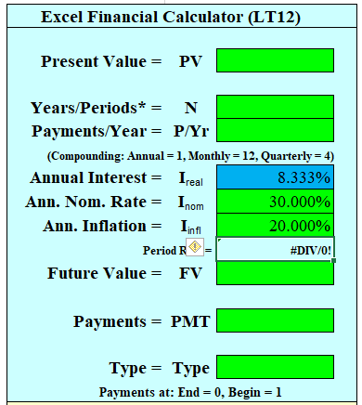
Case Study #4 Answers
The correct way to solve for the real return is to begin with the above formula:
  (1 + real return) * (1 + inflation) =
  (1 + nominal return)
  Divide both sides by (1 + inflation) and subtract 1 from both sides and you get the
  formula discussed earlier:
    Real Return = (1 + nominal return) - 1
    (1 + inflation)

