Slide 1
Personal Finance: Another Perspective
Time Value of Money 1:
Present and Future Value
Updated 2019/07/08
.

Slide 2
Objectives
A. Understand Investments
B. Understand the importance of compound interest and time
C. Understand basic finance terminology
D. Know how to solve problems relating to Future Value (FV) and to Present Value (PV)

Slide 3
A. Understand Investments
What is an Investment?
  Current commitment of money or other resources in the expectation of reaping future benefits.
What is Sacrifice?
  Current commitment of money or other resources in the expectation of reaping future benefits.
Is there a difference?
  Interestingly, in the church we interchange the two.

Slide 4
Investments (continued)
Are there priorities of Investments?
  What are your most important investments?
    Your testimony
    Your family
    Your education
  The prophet Jacob counseled:
    “Wherefore, do not spend money for that which is of no worth, nor your labor for that which cannot satisfy.” (2 Nephi 9:51)

Slide 5

My Most Important Investments

Slide 6
Investments (continued)
What are your other key investments?
  Education and Skills
  Knowledge and Friendships
  Food Storage and Emergency Funds
  Financial Investments
    Do not be too narrow in your view of investments

Slide 7
Investments (continued)
What investments will we be working with in this class?
  Generally financial investments:
    Mutual funds, stocks (equities), bonds, cash, etc.
    We will make reference to other important investments as well

Slide 8
B. Understand the importance of compound interest and time
Albert Einstein commented:
“Compound interest
(which is interest on interest)
is the eighth wonder of the world.”
Why?

Slide 9
How Important is Time?
Time
  The only tool that is equally on everyone’s side
    But you have to have the discipline and the foresight to use it!
    Use it to your advantage by starting early and not stopping for “diversions” in your spending and your goals

Slide 10
How Important is Interest?
What is interest?
  Interest is similar to Rent
    Students will pay to be able to rent a place
      Interest is payment for allowing others to use your money
  Key Principle:
    A dollar received today is worth more than a dollar received in the future.
      The sooner your money can be invested to earn interest, the faster the interest can earn interest and the more money you will have!

Slide 11
Understand Basic Finance Terminology (the language of finance)
1. Principle
The money that you have to invest or save, or the stated amount on a bond or deposit instrument
2. Interest or discount rate
The stated rate that you will receive for investing for a specified time at a specified compounding period
3. Effective Interest Rate
  The actual rate (as opposed to the stated or nominal rate) received after taking into account the effects of compounding

Slide 12
Finance Terminology (continued)
4. Reinvesting
Taking money that you have earned on an investment and investing it again
5. Future Value (FV)
The value of an investment at some point in the future
6. Present Value (PV)
The current value, that is the value in today’s dollars of a future sum of money
7. Compounded Annually (quarterly, daily, etc.)
The number of periods during the year where interest is calculated. The shorter the compounding period, the higher the effective rate of interest.

Slide 13
Finance Terminology (continued)
8. Annuity
A series of equal dollar payments coming at the end of each time period for a specified number of time periods, generally months or years.
9. Compound Annuity
An investment that involves depositing an equal sum of money at the end of each year for a certain number of years and allowing it to grow

Slide 14
Finance Terminology (continued)
10. Amortized Loan
  A loan paid off in equal payments, which payments include both principal and interest
11. Real Return
  The return after the impact of inflation. The formula is [(1+ nominal return)/(1 + inflation)] -1

Slide 15
Investment Question #1: Compounding
Key Question:
  What is the impact of different compounding periods on my investment and investment returns?
    Compounding periods:
      The frequency that interest is applied to the investment
        Examples -- daily, monthly, or annually

Slide 16
Compounding - Key Relationships
Time and the Interest Rate
  The length of the compounding period and the effective annual interest rate are inversely related
    The shorter the compounding period, the quicker the investment grows (daily)
    The longer the compounding period, the slower the investment grows (annual)

Slide 17
Compound Interest With Non-annual Periods
What are Effective Interest Rates?
    The actual rate you are earning on your investment versus the stated rate (they may be different!)
  What is the Formula?
  [(1 + nominal return/# periods)]^{# periods}) -1
    Examples of different periods: daily, weekly, monthly, and semi-annually

Slide 18
Problem #1: Effective Interest Rates – the Impact of Compounding
Which investment would you rather own:
    Investment Return Compounding
      Investment A 12.0% annually
      Investment B 11.9% semi-annually
      Investment C 11.8% quarterly
      Investment D 11.7% daily

Slide 19
Answer #1: Effective Interest Rates
Effective Interest Rate Formula:
  ((1 + Nominal return/# periods) ^{# period}) -1
    (1+.12/1)¹ -1 = 12.00%
    (1+.119/2)² –1 = 12.25%
    (1+.118/4)⁴ –1 = 12.33%
    (1+.117/365)³⁶⁵ – 1 = 12.41%
  Even though D has a lower return, due to the compounding, it has a higher effective interest rate.
  How you compound makes a difference!

Slide 20
D. Know how to solve problems relating to Present Value (PV)
Problem:
  You want to determine the current or present value of an investment
Problem Statement:
  What is the present value of an investment that will come to you (n) years in the future and at (I)% interest or discount rate?
Key information needed:
  Future value of an investment, how many years will the investment be in force, and at what interest or discount rate
Results:
  A dollar amount which is smaller than the investment in the future

Slide 21
Present Value Equation
Present Value Mathematical Formula:
  PV = FV_{n}
      (1 + i)^{n}
  Key Inputs:
    FV_{n} = the future value of the investment at the end of n years
    i = the annual interest or discount rate
    n = the number of years
    PV = the Present Value, in today’s dollars, of a sum of money that you have or plan to have

Slide 22
Problem #2: Present Value
You are promised $500,000 in 40 years by your rich uncle Phil. Assuming 6% interest, what is the value today of Phil’s promise?

Slide 23
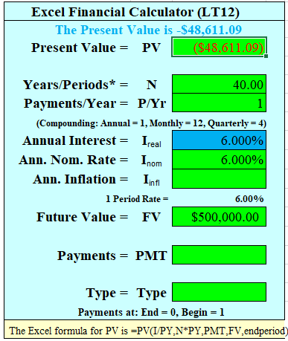
Answer #2: Present Value
Set calculator to end mode and clear registers:
  $500,000 = FV, 40 = N, 6 = I% and Solve for PV
  PV = $48,611
Money in the future is less valuable
than money you have right now
because you cannot use it now
to make more money!
If you have a computer with Excel,
you can use our Excel Financial Calculator
(LT12), which is a spreadsheet-based
financial calculator

Slide 24
Know how to solve problems relating to Future Value (FV)
Problem:
  You want to determine the value of an investment at some point in the future.
Problem Statement:
  What will be the future value of my investment (N) years in the future if my interest rate is (I)%?
Key Information Needed:
  Years in the future, interest rate
Result:
  A dollar amount which is larger than the original investment (an approximation is the rule of 72 which states that each time the interest rates * years = 72 the investment doubles in value)

Slide 25
Future Value Equation
Mathematical Formula
  FV_{n} = PV * (1 + i)^{n}
  Key Inputs:
    FV = the future value of the investment at the end of n year
    i = the annual interest (or discount) rate
    PV = the present value, in today’s dollars, of a sum of money that you already have or plan to have

Slide 26
Problem #3: Future Value
(with a slight change)
A. Calculate the future value, in 15 years, of $5,000 earning 8% assuming an annual compounding period?
B. Calculate the future value of $5,000 earning 8 percent assuming simple interest (the interest earned does not earn interest)?
C. How much did interest on interest earn?

Slide 27
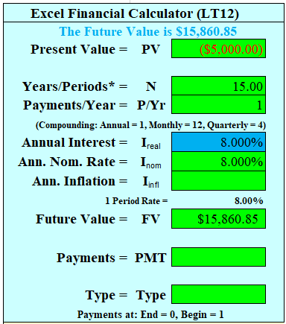
Answer #3: 3-5
A. Compound Interest:
  Clear registers and memory: Set -$5,000 = PV 8% = I 15 = N and solve for FV: FV = $15,861
B. Simple Interest (no interest on interest):
  $5,000 + ((5,000*8%) x 15) = $11,000
C. Difference:
  $15,861 – 11,000 = $4,861
This is the Key to Financial Success –
Earn Interest on Interest!!!!!!!!!!!!!!!!

Slide 28
Review of Objectives
A. Do you understand investments?
B. Do you understand the importance of compound interest and time
C. Do you understand basic finance terminology so you can talk with other finance professionals
D. Can you solve problems relating to Future Value (FV) and Present Value Value (PV)

Slide 29
Case Study #1
Data
  Brian has a goal to have $500,000 saved by the time he turns sixty-five, which is forty years from now.
Calculation
  Assuming he can make 6 percent on his money, what is the value of that goal now (this indicates present value)? The math formula is as follows:
    PV = FV/(1 + i)^{n}

Slide 30
Case Study #1 Answer
The mathematical formula is PV = FV/(1 + i)^{n}, or PV = $500,000/(1.06)⁴⁰, or $48,611.10. This formula shows you how this equation would be calculated on a standard calculator.
Using a financial calculator (or LT12), you would clear your memories and then enter the following information: $500,000 = FV, 6% = I, which is the interest rate (the annual interest, or discount, rate), 40 = N, or the number of years, P/Yr = 1 and then solve for PV:
PV = the present value, in today’s dollars, of a sum of money that you have invested or plan to invest. If you use a financial calculator for this equation, the present value should come out as $48,611.10.

Slide 31
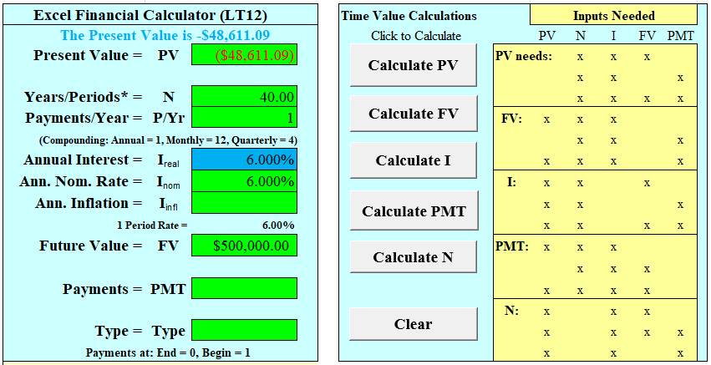
Case Study #1 Answer
Using LT12, click on Clear to clear information. Then put in the information, with money going out as a negative sign. Then click on Calculate FV to get your answer

Slide 32
Case Study #2
Data
  Ron has $2,500 saved.
Calculation
  If his investment earns 8 percent per year for twenty years, how much will his investment be worth in twenty years (the investment’s future value)? The math formula is as follows:
    FV = PV(1 + i)^{n}

Slide 33
Case Study #2 Answer
The formula is FV = PV (1 + i)^{n} where PV = present value, I = interest rate, and n = or number of years. The equation would be FV = $2,500 * (1 +.08)²⁰ or $11,652.39
If you were using a financial calculator, you would clear your memories, then enter the following:
$2,500 = PV, 8% = I, which is the interest rate (the annual interest, or discount, rate), 40 = N, or the number of years, and solve for FV:
FV = the future value of a sum of money that you have invested. The future value should be $11,652.39.

Slide 34
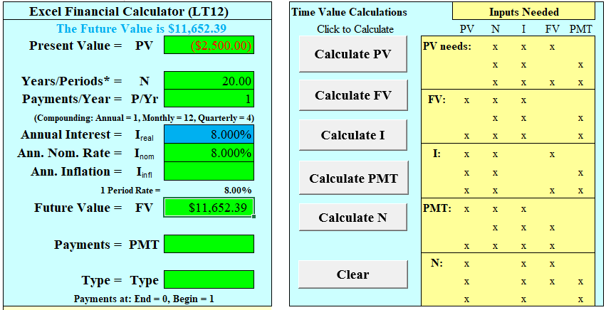
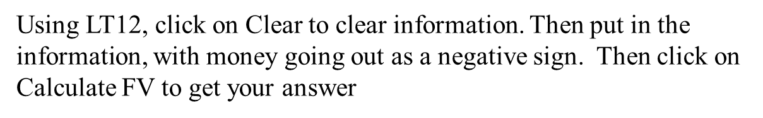
Case Study #2 Answer

