Slide 1

Personal Finance: Another Perspective
Your Future 2:
Decide to Decide
Updated 2020/03/27

Slide 2
Objectives
How to bring Christ into our finances
A look back at our class and learning framework
Understand the key decisions you should make in life to be truly successful
C. Share a list of recommended readings for further information on personal finance

Slide 3
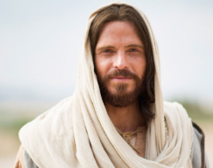
A. Understand How to Bring Christ Into our Finances
The first day we shared how we bring Christ into our finances
1. We increase our knowledge of and faith in the Savior and His atonement
2. We strive to change daily and become a more converted disciple of Jesus Christ
3. We apply His words and create our lives and values more closely with Him
4. We always remember and reach up to Him

Slide 4
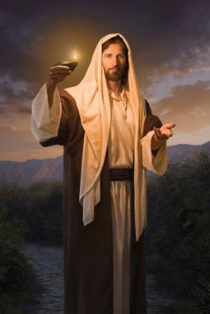
Bringing Christ into our Finances (continued)
1. We increase our love for and faith in the Savior and His atonement
He knows and loves us perfectly, and has designed a detailed, individual, and customized curriculum (called life) exactly tailored to our needs, mission and destiny
Personal finance is simply one of the pieces of that curriculum and is part of living the gospel of Jesus Christ
Understanding this changes personal finance from an “unfortunate necessity” to an important “shared family experience”

Slide 5
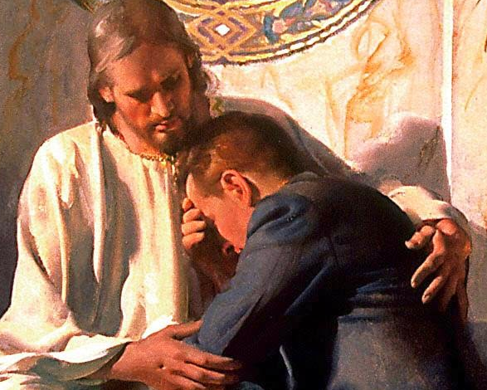
Bringing Christ Into our Finances (continued)
2. We strive to change daily and become a more converted disciple of Jesus Christ
God’s grace, repentance and the atonement of Jesus Christ are perfect tools to help us change and to become more like our Savior
Doctrines and principles, confirmed by the Spirit, can help us change our behavior
As we understand the doctrines and principles, “It magnifies our small acts of obedience [including in our finances] into holy acts of consecration” (Dieter F. Uchtdorf, “Forget Me Not,” Ensign, November 2011).

Slide 6
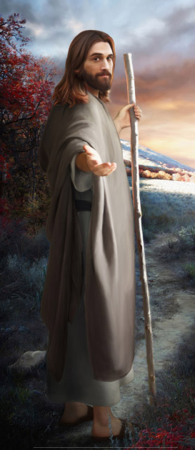
Bringing Christ Into our Finances (continued)
3. We apply His words and create our lives and values more closely with Him
Application is an invitation to learn and create
We learn important lessons from the creation to help us be better creators
We had our first lessons in creation in the pre-existence (Abraham 3:24.)
Mary Ellen Smoot reminds us, “We are all creators. . . We are children of God. Shouldn’t we be about our Father’s business? Shouldn’t we be creators as well?” (“We are Creators,” Ensign May 2000)

Slide 7

Bringing Christ Into our Finances (continued)
4. We always remember and reach up to Him
We need Christ’s inspiration and guidance daily if we are to return with our families to His presence
We must be diligent as Our conduct on our journey is as important as our destination
Russell M. Nelson said,
We increase the Savior’s power in our lives when we make sacred covenants and keep those covenants with precision. Our covenants bind us to Him and give us godly power” (“Drawing the Power of Jesus Christ into our Lives,” Ensign May 2017, 39-42).

Slide 8
B. A Look Back at our Learning Framework
Our framework started with our perspective, that personal finance was living the gospel of Jesus Christ
This let us know that all we were doing in the class was part of His gospel and His plan, and we should do it!

Slide 9
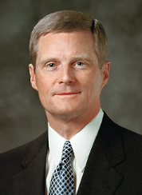
Learning Framework (continued)
Our framework was doctrines, principles and application
David A. Bednar taught,
Somehow we seem to be drawn to application as the primary way to ‘fix’ things, to make life better. . .And far too often we emphasize application without the necessary understanding and divorced from the doctrinal content. . . Whatever the reason, emphasizing the application to the exclusion of fundamental doctrines and principles does not produce spiritual power, protection and direction. . . Appropriate applications are necessary but can never stand alone. What is needed is a balance among doctrines, principles and application. . . The answers always are in the doctrines and principles. And the doctrines and principles need to be in us. (David A. Bednar, p. 170)

Slide 10
Learning Framework (continued)
Why was this learning framework important?
It asked three critical questions that lead to learning
1. Why should we [learn and become better at personal finance]? (this is “why” or a doctrine)
2. What are the principles on which how we [learn and become better at personal finance are based]? (this is “what” or a principle)
3. How do we [learn and become better at personal finance]? (this is “how” or an application)

Slide 11

A Look Back (continued)
It taught that doctrines and principles, confirmed by the Spirit, change behavior
With each area we developed our doctrines and principles
If an apostle says that the answers are all in the doctrines and principles, we should study these doctrines carefully
What were the key doctrines we emphasized this semester?

Slide 12
A Look Back (continued)
What did we learn about identity?
Identity is who we really are, children of God
We are “all the children of God by faith in Jesus Christ” (Gal. 3:26 ), and “if children, then heirs; heirs of God, and joint-heirs with Christ” (Rom. 8:17).
We are children of loving Heavenly Parents and are known individually by name and loved intensely by loving parents
As children and heirs of all God has, we can accomplish anything that the Lord commands us including obeying the commandments to live within our means, stay out of debt, and to save

Slide 13
A Look Back (continued)
What did we learn about obedience?
Obedience is the source of divine guidance and power in our lives
Obedience to God’s commandments is a pre-requisite to the Holy Ghost’s guidance
Blessings from God are predicated on obedience, and with the help of the Holy Ghost, we will be protected and guided in our decisions
When we fail to obey, it leads to diminished happiness and forfeited blessings
Obedience is how we grow and join God in the “family business”

Slide 14
A Look Back (continued)
What did we learn about stewardship?
Stewardship reminds us “whose” we are, that blessings are responsibilities, and we are responsible to learn these things
We are the Lord’s hands here on earth, and are not to be commanded in all things, but to “make use of the means the Lord has provided”
We are to use our time and resources wisely and to “not spend money for that which is of no work, nor your labor for that which cannot satisfy”
We are to become faithful and wise stewards and then we shall “enter into the joy of [our] Lord, and shall inherit all things”

Slide 15
A Look Back (continued)
What did we learn about agency?
Agency is the ability and privilege God gives people to choose and act for ourselves
Agency is a God-given gift, and is a critical part of us becoming as God is
We must have agency if we are to choose and become like our Heavenly Parents
We use our agency wisely over earthly things so we can be worthy of heavenly things, even eternal life

Slide 16
A Look Back (continued)
What did we learn about accountability?
Accountability is how we are accountable to God for our choices
We will be punished for our own sins and not for Adam’s transgression (Articles of Faith 2.)
We will be held accountable to God for our words, works, thoughts, and every dollar we save and spend
Our judgement will not be did we check every box; rather, did we become like our Savior Jesus Christ

Slide 17

A Look Back (continued)
What were the key principles?
We discussed key principles as we discussed each of the 16 different areas of personal finance
Most started with:
Understand yourself, your vision, goals and budget
Seek, receive and act on the Spirit’s guidance
Understand the key areas of whatever topic we were discussing
Then there were specific principles with each respective area

Slide 18
A Look Back (continued)
What were the key areas of your Plans?
We shared principles in each of these areas:
Your Plan for Life Education Plan
Financial Statements Mission Plan
Cash Management Plan Auto/Toy Plan
Tax Plan Retirement Plan
Credit Plan Housing Plan
Insurance Plan Giving Plan
Family Financial Plan Investment Plan
Saving, Income and Expense (budget) Plans
Consumer Loans and Debt Plan

Slide 19

A Look Back (continued)
We shared that application is an invitation to apply His words and create our lives more closely with Him
We shared the creative process—the application of information in each of the 16 key areas
We are all creators, and we shared the process on how we apply these things to become better
God gave us life and He created a plan for us
This class and your PFP has been your chance of creating a plan for this wonderful life He has given you?

Slide 20
A Look Back (continued)
Vision
What is your vision for yourself, your spouse, family and your life?
What do you hope to have accomplished when you have completed your mortal journey?
How does Heavenly Father see you and what does He want for you to do or become?

Slide 21
A Look Back (continued)
Goals
What goals will take you to your vision?
What goals should you have, and are you willing to work toward them?
What is required to take you from where you are now to where you want to be, your vision (the best way to predict the future is to create it)?

Slide 22
A Look Back (continued)
Plans and strategies
What are your plans and strategies for achieving your goals?
What are the strategies you will follow to help you accomplish your goals and eventually your vision?
What are your short-, intermediate- and long-term plans and strategies to take you to your goals?

Slide 23
A Look Back (continued)
Constraints
What are the key paths necessary for you to accomplish your goals and vision?
What are the things that will keep you from your vision and goals?
What are the key problems you will likely encounter and how will you solve them so they don’t hinder your progress?

Slide 24
A Look Back (continued)
Accountability
How will you be accountable to your ultimate accountability partner?
How will you hold yourself accountable for achieving your vision and goals and what will you do to get help from others?
How will you bring your spouse and family into jointly creating and working together toward family vision and goals?

Slide 25
A Look Back (continued)
Why is this learning framework important?
1. It can help us ask the right questions
2. It reminds us where the answers really are. Instead of quickly jumping to the how’s or application, the answers are in the doctrines and principles
3. It helps us lift our perspective and vision. “With increased vision comes increased motivation”
4. Its helps us take a long-term perspective rather than a checklist approach to life. Its all part of living the gospel
5. This framework reminds us of the importance of Christ and of our daily conduct
6. It changes our thinking from doing “mundane acts of obedience” into creating “holy acts of consecration” to our Savior Jesus Christ

Slide 26

A Look Back (continued)
We shared ideas and experiences on how you can apply the things learned in this class
We have worked together on how you create your vision and then become it
You have followed the words of a prophet who said ”Plan your financial future early, then live your plan” (Ezra Taft Benson, “To the Elderly in the Church, Ensign, Nov. 1989, p. 4).
You have completed the “spiritual creation” with your PFP
Now is the hard work, to take your Plan and make your “physical creation” a reality

Slide 27

Three Word Summary for Class
Remember your PFP and “Life is Good.” It will help you remember what I want you to take away from class
L Love the Lord and put and pay Him first
I Invest your money wisely
F Find happiness in your spouse and family
E Enjoy the journey and give back
I Invest in yourself and family for E & M
S Save 20%, and 15% for retirement
G Get and stay out of debt
O Organize yourself, know vision, goals & plans
O Operate on a budget and get good at planning
D Do good, be good, and get better

Slide 28
Summary
1. We increase our knowledge of and faith in the Savior and His atonement
Personal finance is simply living the gospel of Jesus Christ
2. We strive to change daily and become a more converted disciple of Jesus Christ
Doctrines and principles, confirmed by the Spirit, change behavior
3. We apply His words and create our lives and values more closely with Him
Application is an invitation to learn and create. Shouldn’t we be about the “family business?”
4. We always remember and reach up to Him
As we reach up to Him, we will be led in all things we should do

Slide 29
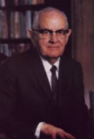
C. Understand the Key Decisions in Life You Should Make
President Kimball said:
We hope we can help our young men and young women to realize, even sooner than they do now, that they need to make certain decisions only once. … We can push some things away from us once and have done with them! We can make a single decision about certain things that we will incorporate in our lives and then make them ours—without having to brood and re-decide a hundred times what it is we will do and what we will not do. … My young brothers [and sisters], if you have not done so yet, decide to decide! (Ensign, May 1976, p. 46; italics added.)
What are the decisions you should take from this class?

Slide 30

Key Decisions (continued)
It is not enough to know what to do. You must bind yourself to do it!
How do we bind ourselves to do what we should?
And thus ye shall become instructed in the law of my church, and be sanctified by that which ye have received, and ye shall bind yourselves to act in all holiness before me (italics added, D&C 43: 9).
How do we bind ourselves to act?

Slide 31

1. Decide to Believe
I will believe in God and myself
God is very interested in you as an individual, that he has a plan and a mission for you, and is anxious for you to succeed. He has provided in the gospel of his Son, the pattern for ultimate success in our lives
When our lives are consistent with His gospel, we can have His Spirit and our “confidence will wax strong in the presence of God” (D&C 121:45). We can say with Nephi:
The Lord is able to do all things according to his will, for the children of men, if it so be that they exercise faith in him. . .Wherefore, let us be faithful to him (1 Nephi 7:12).

Slide 32

2. Decide to Listen
I will take the Holy Ghost as my guide
Decide now that in all you do, you will live worthy of the Spirit and will listen to its guidance
By following the rules, you will never make a serious mistake … without being warned. You will never take the wrong road, you will never go around the wrong bend, or make the wrong decision without your having been warned. That pattern is the pattern of the Latter-day Saint. You were confirmed a member of the Church, and you had conferred upon you the gift of the Holy Ghost to be a guide and a companion to you.” (William D. Oswald, “Obedience is the First Law of Heaven,” Ensign, Jan 2008.)

Slide 33

3. Decide to Learn
I will make learning a lifelong commitment
Gain temporal knowledge as it makes it easier to avoid the financial pitfalls and money surprises
Gain spiritual knowledge as it helps you know what is important in life and how to keep your priorities in order
Plan for a lifetime of stewardship and learning
Reinvent and upgrade your skills daily
The only true insurance you have is your ability to continue to improve yourself and your job skills
Set time aside each day to read and to learn both spiritually and temporally

Slide 34

4. Decide to Work
I will daily work hard, smart, and with the Spirit
Remember your conduct on the journey is as important as your destination
Decide now to work hard and smart, and to pray for Father’s help that you will work beyond your natural abilities, do the right things and in the right way.
Rex D. Pinegar said:
If you and I are to reach the summit of our divine potential, we must work each step of the way. The path may be rugged, difficult, unheralded; but it can be successfully climbed if we are willing to work with all our strength and commitment (“Decide to Decide,” Ensign, Nov. 1980, 71).

Slide 35

5. Decide to Create and Achieve
I will create and achieve my vision and goals
President Kimball counseled:
It is most appropriate . . . to quietly, and with determination, set some serious personal goals in which they will seek to improve by selecting certain things that they will accomplish within a specified period of time (Ensign, May 1976, p. 46).
Set your vision and goals with the Lord’s help, and seek the Lord’s help to achieve them, and you will, with the Lord’s help, achieve them

Slide 36

6. Decide to Budget and Stay Out of Debt
I will live on a budget and stay out of debt
President Kimball stated:
Every family should have a budget. Why, we would not think of going one day without a budget in this Church or our businesses. We have to know approximately what we may receive, and we certainly must know what we are going to spend. And one of the successes of the Church would have to be that the Brethren watch these things very carefully, and we do not spend that which we do not have (inside pamphlet cover, Marvin J. Ashton, One for the Money, 1992).

Slide 37

7. Decide to Protect Yourself
I will protect my family and myself
Utilize insurance for those you love and yourself
Your best insurance is the protection that comes from obedience to the Lord’s commandments
Decide now to protect yourself and your stuff
Have sufficient insurance
Health insurance – a necessity
Life insurance – a necessity if you have dependents
Home and auto insurance – a necessity
Liability coverage – too little can ruin your financial future

Slide 38
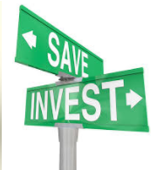
8. Decide to Save and Invest Wisely
I will pay the Lord first, myself second, and then invest my money wisely
Pay the Lord first
Pay first your most important debt to God
Remember the source of all your blessings
Pay yourself second
Savings isn’t what’s left over at the end of the month, it’s the 20% or more that you pay yourself right after you pay the Lord
Then invest that money wisely

Slide 39
Invest Wisely: The Hourglass Top
1. Are your priorities in order and are you “square” with the Lord?
2. Do you have adequate life and health insurance?
3. Are you out of credit card and consumer debt?
4. Do you know your personal goals, are you living on a budget, and do have a well written investment plan?
If you can answer these affirmatively, you are ready to invest!

Slide 40
Invest Wisely: the Hourglass Bottom
Taxable Assets
Retirement Assets
4. Opportunistic: Individual Stocks and Sector Funds
3. Diversify: Broaden and Deepen your Asset Classes
2. Core: Broad Market Index Funds or Core Mutual Funds
1. Basics: Emergency Fund and Food Storage

Slide 41

9. Decide to Give
I will live a consecrated life and give more
Some say when they are rich they will give more and serve more. Of this Moroni said:
And now, I, Moroni, would speak somewhat concerning these things; I would show unto the world that faith is things which are hoped for and not seen; wherefore, dispute not because ye see not, for ye receive no witness until after the trial of your faith (Ether 12:6).
And from the uninspired book of Bryan:
Think about giving in percentage terms. That way, no matter what your income, you will not change your giving (except to give more)

Slide 42

10. Decide to Decide
I will live the gospel of Jesus Christ daily
You have done much this semester. You have caught your vision and developed good goals and plans which will lead you to financial self-reliance
Decide to keep these good habits for the rest of your life!
Rex D. Pinegar said:
You, our beloved young men and women, are in the most critical period of life. Youth is the time when habits are formed, when ideas are adopted. It is the time of decision. Decide today to heed these words of our prophet: “Decide to decide!” (“Decide to Decide,” Ensign, Nov. 1980, 71).

Slide 43
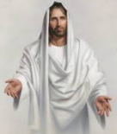
Decide to Decide (continued)
Following Christ is critical
It will make all the difference in your life
Remember He will give you success (Alma 26:27)
Pray, plan and work for your vision and goals
My father came and spoke to my class. He gave, what I consider, the best advice when he said:
The key to life is to live like our Savior and to obey the commandments of God. If you will do this, you will have the Spirit. And if you have the Spirit, you will be successful

Slide 44
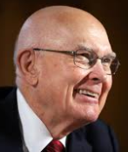
Decide to Decide (continued)
Elder Dallin H. Oaks said:
Some people live the gospel with “short, frenzied outbursts of emotion,” followed by long periods of lapse or by performance that is intermittent or sputtering. What we need in living the gospel is “the tranquil and steady dedication of a lifetime” (Dallin H. Oaks, “The Dedication of a Lifetime,” CES Fireside, Oakland, California, May 1, 2005).
What does it mean, “the tranquil and steady dedication of a lifetime?”

Slide 45
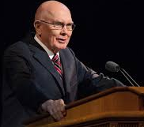
Decide to Decide (continued)
He concluded:
The “dedication of a lifetime” requires one to be tranquil and steady, steadfast and immovable. That is our standard and our goal. This steadfast standard requires us to avoid extremes. Our performance should be the steady 100 percent of a committed servant, not the frenzied and occasional 120 percent of the fanatic (Dallin H. Oaks, The Dedication of a Lifetime, CES Fireside, Oakland, California, May 1, 2005).

Slide 46
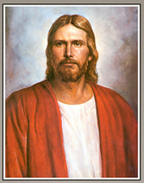
Decide to Decide (continued)
In summary, remember Nephi’s counsel:
And now, my sons [and daughters], remember, remember that it is upon the rock of our Redeemer, who is Christ, the Son of God, that ye must build your foundation; that when the devil shall send forth his mighty winds, yea, his shafts in the whirlwind, yea, when all his hail and his mighty storm shall beat upon you, it shall have no power over you to drag you down to the gulf of misery and endless wo, because of the rock upon which ye are built, which is a sure foundation, a foundation whereon if men build they cannot fall (Helaman 5:12).

Slide 47
Questions
Any questions on why it is so critical to decide to decide now?

Slide 48
C. Recommended Readings List for Personal Finance
Following are a list of recommended readings that may be helpful on your stewardship quest for greater financial understanding.
General Finance
George S. Clayson, Richest Man in Babylon, Signet Press, USA, 1955.
Napoleon Hill, Think and Grow Rich, Random House Publishing, New York, 1960.
Richard Paul Evans, The Five Lessons a Millionaire Taught Me, Arcadia Press, Salt Lake, 2004.
Thomas Stanley and William Danko, The Millionaire Next Door, Pocket Books, New York, 1996.

Slide 49
Readings List (continued)
David Bach, The Automatic Millionaire, Broadway Books, USA, 2004.
Bryan L. Sudweeks, Personal Finance: Another Perspective, USA 2017, at www.personalfinance.byu.edu
Investing in General
John C. Bogle, The Little Book of Common Sense Investing, Wiley, 2007.
William Bernstein, Four Pillars of Investing: Lessons for Building a Winning Portfolio, McGraw-Hill, New York, 2002.
Tim Sanders, Love is a Killer App: How to Win Business and Influence Friends, Three Rivers Press, New York, 2002.

Slide 50
Recommended Readings (continued)
General Budgeting
Dave Ramsey, The Total Money Makeover: A Proven Plan for Financial Fitness, book and workbook, Thomas Nelson, Inc., Nashville Tennessee, 2003.
James Christensen and Clint Combs, Rich on Any Income: the Easy Budgeting System that Fits in Your Checkbook, Shadow Mountain, USA, 1985.
Steven B. Smith, Money for Life: Budgeting Success and Financial Fitness in Just 12 Weeks, Dearborn, USA, 2004.

Slide 51
Recommended Readings (continued)
Marriage and Money
Jeff Hill and Bryan Sudweeks, Fundamentals of Family Finance: Living Joyfully within your Means, BYU Publishing, 2017.
Bernard E. Poduska, Love and Money: How to Share the Same Checkbook and Still Love Each Other, Deseret Book Company, USA, 1995.
Teaching Children about Money
Dave Ramsey, Financial Peace Jr.: Teaching Kids About Money: Cool Tools for Training Tomorrow’s Millionaires, Lampo Group, USA, 2003.

Slide 52
Review of Objectives
A. Do you understand our look back on the class?
B. Do you understand the key decisions you must make to become truly successful in life?
Do you understand my suggestions for a few recommended readings for further information on personal finance?

