Slide 1
Personal Finance: Another Perspective
Your Future 1:
Learning to Give
Updated 2020-03-26

Slide 2
Objectives
A. Understand giving and the myths and realities of giving
B. Understand the principles of wise giving
C. Understand how to give effectively
D. Understand how to create your “Giving Plan”

Slide 3
Your Personal Financial Plan
Section XIV. Giving Plan (not to be handed in now but to be included in your PFP after it is returned, Giving Plan (LT01-14))
What are your vision and goals for your personal and family giving plan?
How will you handle both your institutional (Church/institutional contributions) and personal (individual/family contributions/service) giving?
What are your plans and strategies for giving?
What is your plan for tithes, offerings, and other contributions? Door-to-door, phone, and other solicitors? How will you teach your children?
What are your constraints and accountability?

Slide 4

A. Understand Giving
Why should we have a correct view about finance (we talked about this the first day)?
Because you can only manage your finances in one of two ways:
1. With an eternal perspective, which says that everything is the Lord’s and that we are stewards over these resources to bless His children, or
2. With the world’s perspective, which is any other way
How we answer this question will have a big impact on what we do with our lives and resources

Slide 5

Giving (continued)
How would you define “giving”?
From a narrow (i.e., temporal) perspective, some may say it is sharing what you have with others
But where did you get it? Where did you get the intelligence to get it? Who gives you your breath to work for it? Who gave you your bodies that you could use to get it?
From our broader (i.e., eternal) perspective, it is the sharing of the things you have been given by God with your families and your fellow men
It is your sharing God’s gifts with others

Slide 6

Giving (continued)
Is giving inherited or learned?
The Lord through the prophet Joseph said:
See that ye love one another; cease to be covetous; learn to impart one to another as the gospel requires (italics added, D&C 88:132).
Elder Mark E. Petersen said:
Instead of taking from our fellowmen, we must learn to give—to be good Samaritans in very deed; to share with our less fortunate neighbors, and in reality show love for our fellowmen (italics added, “Honesty, a Principle of Salvation,” Ensign, Dec. 1971, 72).

Slide 7

Giving (continued)
Is giving expected or required?
The Lord has said:
“For of him unto whom much is given, much is required” (italics added, D&C 82:3).
“For unto whomsoever much is given, of him shall be much required” (Luke 12:48).
“But behold, they have not learned to be obedient to the things which I required at their hands, but are full of all manner of evil, and do not impart of their substance, as becometh saints, to the poor and afflicted among them” (italics added, D&C 105:3).

Slide 8

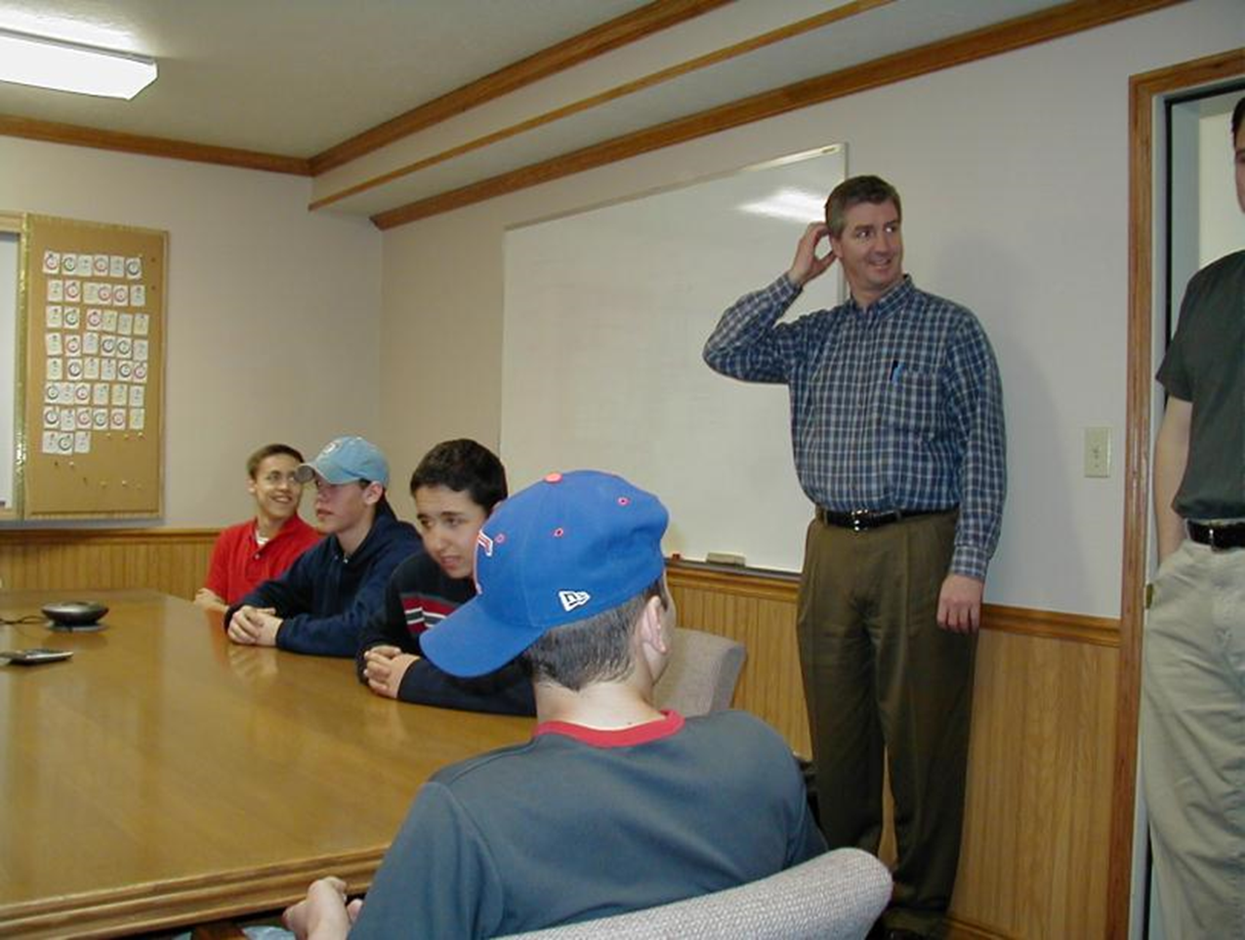
Taz Murray’s Candy Store

Slide 9
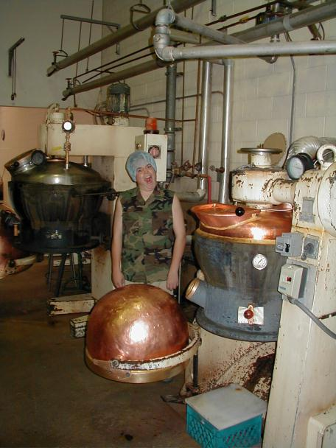
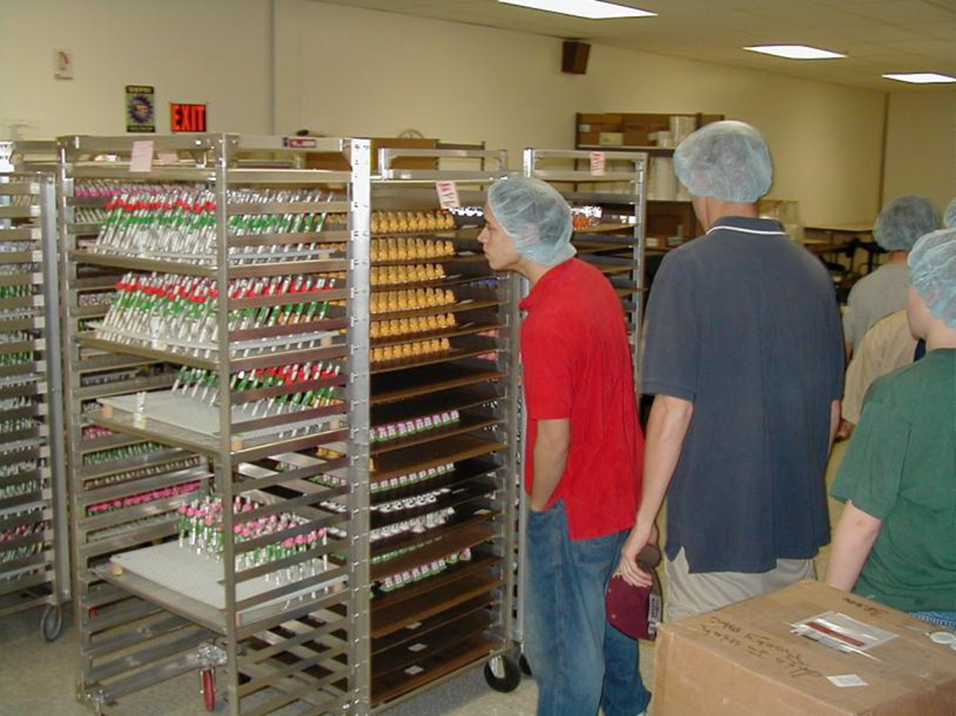

Slide 10
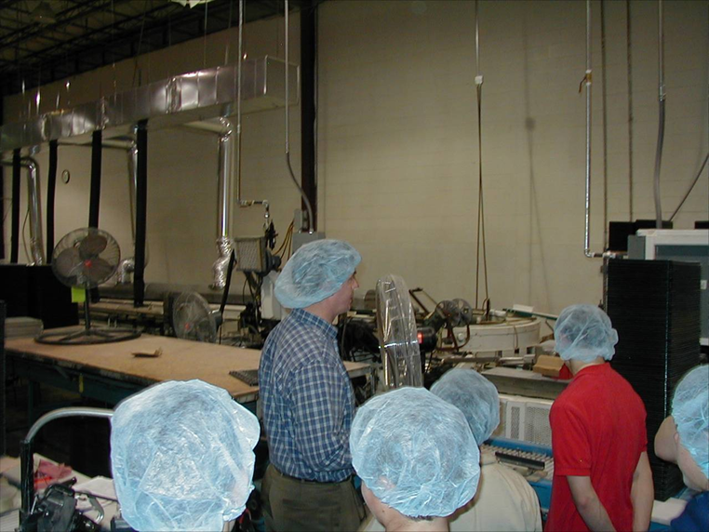
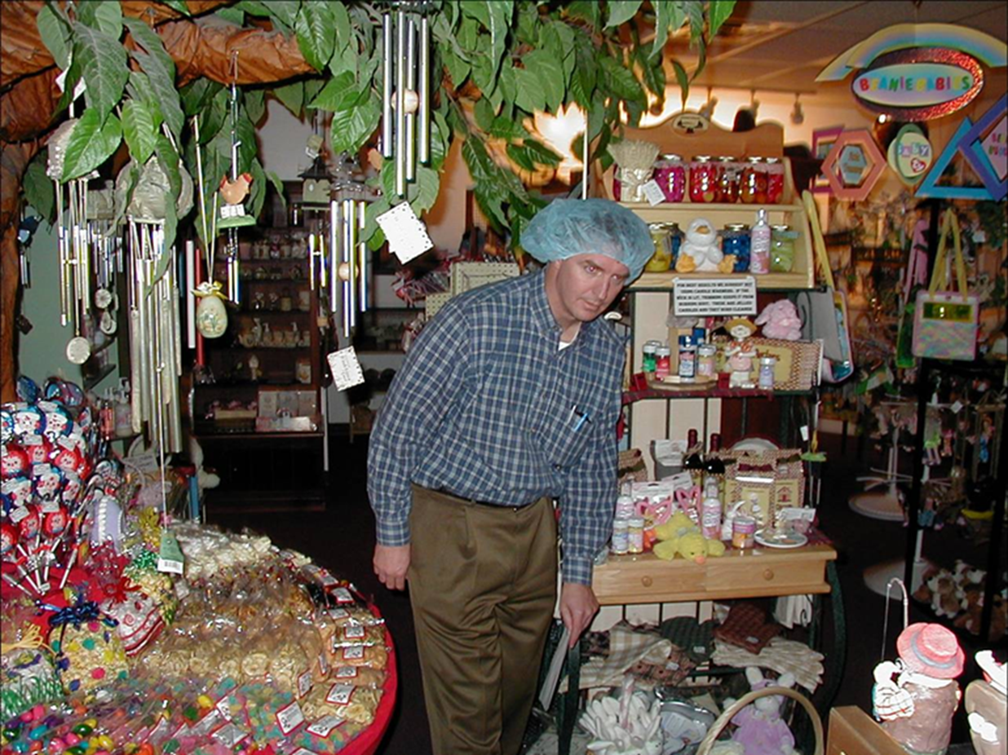

Slide 11
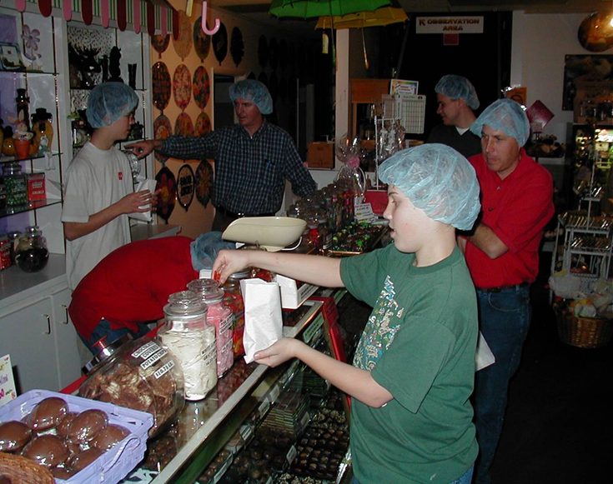
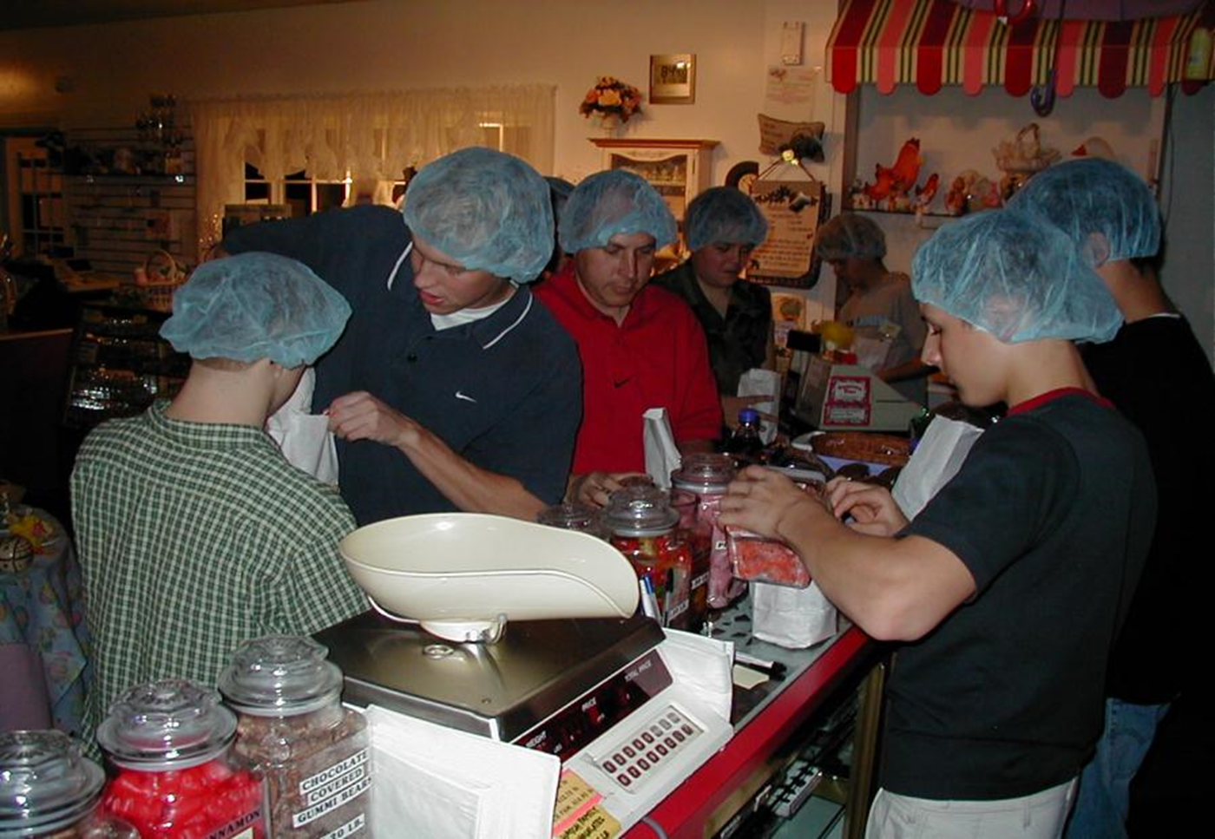

Slide 12
Taz Murray’s Candy Store
How is life is like Taz’s candy store?
We all have our little bags of candy, the experiences we are to have while here on earth
We have been given instructions as to what is good and bad—we have agency and can choose
If we choose wisely, we can enjoy the good
If we do not, we lose blessings and happiness, and suffer the consequences of our choices
And interestingly, the more we share, the greater will be our joy later on

Slide 13

Myths and Realities of Giving
Myth 1. Giving makes us poorer
While in giving we have less financially, but we are really richer in the long term
Givers are happier. Research has shown that happy people make more money, have better marriages, and contribute more to society
Givers are healthier. Research has shown that when people are happier, they put less stress on their bodies and live longer
Givers are leaders. Research has shown that those who give are perceived to be leaders by those who observe. We are all leaders!
(Arthur C. Brooks, “Why giving Matters, BYU Magazine, Summer 2009, p. 25-28)

Slide 14

Myths and Realities (continued)
Myth 2. People are naturally selfish
People are selfish yes, but not naturally selfish. People are unnaturally selfish—we learn selfishness
Research as shown that when we are at our best selves, in equilibrium, where we are supposed to be cognitively, neuro-chemically, and spiritually, we are a giving people (Ibid.)

Slide 15

Myths and Realities (continued)
Myth 3. Giving is a luxury
Giving is not a luxury--it is a necessity. It is interesting that the Lord requires the critical first 10%, not the last 10%
And this is not just from a spiritual point of view either
And if we want to do better and to be better, we must learn to give

Slide 16
Myths and Realities (continued)
Myth 4. If the government would do its job correctly, we would not need to give
The day the government does all the giving in this country is the day we become poorer, unhappier, and unhealthier (Ibid.)
We must continue to take our place as givers and support the communities and people who need what we can give

Slide 17

Myths and Realities (continued)
Myth 5. You must have money to give
Giving doesn’t depend on the checkbook, but on the heart
What you do is more important than what you have
I believe that if you don’t give when you are poor, you will not give when you are rich

Slide 18
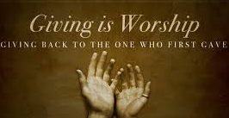
Myths and Realities (continued)
Reality 1. We have been commanded to give
The prophet Jacob taught:
“Think of your brethren like unto yourselves, and be familiar with all and free with your substance” (Jacob 2:17).

Slide 19

Myths and Realities (continued)
Reality 2. Givers are happier
When comparing similar people, ages, family size, religion, race, etc.
Giver’s are happier than non-givers. This includes:
Givers to charity
Those who give blood
Want to be better at work, work on your happiness
Happier people are more successful
Source: Arthur C. Brooks, “Why Giving Matters,” BYU Magazine, p. 27, Summer 2009.

Slide 20
Myths and Realities (continued)
Reality 3. Givers make more money
When comparing similar people, ages, family size, religion, race, etc.
Giver’s make more money than non-givers (and that is statistically attributable to the gift)
People who do volunteer work to better financially than non-volunteers
Even those who give blood do better than non-givers
Source: Arthur C. Brooks, “Why Giving Matters,” BYU Magazine, p. 25-28, Summer 2009.

Slide 21

Myths and Realities (continued)
Reality 4. Giving shows our love for God
King Benjamin stated:
And behold, I tell you these things that ye may learn wisdom; that ye may learn that when ye are in the service of your fellow beings ye are only in the service of your God (Mosiah 2:17).
Carol B. Thomas commented:
Sacrifice is an amazing principle. As we willingly give our time and talents and all that we possess, it becomes one of our truest forms of worship. It can develop within us a profound love for each other and our Savior, Jesus Christ (“Sacrifice: An Eternal Investment,” Ensign, May 2001, 63).

Slide 22

Myths and Realities (continued)
Reality 5. Giving helps others
King Benjamin further counseled:
But ye will teach them to walk in the ways of truth and soberness; ye will teach them to love one another, and to serve one another. And also, ye yourselves will succor those that stand in need of your succor; ye will administer of your substance unto him that standeth in need (Mosiah 4:16-17).

Slide 23

Myths and Realities (continued)
Reality 6. Giving helps us change to become more like Christ!
Marion G. Romney (1897-1988) taught:
The Lord doesn’t really need us to take care of the poor, but we need this experience; for it is only through our learning how to take care of each other that we develop within us the Christ-like love and disposition necessary to qualify us to return to his presence (“Living Welfare Principles,” Ensign, Nov. 1981, 92; emphasis in original).

Slide 24

Myths and Realities (continued)
Reality 7. Giving helps us repay an un-payable debt
There is one final debt, a debt we can never repay. And while we can never repay the debt, we can try.
“I say unto you, my brethren, that if you should render all the thanks and praise which your whole soul has power to possess, to that God who has created you. . . I say unto you that if ye should serve him who has created you from the beginning, and is preserving you from day to day, by lending you breath. . .I say, if ye should serve him with all your whole souls yet ye would be unprofitable servants” (Mosiah 2:20-21).

Slide 25
Myths and Realities (continued)
Our recommendations for giving:
Be Christian in word and deed
Be a diligent full tithe-payer and generous with fast, missionary and other offerings
Bless your family/extended family with resources
Be generous by blessing the poor with your help and look for other ways to share your resources to bless God’s children
Share yourself and your resources anonymously

Slide 26

B. Understand the Principles of Wise Giving
There are a number of principles of wise giving that can help us as we learn to give
1. Understand yourself, your vision, goals and budget
We should give consistent with our vision and goals, and consistent with who we are
We cannot become like our Savior without giving. “Inasmuch as you have done it unto one of the least of my brethren, ye have done it unto me” (Matt 25:20)

Slide 27

Principles of Giving (continued)
2. We seek, receive and act on the Spirit’s guidance
As we obey in the small and simple things, we can hear the Spirit’s guidance, and it will guide us into what we should do.
“For behold, again I say unto you that if ye will enter in by the way, and receive the Holy Ghost, it will show unto you all things what ye should do” (2 Nephi 32:5).

Slide 28

Principles of Giving (continued)
3. Give out of love
We are to give out of gratitude for all that God has done for us. Paul writes:
And though I give all my goods to feed the poor, and though I give my body to be burned, if I have not love, it profits me nothing (1 Corinthians 13:3).

Slide 29

Principles of Giving (continued)
4. Give sacrificially
Ours is a “sacrificial” religion
A religion that does not require the sacrifice of all things never has power sufficient to produce the faith necessary unto life and salvation (Joseph Smith, Lectures on Faith, comp. N. B. Lundwall, Salt Lake City: Bookcraft, n.d.), p. 58.
C. S. Lewis wrote: “If our charities do not at all pinch or hamper us, … they are too small. There ought to be things we should like to do and cannot do because our charitable expenditure excludes them” (Mere Christianity [1952], 67).

Slide 30

Principles of Giving (continued)
5. Give wisely
And see that all these things are done in wisdom and order; for it is not requisite that a man should run faster than he has strength. And again, it is expedient that he should be diligent, that thereby he might win the prize; therefore, all things must be done in order (Mosiah 4:27).

Slide 31

Principles of Giving (continued)
6. Give of your abundance
There is a different type of accounting in heaven, not of dollars and cents, but of our capacity and willingness to give
And he [Christ] looked up, and saw the rich men casting their gifts into the treasury. And he also saw a certain poor widow casting in thither two mites. And he said, Of a truth I say unto you, that this poor widow hath cast in more than they all: For all these have of their abundance cast in unto the offerings of God: but she of her penury hath cast in all the living that she had (Luke 21:1-4).

Slide 32
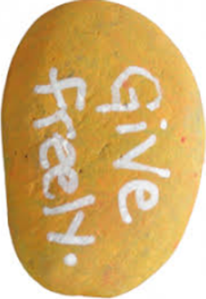
Principles of Giving (continued)
7. Give freely according to what you have been given
And again Alma commanded that the people of the church should impart of their substance, every one according to that which he had; if he have more abundantly he should impart more abundantly; and of him that had but little, but little should be required; and to him that had not should be given. And thus they should impart of their substance of their own free will and good desires towards God, and to those priests that stood in need, yea, and to every needy, naked soul (Mosiah 18:27-28).

Slide 33
Principles of Giving (continued)
Finding Balance
Guiding Principles Doctrines
Understand your vision, goals, budget Identity
We seek, receive and act on guidance Obedience
Give out of love Agency
Give sacrificially Accountability
Give wisely Agency
Give of our abundance Stewardship
Give freely Stewardship

Slide 34
Principles of Giving (continued)
From obedience to consecration
We are children of Christ (identity) listening to the promptings of the Spirit (obedience), using the blessings that God has shared with us wisely (stewardship) to take care of our spouses and family (stewardship and accountability). Then using of our abundance (stewardship), we help build the kingdom of God (agency) through loving, serving and helping our fellowman (accountability) to accomplish our personal and family vision and goals.

Slide 35

C. How to Give Effectively
How do we give now?
On the subject of giving, Elder William R. Bradford commented:
It is not the amount of money that we donate to the Church or others that matters to the Lord. Rather it is whether we give of our abundance or of our living. We should give until it is a sacrifice to give (William R. Bradford, “Words of Jesus: Riches,” Ensign, Feb. 2003, 52).

Slide 36
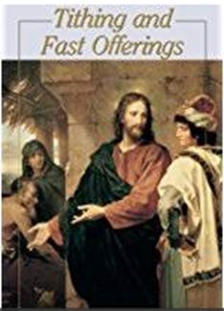
Giving Effectively (continued)
On the subject of fast offerings, Spencer W. Kimball said:
Sometimes we have been a bit penurious (stingy) and figured that we had for breakfast one egg and that cost so many cents and then we give that to the Lord. I think that when we are affluent … we should be very generous and give, instead of the amount we saved by our two meals of fasting, perhaps much, much more—ten times more where we are in a position to do it. I know there are some who couldn’t (in Conference Report, April 1974, p. 184).

Slide 37
Giving Effectively (continued)
Statistics on Charitable giving (1991 data)
Charitable giving as a percent of income:
Individuals earning 20-30K gave $1,207 or 4.8%
Individuals earning 30-40K gave $1,318 or 3.8%
Individuals earning 50-100K gave $1,837 or 2.5%
Why did those who earned more money give less than half, in percentage terms, as those who made less?
Why should our giving decrease as our blessings increase?
Although the data is old, the results have not changed much in the succeeding years

Slide 38
Giving Effectively (continued)
And this is entirely from the book of Bryan
Think about giving in percentage terms, rather than in dollar terms
Tithing is easy, it’s the other contributions that are hard
Put those in percentage terms as well
That way Heavenly Father will know that regardless of how much or how little you are blessed financially, your giving will always be the same

Slide 39
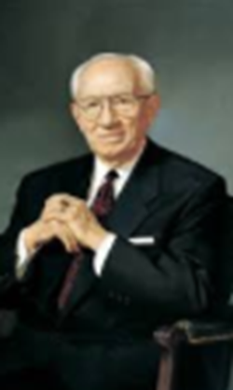
Giving Effectively (continued)
President Gordon B. Hinckley commented:
You know, as I know, that when you pay your honest tithes and offerings, the windows of heaven are opened and blessings are showered down upon you. That which you give is never missed; it becomes not a sacrifice but an investment under the wondrous powers of the Almighty to bless you (Discourses of President Gordon B. Hinckley, Volume 2, Intellectual Reserve, USA, 2005, p. 330).

Slide 40
Questions
Do you have any questions on how to give effectively?

Slide 41

D. Understand and Create Your Giving Plan
As a final PFP chapter, put together your individual/family Giving Plan
Think through and decide how you will give back and how you will help the world become better
Think how you will give, both institutionally, which is through Church and other institutions, as well as personally, which is through personal and family contributions and service
Finally, decide how you will teach your children to give, for your children learn from you

Slide 42
Your Giving Plan (continued)
Thoughts on creating your giving plan
Whereas goals are what you want to accomplish, giving is what you want to give back
Try to make this the culmination of your PFP, and talk this over with your spouse and children
Use it to tie in your goals and values with your actions and efforts you are willing to give
Divide it into both institutional (indirect) and personal (direct) giving
Include in it how you will teach your children to give
Finally, I recommend giving in percentage terms

Slide 43
Your Giving Plan (continued)
Think about Institutional giving
This is indirect giving through Church, through organizations set up to do good, and to help and serve in times of emergency and need.
Examples of Institutional Giving:
We will pay our tithing of 10%, Fast Offering of _% and the Ward Missionary Fund of _%
We will help support our children as missionaries and will set apart $___ to help other missionaries not as fortunate
We will give blood five times a year
We will go on a senior mission at age 65
We will work at the Genealogy Library each week

Slide 44
Your Giving Plan (continued)
Think about Personal giving
This is direct giving, which includes personal and family contributions and service
Examples of Personal Giving:
We will set apart $___ each Christmas and work with our children to help a family who is in need
Each Christmas we will prepare “homeless bags” of food, clothing, and change to give to those in need
We will set aside $____ for scholarships each year to help others who are not as fortunate
We will have a “Family Service Saturday” four times a year where we will go and do service for others, i.e., food kitchens, school work days, etc.

Slide 45

Giving Plan Example (continued)
Vision
From your Plan for Life. Other ideas include:
We will make giving an important part of our lives, budgets and characters.
It is through serving and giving that our children will know that we truly believe and that we truly are Christians.
We will be “Christ’s hands” wherever we live, and we strive through our service to have “His image” in our countenances (Alma 5:14).
We will keep the faith and our covenants, and bless many friends in the process.

Slide 46

Your Giving Plan (continued)
Goals
We will be generous in giving back to God in terms of our time, talents and resources (since it is all His anyway)
We will follow our plans for institutional, personal, individual and family giving.
We will teach our children to give through both word and example, in serving others and family service projects.
We will serve in our local congregations in whatever way we are needed.
Our resources will be God’s resources in our family and other service projects
We will serve 5 missions, starting at age 65

Slide 47
Your Giving Plan (continued)
Plans and strategies:
We will be observant and listen to the Spirit for opportunities to help and serve.
We will do a family service project quarterly, and will help with all community/Church service projects.
We will attend the temple each week/month, and will spend 1-2 hours a week doing genealogy/indexing
We will give blood as often as we can
We will create a “Family Foundation,” where children are all board members, and we distribute 5% of the assets each year to needy people
We will serve in the temple beginning at age 60
We will go on our first senior mission at age 65

Slide 48
Your Giving Plan (continued)
Plans and strategies (continued)
Institutionally
We will pay annually 10% tithing on our gross income, __% for fast offering, __% for missionary work and __% to charity
Personally
We will set aside $____ a month to help others
We will have a family personal giving budget and will involve the children in deciding its use
We will teach children about finance through our Family Foundation

Slide 49

Your Giving Plan (continued)
Constraints:
Living on a budget and saving 20% of every paycheck, with 15% going to retirement and __% earmarked for personal giving.
Our family jointly deciding who we will help, how much, and how that help will be given, as well as the service projects each quarter.
Institutional giving directly from our paycheck each month for tithes and other offerings (or using appreciated securities—the key is to give)
Sin will be a big constraint, so we need to always keep our promises and covenants
Accountability:
From my Plan for Life

Slide 50
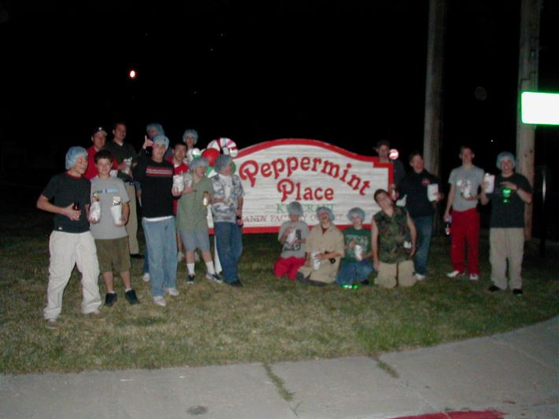
The Visit to Taz Murray’s Candy Store

Slide 51
Review of Objectives
A. Do you understand that we learn to give and the myths and realities of giving?
B. Do you understand the principles of wise giving?
C. Do you know how to give effectively?
D. Do you understand how to create your Giving Plan?

