Slide 1
Personal Finance: Another Perspective
Retirement Planning 2:
Social Security
Updated 2020/03/24

Slide 2
Objectives
A. Understand how Social Security Works and the benefits of the Social Security program
B. Understand the key questions relating to Social Security and the likely future of Social Security
C. Understand Plans and Strategies for Social Security

Slide 3
Getting Your Social Security Statement
How do I get a copy of my current benefits?
You can get a copy of your Social Security benefits online. To get your copy, go to www.ssa.gov
Click on “My Social Security” near the left middle
You must now create a Social Security account. Click on “Sign in or Create an Account” to begin
Next, click on “Create an Account.” You will need to have a valid email, Social Security number, a U.S. mailing address, and be 18 years old.
Read and click on “I agree to the Terms of Service”

Slide 4
Your Social Security Statement (continued)
Fill out your name, middle initial, last name, last names as shown on your latest SS card, mother’s maiden name, social security number, date and place of birth, and other information that is requested, and click on Continue
For added security, they can send you a text message every time you sign in. I think it is a good idea. Click on “Yes, lets start now”
Choose a username and password
Answer the resent questions to successfully complete the account
Agree to the Terms of Service again and click “Next.” You can now view or print your statement

Slide 5

A. How Does Social Security Work and the Key Benefits
Franklin D Roosevelt signed the Social Security Act in 1935 to Aid the displaced and out of work. Major events leading to this passage were:
The Stock Market Crash of 1929
During the four years ending 1932, the stock market fell 64%. Stock speculators were the ones most hurt
The decline in GDP
From 1929-1933, GDP fell 48%, from $105bn in 1929 to $55bn in 1933
Over 9,000 banks failed, and depositors lost over $7bn in assets.
Personal and family devastation was common

Slide 6
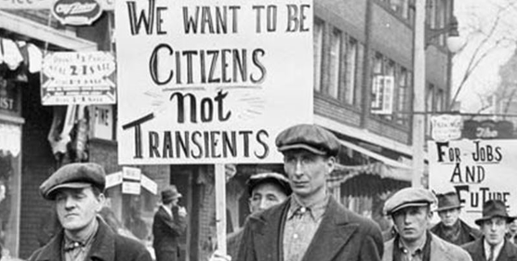
Social Security and Benefits s (continued)
Social Security was set up to aid those out of work
It was a pass-through account
FICA taxes being paid by current workers provided the money for benefit payments to current retirees
When established in 1935, there were 17 workers for each retiree
The assumption is that there will be enough others paying into the system to pay for your benefits when you retire
In 2013, there are only 2.8 workers

Slide 7
Social Security and Benefits (continued)
How much does an employer and employee pay in Social Security and Medicare Taxes?
FICA tax rates (OASDI – HI: Old Age, Survivors, and Disability Insurance and Hospital Insurance)
The employee and employer each pay (assuming your Adjusted Gross Income (AGI) <$250k >250K
Social security tax (OASDI) 6.20% 6.20%
Medicare tax (HI) 1.45% 2.35%
Total Paid 7.65% 8.55%*
Maximum wage base subject to Social Security tax in 2020 is $137,700. There is no maximum for Medicare
Self-employed individuals pay the whole 15.30%
* Note: Investment income (if any) is taxed an additional 3.8%

Slide 8
Social Security and Benefits
What are Social Security taxes based on?
OASDI-HI taxes are on taxable wages including wages, salaries, bonuses, commissions, value of employer provided meals/lodging, sick pay during first 6 months, employer paid group life insurance premiums in excess of $50,000, salary reduction from 401k, 403b, 457 plans, non-qualified deferred compensation no longer at risk, non-qualified stock options, vacation pay, and severance pay
Not included in taxable wages are sick pay after 6 months, employer payments for medical or hospital expenses, and employer contributions to qualified retirement plans

Slide 9
Social Security and Benefits
Average Indexed Monthly Earnings (AIME)
Average lifetime earnings indexed for inflation is your top 35 highest earning years. It entails adjusting each year’s earnings total to reflect its value in the year in which eligibility is requested
Primary Insurance Amount (PIA)
PIA is the basic unit used to express the amount of a worker’s benefit if they received benefits at their full retirement age (FRA). The calculation of PIA is based on the workers AIME, which is split into three segments and multiplied by specific percentages for each segment and summing the parts.

Slide 10
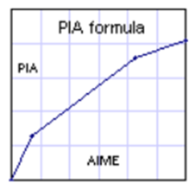
Social Security and Benefits (continued)
Calculating your PIA from AIME is divided into three calculations (numbers are for 2020) called “bend points” because the formula, when graphed, appears as a series of line segments joined at these amounts
1. 90% of the amount for the first $960
2. 32% of earnings from $960 - $5,785, and
3. 15% of earnings above $5,785
If your AIME was $5,000 per month, the amount is:
90% of $960 or $864.00
32% of $5,785 - $960 ($4,040) or $1,292.80
15% of amounts above $5,785 ($0) or $.00
Your total PIA would be $2,156.80

Slide 11
Social Security and Benefits (continued)
PIA Benefit Formula Bend Points
$ in PIA Formula $ in Max Family Benefits
Year First Second First Second Third
2016 856 5,157 1,093 1,578 2,058
2017 885 5,336 1,131 1,633 2,130
2018 895 5,397 1,144 1,651 2,154
2019 926 5,593 1,184 1,708 2,228
2020 960 5,785 1,226 1,770 2,309
Source: http://www.ssa.gov/oact/COLA/bendpoints.html, 24 Mar 2020.
To help you with this calculation, see Social Security Spreadsheet (LT36)

Slide 12
Social Security and Benefits (continued)
Full Retirement Age (FRA)
The age at which a retiree will receive 100% of their entitled benefits
Receiving benefits prior to FRA, lower benefits
Receiving benefits after FRA, higher benefits
Full Retirement Age:
Birth Year Full Retirement Age
1943-1954 66 1955 66 + 2 mo.
1956 66 + 4 mo. 1957 66 + 6 mo.
1958 66 + 8 mo. 1959 66 + 10 mo.
1960 and later 67

Slide 13
Social Security and Benefits (continued)
Have their been changes to Social Security tax rates?
Periodic changes in Social Security Tax Rates have occurred since 1937. The last change was in 1990.
1937 1.0%
1954 2.0%
1960 3.0%
1971 4.7%
1984 5.8%
1990 6.2%
We are likely due for another change soon

Slide 14
Social Security and Benefits (continued)
Insured: A worker is only entitled to receive benefits if that worker is fully insured.
Workers are considered fully insured if they have worked forty quarters of work (a quarter is three months) and earned the amounts below per quarter
To have currently insured status, workers must have worked a minimum of six quarters in the previous thirteen quarters
Year Amount per Quarter
2016 $1,260
2017 $1,300
2018 $1,320
2019 $1,360
2020 $1,410

Slide 15
Social Security and Benefits
Social Security benefits are divided into four areas: Retirement, Disability, Survivors, and Medicare
Social Security benefits are calculated using the worker’s AIME to determine the primary insurance amount or PIA
The PIA is the basis for the benefits that are actually paid. Typically, the highest 35 years of earnings are used to compute the AIME
To determine the benefit, you need only the PIA and the age at which benefits begin

Slide 16
Retirement Benefits (continued)
Retirement Benefits
Retirement benefits can either be reduced or increased depending on your PIA, your FRA and the date when benefits begin. You can begin receiving benefits as early as age 62
Benefits that begin 3 years before FRA will be reduced by a maximum of 20% (or 5/9% of 1% per month for each month benefits begin before FRA or 6.67% per year)
Additional reductions of 5% per year are effective when FRA exceeds age 65
Retirement or disability benefits paid to a spouse who is 62 will be reduced by a maximum of 25%

Slide 17
Retirement Benefits (continued)
Delayed Retirement Credit
Delaying payment beyond full retirement age results in a benefit increase for each year of delay. With a delay the worker’s PIA is not increased and the benefits to family members is not increased
You may delay benefits after age 67 up to age 70 and receive credits amounting to the following percentage increase per year of delay:
Year Born Percentage Year Percentage
1935-36 6.0% 1937-38 6.5%
1939-40 7.0% 1941-42 7.5%
1943 or later 8.0%

Slide 18
Retirement Benefits (continued)
Family benefits
Spouses benefit
A fully insured worker’s spouse age 65 (FRA) is eligible to receive a retirement benefit of 50% of the worker’s PIA subject to the family maximum
This benefit is reduced by 25/36% of 1% for each of the first 36 months that the spouse is under FRA (25% for 3 years). Once the FRA > 65, a reduction of 5/12 of 1% is imposed for each month beyond 36 months the spouse is under the FRA
The reduction of benefit from early retirement will not affect the amount of the spouses benefit

Slide 19
Retirement Benefits (continued)
Spouses benefit (continued)
A spouses benefit is available to a divorced spouse of full retirement age if the marriage lasted at least 10 years, and to a spouse of any age who is taking care of a child who is under 16 or disabled
If a spouse is entitled to benefits from their own employment, the benefit is the higher of 100% of the spouses PIA or 50% of the worker’s PIA

Slide 20
Disability Benefits
Benefits
Workers benefits
Workers who qualify for disability benefits are entitled to 100% of PIA until the earliest of the following
Disability ends: benefits are terminated in the second month after the end of disability
Workers dies: benefits are terminated in the month prior to the month the worker dies
Worker attains full retirement age: disability benefits convert to retirement benefits

Slide 21
Disability Benefits (continued)
Spouses benefit
Disability benefits for spouses are 50% of the worker’s PIA, reduced if the spouse is under FRA, subject to a family maximum amount
Child’s benefit
Any child who is under 18 (19 if still in high school), is eligible for a benefit of 50% of the retired workers PIA, subject to a family maximum
The disable child of a retired or disable worked is entitled to benefits past age 22 if the disability began before age 22

Slide 22
Survivor Benefits
Eligibility
Deceased worker must had had fully insured status; other survivor benefit (mother’s or fathers’ child’s lump sum) will be paid to eligible survivors of a fully or currently insured worker
Lump sum benefit
A lump sum of $255 is available to the surviving spouse, nonresident spouse, or to children eligible for the monthly benefits (for 2020)

Slide 23
Survivor Benefits (continued)
Monthly benefit for survivors
Widow(er)’s benefits
A benefit of up to 100% of the deceased, fully insured PIA will be paid to the surviving spouse who is at least age 60 and who was married to the worker for 9 months.
The surviving spouse is generally eligible if he or she is not remarried and is not entitled to retirement benefits (due to his or her covered employment) of at least the amount of the deceased workers PIA
The surviving spouse also receives any delayed retirement credits as well, above the PIA

Slide 24
Survivor Benefits (continued)
If the worker died before receiving benefits, the surviving spouse of FRA is entitled to a benefit of 100% of the deceased workers PIA (plus amounts attributed to delayed retirement credits)
A surviving spouse between ages of 60 and 65 (below FRA) would receive reduced benefits of 19/40 % per month for each month below age 65 (71.5% of PIA at age 60)
If the worker dies after Social Security benefits had begun, the surviving spouse’s benefit cannot exceed the amount being paid
A widowers benefits terminates at death or at eligibility for an equal or greater retirement benefit

Slide 25
Survivor Benefits (continued)
Child’s benefits:
Child’s benefits terminate at age 18, marriage, or death. The dependent child of a fully or currently insured worker will receive a benefit of 75% of the worker’s PIA (subject to family maximum) if the child:
Is under age 18 (or age 19 is a full-time high school student), or is over age 18 and has been disabled since before age 22, and is not married

Slide 26
Survivor Benefits (continued)
Mother’s or Father’s benefit:
The surviving spouse of a fully or currently insured worker is eligible to receive a benefit of 75% of the worker’s PIA if they are caring for a child who is under age 16 or who was disabled before age 22 (subject to family maximum). The benefit is paid until the earliest of the following events:
The youngest child reaches 16 or marries
Surviving spouse dies or remarries
If the child is disabled before age 22, benefits do not terminate when the child reaches age 16
This benefit is also reduced $1 for $2 for earnings in excess of $18,240 in 2020

Slide 27
Maximum Family Benefit
When benefits are payable to more than one family member, a family maximum applies. This includes all benefits paid to the family
For disability, the family maximum is the lesser of 150% of the workers disability benefit or 85% of the AIME used to calculate the benefit, but is not less than the benefit paid to the worker
When the worker is living, and benefits exceed the family maximum, the worker’s benefit is not adjusted; rather, the reduction is made in other beneficiaries payments

Slide 28
Medicare Benefits
Source of Benefit Funding
Medicate hospital insurance (HI) portion of Medicare, also known as Part A, is largely funded by the 2.9% HI tax on earnings. Part A is compulsory
Supplemental medical insurance, (SMI) portion of the Medicare program (Part B) is financed by premiums paid by participants and by federal government funding
Participation in Part B is voluntary.

Slide 29
Medicare Benefits (continued)
Individuals at least age 65 and eligible for Social Security retirement benefits on their own behalf are entitled to coverage under Medicare Part A. If the individual has applied for Social Security (SS) retirement benefits, no separate application is required.
If the individual continues to work after age 65 and is not receiving SS benefits, an application must be filed in order for the individual to receive Medicare Part A coverage
Recipients of disability benefits are eligible for Part A coverage when they have been eligible for disability benefits for 24 months

Slide 30
Medicare Benefits (continued)
Survivors and dependents of individual who are entitle to Part A coverage must be at least age 65 to be eligible for Part A coverage
US citizens who are not eligible for Part A coverage and who are enrolled in part B may pay a monthly premium to enroll in Part A
Individuals are automatically enrolled for Part B coverage as they become eligible for Part A
Part B coverage can be waived by completing the necessary forms. Other individuals may enroll in Part B coverage if they are at least age 65 and have been citizens or residents for 5 years

Slide 31
Notes on Reductions
1. Benefit is reduced by 5/9% per month for the first 36 months that the worker is under FRA (6.67% per year or 20% for 3 years) and (when FRA exceeds 65) 5/12% per month over the next 24 months (5% per year)
2. Reduced by 25/36% per month for first 36 months spouse is under FRA (8.33% per year or 25% for 3 years) and (when FRA exceed 65) by 5/12% per month over the next 24 months
3. Reduced by 19/40% per month widow(er) is under FRA when benefits commence (benefits are 71.5% of deceased PIA at age 60 and 82.9% at age 62). When FRA changes, benefit at 60 will remain 71.5% of PIA and reduction factor will change

Slide 32
Questions
Do you have any questions on how Social Security works and the key benefits of Social Security?

Slide 33
B. Key Questions about Social Security and the Future of Social Security
If you have a job and a small business on the side, what do you pay?
No more than the amount listed below of combined wages are subject to FICA tax. Additional wages are subject to Medicare tax
Year Amount Subject to FICA Tax
2016 118,500
2017 127,200
2018 128,400
2019 132,900
2020 137,700

Slide 34
Questions about Social Security (continued)
How does one qualify for benefits?
Benefits are determined by an “insured status”—a specific period of employment covered by Social security and by meeting attained age and family status requirements
To qualify for full benefits, i.e. “fully insured”
You need 40 quarters of coverage.

Slide 35
Questions about Social Security (continued)
What does it mean to be “currently insured?”
To be “currently insured,” you must have 6 quarters of coverage in the previous 13 quarter period
Currently insured is adequate for eligibility for survivor benefits paid to children and for a surviving spouse caring for a qualifying child
Eligibility for other benefits generally requires fully insured status or 40 quarters of coverage
To begin payments, they must file a claim. The claim can request that benefits begin in any month after reaching age 62

Slide 36
Questions about Social Security (continued)
How much will I get?
Benefit amounts vary depending on:
Number of years of earnings, average level of earnings, an adjustment for inflation, and age at retirement
Nonworking spouses get benefits equal to 50% of their working spouses benefit
If both spouses worked, each is eligible for benefits based on own earnings or based on 50% of spouse’s benefit, whichever is greater
The goal is to replace 38% of your average earnings

Slide 37
Questions about Social Security (continued)
What is the annual Social Security statement and when does one get it?
You must be age 25 or older
Statement arrives 3 months prior to birth date
How can one apply for benefits?
Apply through the Social Security offices, telephone or internet
You will need to show verification, i.e., birth certificate, Social Security Card, etc
What about cost of living increases?
Benefits are increased annually on January 1 to reflect increases in the cost of living

Slide 38
Questions about Social Security (continued)
When will I receive my retirement benefits?
Benefits are paid second, third, or fourth Wednesdays monthly depending on your birth date
May receive payment by check or direct deposit
Can I earn income after I retire and still keep my retirement benefits?
Taxpayers age 65 or over can earn any amount without having their Social Security benefits reduced. (Senior Citizens Freedom to Work Act of 2001)
An earnings test with partial benefits are possible for those retiring prior to age 65

Slide 39
Questions about Social Security (continued)
What about earned income before age 65?
Earned income has an effect on retirement or survivor benefits paid to individuals who are under age 65 if such earning exceed the earnings limitations
In the first year of retirement, the earnings limit is applied as a monthly amount in the months preceding the 65th birthday
If the worker’s benefit is decreased, the worker’s spouse’s benefit is also decreased

Slide 40
Questions about Social Security (continued)
Do I have to pay federal income tax on benefits?
Possibly, if other income, including pension and wages, is substantial (see an accountant)
About 20% of those who receive SS benefits have to pay some federal taxes on the benefit
Unearned income, such as income from investments, and assets owned by the worker have no effect on eligibility for Social Security benefits

Slide 41
Questions about Social Security (continued)
What is the tax treatment of SS benefits?
Taxpayers are classified into categories depending on the level of provisional income (PI = AGI plus tax-exempt interest plus 50% of Social Security benefits)
Low Income - Single filer with PI < $25,000 or married filing jointly (MFJ) with income below $34,000 -- Social Security benefits are not taxable
Middle Income - Single with PI from $25,000 to $34,000 and MFJ from $32,000 to $44,000 -- Up to 50% of benefits are taxable
Upper Income - Single with income above $34,000 and MFJ with income above $44,000 -- 85% of Social Security benefits are taxable

Slide 42
Questions about Social Security (continued)
What happens if you retire before FRA?
If you retire before Full Retirement Age: One Dollar in Benefits will be withheld for every $2 in earnings above the limit:
Year Benefit Amount
2015 $15,720
2016 $15,720
2017 $16,920
2018 $17,040
2019 $17,640
2020 $18,240

Slide 43
Questions about Social Security (continued)
What happens if you retire early?
In the year you reach Full Retirement Age: One dollar in benefits will be withheld for every $3 in earnings above the limit:
2016 $41,880
2017 $44,880
2018 $45,360
2019 $46,920
2020 $48,600
There is no limit on earnings in the month you reach FRA

Slide 44
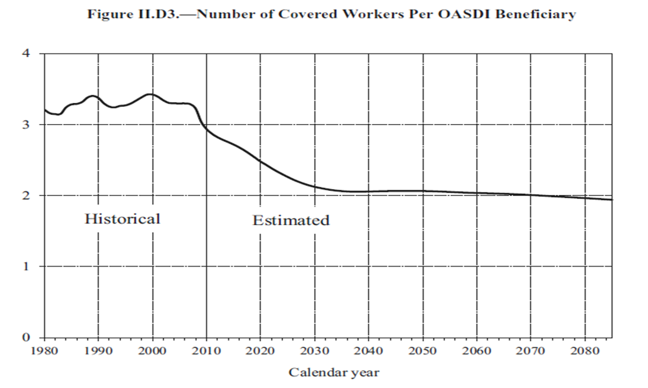
The Likely Future of Social Security
Where is the Social Security program now?
The Social Security program is currently taking in more than it is paying out
It had income of $840.2bn in Calendar Year 2012 ($784.9bn in 2007). and paid out $785.8bn in 2012 ($495.7bn in 2007) in benefits to 56.8mn (54.7mn in 2007) people
Note:
SS income is growing 1.4% per year
SS expenses are growing 9.7% per year
Reserves are in government bonds (SS Trust Fund)
Today there are 2.8 workers per recipient
Source: http://www.socialsecurity.gov/OACT/FACTS/

Slide 45
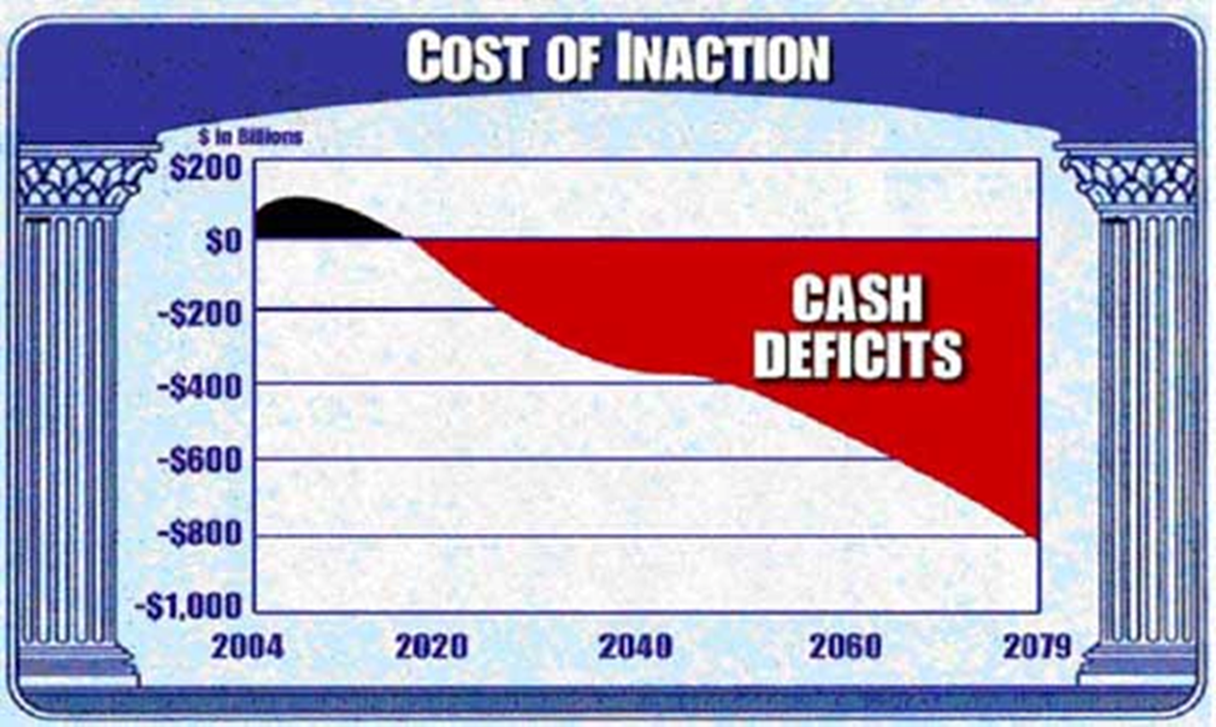
Future of Social Security (continued)
What is the future of Social Security?
Until 2015
Benefits can be paid solely from tax revenues until 2015
Until 2025
From 2016-2025 SS will have to use the interest on the bonds
Beyond 2033
From 2026-2033 the SS will have to redeem bonds
At current projections social security funds will be exhausted in 2033
By year 2075 there will be 2.0 workers per recipient

Slide 46
Future of Social Security (continued)
What about a worst-case scenario in 2033?
Even if SS assets are exhausted in 2033, Social Security calculates that from the regular inflow of tax revenue alone it could pay about 77 percent of scheduled benefits (from Social Security Statement front page, March 18, 2014)
My recommendation?
Don’t plan for much, but if it still is available, be thankful and use it—you paid into it

Slide 47
C. Understand some Plans and Strategies for taking Social Security Benefits
Following are a few ideas of plans and strategies for Social Security
Use Social Security Spreadsheet (LT36) to calculate your Primary Insurance Amount, Family Maximums, Spouse’s benefits, Children’s benefits, as well as determine your breakeven years for taking different benefit options (see Breakeven tab)

Slide 48
Plans and Strategies (continued)
Plans and Strategies
Accumulation
If health is poor, life expectancy low, or needs are great, begin taking benefits as soon as possible
Continue to work and contribute to the SS system as benefits are based on top 35 earning years
If possible, don’t take benefits before full retirement age as there is a tax penalty on benefits if your earnings are above a specific amount before FRA
If needed, you can take benefits up to 5 years before FRA; however, once you start taking benefits you cannot change that choice!

Slide 49
Plans and Strategies (continued)
Plans and Strategies
Retirement (FRA)
The higher-earning spouse should take retirement as late as possible.
This would maximize the amount the lower-earning spouse would have after the higher-earning spouse passes (once the higher-earning spouse passes, the spouse gets either the higher of their amount or the higher-earning spouses amount plus any delayed credits)
If possible, don’t take benefits before full retirement age as there is a tax penalty on benefits if your earnings are above a specific amount before FRA

Slide 50
Plans and Strategies (continued)
Plans and Strategies
Distribution
Try to defer taking benefits as long as possible, especially if you expect to live longer than the SS system determined average
The longer you delay taking benefits, the greater your monthly benefit (up to 3 years beyond FRA)
If you have extra money left over from SS distributions, roll over excess amounts into a Roth IRA to use later

Slide 51
Review of Objectives
A. Do you know how Social Security Works and can you answer key questions relating to Social Security?
B. Do you understand the key questions relating to Social Security and the likely future of Social Security?
C. Do you understand Plans and Strategies for taking Social Security?

Slide 53
Case Study #1
Data:
Bill Smith was born in 1940. He plans to retire and begin receiving Social Security benefits at age 68 and 6 months. His AIME is $2,072 and his PIA is $1,200, and he knows that his PIA will increase by 7% for each year beyond FRA he takes retirement (up to a 3 years).
Full Retirement Age:
Birth Year Full Retirement Age
1937 65
1940 65 + 6 mo.
1941 65 + 8 mo.
Calculations (Social Security Spreadsheet (LT36))
What is his retirement benefit at 3 years beyond FRA?

Slide 54
Case Study #1 Answer
Since Bill was born in 1940, his full retirement age is 65 years and 6 months. At 68 years and 6 months, he would be 3 years beyond his FRA. He would have a benefit of 7% per year of for waiting beyond his FRA for retirement.
His retirement benefit is 3 * 7.0% = (21% + 1) * $1,200 = ?
His retirement benefit is $1,452 per month
Social Security Spreadsheet (LT36) may be useful as you do these case studies.

Slide 55
Case Study #2
Data:
Steve was born in 1960 is thinking about perhaps retiring at age 62. He knows that his full retirement age is 67. He also knows that if he begins retirement 3 years before his FRA his PIA will be reduced by 20% and for each year before that, it will be reduced by 5%.
Calculations:
a. How much in percentage terms would his retirement benefits be reduced if he was to begin receiving Social Security benefits at age 62?
b. If his AIME was $2,010 and his PIA was $1,200, how much would he receive each month in retirement benefits if he retired at age 62?

Slide 56
Bill wants to retire at age 62 and was born in 1960. a. How much would his PIA be reduced if he was to begin receiving Social Security payments at age 62? B. If his PIA was $1,300, how much would he receive each month if he retired at age 62?
Steve’s payments would be reduced by 5/9 percent for each month prior to age 67 for the first 36 months (20% for 3 years) and 5/12 percent for each month prior to that (5% per year for each year after that)
a. To retire at age 62 would be:
5/9 percent x 36 months = 20%
5/12 percent x 24 months = 10%
Total reduction in payments = 30%
b. Bill would receive 1,200 * .7 (1 – 30%) or
$840 each month for the rest of his life before any cost of living adjustment

Slide 57
Case Study #3
Data:
Sam was born in 1955 (FRA is 66 and 2 months) and his wife Ann in 1958 (FRA is 66 and 8 months). They plan to both begin receiving SS benefits when Ann reaches FRA (Sam will be 3 years beyond FRA and the increase is 8% per year (the spouse gets the higher of their PIA or half the working spouses PIA).
Calculations:
a. Assuming Sam’s PIA is $1,500, and Ann’s PIA is only $600, how much would each receive?
b. What would be their combined amount they would receive each month?

Slide 58
Case Study #3 Answer
a. Since Sam was born in 1955, his full retirement age is 66 years and 2 months. At Ann’s FRA of 66 and 8 months, Sam would be 3 years beyond his FRA. He would have a benefit of 8% per year of for waiting beyond his FRA for retirement
His retirement benefit is 3 * 8.0% = (24% + 1) * $1,500 = ? Or $1,860 per month
His wife would receive the higher of half her spouses PIA (before the increase) of $1,500/2 or $600, whichever was higher, subject to the family maximum. In this case she would take the $750
b. Their combined benefit would be $1,860 + $750 or $2,610 per month

Slide 59
Case Study #4
Data:
Jenny and Steve were married for 15 years when Steve passed away. They have four children, all under 12. Steve was a currently insured worker and had a PIA of $1,200 when he passed away. The family maximum amount was $1,800. (Remember the surviving spouse and children get 75% of the insured’s PIA subject to the family maximum)
Calculations:
a. How much would Jenny receive from Social Security survivor benefits to help her with the raising of her children after Steve’s death?
b. How much would the children receive?

Slide 60
Case Study #4 Answer
a. Since Steve was a currently insured worker, Jenny would receive 75% of his PIA regardless of her age as there are children in the home under age 18
Jenny’s survivor benefit would be 75% * Steve’s PIA of $1,200 or $900 per month
b. The children’s benefit would also be 75% of Steve’s PIA
However, because Jenny had already received $900, the four children would only receive together the difference up to the family maximum of $900 ($1,800 family maximum - $900 for Jenny), rather than the 75% per child

Slide 61
Case Study #4 Answer

Slide 62
Case Study #5
Data
Jenny and Steve are both beyond FRA and received $11,000 in Social Security benefits in 2020. Their AGI (taxable pensions, wages, interest and dividends) was $22,500. They had $1,500 in tax-exempt interest income from a mutual fund. (Remember provisional Income (PI) is your AGI (before Social Security) + tax-exempt interest + 50% of your Social Security benefits)
Calculations:
a. Calculate their provisional income (MFJ)
B. How much of that $11,000 is taxable?

Slide 63
Case Study #5 Answers
Low Income: Benefits not taxable
Single filer with PI < $25,000 ($32,000 MFJ)
Middle Income: Up to 50% of benefits taxable
Single filer with PI from $25,000 to $34,000 ($32,000 to $44,000 MFJ)
Upper Income: 85% of benefits taxable
Single filer with PI > $34,000 ($44,000 MFJ)
Their provisional income is $22,500 + $1,500 + ($11,000/2) = $29,500
Since they are married filing jointly, the $29,500 is less than the $34,000 base amount. Therefore, none of the benefits are taxable.

Slide 64
Case Study #6
Data:
Bob has an AIME of $5,800 per month and was born in 1960.
Calculations
Calculate Bob’s PIA based on 2020 bend points of $960 and $5,785
The weights are:
90% of the first bend point
32% of the second and
15% of the remainder

Slide 65
Case Study #6 Answers
Calculating Bob’s PIA from his AIME in 2020 is divided into three calculations called “bend points”
1. 90% of the amount for the first $960
2. 32% of earnings from $960 - $5,785, and
3. 15% of earnings above $5,785
Since Bob’s AIME was $5,800 per month, the amount is:
90% of $960 or $864.00
32% of $5,785 - $960 ($4,825) or $1,544.00
15% of $5,800 - $5,875 ($15) or $2.25
Bob’s total PIA would be $2,410.25
This is the sum of each of the bend calculations

Slide 66
Case Study #7
Data:
Assuming Bob has an AIME of $6,158.33 and a PIA of $2,464 per month in 2020.
Calculations
Calculate Bob’s family maximum from the PIA calculated above based on 2020 family bend points of $1,226, $1,770, and $2,309
Note: For family maximums, the weights are:
150% of the first bend point
272% of the second
134% of the third, and
175% over the third bend point.

Slide 67
Case Study #7 Answers
Calculating Bob’s family maximum benefits in 2020 from his PIA is divided into four calculations
1. 150% of the amount for the first $1,226
2. 272% of earnings from $1,770 - $1,226
3. 134% of earnings from $2,309 - $1,770, and
4. 175% of earnings over $2,309
Since Bob’s PIA was $2,464, the max would be:
150% of $1,226 or $1,839.00
272% of $1,770 - 1,226 ($544) or $1,479.68
134% of $2,309 - $1,770 ($520) or $722.26
175% of $2,464 - $2,309 ($155) $271.25
His family maximum amount would be $4,312.19

Slide 68
Case Study #8
Data:
Bob was born in 1960, has an AIME of $5,335 and a PIA of $2,264 per month. Assuming no time value of money (no interest rate) and no cost of living adjustment (COLA), after what breakeven age would it be more beneficial for Bob to wait for FRA+3 than to retire at his full retirement age.
Hint: Use Social Security Spreadsheet (LT36)

Slide 70
Case Study #9
Data:
John just got his Social Security Statement for 2020. It said that at his full retirement age of 67, his monthly benefit would be $2,056, what was John’s Average Indexed Monthly Earnings?
Hint: Use Social Security Spreadsheet (LT36)

Slide 71
Case Study #9 Answer
John’s monthly benefit at FRA would be $2,056. Lets use Social Security Spreadsheet (LT36), and back into it using 2020 Data. Open, the spreadsheet, put in the tax year and birth year. Since his FRA is 67, he was born after 1960
Using Excel’s Goal Seek command, click on Data, What If Analysis, and Goal Seek, set cell “G20” to “2056” by changing cell “G14.”
What is his average indexed monthly earnings?
$4,685

