Slide 1
Personal Finance: Another Perspective
Retirement Planning 1:
Basics
Updated 2020-03-10

Slide 2
Objectives
A. Understand why retirement planning is critical and the principles of successful retirement planning
B. Know the steps and stages of retirement planning and the payout options at retirement
C. Understand one method of how to monitor your retirement planning progress
D. Understand and create your Retirement Plan

Slide 3
Your Personal Financial Plan
Section XII.: Retirement Planning Section
  What is your vision for retirement? (use Retirement Planning (LT01-12))
  What are your retirement goals? Years until you retire? Age at retirement?
    How much will you need? How much do you now have?
    How much must you save annually to reach your goals (include Retirement Planning Spreadsheet (LT06))?
    Include a copy of your Social Security Statement
  What are your Plans and Strategies for retirement?
    What are your accumulation, retirement and distribution plans?
  What are your constraints and accountability?

Slide 4
Case Study
Data:
Clint and Abby, both age 30, are putting together their future retirement income and expense projection. They hope to retire in 35 years at age 65. They determined that they would have retirement income of $15,000 each year in today’s dollars before-tax ($10,000 from Social Security and $5,000 from their savings), and they would need $60,000 before-tax in retirement income to retire comfortably.
Calculations:
How much must Clint and Abby save annually for 30 years of retirement if they wish to meet their income projection, assuming a 2 percent inflation rate both before and after retirement, and an 7.0 percent return on investments before retirement, and 6.0 percent during retirement.

Slide 5
A. Understand Why Retirement Planning is Critical and the Principles
What three questions does retirement planning answer and when will we cover them?
  1. How much money do you need at retirement to retire according to your vision and goals, and how much must you save annually to accomplish them?
  2. How long do you expect to live and how do you tell if you are on track to reach your retirement vision and goals?
  3. What are the major retirement vehicles available (business, small business, individual and government) and how can you use them to reach your retirement goals

Slide 6
Planning is Critical (continued)
Why is retirement planning so important?
    We are responsible for taking care of ourselves and families
    Adequate retirement planning will help ensure we fulfill our responsibilities to our families.
    Planning for the future ensures a better future
      No one cares for your family like you
  There are 30 Key Decisions for Retirement you should make as you prepare for retirement
    You should make these before you start to retire

Slide 7
Planning is Critical (continued)
What are the factors that determine your savings needs at retirement?
  Desired retirement income (be realistic)
  Other sources of retirement income (Social Security, retirement and investment accounts, real estate, home)
  Age starting investing, age at retirement, and death
  Estimated tax and inflation rates (both before and after retirement)
  Risk tolerance (both before and in retirement)
  Expected return on your savings (both before and after retirement)

Slide 8
Planning is Critical (continued)
Why start saving today ?
  Although retirement seems a long way away, it isn’t!
    Employer benefits are changing, being reduced, or are simply not available
      Plan accordingly
  Government programs are not certain
    The future of government benefits, particularly Social Security, is questionable (and that’s taking a positive view)
    Social Security isn’t likely to be enough to survive on even if it is still around

Slide 9
Planning is Critical (continued)
How long are you expecting to live?
  Interesting statistics
    The life expectancy 1900 2016
      Men 46 76.3
      Women 48 82.3
    There are nearly 67,000 Americans who are at least 100 years old (130% increase from 1990)
      The est. number of centenarians in 2050 is 834,000, with 82% expected to be women
    Source: Kiplinger Magazine, Feb. 2001, http://www.data360.org/dsg.aspx?Data_Set_Group_Id=195

Slide 10
Planning is Critical (continued)
How long are you expecting to live?
  Social Security estimates you will live this long based only on date of birth and gender
    Social Security – Life Expectancy Calculator
  Take one or more of these other quizzes to help get an idea of how long you will live
    Longevity Quiz - Northwestern Mutual Life Insurance
    How Long Will You Live - Blueprint Income
    Life Expectancy Calculator - Bankrate.com

Slide 11
Principles of Successful Retirement Planning
What are the principles for successful retirement planning?
  1. Know yourself, your vision, goals, and risk tolerance
  2. Seek, receive and act on the Holy Ghost’s guidance
  3. Understand the retirement vehicles available to you and use them wisely
  4. Choose wisely the investment vehicles and assets and invest wisely
  5. Know and follow the Retirement Planning Steps
  6. Develop a good retirement plan, write it carefully, and follow it closely
  7. Start today!

Slide 12
Principles (continued)
Finding balance
Principles Doctrines
  Know yourself, your goals and vision Identity
  Seek, receive and act on guidance Obedience
  Understand retirement vehicles Stewardship
  Choose assets wisely Stewardship
  Know the steps for retirement Agency
  Develop and follow your plan Accountability
  Start today Stewardship

Slide 13
Principles (continued)
  From obedience to consecration
  I am a child of God (identity), striving to live worthy of the Spirit (obedience), learning about key areas and steps and strategies of retirement (stewardship). With this information, I can make wise decisions about my future (agency) which will allow me to save and invest appropriately now (accountability) to accomplish my personal mission and individual and family vision and goals.

Slide 14
Questions
Any questions on why planning for retirement is important and the principles of successful retirement planning?

Slide 15
B. Understand the Steps and Stages of Retirement Planning
What are the steps to successful planning?
  1. Catch your vision and set goals and plans for what you want at retirement
  2. Estimate your current annual income available at retirement
  3. Estimate your total retirement needs after inflation (i.e., the inflation-adjusted shortfall)
  4. Determine how much you have accumulated so far on a before-tax basis
  5. Determine the contribution or reduction to your retirement plans from your home
  6. Determine how much more you will need to save and start saving and investing today
  7. Determine your optimal investment vehicles and begin save
  Retirement Planning Needs (LT06) can help with this process

Slide 16
Steps (continued)
1. Catch your vision for how you want to live in retirement and set goals for what you want
  Estimate your needs on a before-tax basis
    How do you want to live when you retire?
    Will you need more or less than now?
2. Estimate your current annual income available at retirement
  This will include on a before-tax basis:
    Social Security, Defined benefit pension income, Qualified retirement plan income, and Savings

Slide 17
Steps (continued)
3. Estimate your total retirement needs after inflation (i.e. the inflation-adjusted shortfall)
  How long will you live?
  What return and inflation rates are likely?
  Assume an annuity to provide your resources
4. Determine how much you have accumulated so far on a before-tax basis
  List the current value of all your retirement and investment accounts
  Take into account tax considerations
  Calculate the future value of your investments at an expected return consistent with your portfolio risk

Slide 18
Steps (continued)
5. Determine the contribution or reduction to your retirement plans from your home
  Forecast the value, estimated growth, cost of a new home, and what you will owe at retirement
  Include the cost of a new home if you plan to move at retirement
6. Determine how much more you will need to save
  Determine your total investment shortfall
  Estimate the growth in investments and inflation, and calculate your monthly and annual payments to meet your goals

Slide 19
Steps (continued)
  You will need to include Retirement Planning Needs (LT06) use Tab “Needs before Tax (Fin200)”
    Based on your estimates of how much you will need and how much you now have, years till and in retirement, returns before and in retirement, and inflation before and in retirement, it shares how much you need.
7. Determine your preferred retirement investment vehicles and financial assets and start now and save and invest
  Save and invest wisely through the optimal investment vehicles using the Priority of Money

Slide 20
Stages (continued)
There are 3 stages to retirement planning. You will need to develop strategies for each stage
Stage 1: Accumulation
    This stage begins when you start work and is the time where you accumulate assets which you will later use for retirement and other goals
      Develop a plan for this stage on how you will save money for retirement in the years before you retire
      Get on a budget and save 20% percent of your income each month (10% minimum)
      Start now (or sooner)

Slide 21
Strategies (continued)
Stage 2: Retirement or Annuitization
  This stage begins when you retire
    It is your plan on how your assets will be distributed at retirement
      Your goal is to have sufficient assets for your lifetime to enable you and your spouse to live like you planned

Slide 22
Strategies (continued)
Stage 3: Distribution/disposition/decumulation
  This stage begins after you have retired
    This is your plan as to how best take distributions from your remaining retirement and taxable accounts to minimize taxes and maximize the availability of your assets

Slide 23
Payout Options at Retirement
Plan ahead before deciding how a distribution or payout is to be received
  Make sure you understand the tax consequences of any payout or distribution option chosen
  Look at all your investment and retirement payouts together. Be diversified in payout options: annuitize some and invest some
  Consider the pros and cons of an annuity versus a lump sum payout, as well as the costs and expenses of annuities and other retirement options
Plan your payouts to minimize taxes and maximize the assets available for you at and during retirement

Slide 24
Payout Options (continued)
What are annuities?
  A financial product designed to accept and grow funds, and then, upon annuitization, make payments for a specified length of time (just like a bond)
    Annuities can be structured many different ways, such as payments for life for annuitant or spouse (i.e., for life of both), duration of payments (i.e., 20 years certain or life, whichever is longer), the type of payments (i.e., fixed or variable), etc.
      They can also provide the flexibility to construct a contract to be meet your cash flow needs (however, it also increases expenses)

Slide 25
Payout Options (continued)
What are the different types of annuities?
  Immediate. Payments begin immediately
  Deferred. Payments are deferred until the specified time the investor elects to begin receiving them
  Fixed. Fixed payments are made to the investor until the end of the contract, usually till the investor dies
  Variable. Variable payments are made to the investor until the end of the contract, but payments are variable based on a specific asset’s performance
  Life. Fixed payments are made each period until the end of the investor’s life
  Period Certain. Fixed payments are made for a specific period, regardless of the investor’s life span

Slide 26
Payout Options (continued)
What are the types of annuity distribution payouts available at retirement
  Single life. You receive payments for the rest of your life only—not including your spouse’s life
  Life with “certain period”. You receive payments for as long as you live; however, if you die, payments continue until the end of the certain period
  Joint and Survivor. You receive payments for as long as both you and your spouse live. Benefits may be reduced for your spouse when you die
  Lump-sum. You receive a single payment of all principal and interest at retirement

Slide 27
Payout Options (continued)
How are retirement payouts taxed?
  Annuity payments
    Payments will be taxed as normal income
  Lump-sum payment:
    Will normally be taxed as if you received the money over a 10 year span. This reduces taxes slightly, but you are still liable for all the tax immediately
    Lump sum payments from an annuity may be rolled over into an IRA to avoid taxes and continue tax-deferred growth

Slide 28
Payout Options (continued)
What percent of retirement assets should be annuitized?
  The key principle is not to outlive your money
    The amount you annuitize is based on many factors, including amount of wealth at retirement, level of Social Security benefits accrued, risk tolerance, level of interest rates, expected returns on asset classes, inflation, marital status, age, pension income, amount wanted to leave to heirs, etc.
      It is a complex task

Slide 29
Payout Options (continued)
Are there general guidelines for annuitization?
  a. Annuitize enough to cover 100% of your minimum acceptable level of retirement income (this is the minimum needed for survival to pay all the bills, be comfortable, but not take that vacation or buy that new car). This minimum level will vary from individual to individual
  b. Once minimum levels are annuitized, the amount of additional assets to annuitize would depend on your risk tolerance and assets available
    The lower (higher) your tolerance for risk, the higher (lower) the amount you would annuitize of your remaining assets

Slide 30
Payout Options (continued)
What about inflation?
  If you are concerned about inflation, you can include a cost of living (cola) rider on your annuity
    This rider allows an adjustment for the amount paid to take into account increases in inflation
    Realize that this rider has a cost, and will likely mean a lower payout initially but a higher payout later on.

Slide 31
C. Understand One Method of How to Monitor your Retirement Planning Progress
Key Points to Remember
  Changes in inflation can have a drastic effect on your retirement planning
    Watch it.
  Once you retire, you may live a long time.
    Plan accordingly
  Don’t neglect your insurance coverage.
    Healthcare costs can quickly reduce a good retirement plan
  Monitor your progress towards your goals and make changes as necessary
    Review and evaluate performance annually

Slide 32
Monitoring Progress (continued)
One of the biggest challenges is how do you know how well you are doing in preparing for retirement?
  Is there a way to monitor your progress on how well you are reaching your retirement goals?
  Is there a tool to give you guidelines as to where you should be as you work toward retirement so you can make changes consistent with your own goals and objectives?
The following article is from Jonathan Clements, “Ugly Math: How Soaring Housing costs are Jeopardizing Retirement Savings, The Wall Street Journal, March 25, 2005, p. D1. Instead of summarizing the article, I chose to copy it into the slides.

Slide 33
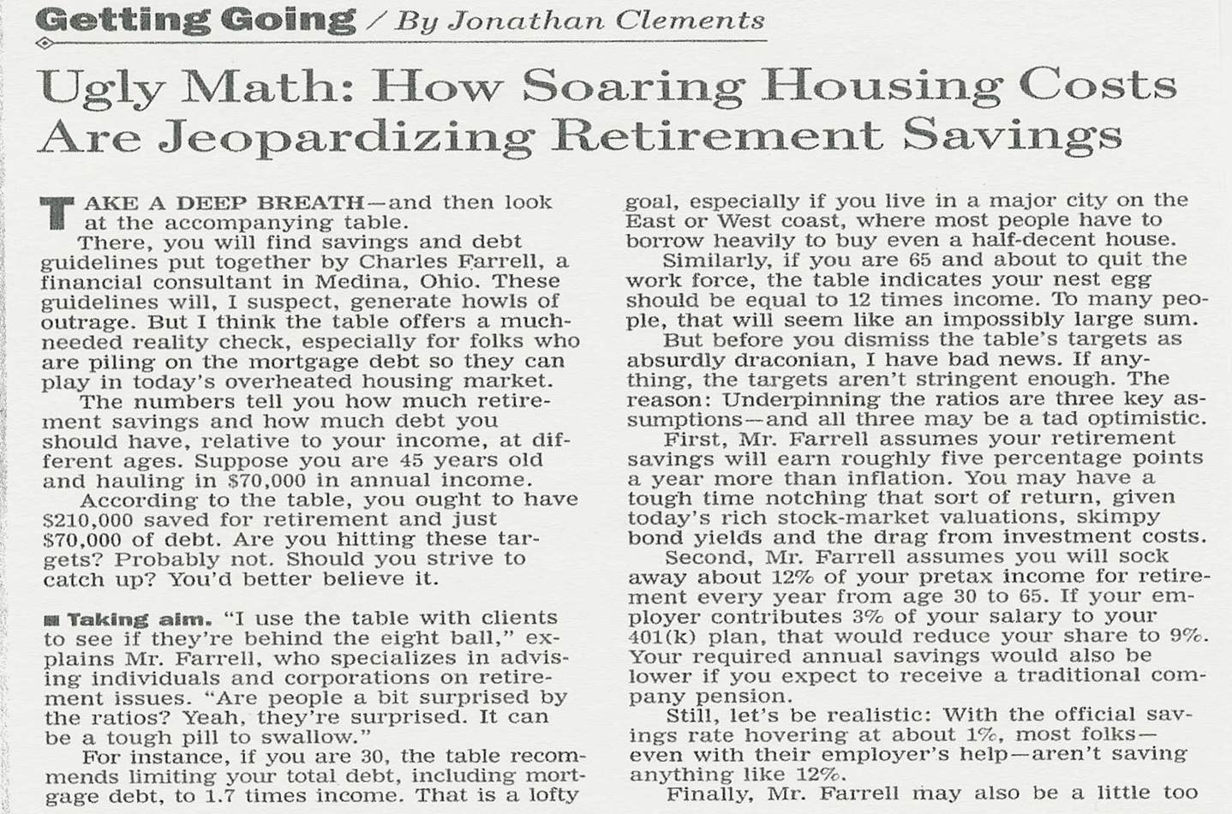
Source: WSJ, 23Mar05, p. D1.

Slide 34
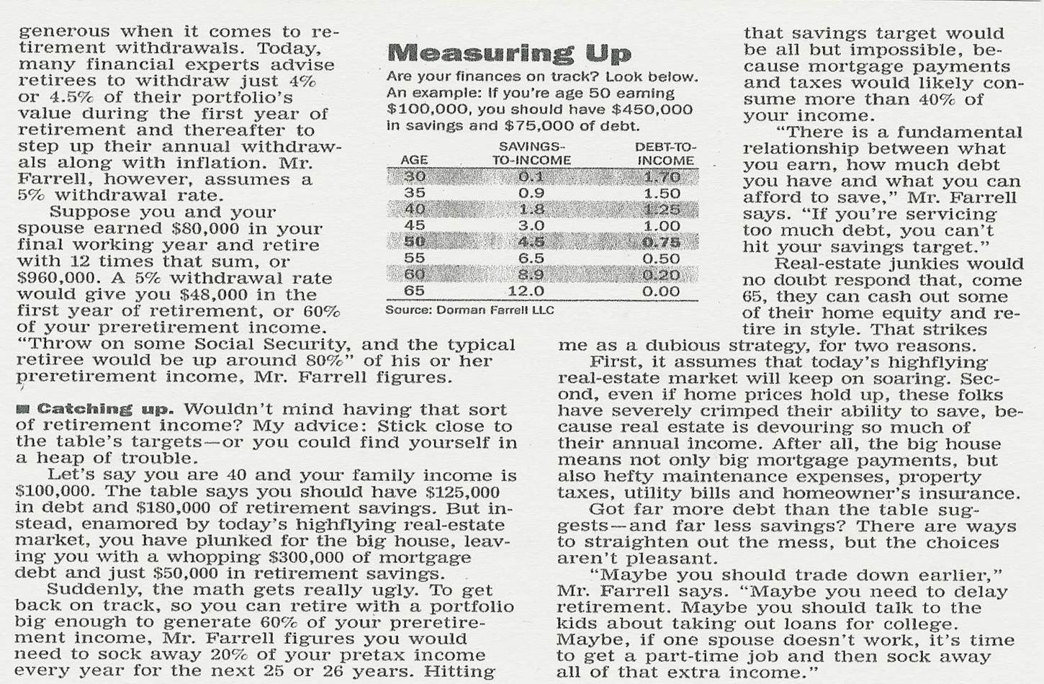
Source: WSJ, 23Mar05, p. D1.

Slide 35
Monitoring Progress (continued)
Savings- Debt-to-
Age to-Income Income
30 0.1 1.70
35 0.9 1.50
40 1.8 1.25
45 3.0 1.00
50 4.5 0.75
55 6.5 0.50
60 8.9 0.20
65 12.0 0.00
This chart is from Doman Farrell, LLC as quoted in: Jonathan Clements, “Ugly Math: How Soaring Housing Costs are Jeopardizing Retirement Savings,” Wall Street Journal, 23Mar05, p. D1.

Slide 36
Monitoring Progress (continued)
What does this framework tell us?
  It gives a reality check in today’s overheated spending frenzy
  It shows the relationship between savings and debt and how we need to manage both
  It encourages us to reduce debt at the same time you increase savings

Slide 37
Monitoring Progress (continued)
Assumptions of the article:
  1. Investors will earn 5% more than inflation
    What do you think?
  2. Investors will save about 12% of pre-tax income every year from age 30 to 65
    What do you think?
  3. Investors will withdraw 5% of portfolio value each year
    What do you think?

Slide 38
Monitoring Progress (continued)
Review of Assumptions
  1. You will earn 5% over inflation?
    You may have a hard time achieving that return unless you have a preference for a larger equity allocation
  2. You will save 12% of pre-tax income
    That is a challenge for most people
      But not for students of this class
  3. You withdraw 5% of portfolio value each year
    This is probably OK
Overall, these guidelines are likely to be too soft. They should probably be made more stringent!!!

Slide 39
Monitoring Progress (continued)
Is there a tool that would take into account where we are, where we want to be, and that could help us as we work toward retirement?
  One suggestion is Retirement Planning Forecasts Ratio (LT25)
    While it is still in preliminary form, it may be useful given different financial situations and goals

Slide 40
Monitoring Progress (continued)
Advantages of Retirement Planning Needs Forecasts (LT25)
  It shows that retirement is a planned process that can be charted and worked on
  It gives basic assumptions that can be changed depending on your situation
  It shows weaknesses in current plans and can help in the monitoring process
Disadvantages
  It is only as accurate as the respective inputs you put into the spreadsheet

Slide 41
D. Understand and Create your Retirement Plan
Is it easy to come up with a retirement vision and plan?
  No. It is very difficult because we all have different visions, goals, and plans
  While it is difficult to develop, it is something that we should think about to give us motivation to prepare for retirement
  Following are a few ideas

Slide 42
Vision and Strategies (continued)
Vision
  From your Plan for Life
Goals
  Take some assets and purchase an immediate annuity, which with Social Security and defined benefit plan will give a minimum level of income each year.
  Take social Security at 3 years beyond full retirement age, and my spouse at full retirement age.
  Our defined benefit payments will be for joint and survivor 100%, so that spouse will have sufficient.
  Our home is paid for and we will have no debt
  Retirement portfolios will be 40% tax-deferred, 30% Roth, and 30% taxable to target tax rates.

Slide 43
Vision and Strategies (continued)
Plans and Strategies
Accumulation Stage: Age 33-65
  Continue to save and invest 20% of all earnings, with 15% going into retirement consistent with our risk
  2% will go into our children’s education and mission accounts consistent with our Mission/Education Plans.
  3% we will use to pay down the mortgage with a goal is to have it paid off by the time I turn 45.
  We will pay all tithes and offerings and rebalance our investment portfolio to asset allocation targets with appreciated securities to minimize taxes.

Slide 44
Stages and Strategies (continued)
Other Accumulation strategies could include:
  Live on a budget , save 20%, get the company match
  Save 20%, 15% into your Roth 401k, 3% for other goals, and 2% for children’s mission and education
  Invest in Roth accounts while young and rates are low. Use these to target tax rate in retirement (to a low level)
  Maximize investments in Roth vehicles as you are actually saving more for retirement
  Plan to have all debts paid off before retirement. Do not go into retirement with debt
  Plan, if desired, to not take social security until 3 years past full retirement age to maximize benefits
  Live like a retiree before you retire, so there are fewer fixed expenses

Slide 45
Vision and Strategies (continued)
Plans and Strategies (continued)
Retirement Stage Age 65 – 70.
  Take a portion of assets and purchase a 5 year immediate annuity, which with Social Security and defined benefit payments, be sufficient to give our minimum level of retirement income.
  Save 5% during this period, although overall resources will be diminished due to helping to pay for our children’s education/missions.
  Go on our 1st mission at 65, and use this time to convert traditional accounts into Roth accounts.
  We will likely come back to teaching until age 70, then go on four other missions, subject to our health.

Slide 46
Stages and Strategies (continued)
Other Retirement strategies might include:
  Calculate a minimum level of retirement income, and annuitize that amount (if you have assets).
  Take a percentage of your assets at retirement (if sufficient) to purchase an immediate annuity to give you your minimum acceptable level of income
  Regardless of when you retire, take SS at 3 years beyond Full Retirement Age to get the maximum you can and leave the most for your spouse at death
  Have all debts paid off before you retire so you have fewer fixed expenses and hence taxes
  Have both Roth and traditional retirement assets so you can target your tax rates in retirement

Slide 47
Vision and Strategies (continued)
Plans and Strategies (continued)
Distribution Stage: Age 70 - 97
  Take social Security at 3 years beyond full retirement age, and my wife at full retirement age.
  Our work defined benefit payments will start at age 70, and will be for joint and survivor 100%.
  Our home will be paid for and we will have no debt
  We pay cash for all vehicles and keep them a minimum of 10 years.
  We will continue to pay tithes and offerings with appreciated securities and will enjoy life to the fullest.

Slide 48
Stages and Strategies (continued)
Other Distribution strategies might include:
  Set up a framework to not outlive your assets.
    Take out a maximum of 3.6% of assets each year
    Take out earnings from investments of previous year
  Have taxable (tax now), Roth (rarely taxed) and traditional (taxes later) to target your rate in retirement
  Set a target tax rate, then use traditional assets to that amount, then Roth assets afterwards to reduce taxes
  Make sure to pay your Required Minimum Distributions
  During your later years which your income is less, i.e., during missions, transfer money from your tax-deferred to tax-eliminated Roth accounts
  Have your house paid for so you have fewer fixed expenses

Slide 49
Vision and Strategies (continued)
Constraints
  Budget. We will continue to live on a budget and save for our individual and family vision and goals
  Saving. We will continue to save 20% of gross income per year, with 15% going into retirement vehicles
  Health. We will always have sufficient health coverage, through both government and private coverage
  Sin. We will guard against loss of the Spirit, testimony and eternal lives. We will continue serving, reading our scriptures, attending the temple, etc. to help us become more like the Savior
Accountability:
  From your Plan for Life

Slide 50
Review of Objectives
A. Do you understand why retirement planning is critical and the principles of successful retirement planning?
B. Can you name the important steps and stages of retirement planning and the key payout options at retirement?
C. Do you know one way of how to monitor retirement performance?
D. Can you create your Retirement Plan?

Slide 51
Case Study #1
Data:
Clint and Abby, both age 30, are putting together their future retirement income and expense projection. They hope to retire in 35 years at age 65. They determined that they would have retirement income of $15,000 each year in today’s dollars before-tax ($10,000 from Social Security and $5,000 from their savings), and they would need $60,000 before-tax in retirement income to retire comfortably.
Calculations:
How much must Clint and Abby save annually for 30 years of retirement if they wish to meet their income projection, assuming a 2 percent inflation rate both before and after retirement, and an 7.0 percent return on investments before retirement, and 6.0 percent during retirement.

Slide 52
Clint and Abby, 30, retire in 35 years, have retirement income of $15,000 each year in today’s dollars before tax, need $60,000 before-tax. Calculate the amount to save annually for 30 years of retirement, assuming 2% inflation both before and after retirement, and an 7% return before retirement, and 6% during retirement.
First, draw the diagram, then:
1. Calculate the Shortfall
2. Inflation adjust the shortfall
3. Calculate the real return and the annuity
4. Calculate the period payment
Time 35 years 30 years
Return 7.0% Return 6.0%
Inflation 2.0% Inflation 2.0%
Now Retirement Death

Slide 53
Clint and Abby, 30, retire in 35 years, have retirement income of $15,000 each year in today’s dollars before tax, need $60,000 before-tax. Calculate the amount to save annually for 30 years of retirement, assuming 2% inflation both before and after retirement, and an 7% return before retirement, and 6% during retirement.
1. Calculate the shortfall (all on a before tax basis as stated):
  The shortfall is $60,000 – $15,000 = ?
    C and A's shortfall is $45,000 before tax.
2. Calculate the inflation-adjusted shortfall (end mode):
  The adjustment is PV=$45,000, I=2%, N=35, FV=?
    Clint and Abby need $89,995 each year (you can round to the closest dollar)
3. Calculate the real return and annuity:
  The real return is (1 + nominal return)/(1 + inflation) – 1 or (1.06)/(1.02) – 1 = ?
    The real return is 3.92%

Slide 54
Clint and Abby, 30, retire in 35 years, have retirement income of $15,000 each year in today’s dollars before tax, need $60,000 before-tax. Calculate the amount to save annually for 30 years of retirement, assuming 2% inflation both before and after retirement, and an 7% return before retirement, and 6% during retirement.
  To calculate an annuity (remember you will want the payments at the beginning of the period so use the begin mode on your calculator)
    To get the annuity, set PMT = $89,995, N = 30, I = 3.92%, and solve for PV
      C and A need $1,632,737 to be available in 35 years to give them the annuity for 30 years
4. Calculate the period payment (use end mode)
  To get this future amount, we set the FV = $ 1,632,737, N = 35, I = 7.0%, and calculate the PMT=?
  C and A need to save $11,811 each year to meet their retirement goal ($907 per month)

Slide 55
Clint and Abby, 30, retire in 35 years, have retirement income of $15,000 each year in today’s dollars before tax, need $60,000 before-tax. Calculate the amount to save annually for 30 years of retirement, assuming 2% inflation both before and after retirement, and an 7% return before retirement, and 6% during retirement.

Slide 56
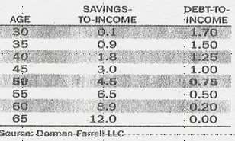
Case Study #2
Data:
Clint and Abby Smith are now 45 years old with six kids and are making $82,000 per year. They are 20 years into their retirement plan. They have $115,000 in savings, and their remaining balance on their home mortgage and credit card debt is $150,000. They have saved only 5% per year and have earned 7% on their savings, and have felt that was sufficient.
Calculations:
  Are they on-track for retirement or not?
  Calculate their income/debt ratio’s from the Wall Street Journal article
Application:
  How are they doing, and what more should they be doing?

Slide 57
Source: WSJ, 23Mar05, p. D1.

Slide 58
Source: WSJ, 23Mar05, p. D1.

Slide 59

Clint and Abby, 45, $82,000 salary, 20 years into their retirement plan, $115,000 in savings, and $150,000 in debt. Are they on-track for retirement or not? How are they doing? What should they do more?
Calculations
Are they on track? You can’t tell until you calculate their ratios
  Current Salary Savings Debt
    Age 45 $82,000 $115,000 $150,000
  Ratios Current Recommended
    Savings to income ratio 1.40 ($115/82) > 3.0
    Debt to income ratio 1.83 ($150/82) < 1.0
Results
They are way behind on their
savings and debt goals for
retirement.

Slide 60
Clint and Abby, 45, $82,000 salary, 20 years into their retirement plan, $115,000 in savings, and $150,000 in debt. Are they on-track for retirement or not? How are they doing? What should they do more?
Application:
  They have too little savings and too much debt
    They need to save an even bigger percentage of their salary (I suggest 20%)
    They need to work harder if retirement is really a goal
  What should they be doing?
    They have too much debt
      They may need to sell assets to reduce debt
      They may need to downsize
    They have not been saving enough
      They need to begin saving a larger percentage of their income!

Slide 61
Case Study #3
Data
  Lets take this same couple who have only been saving 5% and make a few more assumptions to bring it in line with our previous case. Assume they took out a $250,000 mortgage at age 30 at 4% (which would give them their $150,000 remaining debt). Add in their $115,000 savings. Assuming they can buy an annuity at retirement earning 4.0%, how much will saving 20% until retirement allow them to take out each year.
    To answer this question, I tried to take the WSJ article intent and allow for changes due to age, buying a house, prepaying the mortgage, etc. to create Retirement Planning Forecasts Ratio (LT25). While it is still in preliminary form, use it to solve for how much will saving 20%, starting now, roughly give them in retirement?

Slide 62
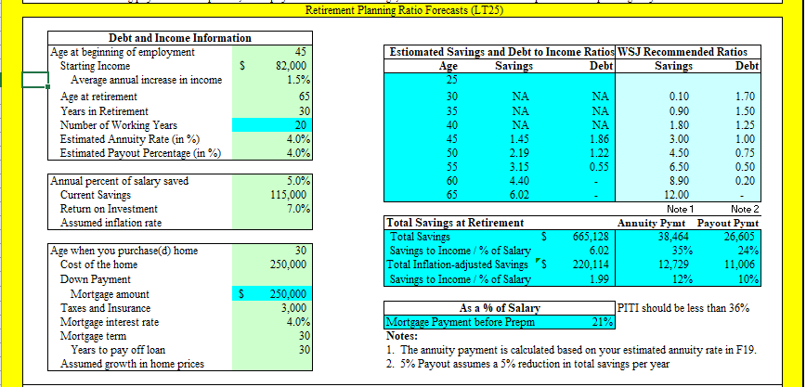
Case Study #3 Answers
Saving their current 5%, they will only have about 35% of what they need. They must save more

Slide 63
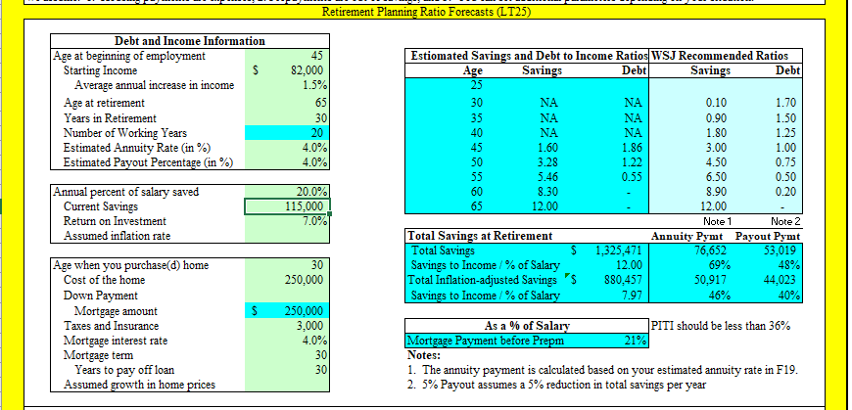
Case Study #4 Answers
Increasing their savings rate to 20%, they will have about 70% of what they need. They must get serious and save more

Slide 64
Case Study #4
Data:
Clint and Abby, both age 35, recently reviewed their future retirement income and expense projection. They hope to retire in 25 years. They determined that they would have a retirement income of $25,000 each year in today’s dollars before-tax ($10,000 from Social Security and $15,000 from their savings), but they would actually need $67,500 before-tax in retirement income to retire comfortably.
Calculations:
How much must Clint and Abbysave annually for 30 years of retirement if they wish to meet their income projection, assuming a 2 percent inflation rate both before and after retirement, and an 6.5 percent return on investments before retirement, and 5.5 percent during retirement.

Slide 65
Clint and Abby, 35, retire in 25 years, have retirement income of $25,000 each year in today’s dollars before tax, need $67,500 before-tax. Calculate the amount they must save annually for 30 years of retirement, assuming 2% inflation both before and after retirement, and an 8% return before retirement, and 7% during retirement.
First, draw the diagram, then:
1. Calculate the Shortfall
2. Inflation adjust the shortfall
3. Calculate the real return and the annuity
4. Calculate the period payment
Time 25 years 30 years
Return 6.5% Return 5.5%
Inflation 2.0% Inflation 2.0%
Now Retirement Death

Slide 66
Clint and Abby, 35, retire in 25 years, have retirement income of $25,000 each year in today’s dollars before tax, need $67,500 before-tax. Calculate the amount they must save annually for 30 years of retirement, assuming 2% inflation both before and after retirement, and an 6.5% return before retirement, and 5.5% during retirement.
1. Calculate the shortfall (all on a before tax basis as stated):
  The shortfall is $67,500 – $25,000 = ?
    C and A's shortfall is $42,500 before tax.
2. Calculate the inflation-adjusted shortfall (end mode):
  The adjustment is PV=$42,500, I=2%, N=25, FV=?
    Clint and Abby need $69,726 each year (you can round to the closest dollar)
3. Calculate the real return and annuity:
  The real return is (1 + nominal return)/(1 + inflation) – 1 or (1.055)/(1.02) – 1 = ?
    The real return is 3.43%

Slide 67
Clint and Abby, 35, retire in 25 years, have retirement income of $25,000 each year in today’s dollars before tax, need $67,500 before-tax. Calculate the amount they must save annually for 30 years of retirement, assuming 2% inflation both before and after retirement, and an 6.5% return before retirement, and 5.5% during retirement.
  To calculate an annuity (remember you will want the payments at the beginning of the period so use the begin mode on your calculator)
    To get the annuity, set PMT = $69,726, N = 30, I = 3.43%, and solve for PV
      C and A need $1,337,882 to be available in 25 years to give them the annuity for 30 years
4. Calculate the period payment (use end mode)
  To get this future amount, we set the FV = $1,337,882, N = 25, I = 6.5%, and calculate the PMT=?
  C and A need to save $22,719 each year to meet their retirement goal ($1,787 per month)

Slide 68
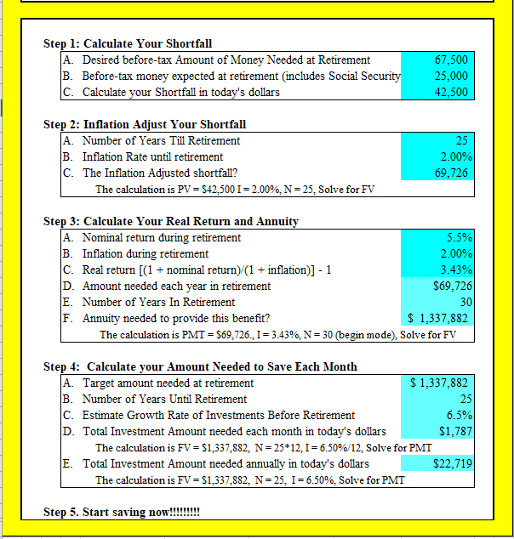
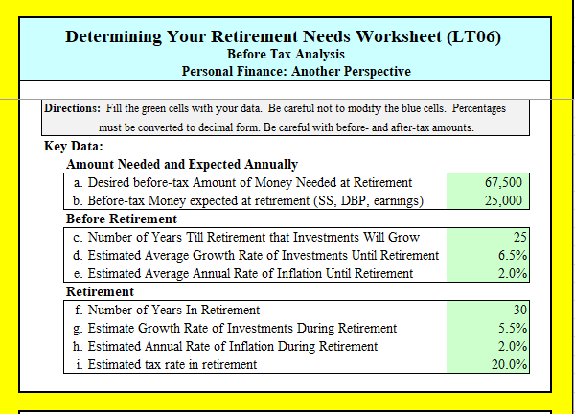
Clint and Abby, 35, retire in 25 years, have retirement income of $25,000 each year in today’s dollars before tax, need $67,500 before-tax. Calculate the amount they must save annually for 30 years of retirement, assuming 2% inflation both before and after retirement, and an 6.5% return before retirement, and 5.5% during retirement.
From Retirement Needs Worksheet (LT06), Retirement Needs – Before Tax Tab

