Slide 1
Personal Finance: Another Perspective
Investing 9:
Portfolio Evaluation, Rebalancing,
and Reporting
Updated 2020-03-06

Slide 2
Objectives
A. Understand portfolio rebalancing
B. Understand the importance of portfolio management and performance evaluation
C. Understand and calculate risk-adjusted performance measures
D. Understand how to open up a mutual fund account

Slide 3
Investment Plan Assignments
Investments 9: Portfolio Rebalancing and Reporting
  1. Determine the type of rebalancing you will likely use and how often you will rebalance, and include it in your investment plan under section IV.B.2 of your Investment Plan (LT05A).
  2. Think through the new money/donations addendum, and how you will utilize it to minimize taxes and transactions costs in rebalancing
  3. Determine how often you will monitor and report on your portfolio, and include it in IV.A.1.
  4. Determine how you will communicate portfolio results and include it in section IV.C.

Slide 4
Investment Plan Assignments
Investments 10: Behavioral Finance
  There are no required assignments for your Investment Plan from this section
    Read through and try to determine principles and ways Behavioral Finance can help you to be a better investor

Slide 5
Case Study
Data
Steve and Suzie, both 45, are aggressive investors, and have a portfolio of over $250,000. Their target asset allocation is 60% equities and 40% bonds and cash which they have invested in 10 mutual funds. Their actual asset class weights are different from their targets due to the out-performance of the equity part of their portfolios.
  Asset Class Actual Weight Target Weight Difference
  Equity 70% 60% 10%
  Bonds 20% 30% -10%
  Cash 10% 10% 0%
Application: When should they rebalance their portfolio and how should they do it effectively (including costs and taxes)?

Slide 6
A. Understand Portfolio Rebalancing
What is portfolio rebalancing?
  The process of bringing portfolios back in line into given target asset allocation percentages so you can maintain your target risk level
What causes the need to rebalance?
  Changes occur due to:
    Asset class performance
    Changes in investor objectives or risk
    Introduction of new capital
    Introduction of new asset classes

Slide 7
Portfolio Rebalancing (continued)
Why is this rebalancing so critical?
  There are competing principles:
    Minimize transactions costs and taxes
    Minimize tracking error at your risk level
  What is tracking error?
    It is the return that is lost or gained from your actual portfolio being different from your target portfolio
  What are the different ways of rebalancing?
    There are different ways. The most used are:
      Periodic-based (or calendar-based)
      Percent-range-based (or volatility-based)

Slide 8
Portfolio Rebalancing (continued)
Periodic-based rebalancing
  Specify a time period, i.e. bi-annually, annually, etc. After each time period, rebalance the portfolio back to your original asset allocation targets
  Advantages
    Most simple of the methods
    Longer periods have lower transactions and tax costs (but higher tracking error costs)
  Disadvantages
    Independent of market performance
    Performance will depend on relative timing of large market moves and rebalancing

Slide 9
Portfolio Rebalancing (continued)
Percent-range-based rebalancing
  Rebalance the portfolio every time actual holdings are +/-5% (or +/-10%) from target ratios. Rebalance whenever you are outside this range
  Advantages
    Easy to implement
    Wider ranges will reduce transactions costs (at the expense of higher tracking error)
    Asset performance will trigger rebalancing
  Disadvantages
    Setting an effective range is difficult
    Assets with higher target ranges and volatility will generate the most rebalances

Slide 10
Portfolio Rebalancing (continued)
“NMD” (New Money / Donations) Addendum
  Since you pay yourself monthly and are very careful in your selection of assets, you can combine the previous strategies with a “New Money / Donation” strategy to effectively rebalance
    New Money. Rebalance as determined previously. But use monthly new money to purchase “underweight” assets, so you do not sell and incur taxable events. This works in both taxable and retirement accounts
    In addition, this strategy helps you to buy “low,” as you are generally purchasing underperforming asset classes

Slide 11
Portfolio Rebalancing (continued)
NMD Addendum (continued)
    Donations. In taxable accounts, rebalance your portfolio using appreciated assets for your charitable contributions (see Learning Tool 8)
      Donate “appreciated” assets for your charitable contributions. Then use the money you would have spent on contributions to purchase underweight assets
      This way you eliminate your capital gains taxes for the contributed assets, and you get the full benefit of the deduction for your taxes, i.e., you sell “high” without tax consequences

Slide 12
Portfolio Rebalancing (continued)
Which are the best methods?
  Generally, for most investors with fewer investable assets, the easiest is likely to be most useable
    Generally, a combination of periodic-based or percent-range-based rebalancing is most useful with the NMD addendum
      Review the portfolio annually, but only rebalance when you are +/- 5% to +/-10% (or some range) beyond your targets. Then rebalance back to your targets
      Remember, the goal is to minimize transactions costs, taxes, and tracking error costs

Slide 13
Questions
Any questions on portfolio rebalancing?
  We are truly selling high and buying low
    Our investment strategy is dollar cost averaging (20% with 15% into retirement accounts monthly) and portfolio rebalancing using new money/donations strategy

Slide 14
B. Understand the Importance of Portfolio Management and Evaluation
What is portfolio management?
  The development, construction, and management of a portfolio of financial assets to attain an investor’s specific goals
What is performance evaluation?
  The process of evaluating a portfolio’s performance with the goal of understanding the key sources of return
Why are these two topics so important?
  Both are complicated subjects and both are critical to investing

Slide 15
Management and Evaluation (continued)
What is “active” portfolio management?
  The process of using publicly available data to actively manage a portfolio in an effort to:
    Beat the benchmark after all transactions costs, taxes, management, and other fees
      However, you must do this consistently year-after-year, and not just from luck
Why is “active” management such a hot topic?
  Management fees for mutual funds which can consistently outperform their benchmarks are 5-25 times higher than those on passive management (19 basis points versus 250 basis points)

Slide 16
Management and Evaluation (continued)
What is “passive” portfolio management?
  The process of buying a diversified portfolio which represents a broad market index (or benchmark) without any attempt to outperform the market or pick stocks
Why is “passive” management such a hot topic?
  Most active managers fail to outperform their benchmarks, especially after costs and taxes
    Investors have realized that if you can’t beat them, join them, so they buy low-cost passive funds which meet their benchmarks consistently and minimize taxes

Slide 17
Management and Evaluation (continued)
What factors lead to above-benchmark or excess returns?
  1. Superior asset allocation
    Shifting assets between a poor-performing asset class and a better performing asset class, i.e. between large cap to international or small cap
  2. Superior stock selection
    Picking sectors, industries, or companies within a specified benchmark which, as a whole, outperform the return on the specified benchmark

Slide 18
Management and Evaluation (continued)
What is superior asset allocation?
  The process where the investor gains a higher return than the benchmark from adjusting the investment portfolio for movements in the market
    The investor shifts among stocks, bonds and other asset classes based on their expectations for returns from each of the asset classes
  What are the results?
    Done well, superior asset allocation yields higher returns with lower risk.
    Done poorly, it yields lower returns, higher transactions costs, and higher taxes
Notes:
3

Slide 19
Management and Evaluation (continued)
What is superior stock selection?
  The process where the investor builds an investment portfolio which earns returns in excess of the benchmark through buying or selling undervalued stocks, sectors or industries
    The investor shifts among the various securities of the index in an attempt to buy the securities with the highest growth potential
  What are the results?
    Done well, superior selection yields higher returns with lower risk.
    Done poorly, it yields lower returns, high transactions costs, and high taxes
Notes:
8

Slide 20
Management and Evaluation (continued)
What is portfolio evaluation?
  The process of monitoring financial asset performance in your portfolio, comparing asset performance to the relevant benchmarks
    It is determining how well the fund is meeting its objectives. If the assets are underperforming benchmarks, the investor may sell and purchase other assets
  What are the results?
    It allows you to see how all assets are doing
    Unless you monitor performance, you will not know how well you are doing in working toward accomplishing your objectives

Slide 21
Management and Evaluation (continued)
How do you evaluate performance?
  Calculate:
    1. The period return on each owned asset
    2. The period index return for each benchmark
    3. The difference between the asset return and benchmark return
    4. The weight of each asset or portfolio in the overall portfolio
    5. The overall portfolio return
  With this information, you can know how each asset is performing versus its benchmark, and how well the portfolio is moving toward its objectives

Slide 22
Management and Evaluation (continued)
What is portfolio reporting?
  The process of reviewing portfolio performance with the necessary participants, i.e. your accountability partners
    If you are managing your portfolio, you should report performance to your spouse at least monthly or quarterly
    If others are helping you manage your portfolio, they should report performance to you and your spouse at least quarterly as well.
  Be careful not to do too much buying and selling, as these incur transactions costs and taxes

Slide 23
Questions
Any questions on the importance of portfolio management and evaluation?

Slide 24
C. Calculate Risk-adjusted Performance
How do you determine whether a portfolio manager is out-performing, i.e., generating excess returns or returns above the manager’s benchmark?
  Is it only returns?
Should you also be concerned about risk?
  It is not just returns that matters—they must be adjusted for risk.
There are a number of recognized performance measures available:
    Sharp Index
    Treynor Measure
    Jensen’s Measure

Slide 25
Risk Adjusted Performance: Sharpe
Sharpe Index
  A ratio of your “excess return” divided by your portfolio standard deviation
      r_{p} – r_{f}
s_{p}
  r_{p} = Average return on the portfolio
  s_{p} = Standard deviation of portfolio return
  The Sharpe Index is the portfolio risk premium divided by portfolio risk as measured by standard deviation

Slide 26
Risk Adjusted Performance: Treynor
Treynor Measure
  This is similar to Sharpe but it uses the portfolio beta instead of the portfolio standard deviation
      r_{p} – r_{f}
      ß_{p}
  r_{p} = Average return on the portfolio
  r_{f} = Average risk free rate
  ß_{p} = Weighted average b for portfolio
  It is the portfolio risk premium divided by portfolio risk as measured by beta

Slide 27
Risk Adjusted Performance: Jensen
Jensen’s Measure
  This is the ratio of your portfolio return less CAPM determined portfolio return
      a_{p} = r_{p} - [ r_{f} + ß_{p} (r_{m} – r_{f}) ]
  a_{p} = Alpha for the portfolio
  r_{p} = Average return on the portfolio
  ß_{p} = Weighted average Beta
  r_{f} = Average risk free rate
  r_{m} = Average return on the market index portfolio
  It is portfolio performance less expected portfolio performance from CAPM

Slide 28
Risk-adjusted Performance
Where can you find risk-adjusted measures such as those discussed above?
  One of the easiest places is Morningstar which you have already used
    Go to Risk and you can choose 3-year, 5-year and 10-year
    Determine your period: 3-, 5-, 10-, 15-year
      Review the relevant statistics on the next page (color coded)
        Sharp Index
        Treynor Measure
      Note: With a little help you can calculate the
        Jensen’s Alpha

Slide 29
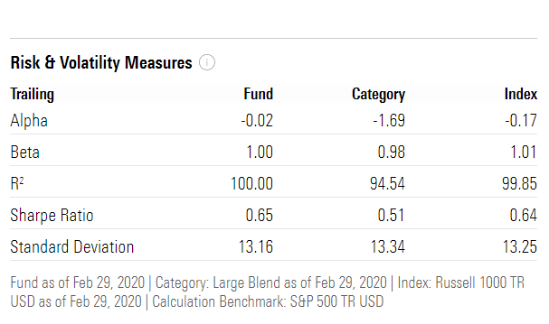
Risk Adjusted Performance (continued)
Jensen’s Alpha:
These are not as good as they were before. Roughly, if the Fund has a higher alpha then the Index, it has outperformed. Since its alpha is -.02 and the index is -.17, the alpha of the fund versus the index is .15%(-.01--.17)
Treynor:
Assume a risk-free rate of 0.5%. It is the return on the portfolio – the risk free rate divided by the standard deviation. Do this for the market as well.

Slide 30
Risk Adjusted Performance (continued)
Which measure is most appropriate? Are there some general guidelines?
  Generally, if the portfolio represents the entire investment for an individual, the Sharpe Index compared to the Sharpe Index for the market is best
  If many alternatives are possible, or if this is only part of the overall portfolio, use the Treynor measure versus the Treynor measure for the market, or the Jensen’s α alpha
    Of these two, the Treynor measure is more complete because it adjusts for risk

Slide 31
Risk Adjusted Performance (continued)
Are their limitations of risk adjustment measures?
  Yes, very much so. The assumptions underlying measures limit their usefulness
    Know the key assumptions and be careful!
  When the portfolio is being actively managed, basic stability requirements are not met
    Be careful when portfolios are actively managed
  Practitioners often use benchmark portfolio comparisons and comparisons to other managers to measure performance
    This is largely because they are easier

Slide 32
Risk Adjusted Performance (continued)
What about style analysis?
  Another way of obtaining abnormal returns is chasing style
    Growth versus value—what’s hot?
  You can decompose returns by attributing allocation to style
    Style tilts and rotation are important active portfolio strategies
    Style analysis has become increasingly popular in the industry

Slide 33
Questions
  Any questions on risk-adjusted performance measures?

Slide 34
D. Setting Up an Investment Account
There are many different ways to set up an investment account
  You can do this with a mutual fund company, a bank, or other financial services company
    Remember one key objective is to minimize costs including transactions costs and taxes
  Generally, I select which no-load mutual funds I want to purchase first, and then go directly to the mutual fund company or brokerage house and purchase the mutual fund shares through them
    I make sure the mutual fund company is Quicken compatible so I can use Quicken to update my holdings and track changes

Slide 35
Setting Up an Account (continued)
There are four parts to setting up an online account:
  1. Select your Account Type
    Is this for retirement or for general investing?
      If retirement, is it a Roth or traditional IRA, SEP or SIMPLE?
    If general investing, what kind of securities will you be investing in?
      Mutual funds, stocks, bonds, ETFs
  Once you have your type, you will need your social security number, your birth date, email address, and your home address to begin filling out the forms

Slide 36
Setting Up an Account (continued)
2. Select your investments
  Here is where you select from the available mutual funds and other assets from the mutual fund company
    Make sure you have sufficient funds for the initial investment
    Check to see if they charge for accounts under a certain dollar amount of assets
      Make sure you have enough for the minimum purchase amount or agree to the Automatic Investment Program
    Select the funds and the dollar amounts

Slide 37
Setting Up an Account (continued)
3. Select your funding method
  How will you get your money to the mutual fund company or brokerage account
    A. Write a check
      You can write a check and mail it in
    B. Electronic bank transfer
      You can give them your bank account number and your bank routing number, and they can take the money out of your account
    C. Bank wire
      You can have your bank wire the funds to the mutual fund company (more expensive)

Slide 38
Setting Up an Account (continued)
4. Review and finalize your information
  Review your information for correctness
    Electronically sign or print your application
    Sign up for online access
    Prepare to connect to the mutual fund company through Quicken or other program to monitor account and individual asset performance

Slide 39
Setting Up an Account (continued)
Once you have done these things, you are set up (initially). Now:
  Set up Quicken or other program to track your mutual funds by asset class each week
    Watch your investment asset allocation to make sure you are within your target percentages
    If it is not an index fund, make sure you can compare performance versus benchmarks each quarter and each year to make sure the mutual fund managers are adding value (i.e., performing better than the benchmarks after costs and fees)

Slide 40
Setting Up an Account (continued)
What are the criteria for choosing a mutual fund company?
  Do they have the lowest fees, in sales charges (loads) and expense ratios (12b-1 and management fees)? There are funds with 0% expense ratios
  Do they charge fees if you do not have a specific amount invested with them? (If you have less than $10,000 with Vanguard, there is a quarterly fee)
  Do they have high minimum balances, which is the minimum you can put in to invest? (Vanguard’s minimum balance is $3,000 unless you do an automatic investment program (AIP). Schwab is $0)

Slide 41
Questions
Any questions on setting up an account?

Slide 42
Review of Objectives
A. Do you understand portfolio rebalancing?
B. Do you understand the Importance of Portfolio Management and Performance Evaluation?
C. Do you understand risk-adjusted performance measures?
D. Do you understand how to set up an account with a mutual fund company/brokerage house?

Slide 43
Case Study #1
Data
Steve and Suzie, both 45, are aggressive investors, and have a portfolio of over $250,000. Their target asset allocation is 60% equities and 40% bonds and cash which they have invested in 10 mutual funds. Their actual asset class weights are different from their targets due to the out-performance of the equity part of their portfolios.
  Asset Class Actual Weight Target Weight Difference
  Equity 70% 60% 10%
  Bonds 20% 30% -10%
  Cash 10% 10% 0%
Application: When should they rebalance their portfolio and how should they do it effectively (including costs and taxes)?

Slide 44
Case Study #1 Answers
The decision of when to rebalance should be part of their Plan. They need to determine the best time and the most cost effective means (i.e., minimize transactions costs, taxes and tracking error)
  They could use the “New Money/Donation” (NMD) strategy. Use new money to buy underweight asset classes. If this is insufficient, then donate appreciated assets to rebalance in taxable accounts. Since this change is due to appreciation of equities, they will donate the appreciated equity assets, then take the money they would have spent on their charity and purchase more bonds (See Tithing Share Transfer (LT08)) thereby rebalancing their portfolio efficiently

Slide 45
Case Study #2
Data
Steve is reviewing the performance of his largest asset, the actively managed Fidelity Magellan Fund (FMAGX) for the most recent 3 and 5 year periods (ending 3/14/2017). The T-bill or risk free rate proxy during the period was 0.8%.
  3 Year 5 Year
  FMAGX SPX FMAGX SPX
  Average return 9.4% 6.5% 13.1% 13.5%
  Beta 1.08 1.0 1.06 1.0
  Std. Deviation 9.8% 9.2% 11.4% 10.4%
Calculations and Application
A. Calculate Sharpe ((r_{p} – r_{f} )/ sd_{p}), Treynor ((r_{p} – r_{f} )/ ß_{p}), and Jensen (r_{p} – [r_{f} + ß_{p} (r_{m} – r_{f})]) measures for the 3 & 5 year periods
b. On a risk-adjusted basis, did it outperform the market?
c. Which risk-adjusted measure should Steve use?

Slide 46
Case Study #2 Answers
  3 Yr-FMAGX SPX 5-Yr FMAGX SPX
  Average return 9.4% 6.5% 13.1% 13.5%
  Beta 1.08 1.00 1.06 1.00
  Std. Deviation 9.8% 9.2% 11.4% 10.4%
  T-Bill rate 0.8%
a. Performance measures
  Sharpe = (r_{p} – r_{f} )/ sd 3 Year 5 Year
    Portfolio (9.4-.8)/9.8 = .88 1.08
    Market (6.5-.8)/9.2 = .62 1.22
  Treynor = (r_{p} – r_{f} )/ ß_{p}
    Portfolio (9.4-.8)/1.08 = .08 .12
    Market (6.5-.8)/1.0 = .06 .13
Note: for the purpose of being consistent, please use whole percentage numbers instead of the decimal

Slide 47
Case Study #2 Answers
  3 Yr-FMAGX SPX 5-Yr FMAGX SPX
  Average return 9.4% 6.5% 13.1% 13.5%
  Beta 1.08 1.00 1.06 1.00
  Std. Deviation 9.8% 9.2% 11.4% 10.4%
  T-Bill rate 0.8%
  Jensen’s alpha = r_{p} – [r_{f} + ß_{p} (r_{m} – r_{f})]
    3 Year Alpha = 9.4 – [.8 + 1.08 (6.5-.8) ] = 2.4%
    5 Year Alpha = 13.1 – [.8 + 1.06 (13.5-.8) ] = -1.2%
b. Steve’s Fund risk adjusted performance:
        3 Year 5 Year
  Sharpe Ratio .88 vs .62 (Y) 1.08 vs 1.22 (N)
  Treynor measure .08 vs .06 (Y) .12 vs .13 (N)
  Jensen’s Alpha 2.4% (Y) -1.2% (N)

Slide 48
Case Study #2 Answers
c. Which measure is most appropriate?
  Generally, if the portfolio represents the entire investment for an individual, the Sharpe Index compared to the Sharpe Index for the market is best. This is not the case here.
  If many alternatives are possible, or if this is only part of the overall portfolio, use the Treynor measure versus the Treynor measure for the market, or the Jensen’s alpha
    Of these two, the Treynor measure is more complete because it adjusts better for risk

Slide 49
Case Study #3
Data
You have five mutual funds in your portfolio, an emergency bond fund (VIPSX), a large cap index fund (SWPPX), a small cap fund (FSCRX), an emerging markets fund (SSEMX), and a REIT (VGSIX). How have they done versus their benchmarks (or categories) over the past three years?
Calculations
Using the data from Morningstar at the BYU Library, type in the ticker and go to the Risk tab for each fund. Look at their 3 year performance versus their categories (as a proxy for the market). Did they outperform their benchmarks?
  Did these funds outperform over the past three years on a risk-adjusted basis?

Slide 50
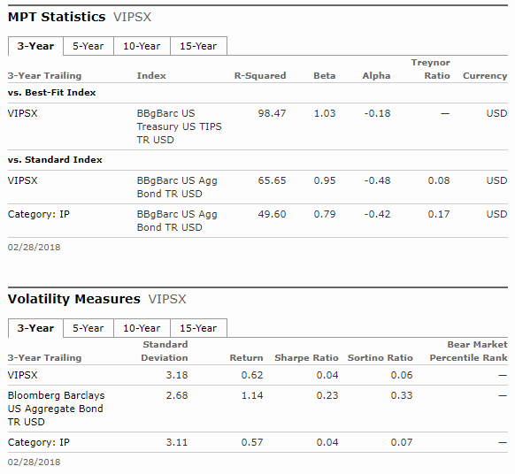
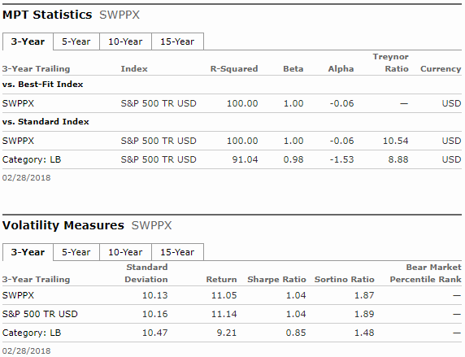

Case Study #3 Data

Slide 51
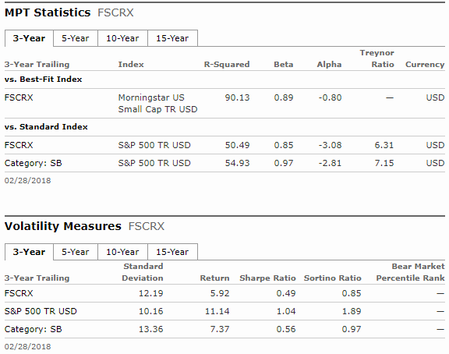
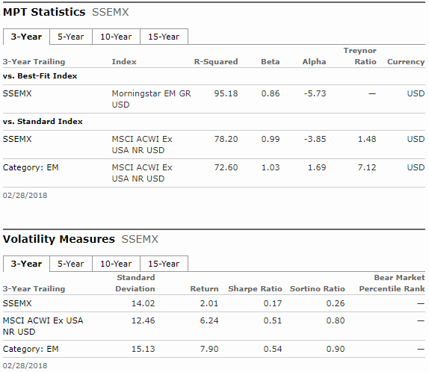
Case Study #3 Data

Slide 52
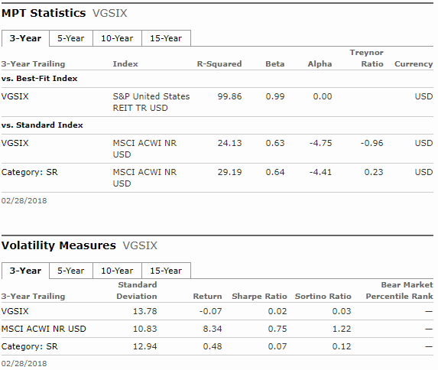
Case Study #3 Data

Slide 53
Case Study #3 Answers
We will use the category as the proxy for the market (as of March 12, 2018)
3 Year Outperformed*
  Name Sharpe Category Treynor Category Sharpe Treynor
  VIPSX .62 .57 .08 .17 Yes No
  SWPPX 1.04 1.04 10.54 8.88 Yes Yes
  FSCRX .49 .56 6.31 7.15 No No
  SSEMX .17 .54 1.48 7.12 No No
  VGSIX .02 .07 -.96 .23 No No

