Slide 1
Personal Finance: Another Perspective
Investing 8: Selecting Financial Assets
Updated 2020-03-03

Slide 2
Objectives
A. Understand why you should wait to pick stocks (until your assets have grown substantially)
B. Understand where to find important information on mutual funds and stocks and taxes on financial assets
C. Understand what makes a good mutual fund and the big deal about index funds
D. Understand how to pick the mutual/index funds for your portfolio
E. Understand plans and strategies for picking financial assets

Slide 3
A. Understand why you shouldn’t be picking stocks until later
Why have we not yet talked about picking stocks?
There are five major reasons why we have not talked about picking stocks. Picking single stocks initially violates the following investing principles:
1. Principle 3: Stay Diversified
Picking single stocks violates the principle of diversification, especially when you are just beginning to build your portfolio
With a small portfolio, it is difficult to achieve acceptable diversification with limited numbers of stocks

Slide 4
Stock Selection Strategies (continued)
2. Principle 4: Invest Low-cost and tax-efficiently
Investing in stocks when you have a small portfolio (less than $500,000) is very expensive.
Transactions costs for purchasing stocks are among the highest of any major asset class
3. Principle 6: Know What You Invest In
Picking stocks when you have not developed the knowledge and skill base necessary to evaluate stocks is very risky, bordering on speculation or gambling
Most (and this includes Finance students) have not yet developed the skills needed to make good stock selection decisions for a portfolio

Slide 5
Stock Selection Strategies (continued)
4. Principle 8: Don’t spend too much time trying to “Beat the Market”
Picking stocks is very difficult and challenging task
There is so much more to be learned about valuation that can’t be taught in a single class.
I have given only the very basics in this course
5. Stock selection is not required to have a successful investment portfolio
While it is intellectually challenging to select stocks, you can generally improve returns and reduce risk more by properly selecting asset classes.
You may never need to buy an individual stock

Slide 6
Questions
Any questions on why you shouldn't be picking stocks until later?
(Remember, since analyzing companies is not likely going to be many of your daytime jobs, it will be in most of your best interests to develop a “sleep-well portfolio” plan and follow it.)

Slide 7
B. Understand where to find Information on Financial Assets and Taxes
Where do you find mutual fund, bond and stock information?
Stockbrokers
Mutual Fund Supermarkets
Schwab, Fidelity, TD Waterhouse
Mutual Fund Monitoring companies
Morningstar, Lipper
Financial Websites and the Financial Press
Yahoo, MSN Money, CNN Money
Kiplinger’s, Smart Money, AOL Finance
BYU Libraries
HBLL has great information – See TT10

Slide 8
Mutual Fund Information (continued)
What is the best format for the information?
In a database of consistent, pertinent information that is updated on a regular basis
The database must be directly searchable with a consistent framework and structure
One example:
Morningstar
Note that this is just one of the many available databases. By choosing this database, I am neither implying or endorsing Morningstar (although I think they are pretty good). It is just that it is available free in the library

Slide 9
Taxes on Financial Assets
All investment earnings are not created equal.
There are different taxes and tax rates on different types of financial assets. Some have preferential federal, and others preferential state tax rates
Taxes fall under three main headings: a. Stocks, b. Bonds and Savings vehicles, and c. Mutual funds (which include index funds and exchange traded funds)
Note that each of these assets are taxed at the federal level and may be taxed at the state and local level as well, depending on your state of residence.
Many are taxed at your marginal tax rate (MTR), which is your highest tax rate, the tax on each additional dollar of income

Slide 10
Taxes on Financial Assets (continued)
A. Stocks (or Equities)
There are two main types of taxes on stocks
1. Capital gains are earnings from selling a stock.
Short-term are from stocks held < 366 days
Long-term are from stocks held >= 366 days
2. Stock dividends are qualified or ordinary
Qualified dividends are held > 60 days during the 121-day period beginning 60 days before the ex-dividend date (see Taxes on Securities Earning Including Qualified Dividends (LT32)
Ordinary dividends are dividends that are not qualified

Slide 11
Taxes on Financial Assets (continued)
B. Bonds and Savings Vehicles
Bond taxes are mainly two types: capital gains taxes and taxes on interest/coupon payments
1. Capital gains include both short-term and long-term capital gains, and are the gains received from the realized sale of the bonds that are related to price appreciation
2. Interest/coupon payments are payments received as part of the contractual agreement to receive interest payments
Bonds which have preferential interest tax treatment, i.e., muni’s and Treasuries, must still pay capital gains taxes

Slide 12
Taxes on Financial Assets (continued)
C. Mutual Funds
Mutual funds are pass through vehicles, which means that taxes are not paid at the Fund level but are passed through to the individual shareholders who must pay the taxes.
Mutual fund taxes are mainly capital gains, stock dividends and interest/coupon payments. They are handled the exact same way as the taxes for stocks and bonds discussed earlier

Slide 14
Questions
Any questions on taxes on where to find information on financial assets and taxes on financial assets?

Slide 15
C. What Makes a Good Mutual Fund?
What are the criteria for a good mutual fund?
1. Good diversification
2. Low cost
3. Tax efficiency
4. Low turnover
5. Low un-invested Cash
6. No manager style drift
7. Small (or positive) tracking error
Please note that these slides refer to Morningstar Pages for specific funds. The first title is the Morningstar Button. The second is the tab (separated by a colon if available), and the third is the heading (separated by a dash). For example, Portfolio: Portfolio – Market Capitalization, refers to the Market Capitalization heading from the Portfolio tab of the Portfolio button

Slide 16
1. Good Diversification
Diversification is your key defense against market risk
Stay diversified at all times. Pick a fund with many companies in their portfolios within each asset class
Diversification your primary defense against things that might go wrong in investing
Remember where you are in the hourglass
Avoid sector (industry) funds, individual stocks or concentrated portfolios of any kind until you have sufficient education, experience, and assets
And even then, keep that percentage of these assets small in relation to your overall assets

Slide 17
Where do you find Diversification?
Diversification by:
Numbers (Portfolio: Holdings)
Total: Number of Stock, Bond, and Other Holdings
Concentration: Assets in top 10 holdings
Type (Portfolio: Holdings)
Type of holdings (stocks, bonds, cash)
Location (Portfolio: Exposure: Region)
World Regions: Location of companies invested in by geographic area
Sector Weightings (Portfolio: Exposure: Sector)
Sector (or industry) weightings

Slide 18
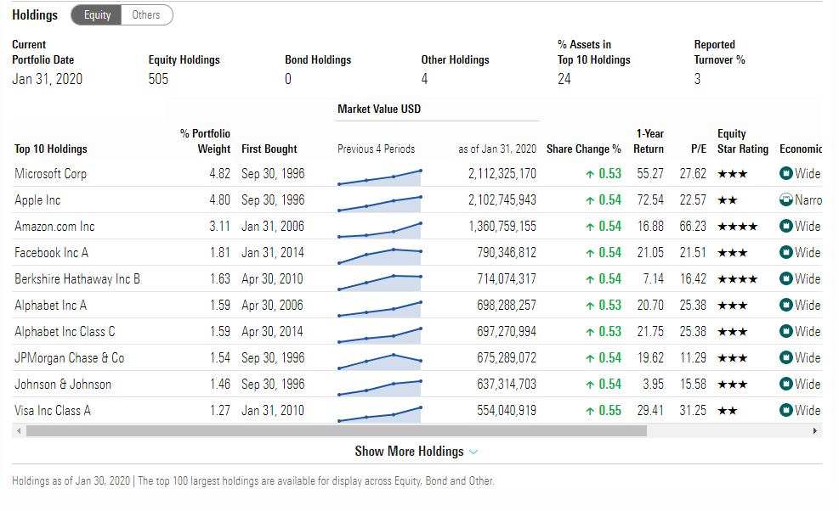
Good Diversification
1b
1a
Source: All Morningstar charts are from Morningstar Library Edition, 2020-03-03

Slide 19
2. Low Cost
Invest low cost
In a world where investment returns are limited, investment costs of any kind reduce your returns
Invest in no-load mutual funds
You should rarely (if ever) pay a sales load of any kind (front end, level load, 12-b1, etc.).
Rear-end loads are OK, since you are long-term investor, as long as the loads are less than 180 days
Keep management fees to the lowest possible within the sector
Remember: A dollar saved is a dollar you can earn more money with (and that has already been taxed)

Slide 20
Where do you find costs?
Costs (Price)
Expense Relative to Category
This is a key ratio: Total Expense Ratio
Compare that to your category average
Maximum Sales Fees (or Loads)
Front Load
Deferred
Redemption
Other Fees/Expenses
Administrative
Management fees
12b-1 Fees

Slide 21
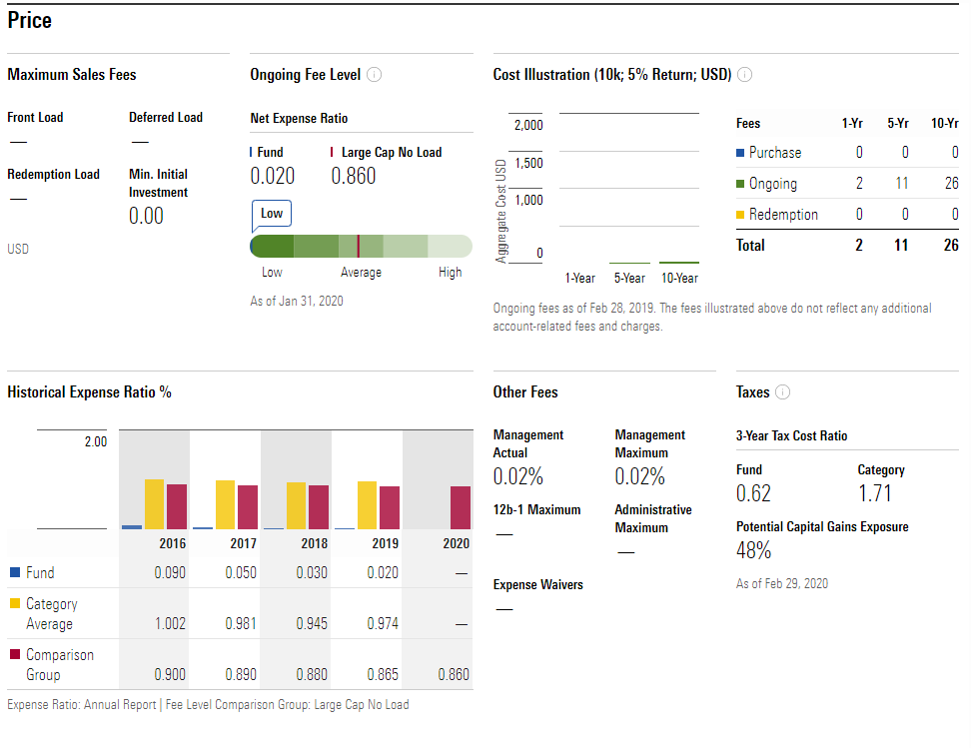
Low Cost (Fees and Expenses)
2e
2b
2c
2d
2f
Source: Morningstar 2020

Slide 22
3. Tax Efficiency
Invest in taxable funds with an eye to obtaining high returns while keeping taxes low
Taxes reduce the amount of money you can use for your personal and family goals
Watch the historical impact of taxes, for it will likely continue
Remember: It is not what you earn, but what you keep after taxes that makes you wealthy

Slide 23
Where do you find Tax Efficiency?
Tax analysis (Price: Taxes)
Pretax Return: Return before taxes
Tax-adjusted Return: Return after taxes
Tax Cost Ratio: The percent of nominal Fund return attributable to taxes, assuming the fund is taxed at the highest rate. If a fund had an 8.0% return, and the tax cost ratio was 2.0%, the fund took home (1 + return) * (1 – tax cost ratio) -1 or (1.08*.98)-1 or 5.84%
Potential Cap Gains Exposure: An estimate of the percent of a funds asset’s that represent gains. If this is high, the probability is high that these may come to the investor as capital gains

Slide 24
Tax Efficiency
0.6% of the annual return goes to taxes each year—this pretty tax efficient, especially compared to the category
Source: Morningstar 2020

Slide 25
4. Low Turnover
Keep turnover low, as it’s a proxy for fund expenses and taxes
The costs associated with turnover are hard to quantify and may not be disclosed in the prospectus. These costs include commissions, bid-ask spreads, and market impact
Each transaction generates a taxable event for you, and these cumulative costs can be very expensive.
Stick to funds with the low turnover (and low management fees), as they generally have lower costs and are more tax efficient as well

Slide 26
Where do you find Turnover?
Turnover
Annual Turnover (Quote)
This is the Fund turnover
This is a proxy for taxes. The higher the turnover, the higher the taxes in a taxable account

Slide 27
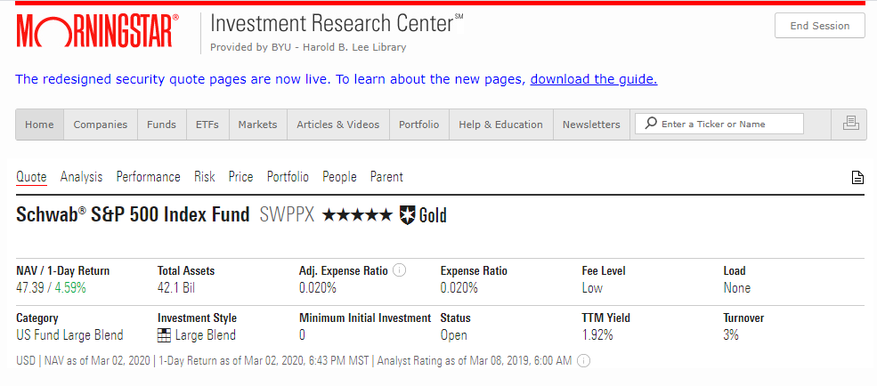
Low Turnover
4a
Source: Morningstar 2020

Slide 28
5. Low Un-invested Cash
High cash levels are drags on performance. Keep un-invested cash low
Many funds hold cash to fund potential redemptions, or as part of their investment policy, which are drags on performance
Choose funds that are fully invested (95%-99% depending on the asset class and fund size) in the market segment that you are targeting
Do not pay others to manage cash
Please note that some frictional cash is OK though for open-end mutual funds

Slide 29
Where do you find Un-invested Cash?
Un-invested Cash (or cash drag)
Percent of cash in the fund (Portfolio)

Slide 30
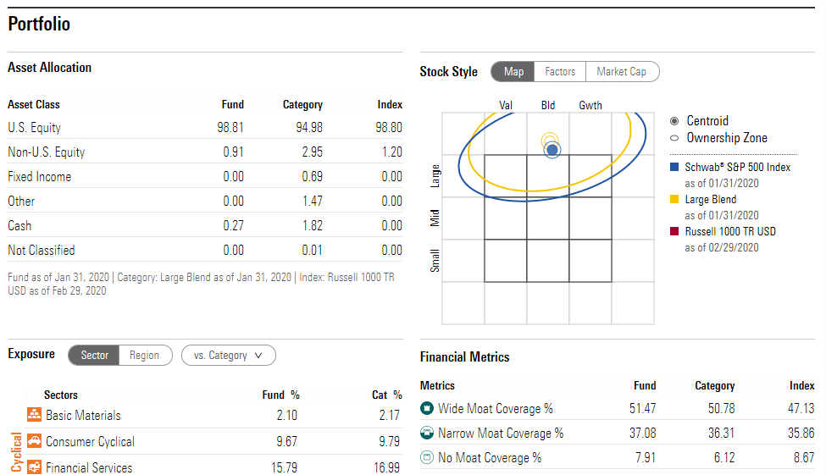
Un-invested Cash
5a
Source: Morningstar 2020

Slide 31
6. No Manager Style Drift
Make sure the managers investment style remains constant
Investment fund managers have no authority to change the asset class
If you purchase a small cap fund, the manager should purchase small cap shares
The fund's prospectus should clearly define the market, size company, and portfolio style tilt
If you are looking for a domestic small value fund, screen for funds with the all of their assets invested in the U.S., the smallest average company size, and the highest book-to-market (or lowest price-book) ratios

Slide 32
Where do you find Manager Style drift?
6a
Source: Morningstar 2020

Slide 33
7. Low (or positive) Tracking Error
Tracking error should be small
Tracking error is the historical difference between the return of a fund (i.e. a mutual fund) and its specific market/sector benchmark or index.
The smaller the tracking error, the better the performance of the Index fund relative to the benchmark
However, you won’t complain if the tracking error is positive (i.e., your fund had higher returns than the index or benchmark)

Slide 34
Where do you find Tracking Error?
Tracking Error (Performance)
Returns. Fund annual returns
+/- S&P 500 TR. This is tracking error versus the S&P 500 Index (+/- Index). Note that Morningstar’s choice of index is sometimes very poor, i.e., using MSCI EAFE for emerging markets
+/- Category. Tracking Error versus the Category. In this case it is large cap blend. This is a better check on performance—versus all funds in a similar category
% Rank in Category (Number is in top %--the lower the number the better)

Slide 35
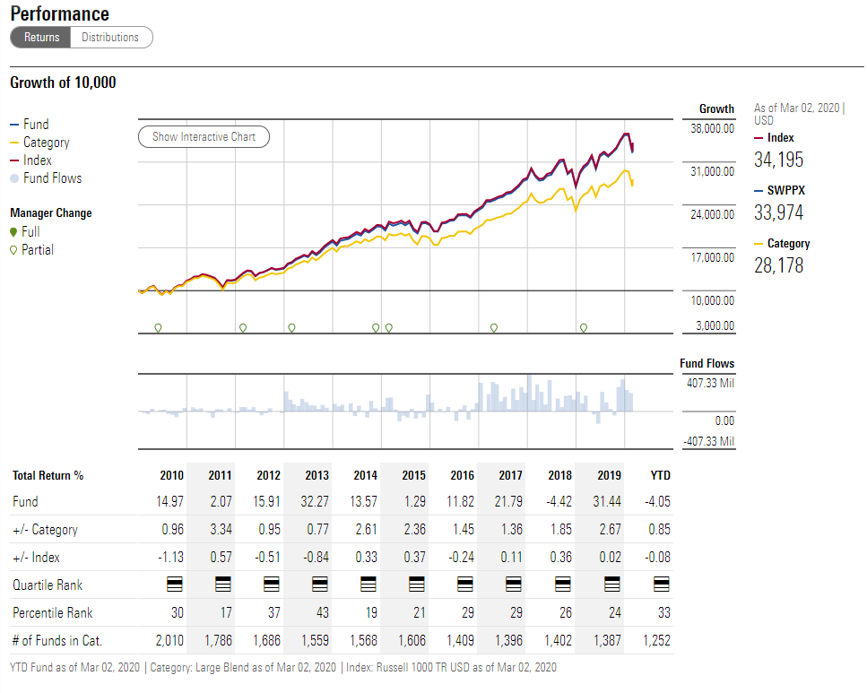
Tracking Error
Source: Morningstar 2020
7a

Slide 36
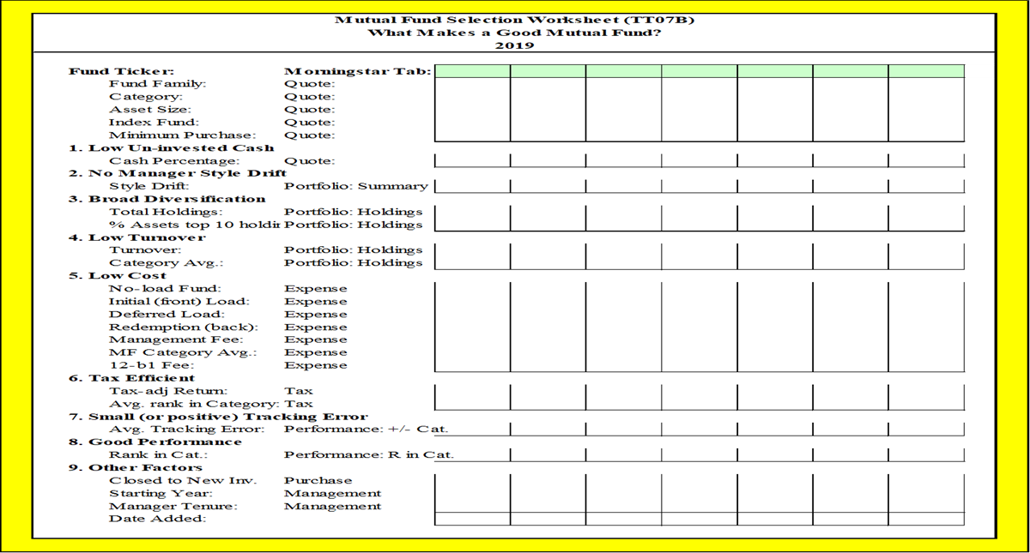
Mutual Fund Information (continued)
For help with how to select funds, see Using Morningstar to Select Mutual Funds (LT07) using the HBL Library or the Internet. Record what you have found with each candidate and select the funds using Mutual Fund Worksheet (LT07B) (note: the “Filled In” tab gives some work previous students have done on specific funds)

Slide 37
What is the Big Deal About Index Funds?
What are index funds?
Mutual funds or ETFs which hold specific shares in proportion to those held by an index
Their goal is to match the benchmark performance
Why have they come about?
Investors are concerned that most actively managed funds have not been able to beat their benchmarks after all fees, taxes and costs.
So instead of trying to beat an index, investors accept the index return and risk
Interestingly, index funds have tended to outperform most actively managed funds

Slide 38
Index Funds (continued)
Why have index funds and ETFs grown so quickly?
There is no correlation between last year’s winners and this year’s winners for actively managed funds
Actively managed funds tend to reduce performance through excessive trading, which also generates taxes for the investor
Actively managed funds generally have higher management fees which must be overcome through higher returns (18 basis points for an index fund versus 80-250 basis points for an actively fund)
It is very difficult to beat these funds on a consistent basis after all fees and taxes

Slide 39
Index Funds (continued)
Jason Zweig, a senior writer for Money Magazine commented:
With an index fund, you're on permanent auto-pilot: you will always get what the market is willing to give, no more and no less. By enabling me to say "I don't know, and I don't care," my index fund has liberated me from the feeling that I need to forecast what the market is about to do. That gives me more time and mental energy for the important things in life, like playing with my kids and working in my garden (Jason Zweig, “Indexing Let’s You Say Those Magic Words,” CNN Money, August 29, 2001).

Slide 40
Index Funds (continued)
Warren Buffet commented:
By periodically investing in an index fund, the know-nothing investor can actually outperform most investment professionals. Paradoxically, when 'dumb' money acknowledges its limitations, it ceases to be dumb (Warren Buffett, Letter to Berkshire Hathaway Shareholders, 1993).
Doing reasonably well investing in stocks is very, very easy. Buy an index fund, preferably over time, so you end up owning good businesses at a reasonable average price. If you own a cross-section of American businesses, you are going to do well (“Warren Buffet: Top 3 Investment mistakes to avoid,” USA Today, October 26, 2013).

Slide 41
Index Funds (continued)
Insights on Indexing
Most actively managed funds will under-perform index funds in the long run after all taxes, costs and fees (according to research)
Competition in stock-market research is intense and will get more competitive going forward, making markets more efficient and indexing more attractive
Indexing or “passive investing” is a free-ride on the competition
Indexing is a time-efficient and cost-effective way to invest due to eliminating the need to evaluate individual securities and low turnover and distributions

Slide 42
Questions:
Any questions on what makes a good mutual fund and the big deal of index funds?

Slide 43
D. Understand How to Pick Mutual Funds
The process to pick YOUR mutual funds is:
1. Determine the asset classes needed for your Plan and choose the appropriate benchmarks - Done
2. Determine what makes a good mutual fund and which asset classes you need exposure
3. Using a database program, set those principles and evaluate each of the potential mutual funds
4. Select the best mutual funds using Using Morningstar to Select Funds (LT07) and Mutual Fund Selection Worksheet (LT7B) (with hints on the “Filled in” tab)
5. Now put your Investment Plan together

Slide 44
Picking Your Mutual Funds (continued)
Assume your asset class was Large Cap, and you choose SWPPX for your fund. What next?
1. Go to Morningstar, and type the ticker “SWPPX” in upper right box
You will print off from the Quote to the Trailing Returns.
If you need help, see Mutual Fund Selection Worksheet (LT7B), Filled In for possible fund ideas and tickers

Slide 45
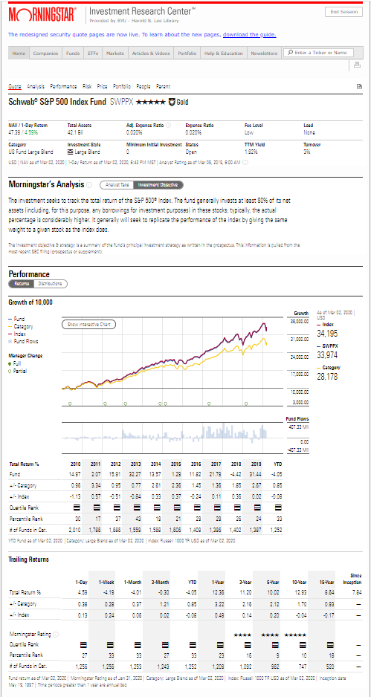
Picking Your Mutual Funds (continued)
For your PFP:
Print off from the top of the page to the end of the “Trailing Returns”
This will give me sufficient information to ensure this will give you exposure to your chosen asset class

Slide 46
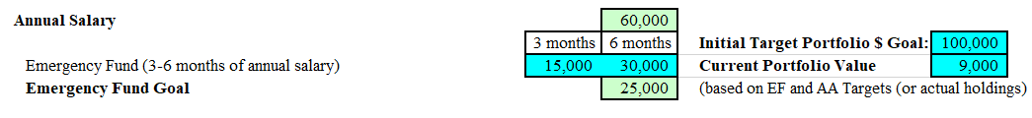
Picking Your Mutual Funds (continued)
2. Download the Investment Process Spreadsheet (LT13)
For most, the first tab (4-10 assets) will be sufficient.
Put in your Salary and emergency fund goal and percentage.
It will automatically determine your target portfolio fund size (your emergency fund amount divided by your bonds/cash percentage).
Assuming a salary of $60,000 and a 25% allocation to bonds and cash. Your target portfolio size would be $100,000.

Slide 47
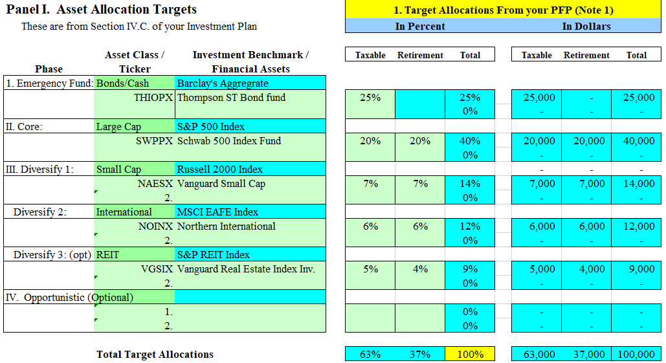
Picking Your Mutual Funds (continued)
3. Add data to the Investment Process Spreadsheet (LT13)
Put in your asset classes and benchmarks, and percentages in Panel I. Use the dropdown boxes for asset classes and benchmarks
Then put in the tickers and Fund names

Slide 48
Picking Your Mutual Funds (continued)
4. Print off all your Exhibits
Print off your filled in Exhibit I. Expected Return Simulation (LT27)
Print off your filled in Exhibit II. Investment Process Spreadsheet (LT13)
Print off Exhibit III. Mutual Fund Pages from Morningstar. There should be a minimum of 4 funds from 4 different asset classes
Include these with your completed and filled in Investment Plan and you should be good

Slide 49
Plans and Strategies for Selecting Financial Assets
Following are a few ideas for plans and strategies for picking financial assets
Plans and Strategies
General
I will use mutual/ETF/index funds as they give immediate diversification and low cost
With my broadly diversified funds, I will get the performance of the asset class and do not need to know much about each individual stock
I have, like most business students, not developed the skills necessary to effectively analyze individual stocks and bonds

Slide 50
Selecting Financial Assets (continued)
General (continued)
If you choose to invest passively:
I recommend index funds for diversification, low cost, tax efficiency and returns
Broadly diversified index funds eliminate most of the required work to understand the individual stocks and bonds in the portfolio
If you choose to invest actively
Monitor performance versus benchmarks over 24 and 36 months
If you do both passive and active, that is also OK
Determine your target asset allocation and follow it
Ensure your chosen assets give exposure to the asset classes you need

Slide 51
Review of Objectives
A. Do you understand why you shouldn’t be picking stocks until the “deepen” phase when your assets and experience have grown?
B. Do you understand where to find important information on mutual funds?
C. Do you understand what makes a good mutual fund?
D. Do you understand index funds and why they are attractive investment assets?
E. Do you understand taxes on financial assets?
F. Do you understand how to pick the mutual/index funds for your portfolio?
F. Do you understand plans and strategies for picking financial assets?

Slide 52
Case Study #1
Data
Bill can only invest $50 per month and he already has his Emergency Fund. He would like to find an index fund that follows the large capitalization stocks, with his chosen benchmark being the S&P 500 Index. He has determined his criteria as large capitalization stocks, index funds, minimum purchase of $2,500, asset size > $750 million, a no load fund, with fees and expenses =<.10% available to a retail investor.
Application
Using Morningstar library and Learning Tool 7, how many funds meet Bill’s criteria, and which would you choose?

Slide 53
Case Study #1 Answers
Go to Morningstar Library Edition Online, and go to the Fund Screeners (see LT07). Set up the problem with the following criteria:
Fund Category = U.S. Equity and your category is Large Blend
Special Fund Types, and Index Fund = Yes
Minimum Purchase, MIP <= a Value, $50
Fund Size (Total Assets), FS >= Value, $750
Fees and Expenses, No-Load Funds = Yes
Fees and Expenses, Expense Ratio <= Value, .10
Minimum Purchase, Institutional Funds = No

Slide 54
Case Study #1 Answers
As of 3/3/2020, there were 10 funds that passed.
Fidelity ZERO Large Cap Index
Fidelity ZERO Total Market Index
Fidelity SAI US Large Cap Index
Schwab 1000 Index
Schwab Total Stock Market Index
Schwab S&P 500 Index
State Street Equity 500 Index
TIA-CREF Equity Index W
TIA-CREF S&P 500 Index W

Slide 55
Case Study #1 Answers
Which fund you choose will depend on which factors you consider most important, such as tenure of managers, expense costs, asset size, and tax position.
Please note that after doing the analysis in Morningstar, you need to call each fund family to make sure the information is correct. Toll-free numbers are available under the Purchase Info tab.

Slide 56
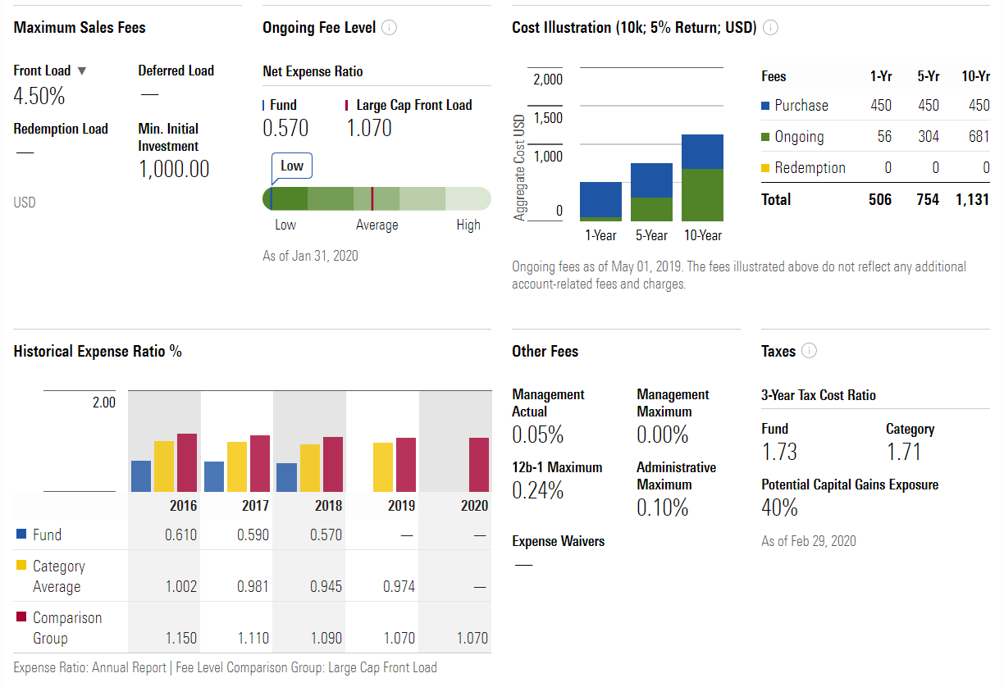
You pay a sales charge of 4.5% of every dollar invested
You pay a Net Expense fee of .57% annually. Note this is huge compared to the mgmt. fee.
You pay a 12-b1 and administration fee, this so the company can market it to others
Most index funds are low cost. This was not one of the chosen index funds. Why? What fees and loads does it have for each class of share?
1.73% of the annual return goes to taxes—this is not tax efficient

Slide 57
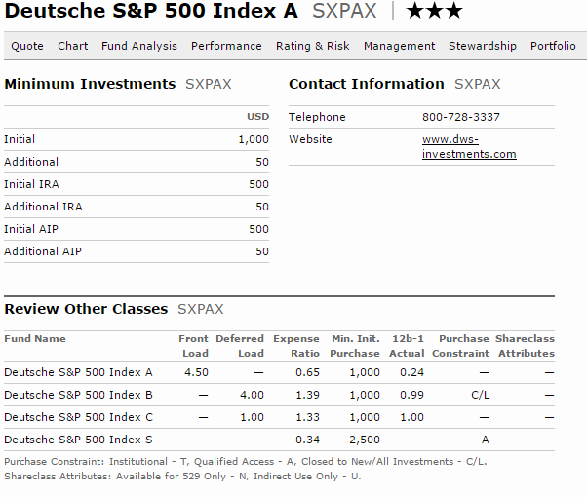
Case Study #2 Answers
This fund, depending on your class of share, has a 4.5% front end load, 1.0-4.0% deferred load, expense ratios between .34 and 1.39%, and 12b-1 fees from 0-1.0%. This index fund will cost you a lot in expenses.

Slide 58
Case Study #3
Given the old Morningstar report for VFINX following, highlight the areas where you find the critical information below (with the colors listed): (report is from Morningstar, 9/30/18)
1. Diversification (orange)
2. Costs and Fees (orange)
3. Taxes (light green)
4. Turnover (red)
5. Un-invested cash (blue)
6. Style and style drift (green)
7. Tracking error and performance (blue)

Slide 59
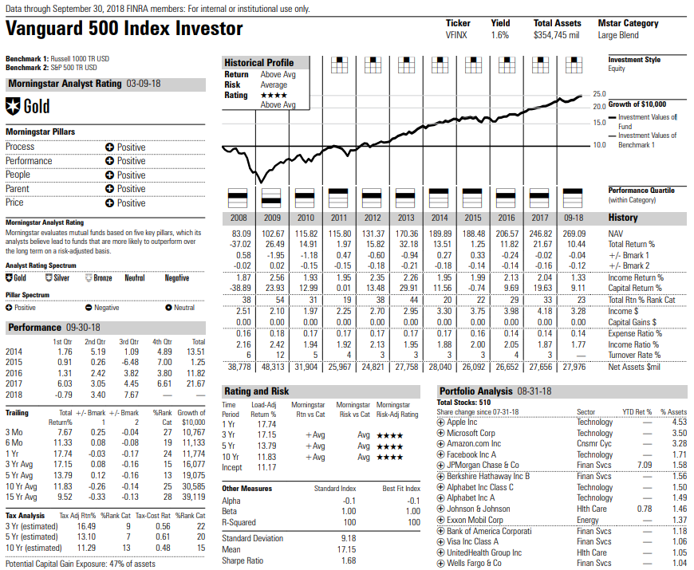

Slide 60
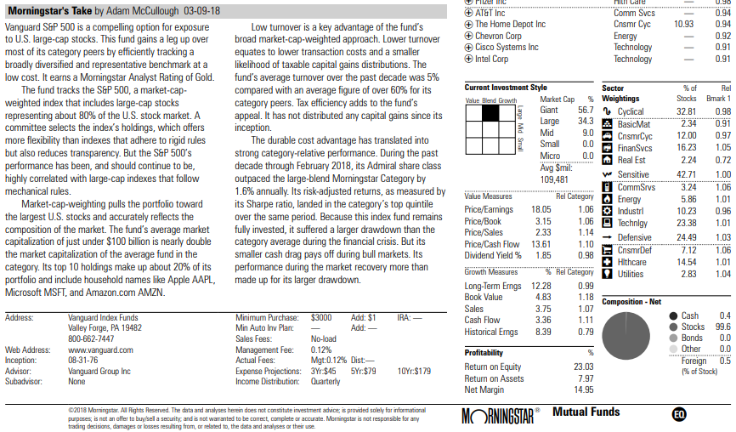

Slide 61
Cast Study #3 Answers
Morningstar Report Coding
To help you in finding the information, we have color coded a report in the following slides to show you where the criteria discussed can be found
1. Diversification (orange)
2. Costs and Fees (orange)
3. Taxes (light green)
4. Turnover (red)
5. Un-invested cash (blue)
6. Style and style drift (green)
7. Tracking error and performance (blue)

Slide 62







Slide 63




