Slide 1
Personal Finance: Another Perspective
Investing 7:
Building Your Investment Portfolio
Updated 2020/02/26

Slide 2
Objectives
A. Understand Which Factors Control Investment Returns and the “Priority of Money”
B. Understand the “Elements” of a successful Investment Portfolio
C. Understand the “Investment Process” and how to build a successful portfolio
D. Understand plans and strategies for building your portfolio

Slide 3
Investment Plan Assignments
Investments 5: Stock Basics
1. Review the risk and return history for stocks from the Investments 1: Before You Invest PowerPoints. Review Return Simulation for Asset Classes (LT23) to understand the volatility of the equity asset classes
2. Finalize your preferred asset classes and allocations within each of the broader asset classes, i.e. within stocks, what are your allocations to large cap, small cap, international, emerging markets, REIT etc. assets

Slide 4
Investment Plan Assignments (continued)
Investments 7: Building Your Portfolio
1. Know how to build your portfolio and the difference between investment assets and vehicles
2. Determine the size of your Emergency Fund in dollars
3. Divide asset allocation percentages between taxable and retirement accounts
4. Calculate your allocations to each of your individual asset classes
5. Transfer this data to Investment Process Worksheet (LT13)

Slide 5

Understand Which Factors Control Investment Returns

Slide 6
Factors Which Control Returns (continued)
Reinhold Niebuhr in the Serenity Prayer wrote:
God grant me the serenity to accept the things I cannot change; courage to change the things I can; and wisdom to know the difference.” (Fred R. Shapiro, “Who Wrote the Serenity Prayer,” Yale Alumni Magazine (July/Aug. 2008).
Jim Seaberg reminds of the six factors which control investment returns.
Five of those factors are within your control
Only one is outside your personal control

Slide 7
Factors Which Control Returns (continued)
These six factors affect investment returns:
The factors you control:
1. How much you save
2. How long your investments grow
3. Your mix of investments, i.e., your asset allocation
4. How much you pay in expenses
5. How much you pay in taxes
The factor you do not control:
6. Your investment returns

Slide 8
Factors Which Control Returns (continued)
Want to do well on your investing?
Work on the things you can control!
1. Focus on saving money each week or month
Reduce your spending and save more
2. Focus on keeping your investments working
Keep your money in the market
3. Focus on investing at your level of risk
Watch your asset allocation mix carefully
4. Focus on reducing your expenses
Try to reduce turnover, fees and costs
5. Focus on reducing your taxes
Watch the tax implications of your investments

Slide 9
Factors Which Control Returns (continued)
Successful investors spend their time on those areas that are within their personal control
They work on areas under their personal control
They minimize their time spent on areas outside their personal control
Some investors use passive management as an investment strategy to minimize risk or give some control over the area they cannot control
Most novice investors spend their time on areas they cannot control, i.e. investment returns, and fail to be concerned over areas they can control, i.e., savings, asset allocation, time, and expenses

Slide 10


Selecting Investment Vehicles
What is the difference between investment vehicles and financial or investment assets?
The investment vehicle is the tax-law defined framework that has specific tax advantages, i.e., 401k, 403b, Individual Retirement Account (IRA), SEP IRA, Roth IRA, Roth 401k, etc.
It is like the shopping cart in the grocery store
The financial assets are the securities that are invested in by the vehicles, i.e., stocks, bonds, mutual funds, REITs, MMMFs, CDs, etc.
It is like the groceries you put in your shopping cart

Slide 11
Investment Vehicles (continued)
What is the process of selecting investment vehicles?
It is the process of understanding and using the types of investment vehicles that will help you achieve your goals the fastest
Why should we learn it?
Investment vehicles have different benefits, i.e., due to matching (free money), tax elimination, tax deferral, or just tax-efficient and wise investing.
The wise use of correct investment vehicles will help you save more money to help you reach your financial goals faster

Slide 12
Selecting Investment Vehicles (continued)
Select Investment Vehicles for 2020 (before catch-up)
Tax- Tax- Maximum
Plan deferred eliminated Amount For Employees of:
401-k Y $19,500 Businesses w/plans
Roth 401-k Y 19,500 Businesses w/plans
403-b Y 19,500 Non-profit, tax-exempt
Roth 403-b Y 19,500 Non-profit, tax-exempt
457 Y 19,500 State/municipalities
SEP IRA Y 57,000 Small businesses
SIMPLE IRA Y 13,500 Small businesses
IRA Y 6,000 Individuals
Roth IRA Y 6,000 Individuals
Education IRA Y 2,000 Individual Education
529 Plans Y >485,000 p.c. Individual Education

Slide 13
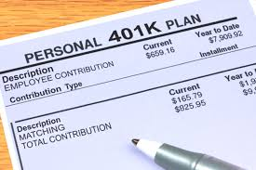
Selecting Investment Vehicles (continued)
What is the “priority of money”?
1. Free money
Money made available by your company, on a matching basis, to encourage participation in retirement plans, i.e., 401k, Roth 403b, Keogh, etc.
Money made available through tax benefits, i.e. 529 plan contributions deductible from state taxes
What are the risks?
You must stay at the company a certain number of years to become fully vested, i.e., to be able to take full ownership of these funds, or use the funds for education expenses for 529 plans

Slide 14
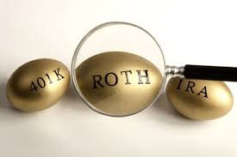
Selecting Investment Vehicles (continued)
2. Tax-advantaged money
a. Elimination of all future taxes
This money can be used at retirement (or for education) without penalty and without taxes, i.e., a Roth IRA/410k/403b for retirement, and 529 Funds and Education IRA for education
What are the risks?
You must be 59½ to receive earnings
Money from 529 Funds, Education IRA, and EE/I bonds must be for qualified educational expenses to be tax-free

Slide 15
Selecting Investment Vehicles (continued)
b. Tax-deferred money
This money has the ability to be invested before-tax, with principle and earnings taxed only at retirement (IRA, SEP IRA, etc.)
What are the risks?
You must be 59½ to take distributions. If you take the funds out before retirement, there is a 10% penalty and funds are taxed at your ordinary income tax rate for both federal and state
This money converts long-term capital gains into short-term income for tax purposes

Slide 16
Selecting Investment Vehicles (continued)
3. Tax-efficient and wise investments
This is money that is invested tax-efficiently and wisely, consistent with the investment principles discussed earlier
What are the risks?
Earnings are taxed consistent with the assets invested in
You need to take into account the tax and transaction cost implications of whatever you invest in

Slide 17
Selecting Investment Vehicles (continued)
How do you invest tax efficiently?
1. Know the impact of taxes
After-tax return = Before-Tax * (1 – Marginal Tax Rate)
Your marginal rate includes both your federal, state and local (if any) taxes
Remember, investment earnings from assets not in retirement vehicles are not all created equal
Know your tax rate on each type of earnings

Slide 18
Selecting Investment Vehicles (continued)
2. Reduce taxes and defer earnings to the future
Long-term capital gains are taxed at a preferential rate (Federal), whereas earnings from interest and short-term capital gains (assets held one year or less) are taxed at ordinary income rates, up to 35%
Contribute to your qualified retirement plans
How do you do this?
Get earnings in the form of long-term capital gains
Invest with a buy and hold strategy, don’t trade in taxable accounts, and hold assets for a long time.
Invest in your 401k and other retirement plans

Slide 19
Selecting Investment Vehicles (continued)
3. Minimize Turnover and Taxable Distributions
Minimize turnover. Turnover leads to higher transactions costs and taxes
Minimize distributions (from mutual funds). They are required by law to distribute 90% of realized capital gains, dividends and interest annually to the shareholders in the fund, which are taxed at the shareholder level
How do you do this?
Utilize a buy and hold strategy
Do your research and invest in mutual funds that limit trading and minimize distributions

Slide 20
Selecting Investment Vehicles (continued)
What is the impact of taxes on these two bond funds?
Mutual Funds Fund A Fund B
Beginning Net Asset Value $10.00 $10.00
Short-term distributions .10 .90
Ending NAV 10.90 10.10
YTD Nominal returns 10% (.10+.90)/10 10% (.90+.10)/10
Turnover 10% (estimate) 90% (estimate)
Fed tax rate on ST distributions 35% 35%
Taxes paid (without selling) .035 (.10 * 35%) .315 (.90 * 35%)
After-tax return 9.65% (.90+.065)/10 6.85% (.10+.585)/10
Loss from return due to taxes .35% 3.15%
Although both have the same nominal return, fund B had a 29% lower return due to taxes, even though both had the same before-tax return (and this doesn’t include state taxes!)

Slide 21
Selecting Investment Vehicles (continued)
4. Replace interest income with qualified stock dividends
If you can handle the increased risk, you can replace interest income, which is taxed at your ordinary income tax rate (which is usually higher), with qualified stock dividend income, which is taxed at a preferred rate of 15%
How do you do this?
Invest a slightly higher percentage of your assets in stocks

Slide 22
Selecting Investment Vehicles (continued)
5. Invest tax-free
If you are in a high marginal tax bracket, you can invest tax-free by investing in assets which require you to pay no or minimal taxes on earnings or capital gains
How do you do this?
Invest in municipal bonds from your state which may be both federal and state tax-free
Invest in treasury bonds which are state tax-free
Invest in government EE/I savings bonds and use the proceeds for your children’s tuition expenses, and hence these investments are federal and state tax free

Slide 23
Selecting Investment Vehicles (continued)
How do you prioritize investment vehicle choice?
Some investment vehicles are higher on the priority list than others, but they also have lower contribution amounts (i.e., $6,000 for the Roth in 2020). What should you do?
Use the highest priority money first, and then next highest, etc. until you have utilized all your available investment funds

Slide 24
Selecting Investment Vehicles (continued)
Where should you put different types of financial assets?
Retirement Accounts: 401k, IRA’s, 529 Funds, etc.
Financial assets in which you trade actively
Taxable bonds and high turnover mutual funds
You do not pay taxes until you take out funds
Taxable Accounts: Investment portfolios
Stocks and mutual funds with a buy and hold strategy
Tax-free bonds and tax-efficient index funds
You pay taxes on fund distributions yearly

Slide 25
Questions
Any questions on the Selecting Investment Vehicles and how it should impact your portfolio?

Slide 26
B. Understand the Elements of a Successful Investment Portfolio
Portfolio selection strategies will differ by individual, portfolio manager, institution and view of the market
It is impossible to discuss how every portfolio manager builds every portfolio
But general concepts and principles are applicable to everyone
As I review the principles of successful investing and the successful portfolios of the past, there appears to be a pattern. I call it the bottom of the Investment Hourglass

Slide 27
Investing: The Hourglass Bottom
Taxable Assets
Retirement Assets
4. Opportunistic: Individual Stocks, Bonds and Sector Funds
3. Diversify: Broaden and Deepen your Asset Classes
2. Core: Broad Market (Large Cap) Index Funds/ETFs, or Core Mutual Funds
1. Basics: Emergency Fund and Food Storage

Slide 28
The Investment Hourglass (continued)
The hourglass bottom teaches 3 important lessons:
It helps keep risk in perspective
It starts from lowest risk to highest risk
It teaches the “how to” about investing?
You invest first in lower-risk assets, and then move up to more risk as your assets (and investment experience) increase
It separates out taxable and retirement assets
Retirement and taxable assets should be managed differently due to taxes and time horizon

Slide 29
Level 1: Basics: Your Emergency Fund and Food Storage
Key Objectives:
Liquidity, safety, and preservation of principle
New Assets to Purchase
Taxable
1a. Low cost, high liquidity money market mutual fund or other savings vehicle (savings account, MMDA, short-term T-bills , CDs, MMMFs and short-tern bond funds, etc.)

Slide 30
Level II: Core: Broad Market Index or Mutual Funds
Key Objectives:
Broad exposure to your main equity markets
Assets Owned: Your Emergency Fund
New Assets to Purchase
Taxable
2a. Broad market index fund or core mutual fund
Any low fee fund (under 25 basis points or .25%)
Invest new assets in this broad market fund
Retirement
2b. Broad market index or core mutual fund for your retirement accounts (i.e., through your 401k, IRA, etc.)

Slide 31
Level III: Diversify: Broaden and Deepen your Asset Classes
Key Objectives:
Additional diversification beyond core market exposure
Assets Owned: Emergency and core index funds
New Assets to Purchase (Taxable and Retirement)
3a. Broaden
Funds to “broaden” your asset classes, such as international equity and bonds, emerging markets, real estate, etc.
3b. Deepen
Funds to “deepen” your asset classes, such as small-cap, mid-cap, value, growth, etc.

Slide 32
Level IV: Opportunistic: Individual Stocks Bonds and Sector Funds
Key Objectives:
Opportunistic return (this is purely optional)
Assets owned – Emergency and core market index funds, as well as funds to broaden and deepen your exposure, i.e., international, small-cap, real estate, and narrower index funds, etc.
Optional New Assets to Purchase (not recommended)
Taxable and retirement
4a & 4b. Individual stocks or sector funds

Slide 33
Final Thoughts
Once you have your triangle filled, you can continue to diversify through additional funds and individual assets, all consistent with the principles and priorities discussed
The goal is a well diversified, low cost, low turnover, and low cash portfolio

Slide 34
Questions
Any questions on building a successful investment portfolio and the bottom of the Investment Hourglass?

Slide 35
C. Understand the Investment Process
What is the process of investing, i.e., of going from the theory of the investment hourglass to the practice of buying the securities?
There is a disciplined, consistent approach to building a portfolio
It includes a process of minimizing transaction costs and taxes
It includes an order to buying securities for your account
What is that approach?
It is a five-step process

Slide 36
The Investment Process (continued)
Step 1. Determine your initial target portfolio monetary goal
An easy method is to take your Emergency Fund goal and divide it by the percentage of assets in cash and bonds (which are generally used for your Emergency Fund)
If your goal is 3 months income of $20,000 and your target allocation for cash and bonds is 20%, your target fund size would be ($20,000/.20) or $100,000

Slide 37
The Investment Process (continued)
Step 2. Determine asset classes and target percentages
Multiply your asset class percentages by your initial target portfolio size to get your asset allocation targets by asset class. For example:
Emergency Fund (20% * $100,000) $20,000
Note: Your first allocation should exactly produce your Emergency Fund target
U.S. (60% * $100,000) 60,000
International (10% * 100,000) 10,000
Small cap (10% * 100,000) 10,000
Total Portfolio target $100,000

Slide 38
The Investment Process (continued)
Step 3. Calculate the target amount for each asset class in both taxable and retirement accounts
Take the target weight of each asset in both the taxable and retirement side multiplied by the target portfolio size to get the target asset size
For example, if you decided that 4% of their small cap allocation of 10% is in the taxable accounts, with the remaining 6% in their retirement accounts. Their dollar allocations would be:
Taxable: 4% * $100,000 = $4,000
Retirement: 6% * $100,000 = $6,000

Slide 39
The Investment Process (continued)
Step 4. Determine most appropriate assets for your portfolio through research of potential funds
Research potential funds using available tools and resources
We will share later about using Morningstar Investment Research to select mutual/index funds and ETFs

Slide 40
The Investment Process (continued)
Step 5. Purchase the assets
Follow the investment hourglass to build your portfolio
Purchase low-cost, tax-efficient and diversified assets (mutual/index funds) and hold them for 40 years (meaning along time)
Rebalance tax-efficiently

Slide 41
The Investment Process (continued)
Investments Process Summary
Once you have the targets, the rest is easy:
Purchase the assets for your Emergency Fund Level I until you reach targets
Then put all new money into Level II
Purchase core assets for Level II until you reach your target asset allocation
Then put all new money into Level III
Purchase broaden and deepen assets for Level III until you reach your target asset allocation
Once you have reached this, put all new money in consistent with your allocations

Slide 42
The Investment Process (continued)
Investments Process Summary (continued)
Purchase opportunistic assets for Level IV (if desired) to reach your target allocation
This is an optional phase. I do not recommend you purchase individual stocks and bonds
At this point, you will have achieved your initial target portfolio size.
To reach your next goal, readjust your portfolio size upward, i.e. add $200,000 to your first goals of $100,000 (it is now $300,000), and repeat the process again

Slide 43
Questions
Any questions on the process of building your portfolio?

Slide 44
G. Understanding Plans and Strategies for Building Your Portfolio
Following are a few ideas for your plans and strategies for building your portfolio
Plans and Strategies
Finalize your Introduction and Purpose
Who is this plan for? (I.A.)
What is the purpose of this plan? (I.B.)
What are the investment principles you will use to develop your investment plan? (I.C.)
Note: the letters in parenthesis refers to the section in the Investment Plan where you respond to this question, i.e., I.A. refers to Introduction

Slide 45
Portfolio Plans and Strategies (continued)
Plans and Strategies
Finalize your investment goals and objectives
What are your objectives? (II.A.)
Which investment vehicles will you use? (II.B.)
What are your time frames for these investments? (II.C.)
What is your expected return for your portfolio for each time frame? (II.D.)
What risk-type of investor are you? What is your expected risk for your portfolio for each time frame? (II.E).)

Slide 46
Portfolio Plans and Strategies (continued)
Plans and Strategies
Finalize your investment guidelines and constraints
What are your investment guidelines before retirement and after retirement? (III.A.)
What are your investment constraints (liquidity, time horizon, taxes and unique needs)? (III.B.)

Slide 47
Portfolio Plans and Strategies (continued)
Plans and Strategies
Finalize your investment policies
What are your acceptable asset classes? Unacceptable? Will you use debt to invest (buy on margin or sell short – I recommend no)? (IV.A.)
What investment benchmarks will you use for each asset class? (IV.B.)
What is your target asset allocation strategy both before and during retirement? (IV.C.)

Slide 48
Portfolio Plans and Strategies (continued)
Plans and Strategies
Decide your investment and funding strategies (IV.D.)
Will you invest active, passive or both?
What is the maximum you will invest in any individual asset, i.e., company stock, in any single investment, or in any single sector?
What is the maximum you will invest in any new investment (except broad mutual funds)?
How much will you invest in company stock?
Will you invest in unlisted securities? (NO)
What is your current investment strategy?
What is your tax strategy and what different types of investment vehicles will you use?

Slide 49
Portfolio Plans and Strategies (continued)
Plans and Strategies
Finalize your monitoring and evaluation strategies
How will you monitor your portfolio? (V.A.)
How and how often will you rebalance your portfolio and what rebalancing method will you use? (V.B.)
How often will you communicate results to your spouse? (V.C.)
How and how often will you revise your Investment Plan? (V.D.)
Who will be following and following up on this Plan? (V.E.)

Slide 50
Questions
Any questions on strategies for building your portfolio?

Slide 51
Review of Objectives
A. Do you understand the factors which control investment returns?
B. Do you understand the “Priority of Money”?
C. Do you understand the elements of a successful investment portfolio?
D. Do you understand the investment process and how to build your portfolio?
E. Do you understand plans and strategies for building your portfolio?

Slide 52
Case Study #1
Data
Suzie is 25, single, and makes $50,000 per year at her current job in 2020. She is in the 12% federal and 5% state marginal tax bracket, and expects her tax rates to increase at retirement. Her company has a 401(k) plan (but no Roth 401k) that matches 50 percent of her contributions up to 3 percent of her salary. She determined that she can save 20% of her salary every year, and will put all 20% or $10,000 away for retirement.
Application
A. Which investment vehicles should she use and why?
B. How much did she save considering her savings, company match, and tax saving?

Slide 53
Case Study #1 Answers
First, look to free money
If Suzanne will save 3 percent of her salary, or $1,500 per year, her company will match that with 50 percent of that amount, or $750
Note that this is tax-deferred money, or money that has not been taxed yet. The maximum contribution for 2020 in a 401(k) account is $19,500 (if under age 50)
Since her first “Priority of Money” is free money, she should invest $1,500 here first
Note that there is also a tax saving here, as investments reduce her adjusted gross income

Slide 54
Application #1 Answers (continued)
Second, look to tax-advantaged money.
A Roth IRA would likely be her second choice as she expects taxes to rise in the future
A Roth IRA not only offers total elimination of future taxes, it also has an additional benefit: should she need funds in the future, she can withdraw the principle without penalty as it has already been taxed
She can invest up to $6,000 per person in 2020 in a Roth or Traditional IRA
She invested $1,500 in her 401(k) plan and $6,000 for herself in a Roth IRA
What about the remaining $2,500?

Slide 55
Application #1 Answers (continued)
Third, look to tax-deferred money.
With the remaining $2,500, she could invest that in her 401(k), even though there is no additional match. She could not invest in an IRA as she has already invested the maximum in the Roth IRA
Note that her goal was to invest $10,000 for retirement. In reality, she:
Invested $10,000 of her own money
Got a free $750 match from the company
And saved taxes on the $4,000 in her 401k ($1,500 + $2,500). At a 12% federal and 5% state rate, that 401k tax deferral saved her $680 ($4,000 * .17) in next years taxes
Total savings of $11,430

Slide 56
Case Study #2
Data
Suzie married, and her husband Bill just graduated from BYU. They are square with the Lord, have adequate insurance, are out of credit card debt (except some student loan debt), and they know their goals but have not yet written their investment plan. They have agreed to save 20% to pay themselves. Bill starts his first job soon and will be making $45,000 per year, and Suzie is now making $55,000 per year. They will be investing 20% or $20,000 each year.
Application
How should they build their investment portfolio? Which assets should they invest in first? Second? Third? How about amounts? How should they invest?

Slide 57
Case Study #2 Answers
Bill and Suzie should follow the bottom of the investment hourglass to build their investment portfolio.
While we do not have enough information to give allocations and amounts, we can give guidelines:
1. Invest in their Emergency Fund and food storage. Once filled, go on to their core assets
2. Invest in their core assets. Once this is filled, go on to their “diversify” assets
3. Invest in their diversify assets

Slide 58
Case Study #3
Data
Bill and Suzie are now both 30, married with one child. They are earning $60,000 per year, are full tithe payers, have adequate health and life insurance, are out of credit card and consumer debt, and have an investment plan. They are aggressive investors, want 3 months income as an emergency fund, and have determined their asset classes and investment benchmarks as 75% equities and 25% bonds and cash with targets:
25% bonds/cash (Lehman Aggregate) 25% Taxable, 0% Retirement
55% U.S. large cap (S&P 500 Index) 35% T, 20% R
10% small cap (Russell 5000 Index) 4% T, 6% R
10% international (MSCI EAFE Index) 4% T, 6% R
How should Bill and Suzie build their investment portfolio using the bottom of the investment hourglass?

Slide 59

Case Study #3 Answers
1. Determine their initial target portfolio size goal
An easy method is to take their Emergency Fund goal and divide it by the percentage of assets in cash and bonds (which are generally used for your Emergency Fund)
If their goal is 3 months income ($15,000) and their target allocation for cash and bonds is 25%, their target fund size would be ($15,000/.25) or $60,000 (see Investment Process (LT13)

Slide 60
Case Study #3 Answers (continued)
2. Determine asset classes and target percentages
Multiply their asset class percentages by their initial target portfolio size to get their asset allocation targets
Emergency Fund (25% * $60,000) $15,000
Note that your first allocation will always produce your target Emergency Fund amount
Core: U.S. Large cap (55% * $60,000) 33,000
Diversify: International (10% * 60,000) 6,000
Diversify: US Small cap (10% * 60,000) 6,000
Total Portfolio target $60,000

Slide 61
Case Study #3 Answers (continued)
3. Calculate target amounts for each asset class in both the taxable and retirement accounts
Take the target weight of each asset in both the taxable and retirement side multiplied by the target portfolio size to get the target asset size
For example, Bill and Suzie decided that 4% of their small cap allocation of 10% is in the taxable accounts, with the remaining 6% in their retirement accounts. Their dollar allocations would be:
Taxable: 4% * $60,000 = $2,400
Retirement: 6% * 60,000 = $3,600

Slide 62
Case Study #3 Answers (continued)
Taxable Assets
Retirement Assets
4. Opportunistic: Individual Stocks and Sector Funds
0% 0%
3. Diversify: Small Cap, Vanguard SmCap, Russell 2000
4% $2,400 6% $3,600 $6,000
International, Northern Foreign: MSCI EAFE
4% $2,400 6% $3,600 $6,000
2. Core: LgCap, Schwab S&P 500: S&P 500 Index
35% $21,000 20% $12,000 $33,000
1. EmFund: Bonds/, Schwab ST Bond, 1-mon. T-Bill Index
25% $15,000 $15,000
Total: $60,000

Slide 63
Case Study #3 Answers (continued)
4. Research potential candidates for financial assets and select the assets most likely to deliver the return you need
Using the principles discussed earlier, Bill and Suzie would select the assets they would purchase to gain exposure to their chosen asset classes
For example, if Suzie and Bill decided that their Core U.S. allocation was to be via the Vanguard S&P 500 Index fund, their dollar allocations to Vanguard would be:
Taxable: 35% * $60,000 = $21,000
Retirement: 20% * 60,000 = $12,000

Slide 64
Case Study #3 Answers (continued)
5. Purchase the assets and compare the actual portfolio against the target portfolio
1. Purchase the Emergency Fund and food storage
2. Purchase Core assets next
You can purchase either your taxable assets first, your retirement assets first, or purchase both at the same time
3. Then purchase Diversify assets
4. Then purchase Opportunistic assets (optional)
Assuming you were Bill and Suzie, your portfolio would be:

Slide 65
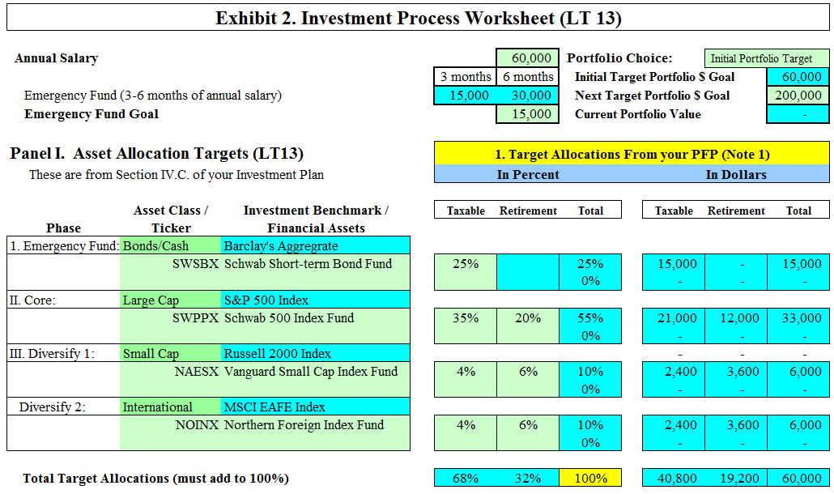
Case Study #3 Answers (continued)

Slide 66
Case Study #4
Data
Bill and Suzie (from the previous case study) are now both 40, parents of four children. They are earning $80,000 per year and have achieved their initial target portfolio size goal. Their financial house is in order, they have 3 months income in their Emergency Fund, and have determined the same asset classes and investment benchmarks as they did before. Their holdings and allocations are:
Schwab ST Bond Fund $20,000 25%
Schwab S&P 500 Fund (lg cap) $35,000 55%
Vanguard Small Cap Fund $10,000 10%
Northern International Fund $10,000 10%
How should they adjust their portfolio now that they have surpassed their initial target portfolio size?

Slide 67
Case Study #4 Answers
1. Determine their next target portfolio goal
For example, Bill and Suzy could add $140,000 to their initial portfolio size goal of $60,000. Their next goal is $200,000. They will need to readjust their target allocations consistent with this goal.
With their current salary of $80,000, their three month Emergency Fund value should be $20,000, which they have
Their allocation to bonds and cash, however, is now 25% * $200,000 or $50,000. Since their Emergency Fund is filled, they now can purchase additional fixed income securities to fill this gap, i.e., bond funds, MM Funds, etc.

Slide 68
Case Study #4 Answers (continued)
2. Determine asset classes and target percentages
Multiply their asset class percentages by their next target portfolio size to get their asset allocation targets
EF: Bonds/Cash (25% * $200,000) $50,000
Core: U.S. Large Cap (55%*$200,000) 110,000
Div. 1: International (10% * 200,000) 20,000
Div. 2: U.S. Small cap (10% *200,000) 20,000
Total Portfolio target $200,000

Slide 69
Case Study #4 Answers (continued)
3. Calculate the target amount for each asset class in both the taxable and retirement accounts
Take the target weight of each asset in both the taxable and retirement side multiplied by the target portfolio size to get the target asset size
For example, Bill and Suzie decided that 4% of their small cap allocation of 10% is in the taxable accounts, with the remaining 6% in their retirement accounts. Their dollar allocations would be:
Taxable: 4% * $200,000 = $8,000
Retirement: 6% * 200,000 = $12,000

Slide 70
Case Study #4 Answers (continued)
4. Research additional candidates
Bob and Suzie’s Emergency Fund is completed. But they still have allocation in the Bonds/Cash asset class of $30,000. Using the principles discussed earlier, Bill and Suzie could then select another asset to gain exposure to their chosen asset classes
Suppose they decided to add the Charles Schwab Intermediate Term Bond Fund to their portfolio. Their Bonds/Cash allocation would be:
Bonds/Cash allocation 25%*$200,000 = $50,000
Emergency Fund = (20/200) = 10% or 20,000
Remainder for other bond funds $30,000

Slide 71
Case Study #4 Answers (continued)
5. Purchase the new assets and compare the actual portfolio against the target portfolio
1. Since their Emergency Fund is full, they could begin purchasing the Schwab Intermediate Bond Fund, a municipal bond fund, or a high-yield fund depending on their risk tolerance
2. Purchase Core assets next
3. Then purchase Diversify assets
4. Then purchase Opportunistic assets (optional)
For Bill and Suzie, their portfolio would be:

Slide 72
Case Study #4 Answers (continued)
Taxable Assets
Retirement Assets
4. Opportunistic: Individual Stocks and Sector Funds
0% 0%
3. Diversify 1: SmCap, Vanguard SmCap, Russell 2000 Index
4% $8,000 6% $12,000 $20,000
International, Northern International: MSCI EAFE Index
4% $8,000 6% $12,000 $20,000
2. Core: LgCap, Schwab S&P 500: S&P 500 Index
35% $70,000 20% $40,000 $110,000
1. Bonds/Cash: Schwab Int. Bond 15% $30,000 $30,000
Emergency Fund: Schwab ST Fund 10% $20,000 $20,000
Total Portfolio: $200,000

Slide 73
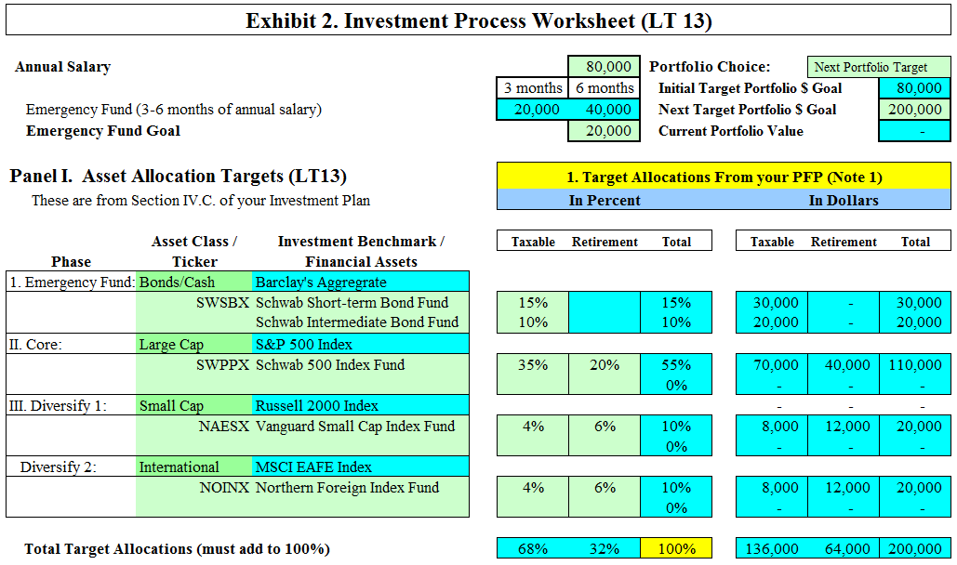
Case Study #4 Answers (continued)

