Slide 1
Personal Finance: Another Perspective
Investing 1: Before you Invest
Updated 2020/02/21

Slide 2
Objectives
A. Know what to do before you invest
B. Understand the principles of successful investing
Understand the major asset classes and their risk and return history
Note: For a general overview of how we teach investing, please see Beginning Investing Overview.

Slide 3
Your Personal Financial Plan
Section XII: Investment Plan
Includes your detailed Investment Plan (you can copy an outline from Investment Plan Template (LT5A) and instructions are LT5B. Your Investment Plan includes:
I. What are your risk and return goals and objectives?
II. What are your investment guidelines and constraints?
III. What is your Investment Policy, your Plans and Strategies?
IV. When will you Evaluate, Modify, and Communicate results to accountability partners?

Slide 4
Your Financial Plan (continued)
What are your proposed investments and allocations, your plans and strategies?
Include copies of your proposed investments from Morningstar on a minimum of 4 financial assets for your:
Emergency Fund
Core Financial Asset(s)
Diversification Asset(s)
Opportunistic Asset(s) (only if you want)
Include Expected Return Simulation (LT27) and Investment Process spreadsheet (LT13)

Slide 5
Teaching Investments
Please note that my teaching is different
Most textbooks take a financial assets approach – we teach principles and how to build a portfolio
Be patient! Our framework for teaching is:
Day 1 (14) – Principles of investing/before you invest
Day 2 (15) – Creating your Investment Plan
Day 3 (16) – Building your investment portfolio
Day 4 (17) – Selecting your financial assets
Day 5 (18) – Portfolio monitoring and rebalancing
Day 6 (19) – Speaker and summary

Slide 6
Investment Assignments for Today
Investments 1: Before you Invest
1. Copy Investment Plan Example Template (LT5A).
2. Add your information and complete the introduction to each of the four sections
3. Take Risk Tolerance Test (LT16). Determine the type of investor you are: very conservative, conservative, moderate, aggressive, very aggressive
4. Develop your preliminary “asset allocation” targets, i.e., your weights of stocks, bonds, and cash in your portfolio for before retirement and after retirement from your risk tolerance test.

Slide 7
Investment Assignments for Today (continued)
Investments 4: Bond Basics
1. Bond Volatility. Open Return Simulation for Asset Classes (LT23). Look at the volatility for bonds compared to other asset classes in the tab labeled “Charts” when you push F9 (calculate)
2. Bond Returns. Open Expected Return Simulation and Benchmarks (LT27). Go to the tab labeled “Returns and Risk.” Review the 1, 5, 10, 25, etc. year return for bonds compared to other asset classes. Are they more or less volatile? Do you know why market rates and bond prices are inverse (see Investment Expenses - Bond Prices tab)?
3. Think about what percentage of your portfolio should be in bonds from your risk tolerance results

Slide 8
A. Questions to Ask Before you Invest
What should you do before you start investing?
Is there a priority to paying bills?
Are there certain things you should never do without?
Are their other bills more important than investing?
Is there a purpose to investing?

Slide 9
Before You Invest: The Hourglass Top
1. Are your priorities in order and are you “square” with the Lord?
2. Do you have adequate auto, health and life insurance?
3. Are you out of high-interest rate credit card and consumer debt?
4. Have you written down your personal vision and goals, do you live on a budget, and do you have a well-written investment plan?
If you can answer these affirmatively, you are ready to invest!

Slide 10
Before you Invest (continued)
What does the top of the hourglass do?
It helps you keep your priorities in order
And what should those priorities be?
God
Family
Personal responsibility
Your personal vision, goals, budget, and a well-written Investment Plan

Slide 11

B. Understand the Principles of Successful Investing
Is there one right way to invest?
No. There are multiple ways and multiple methods depending on your personal vision, goals and budget
The key is for you to know yourself, what you are trying to accomplish, and follow the principles of successful investing
Is there one right way to teach investing?
No. But while there are many different ways, the principles should be the same.

Slide 12
Principles for Successful Investing (continued)
How have most equity investors done?
Each year, DALBAR puts out an annual book on Quantitative Analysis of Investor Behavior. It discusses how average equity fund investors have done versus benchmarks over the past 20 years.
Investor Index
Year Period Returns* Returns Difference
2014 1994-2013 3.7% 11.1% -7.4%
2015 1995-2014 5.2% 9.9% -4.7%
2016 1996-2015 4.7% 8.2% -3.5%
2017 1997-2016 4.8% 7.7% -2.9%
2018 1998-2017 5.3% 7.2% -1.9%
2019 1999-2018 3.9% 5.6% -1.7%
* Dalbar 2013-2019

Slide 13
Principles for Successful Investing (continued)
How have most bond investors done?
According to DALBAR, bond investors have done equally poorly versus the bond benchmark over the past 20 years.
Investor Index
Year Period Returns* Returns Difference
2014 1994-2013 0.7% 7.7% -7.0%
2015 1995-2014 0.8% 6.2% -5.4%
2016 1996-2015 0.5% 5.3% -4.8%
2017 1997-2016 0.5% 5.0% -4.5%
2018 1998-2017 0.4% 4.6% -4.2%
2019 1999-2018 0.2% 4.6% -4.4%
* Dalbar QAIB 2013-2019, www.dalbar.com, ** Estimate

Slide 14
Principles for Successful Investing (continued)
How have most asset allocation investors done?
According to DALBAR, asset allocation investors have done equally poorly versus the bond benchmark over the past 20 years.
Investor Index
Year Period Returns* Returns** Difference
2014 1994-2013 1.9% 9.7% -7.8%
2015 1995-2014 2.5% 8.4% -5.9%
2016 1996-2015 2.1% 7.0% -4.9%
2017 1997-2016 2.3% 6.6% -4.3%
2018 1998-2017 2.6% 6.2% -3.6%
2019 1999-2019 2.9% 5.2% -2.3%
* Dalbar QAIB 2013-2019, www.dalbar.com, ** Estimate of 60% S&P 500 and 40% Barclay’s Aggregate

Slide 15
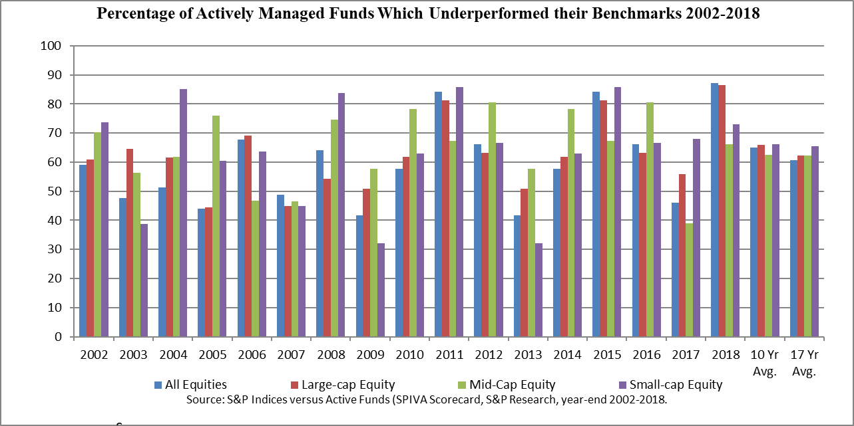
Principles for Successful Investing (continued)
Have most actively managed funds outperformed their benchmarks?
NO!
LIfe is Good

Slide 16
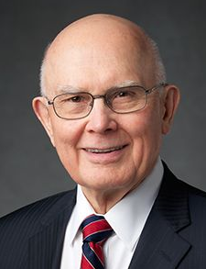
Principles for Successful Investing (continued)
Elder Dallin H. Oaks commented:
We live in a complex society, where even the simplest principle can be exquisitely difficult to apply. I admire investors who are determined not to obtain income or investment profits from transactions that add to the sum total of sin and misery in the world. But they will have difficulty finding investments that meet this high standard. Such complexities make it difficult to prescribe firm rules. We must rely on teaching correct principles, which each member should personally apply to govern his or her own circumstances (italics added, Dallin H. Oaks, “Brother’s Keeper,” Ensign, Nov. 1986, 20).

Slide 17
Principles for Successful Investing (continued)
1. Know yourself
Know your vision, goals and plans
Have well-written and thought-out vision, goals, and plans
Know your budget
Live within your means, save 20% and invest
Know your ability to tolerate risk
Know what kind of investor you are
Invest accordingly
Develop a sleep-well portfolio – based on principles you can depend on for a lifetime so that you can “sleep well” at night

Slide 18
Principles for Successful Investing (continued)
Watch overconfidence
Men trade 45% more than women
Their annualized returns were 2.7% less
Single men trade 67% more than single women
Their annualized returns were 1.4% less
Most investors have significantly (> 5% a year) underperformed the market over the last 20 years
(DALBAR’s Annual Quantitative Analysis of Investor Behavior 2018)
Watch on-line trading
Before on-line, investors beat the market by 1.9%
Afterwards, they underperformed by 3.6%
Carla Fried, “The Problem with your Investment Approach,” Business 2.0, November 2003, p. 146

Slide 19

Principles of Successful Investing (continued)
2. Seek, receive and act on the Spirit’s guidance
Carlos E. Asay said,
When the Spirit is with us, we can think thoughts we’ve never thought before, we can say words we’ve never said before, we can perform beyond our natural abilities. That power is related to truth, to the scriptures, to the stirring of the Spirit within. And the power won’t come unless we’re actively courting the influence of the Holy Ghost (“Scriptures and Sunday Classes,” Ensign, January 1986).

Slide 20
Principles for Successful Investing (continued)
3. Understand Risk
Risk is inherent in all investing activities
There are lots of different types of risk
Inflation, business, interest rate, financial, market, political and regulatory, exchange rate, call, and liquidity risk
Invest at a risk level you are comfortable with
Find that risk level
Taking a risk tolerance test may help. Take A Risk Tolerance Test (LT16) to get a sense on how much risk you can tolerate

Slide 21
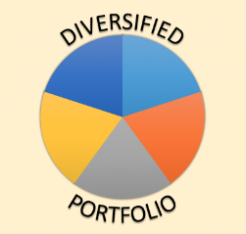
Principles for Successful Investing (continued)
4. Stay diversified
Always invest in different asset classes and assets
Diversification is your key defense against risk
Make sure you understand the risks of each and every asset class you invest in
It’s a risky place out there. Be prepared!
Remember that the numbers you see for specific asset class performance are from diversified portfolios, not single assets!
Use Return Simulation Worksheet (LT23) to see the effects of diversification

Slide 22
Principles for Successful Investing (continued)
5. Invest low cost and tax-efficiently
Control what you can.
You cannot control returns, but you can control your risk, costs, fees, and taxes
A $1 saved is more than a $1 earned
Lower cost index funds tended to outperform
Defer or eliminate taxes as much as possible
Mutual funds distribute 90% of all earnings each year (that you must pay taxes on)
Invest tax-efficiently so you don’t have to pay more taxes each April
Notes:
You pay taxes, charitable contributions and savings on every new dollar earned, and a dollar saved can earn income and income on income (compound interest)

Slide 23
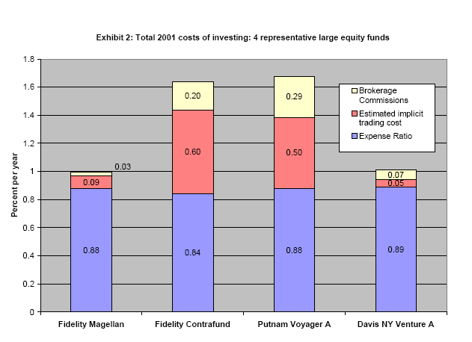
Source: Jason Karceski, Miles Livingston, Edward O’Neal, “Mutual Fund Brokerage Commissions, January 2004, p. 12.
Source: Jason Karceski, Miles Livingston, Edward O’Neal, “Mutual Fund Brokerage Commissions, January 2004, p. 12.

Slide 24
Principles for Successful Investing (continued)
6. Invest long-term
Avoid short-term and day trading
Its expensive and generates transactions costs and taxes
Invest wisely
There are no get-rich-quick schemes that work.
Stay at least partly in the market
Taking money out of the market or not continuing to save and invest stops your progress

Slide 25
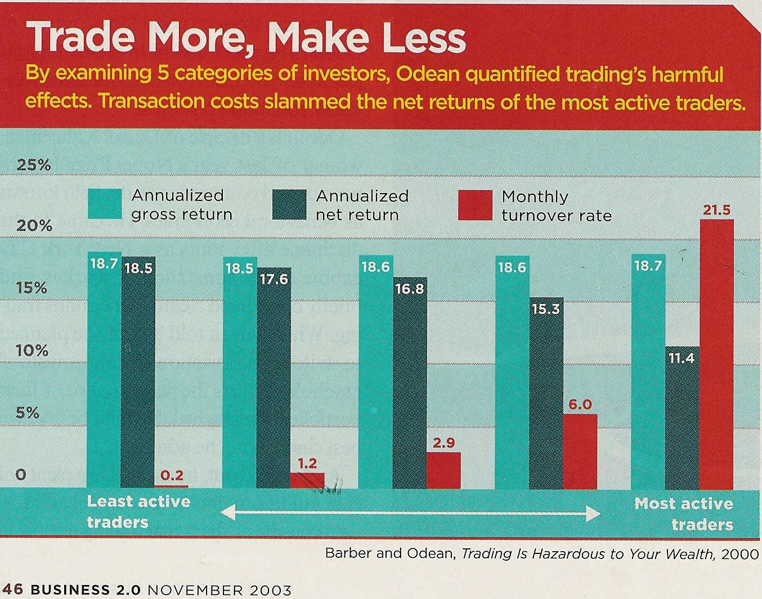
Trading Costs and Returns

Slide 26

Principles for Successful Investing (continued)
7. If you want to invest in individual assets, know what you invest in and who you invest with
When investing in individual assets, do your homework
Know what you are investing in
Know who you are investing with
Be aware of the environment in which the company operates
Be very careful and invest wisely

Slide 27
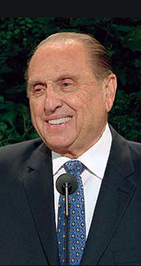
Principles for Successful Investing (continued)
8. Monitor portfolio performance
Measure performance. President Thomas S. Monson stated:
When performance is measured, performance improves. Where performance is measured and reported, the rate of improvement accelerates (General Conference reports, 1970).
How can you know how you are doing if you don’t check your performance against some benchmark?
Interestingly, most investors have underperformed the market benchmarks over the last 20 years
(DALBAR’s Annual Quantitative Analysis of Investor Behavior 2018)

Slide 28
Principles for Successful Investing (continued)
9. Don’t waste too much time, money, and energy trying to beat the market, unless you have a lot of time, money, and energy
It is very difficult, expensive, and time consuming to try and beat the market
If you want to trade, trade tax-efficiently and in tax-deferred accounts

Slide 29
Principles for Successful Investing (continued)
10. Invest only with high quality, licensed, and reputable people and institutions
When help is needed, don’t be afraid to get help.
But get good help from good people consistent with the principles discussed and compare their performance to your benchmarks after taxes (and to a passive portfolio)
Use the best resources available
Know how those resources are compensated

Slide 30
Principles for Successful Investing (continued)
11. Develop a good investment plan consistent with your vision, budget, and these principles, and follow it closely
Think it through and write it wisely
It’s your roadmap to success
If you write it wisely and invest accordingly, it will save you much heartache in the future
And you will likely achieve your personal vision and goals

Slide 31
Principles for Successful Investing (continued)
Guiding Principles Doctrines
Know yourself, your goals and vision Identity
Seek, receive and act on guidance Obedience
Understand risk (there is lots of it) Stewardship
Stay diversified Accountability
Invest low-cost and tax efficiently Stewardship
Invest long-term Stewardship
Know what you invest in Agency
Monitor performance vs. benchmarks Accountability
Don’t waste time Stewardship
Invest with good people and firms Stewardship
Develop a good Plan (IPS) and follow it Stewardship

Slide 32
Principles for Successful Investing (continued)
From obedience to consecration
I am a child of a Creator (identity), living worthy of the Spirit (obedience), striving to understand myself and my risk tolerance (agency), and learning to understand financial markets and instruments (accountability). I am developing my investing talents carefully (stewardship), so I can invest my resources wisely (agency), to earn the return I am expecting (stewardship), to accomplish my personal mission and individual and family vision and goals.

Slide 33
C. Understand Asset Classes and their History
What are asset classes?
Asset classes are broad categories of investments with specific (and similar) risk and return characteristics
How are they distinguished?
Asset classes are distinguished by characteristics specific to particular groups of securities, such as type of financial instrument, market capitalization, maturity, geographic location, etc.
What are the major asset classes?
Cash and cash equivalents, fixed income, and equities

Slide 34
Cash and Cash Equivalents
Major Goal: Liquidity and to preserve capital
Cash includes CDs, money market funds, T-bills, and commercial paper, etc. with a fixed return
Cash includes:
Money market funds, CDs, short-term bond funds, short-term investments, i.e., treasury bills, savings bonds, loans to the government, commercial paper, loans to corporations
Advantages
Liquidity, stability, little risk of losing principal
Good investment for money you plan to use in less than 3-5 years and don’t want to take risks

Slide 35
Cash and Cash Equivalents (continued)
Disadvantages
Less attractive as medium-to-long-term investments (> 5 years)
Returns on cash and cash equivalents are unlikely to keep up with inflation
Thoughts on Cash:
Cash is great for liquidity—especially for your Emergency Fund
However, returns on cash are unlikely to keep up with taxes and inflation
Use cash for liquidity and some diversification, but realize that this asset class will add little to performance

Slide 36
Fixed Income (or Bonds)
Major Goal: Income and returns in excess of inflation
Fixed income includes:
Taxable bonds: U.S. Treasuries, corporate bonds and agency issues (bonds issued by U.S. government agencies, like Ginnie Mae).
Tax-free bonds: Revenue or general obligation bonds issued by local or state governments
Types of fixed-income asset classes:
Short-term bonds/bond funds (mature in < 3 years)
Intermediate-term bonds/bond funds (3-10 years)
Long-term bonds/junk bonds/bond funds (10 or more years)

Slide 37
Fixed-income (continued)
Types of fixed-income asset classes (continued)
Inflation Protected securities - Securities whose yield is linked to inflation
U.S. Government Savings bonds – EE and I bonds
Bond mutual funds. These funds buy and sell bonds before they mature. You are buying a share in portfolio of bonds in a changing portfolio.
Advantages
Greater return than cash, but greater risk
Good diversification as bonds move differently than stocks

Slide 38
Fixed-income (continued)
Disadvantages
Returns historically lower than stocks, and susceptible to interest rate and other risks
Generally, best as part of an overall portfolio as generally do not provide enough growth
Thoughts on fixed income
Fixed interest and the future principle
Income and capital may be subject to taxes
The longer the bond’s maturity, the higher the yield.
The lower the borrower’s credit, the higher the yield
The price of bonds fluctuate with changes in interest rates

Slide 39
Equities (or Stocks)
Major Goal: Provide growth and earn returns in excess of inflation.
A share is ownership in a businesses’ earnings and assets
Types of equity asset classes
Capitalization: Large, mid, and small
Type: Growth, blend, and value
Geographic area: US, international, global and emerging markets

Slide 40
Equities (continued)
What is market capitalization?
It is one measure of the size of a company, and is calculated by multiplying the market price by the number of shares outstanding
Large-cap (capitalization) stocks
Stocks with a market capitalization >$10bn in the US, and smaller capitalizations for international
Generally the largest, most well established companies in the US, with a history of sales and earnings as well as notable market share
These are generally mature corporations with a long track record of steady growth and dividends

Slide 41
Equities (continued)
Mid-cap or mid-capitalization stocks
Stocks with capitalization between $2-10 billion
These tend to grow faster than large cap companies, and are generally less volatile than small cap
Mid-caps generally perform similar to the small-cap asset class.
Small-cap or small capitalization stocks
Stocks with a market capitalization < $2 billion
These are smaller, sometimes newer, US and global companies that are still developing
They are subject to greater volatility, but are expected to grow faster than bigger companies

Slide 42
Equities (continued)
What are growth, value and blend stocks?
Growth stocks
These are companies whose earnings are expected to grow very rapidly. Frequently these are companies developing new technologies or new ways of doing things
Value stocks
These are inexpensive companies (determined by low PE and P/BV ratios) that have potential for good long-term return through appreciation and dividends
Blend stocks
These are a both value and growth companies

Slide 43
Equities (continued)
What are International/Global/Emerging Market stocks?
Funds that contain a mixture of both U.S. and foreign stocks are called global funds, funds from outside the US are called international funds; and funds with stocks from the developing countries are called emerging market funds
These can be of any size (small-cap, large-cap), any type (value, growth) and from anywhere
International investments involve additional risks, which include differences in financial accounting standards, currency fluctuations, political instability, foreign taxes and regulations, and the potential for illiquid markets.

Slide 44
Equities (continued)
Stock Mutual Funds
Funds that own groups or types of companies. You are buying a share in a portfolio of stocks
You are responsible for paying taxes on all distributions by the mutual fund, which are taxed at your level—not the fund level
Advantages
Offer highest return of the major asset classes
Growth and value stocks tend to perform in alternating cycles—it makes sense to own both
Good investment for long-term investing—they have consistently beat inflation over the long-term

Slide 45
Equities (continued)
Disadvantages
Offer less stability of principal than other asset classes, and subject to short-term price fluctuations
If investing for less than 3-5 years, only a small portion of your investments should be in stocks
Thoughts on Stocks
Stocks have given the highest consistent returns of any asset class, although with the highest risk
While volatile in the short-term, they have continued to deliver returns in excess of inflation
Through broad diversification, you can reduce some of the risk of this asset class

Slide 47
Asset Class Risk and Return History
What is risk?
Is it the risk of losing all your money?
Is it the risk of losing principle?
It is the risk of not achieving a specific holding period return?
How is it measured?
Historically, government securities were considered risk-free
Later, analysts started using variance (or standard deviation squared) as a better measure of risk.
Currently, investors use Beta, which is a measure of how the stock moves with the market

Slide 48
Return
What is return?
It is the change in the value of an asset or portfolio over a specific period, which includes dividends, distributions, or interest received during that period.
How is it calculated?
Your “holding period” return is:
HPR = (Price_{End}–Price_{Begin}+Div./Distrib.)/Price_{Begin}
It includes all dividends and distributions, including those received and reinvested
To calculate after-tax returns, deduct the taxes to be paid from your dividend and distribution amounts

Slide 49
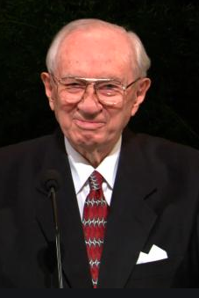
Return (continued)
Why study asset class performance?
We know the future will not be like the past?
Gordon B. Hinckley stated:
All of us need to be reminded of the past. It is from history that we gain knowledge which can save us from repeating mistakes and on which we can build for the future (“Reach with a Rescuing Hand,” New Era, July 1997, 4).
Note: Data are from Ibbottson Associates for 1925-2014 periods, and from Bloomberg for after 2014.

Slide 50
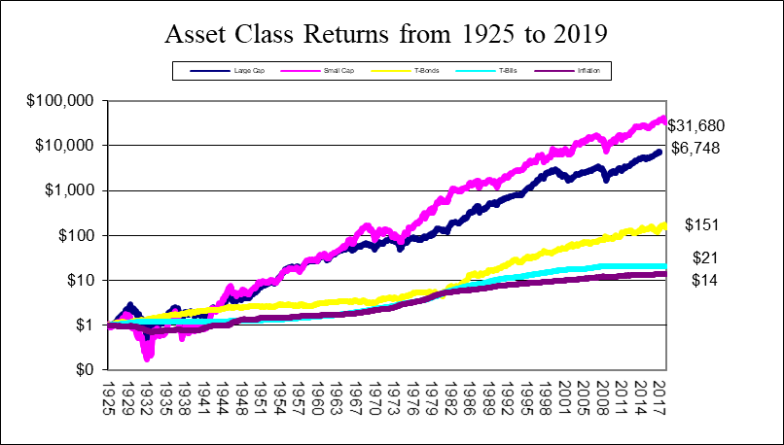
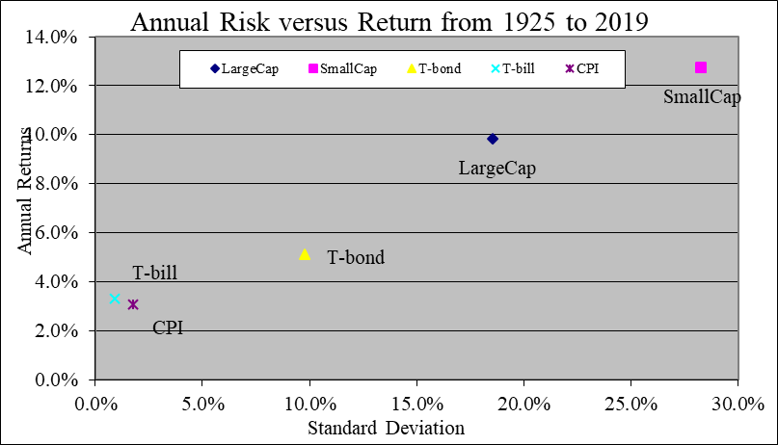
Return: Asset Class Returns

Slide 51
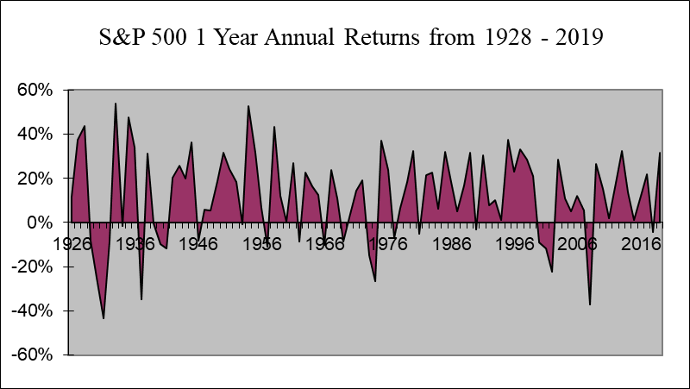
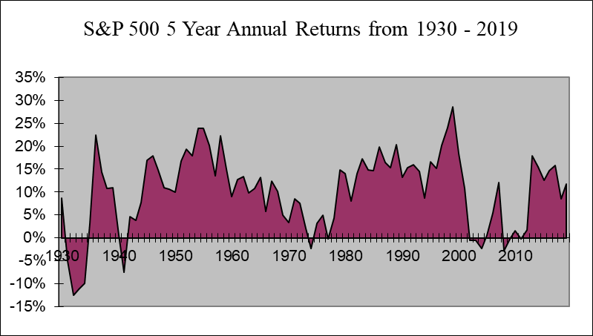
Returns: S&P 500 1 Year Returns

Slide 52
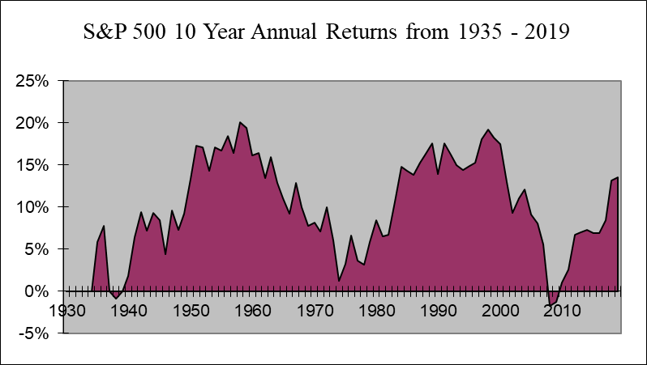
Returns: S&P 500 10 Year Returns

Slide 53
Questions
Any questions on asset class risk and return history? (see Return Simulation Worksheet (LT23))

Slide 54
Review of Objectives
A. Do you know what to do before you invest?
B. Do you understand the principles of successful investing?
C. Do you understand the various asset classes and their risk and return history?

Slide 55
Case Study #1
Data
Bill wants to know how much he will need to save each month to have $1 million in savings when he retires in 30 years.
Calculations
Assuming Bill can earn an 6.5% return on his investment, how much must he save each month
Application
What assets would you recommend Bill use to save?

Slide 56
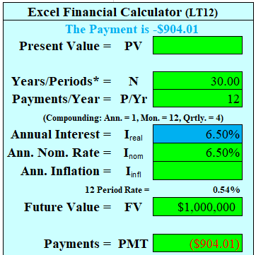
Case Study #1 Answer
Calculations for $1mn in 30 years
Set your calculator to 12 payments per year (monthly)
N = 30, I = 6.5%, PV = 0, FV = $1,000,000, P/Yr = 12
Solve for Bill’s monthly payment?
Bill would need to save $904.01 per month
Recommendations
Bill could use any number of investment assets, including stocks, bonds, cash, mutual funds, etc. Because he is just starting out, I would encourage him to consider the use of inexpensive, no-load mutual funds as investment vehicles.

Slide 57
Case Study #2
Data
Last year you purchased 100 shares of MSAM Corporation for $40 per share. Over the past 12 months MSAM’s price has gone up to $45 per share, and you received a dividend of $1 per share.
Calculations
What was your total rate of return on your investment in the MSAM stock?

Slide 58
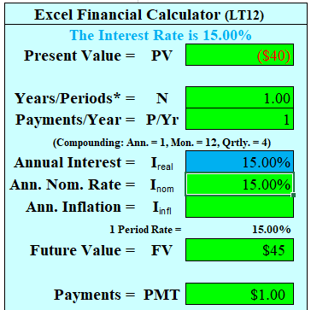
Case Study #2 Answer
Calculations
This can be solved either on a total portfolio basis or on a per share basis.
Total Portfolio
(($45*100 - $40 *100) + 1*100) / $40*100 = ?
Your return is 15.0%
Per Share basis
(($45 - $40) + 1) / $40 = ?
Your return is 15.0%

Slide 59
Case Study #3
Data
Your investment in MSAM stock was so successful that you decided to hold it for 5 more years. Remember, you purchased 100 shares for $40 per share. Unfortunately, the price of MSAM stock has not risen; it is back to where you purchased it. The good news is that you earned $1 per share for five years.
Calculations
What was your annualized total rate of return?
Application
Compared to a bank account earning 2.25% over this same period, how did your stock do?

Slide 60
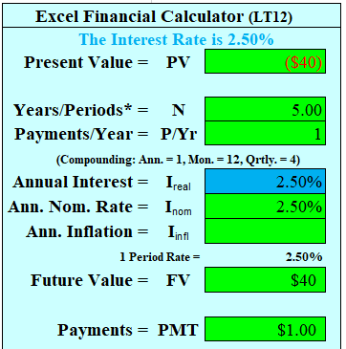
Case Study #3 Answer
Calculations
Your annualized rate of return is your return for the total period, annualized, i.e., taking the geometric return.
Your total return for 5 years is:
(($40*100 - $40*100) + 5*100) / ($40*100) = ?
12.5%
Annualizing for 5 years gives:
Geometric return = (1 + .125)^(1/5) = 2.38%
Average return = 12.5% / 5 = 2.5%
Using either method, it performed better

Slide 61
Case Study #4
Data
Sam recently purchased a bond with a 10 year maturity for $1,000 which pays annual interest of $100.
Calculations
What interest rate is Sam receiving?
If interest rates for ten year bonds today are 5%:
How much can Sam sell his bond for today?
How much could he sell the bond for tomorrow if interest rates move up to 10%?
Applications
Based on your calculations, what is the relationship between interest rates and the value between bonds?

Slide 62
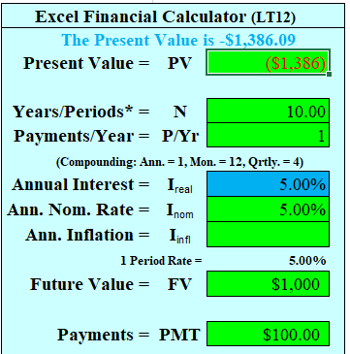
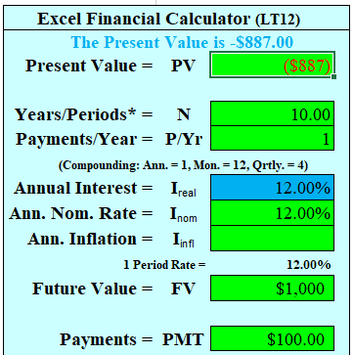
Case Study #4 Answer
Calculations
The bond’s current yield is $100/$1000 = 10%
At 5% Sam can sell his bond for:
N=10, I=5%, PMT=100, FV=1,000, PV= ?
$1,386.09
At 12% Sam can sell his bond for:
N=10, I=12%, PMT=100, FV=1,000,PV=?
$887.00
This implies a negative relationship between bond prices and interest rates. In other words, as rates increase (fall) bond prices fall (rise)

Slide 63
Case Study #5
Data
Ryan is 35 years old, and took the Risk Tolerance test from the teaching tools (Teaching Tool 16). He determined that he was “moderate” in terms of risk.
Application
Based on the rule of thumb of his age in bonds and the results from the Risk Tolerance test, which of the following most likely represents Ryan’s preferred asset allocation (assume his emergency fund is included in cash and bonds):
A. 35% cash, 40% large cap, 25% bonds
B. 25% cash, 35% large cap, 25% small cap, 15% international
C. 10% cash, 25% bonds, 50% large cap, 15% small cap
D. 15% bonds, 30% large cap, 30% small cap, 25% international

Slide 64
Case Study #5 Answer
Ryan’s preferred allocation would likely be C for the following reasons:
Portfolio A has too much exposure to cash and bonds.
Portfolio B has too large an allocation to international and small cap (40%), both much more risky.
Portfolio C is more consistent with your risk exposure, i.e., 35% in bonds and cash, and has some (limited) exposure to small caps
Portfolio D has too little exposure to bonds and cash, and too much small cap and international.

Slide 65
Case Study #6
Data
Assume the same information from Problem 5, but now Ryan’s result (age 35) from his Risk Tolerance test (Learning Tool 16) was “aggressive” in terms of risk.
Application
(a) Based on the same rule of thumb, which of the following most likely represents Ryan’s asset allocation:
A. 35% cash, 40% large cap, 25% bonds
B. 25% cash, 35% large cap, 25% small cap, 15% international
C. 10% cash, 25% bonds, 50% large cap, 15% small cap
D. 15% bonds, 30% large cap, 30% small cap, 25% international
(b) What would his allocation be if his results were “very aggressive”?

Slide 66
Case Study #6 Answer
(a) The preferred allocation for “aggressive” would be B.
Portfolio A has too much exposure to cash for his risk level
Portfolio B is recommended. It has a larger allocation to international and small cap (40%), a lesser allocation to bonds and cash, and is more consistent with his risk results
Portfolio C has too much (35%) in bonds and cash, and likely not enough to the riskier assets
Portfolio D has too little exposure to bonds and cash, and likely too much small cap and international.

Slide 67
Case Study #6 Answer
(b) The preferred allocation for “very aggressive“ would be D.
Portfolio A has too much exposure to cash for his risk level, but a good allocation to small cap (more risky)
Portfolio B has a large allocation to international and small cap (40%), consistent with his risk results, but too much cash
Portfolio C has too much (35%) in bonds and cash, and likely not enough to riskier assets
Portfolio D has less exposure to bonds and cash, and much more small cap and international (55%), consistent with “very aggressive” risk

Slide 68
Summary
The key to investing is to know yourself, your vision and your goals. Then do 5 key things:
1. Know what to do before you invest, and understand the principles of successful investing
2. Know the factors you control, assets, asset classes and investment vehicles
3. Understand your risk level, and determine an asset allocation consistent with your level of risk
4. Understand what makes a good mutual/index fund, and write your investment plan
5. Choose good mutual/index funds, rebalance tax-efficiently, and hold for 40 years or longer

