Slide 1
The Home Decision 2 - Comparing Loans and Creating your Housing Plan Updated 2020-05-27
Personal Finance: Another Perspective

Slide 2
Objectives
Day 11 (Home Decision 2)
A. Understand your options in the housing decision
B. Understand how to compare different mortgage loans
C. Understand and create your Housing Plan
(Home Decision 3)
Answer questions relating to the Housing Decision

Slide 3
Your Personal Financial Plan (optional)
Section XVIII: Your Home Decision Plan
What is your vision and goals for your housing plan? (use template (Education, Mission, Home Auto Template LT01-15)
Where do you currently live?
What expenses are you paying, including rent, mortgage, utilities, gas, repair and insurance?
What are your home plans and strategies?
This may include how often you will move, down payment strategy, negotiation strategies, strategies for warranties, etc.
What are your constraints and accountability?

Slide 4
Case Study
Data
Jen and Trent are looking to buy a home. Trent estimates that they will be in the home for 12 years. They have the choice between the two $200,000 fixed rate loans, amortized over 30 years, but which will be paid back in 12 years. Loan A is for 4.0% with no points or fees, and loan B is for 3.75% with $1,500 loan fee and 1 point. Calculate the EIR for both loans with prepayments
Application
Which loan is more advantageous to Jen and Trent using the EIR as a measure of their best loan?
Note: Home Loan Comparison (LT19) may be helpful

Slide 5
A. Understand Options in the Housing Decision
What are your options in the housing decision?
Generally, key options relate to:
Renting
Buying
Building
Renovating
Other
Key is to understand their advantages and disadvantages

Slide 6
Renting
Advantages
High mobility and can move with minimal costs, no repairs and maintenance, minimal financial commitment, lower initial costs, lower monthly costs, and easier budgeting
Disadvantages
Lack of permanence and pride of ownership, rents may increase unexpectedly, possible restrictions, no tax benefits, no potential for property appreciation, and no equity buildup

Slide 7
Buying
Advantages
Permanence and pride of ownership, get what you see, tax benefits, generally a fixed monthly mortgage payment, leverage, can build equity and can borrow against it, minimal time commitment relative to building, mature landscaping and neighborhood, few surprises in terms of neighborhood, schools, shopping, etc., may be able to negotiate a favorable price and terms
Disadvantages
Low mobility and low liquidity so difficult to sell if needed, significant upfront costs, higher living expenses, large financial commitment, possible decrease in value, and possible mortgage default

Slide 8
Building
Advantages
Can build exactly what you want, sometimes cheaper to build than buy, have all new appliances and housing systems, can pick the location and style
Disadvantages
Interpreting building plans (size of rooms, etc.) can cause difficulty, often over budget and delays, unanticipated additional expense for yard and fencing, combined construction loan interest and rental expense can be high, high monitoring costs!!!, high stress!!!, and high risk!!

Slide 9
Renovating
Advantages
May be faster than building, can see what you want, may be cheaper to buy and renovate than build, and there may not be available lots in a desired area
Disadvantages
May be more expensive than to build it new, often over budget and delays, large unanticipated additional expenses for yard and fencing depending on what was renovated, combined construction loan interest and rental expense can be high, may have other major problems not noted before, high monitoring costs!!! high stress and high risk!!

Slide 10
Other Options
Other options include:
Mobile homes, tiny houses, recreational vehicles
Advantages
Lower cost
Disadvantages
Lower resale value, lack of permanence, challenge getting finances, difficulty in building equity

Slide 11
Questions
Any questions about housing options and the principles of home ownership?
Rent versus buy calculators
New York Times

Slide 12
B. How to Compare Different Mortgage Loans
What factors go into choosing a loan?
You have lots of options for your mortgage
Fixed rate, adjustable rate, fixed with interest only and variable with interest only option
What factors do into your choice of mortgage?
Time horizon
Risk tolerance
Cash flow preferences
Goals
See Choosing a Mortgage Loan (LT35)

Slide 14
Comparing Loans (continued)
How do you compare different mortgage loans?
Remember, the cost of a mortgage loan is based on points, up-front costs and expenses, escrow costs, principle and interest costs, property taxes and property insurance and PMI
Understand these costs and you can calculate a comparable rate on loans with different points, fee structures and up-front fees

Slide 15
Comparing Loans (continued)
Lenders will give you not one loan, but many different choices on interest rates and points
Your challenge is to minimize your effective cost of borrowing and get the least expensive loan
Remember, the broker retains the amount attributed to points when distributing the loan proceeds; however, the monthly payment will be based on the entire loan amount

Slide 16
Comparing Loans (continued)
What are points?
1% or one hundred basis points of the loan
Lenders charge points to:
To recover costs associated with lending.
To increase the effective interest rate
To provide for negotiating flexibility (in a market where interest rates fluctuate), or
To adjust for differences in risk between loans
Note that origination points are not tax deductible (line 801), but discount points are all tax deductible in the year of the purchase

Slide 17
Comparing Loans (continued)
What is a Loan Estimate (LE)?
It is a 3-page form received from a mortgage lender or broker after applying for a loan which includes an itemized list of all up-front fees and costs associated with your loan.
Fees include loan fees, fees paid in advance, reserves (escrow), title charges, government charges, and additional charges.
You do not have to have a signed purchase contract to apply for a mortgage loan and receive a LE
You will use it to compare different offers or quotes from different lenders and brokers
What does a Loan Estimate form look like?

Slide 18
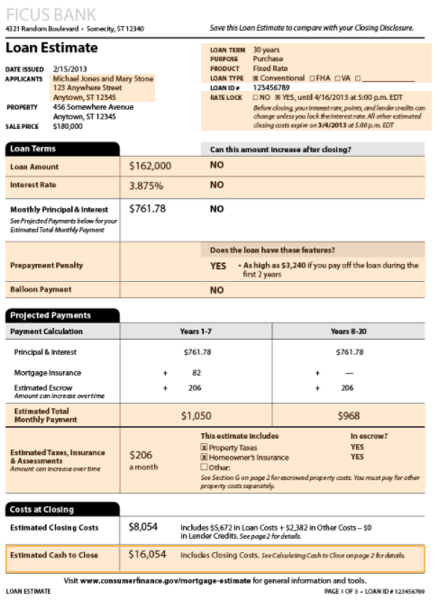
Loan Estimate – Page 1 It includes information on:
Loan terms:
Amount
Interest rate
Prepayment penalty
Balloon payment
Projected payments
Principal and insurance
Mortgage insurance
Estimate escrow, taxes, insurance and assessments
Costs at closing
Estimated cash to close

Slide 19
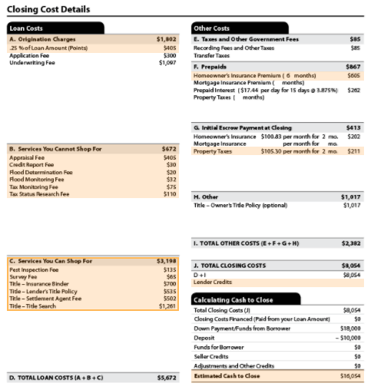
Loan Estimate – Page 2 It includes information on:
Loan costs including:
Origination charges (points)
Application fees
Underwriting fees
Service you cannot shop for
Appraisal fee
Credit report fee
Tax monitoring fee
Services you can shop for
Pest inspection fee
Survey fees
Title fees
Total closing costs
Cash to close

Slide 20
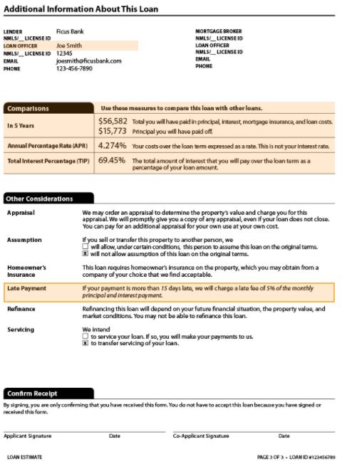
Loan Estimate – Page 3 It includes information on:
Comparisons
In 5 years
Annual percentage rate
Total interest percentage
Other considerations
Appraisal
Assumption
Homeowner’s insurance
Late payment
Refinancing and Servicing
Confirm receipt
This confirms you have received this, not that you must take the loan

Slide 21
Comparing Loans (continued)
What is the difference between the Annual Percentage Rate (APR) and the Effective Interest Rate (EIR)? (Note: this is different from the effective annual interest rate!)
The APR is a rate that is generated from a precise calculation specified in Regulation Z
The EIR is the precise interest rate the borrower is paying after all fees and costs are taken into account. We assume all costs come out of the loan or are paid back by the loan
If no prepayment or other costs, the EIR = APR
Notes:
The EIR allows you to quickly compare rates from various lenders

Slide 22
Comparing Loans (continued)
What is the effective interest rate?
This is the effective rate to the borrower after all costs and fees are taken into account
The broker retains the amount from points while the payment is based on the entire loan amount.
The borrower pays many additional fees and out-of-pocket costs over and above costs that are included in the loan documents
How do you account for these additional out-of-pocket costs in your calculations?

Slide 23
Comparing Loans (continued)
The Effective Interest Rate calculation takes into account all costs, both out-of-pocket and loan costs
How is it calculated?
1. Calculate the payments on the total amount you will be repaying, i.e. the amount borrowed = PMT
2. Calculate the amount of money you actually received, i.e., the total loan less all costs = - PV
3. Set PMT, PV = - what you actually received, N = years, and solve for your interest rate. This is the rate you are actually getting.
It takes into account all your fees, including explicit and out-of-pocket costs and fees
Where do you find your costs and fees?

Slide 24
Comparing Loans: EIR Problem #1
Data
Trent and Jen, both 24, have decided on their dream house (well, at least their first house). In discussions with their mortgage broker, they have the choice between two $200,000 fixed rate loans, both which are amortized over 30 years. Loan A is for 4.0% with no points or loan origination fees, and loan B is for 3.75% with a $1,500 loan fee and 1 point.
Calculations
Assuming Trent and Jen plan to stay in the house for 30 years, which loan is more advantageous based on the Effective Interest Rate (EIR) and assuming annual payments? The Home Loan Comparison (LT19) and Excel Financial Calculator (LT12) may help

Slide 25
EIR Problem #1 Answers Loan A $200,000, 4.0%, no points no fees, 30 years; Loan B $200,000, 3.75%, 1 point $1,500 fees, 30 years
Note: Loan A has an EIR of 4% as there are no fees and costs
1. Calculate payment for loan B
N=30, I=3.75%, PV = -$200,000 PMT = ?
PMT = $11,217.52
2. Calculate the amount you received after all fees
$200,000 – 1 point ($2,000 * 1) - 1,500 = ?
$196,500
3. Calculate your effective interest rate
Set your PMT= $11,217.52, N = 30, PV = -$196,500, Solve for I
I = 3.89% Loan B is the cheaper loan

Slide 26
Comparing Loans (continued)
What is prepayment?
Prepayment is when you repay the loan early
How do you calculate your effective interest rate when you plan to prepay the loan before maturity?
The process is similar, except that you must calculate your balance remaining as of the prepayment date, i.e. the balloon payment
To get balance remaining or balloon amount, take your payment as PMT, N as the number of years remaining after your prepayment, and your interest rate as I, and solve for your Present Value. The PV is the present value of all the payments you will eliminate

Slide 27
Comparing Loans (continued)
With expected prepayment:
1. Calculate your payment = PMT
2. Calculate your amount received = -PV
3. Calculate your balance remaining after you prepay (the balloon amount). This balance remaining will be your FV
4. Set your PMT, number of years before prepayment as your = N, your balance remaining as your FV, amount received as your –PV, and solve for I = your effective interest rate

Slide 28
Comparing Loans: EIR Problem #2
Data
Jen thinks they will only be in the home for 6 years. Trent compromises, and estimates that they will be in the home for 12 years. Review their choice between the two $200,000 fixed rate loans, amortized over 30 years, but which will be paid back in 12 years. Loan A is for the same 4.0% with no points or fees, and loan B is for 3.75% with $1,500 loan fee and 1 point.
Calculations
Calculate the EIR for both loans with prepayments
Application
Which loan is more advantageous using the EIR?

Slide 29
EIR problem #2 Answers Prepay after 12 years: Loan A $200,000, 4.0%, no points no fees, 30 years; Loan B $200,000, 3.75%, 1 point $1,500 fees
1. Calculate payment for loan B
N=30, I=3.75%, PV = -$200,000 PMT = ?
$11,217.52
2. Set PV = to amount received after all costs
$200,000–1 point ($2,000)-1,500 = $196,500
3. Solve for your balloon payment at year 12
N = 18, PMT = $ 11,217.52, I = 3.75, PV = ?
$144,935.59
4. Solve for their effective rate
PMT = $11,217.52, PV= -$196,500, N=12,
FV= $144,935.59, solve for I
I = 3.96% Loan B is still cheaper (barely)

Slide 30
Comparing Loans: EIR Problem #3
Data
Jen and Trent want to know the breakeven point in years which if they move prior to this time, Loan A is better and if they move after this time, Loan Better.
What is the breakeven point for moving that would make the EIR of both loans A & B the same?

Slide 31
EIR problem #3 Answers Prepay after 12 years: Loan A $200,000, 4.0%, no points no fees, 30 years; Loan B $200,000, 3.75%, 1 point $1,500 fees
Use the Home Loan Comparison (LT19) to solve:
What do we want?
Prepayment years
What do we have?
I=3.75%, PV = -$196,500, PMT = $11,217.52
Put 12 years in cell “e16”
Your effective interest rate is 3.96%
Put fewer years in “e16” until you get your 4.0%
Your breakeven point is 9 years
If you stay in the home longer than 9 years, it is better to go with loan B. If you stay shorter than 9 years, go with Loan A

Slide 32
Comparing Loans: EIR Problem #4
Data
Jen’s broker has said that for 1 more “buy down” point (for a total of 2 points with the same $1,500 fees), he can give her loan C with an interest rate of 3.50%.
Calculations
Calculate the EIR for Loan C paid back after 12 years. How much did that extra point save Jen in terms of the effective interest rate over Loan A and Loan B?
Application
Assuming the same 12 year prepayment plan, which loan should Trent and Jen take?

Slide 33
EIR #4 Answers Prepay after 12 years: Loan C $200,000 3.5%, 2 points, $1,500 fees , 30 years. How much did the 2nd point save?
1. Calculate payment for loan C
N=30, I=3.5%, PV = -$200,000 PMT = $10,874.27
2. Calculate amount received after all fees (2 points)
$200,000 –2 points ($2,000 * 2) - 1,500 = $194,500
3. Calculate the balance owed after 12 years (18 years remaining) The PV of 18 years of the PMT is:
N=18, I=5.5%, PMT= - $10,847.27, PV = $143,428.11
4. Calculate effective interest rate to lender
Set your FV at year 12 to = $143,428.11, PMT= $10,847.27, N = 12, PV = -$194,500, Solve I = ?
I = 3.83%
Loan C saves .17% and .13% over Loans A and B

Slide 34
C. Understand and Create Your Housing Plan
Developing a Housing Plan is part of planning and stewardship
If you plan how you will pursue the home decision, you can make better decisions
What is the maximum amount you will borrow?
How soon will you have your house paid off?
At what age do you want it to be paid off?
Strategies can be applied to the five key areas

Slide 35
Housing Plan (continued)
Vision
Likely from your Plan for Life
Goals
A modest and model home, that we can share with family, neighbors and friends.
A play area for the kids, and garages for dad, which we will use to bring the family together.
We will pay our home off by age 45
A home that we keep up its value and live within front- and back-end ratios.
A home that is open to our children’s friends, foreign exchange students and others

Slide 36
Housing Plan (continued)
Plans and Strategies
Understand your limits
We will buy a home consistent with the front- and back-end ratios and keep housing expenses (PITI and utilities costs) for LDS at less than __% (40% maximum). I will not buy too big a house
We will make sure my home fits my budget, not my budget fits my home
We will save 5-20% for my first home down payment and pay 20% down on each future home
We won’t buy a home on two incomes when we know we will go to one income in the future

Slide 37
Housing Plan (continued)
Plans and Strategies
Finding your home
We will understand “must haves” for the home and the “would like to haves” as well
We do our homework before buying/renting to ensure that we are in the best place for myself and my family
We will ensure that the schools are the best for our children and the neighborhood safe for my spouse
We will not buy the largest home in a neighborhood as we know that the highest priced home generally does not sell for more than 10% above the median for a neighborhood

Slide 38
Housing Plan (continued)
Plans and Strategies
Finding, funding and servicing the loan
We will get a minimum of three realtors to bid for my business to ensure that I get the best loan for myself and family
We will get the lowest EIR for the loans provided given my/our expectations of how long we will be in the home
We will not get a home on two incomes when we know we are going to one income in the future

Slide 39
Housing Plan (continued)
Plans and Strategies
Paying off the loan
We will up each mortgage check to the closest $100 to pay it off earlier (but with a separate check and will write on it “use against principle”)
We will make additional payments each month to pay off the loan in 20 years (i.e., 15 years)
We will have PMI insurance removed as quickly as we can
We will then keep paying the PMI amount but to the servicer with a separate check to reduce the balance

Slide 40
Housing Plan (continued)
Plans and Strategies
Enjoying home ownership
We will ensure that we keep up the value of the home by budgeting 1.5% for home maintenance and repair (recommended 1-2% of the value of the home)
We will keep up the appearance of the home by taking care of yard, interior and structure as good stewards
We will use the home as a place to teach our children to work

Slide 41

Housing Plan (continued)
Constraints
We will stay strong in the gospel, keeping our covenants, attending the temple and serving
We will live on a budget and save 20%.
One half of all unexpected money will be put toward paying down principal (after our emergency fund).
We will do all required maintenance and plan on replacing key housing machinery as needed. We will also not skimp on required maintenance.
Accountability
From our Plan for Life
Success Email

Slide 42
Questions
Do you understand how to create your Housing Plan?

Slide 43
Review
A. Do you understand your options in the housing decision?
B. Do you know how to compare different mortgage loans (different types of loans with different fees and points)?
C. Do you know how to create your Housing Plan?

Slide 44
Case Study #1
Data
Trent and Jen, both 24, have decided on their dream house (well, at least their first house). In discussions with their mortgage broker, they have the choice between two $300,000 fixed rate loans, both which are amortized over 30 years. Loan A is for 6.0% with no points or loan origination fees, and loan B is for 5.75% with a $1,500 loan fee and 1 point.
Calculations
Assuming Trent and Jen plan to stay in the house for 30 years, which loan is more advantageous based on the Effective Interest Rate (EIR) and assuming annual payments?

Slide 45
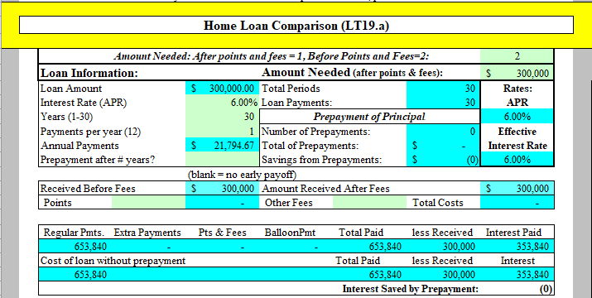
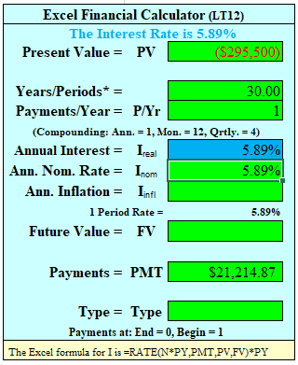
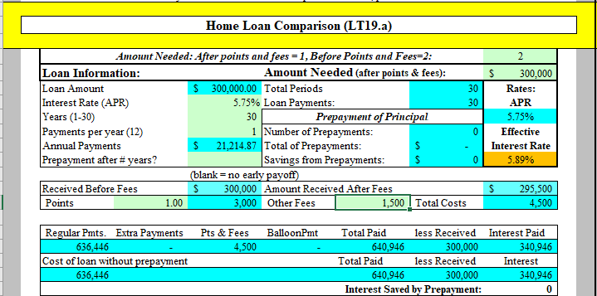
Case Study #1 Answers Loan A $300,000, 6.0%, no points no fees, 30 years; Loan B $300,000, 5.75%, 1 point $1,500 fees, 30 years
Note: Loan A’s EIR is 6% as there are no fees and costs
1. Calculate payment for loan B
N=30, I=5.75%, PV = -$300,000 PMT = ?
PMT = $21,214.87
2. Calculate the amount you received after all fees
$300,000 – 1 point ($3,000 * 1) - 1,500 = ?
$295,500
3. Calculate your effective interest rate
Set your PMT= $21,214.87, N = 30, PV = -$295,500, Solve for I
I = 5.89% Loan B is the
cheaper loan

Slide 46
Case Study #2
Data
Jen thinks they will only be in the home for 6 years. Trent compromises, and estimates that they will be in the home for 12 years. Review their choice between the two $300,000 fixed rate loans, amortized over 30 years, but which will be paid back in 12 years. Loan A is for the same 6.0% with no points or fees, and loan B is for 5.75% with $1,500 loan fee and 1 point.
Calculations
Calculate the EIR for both loans with prepayments
Application
Which loan is more advantageous using the EIR?

Slide 47
Case Study #2 Answers Prepay after 12 years: Loan A $300,000, 6.0%, no points no fees, 30 years; Loan B $300,000, 5.75%, 1 point $1,500 fees
1. Calculate payment for loan B
N=30, I=5.75%, PV = -$300,000 PMT = ?
$21,214.87
2. Set PV = to the amount you receive after all costs
$300,000 – 1 point ($3,000 * 1) - 1,500 = ?
$295,500
3. Solve for your balloon payment at year 12
N = 18, PMT = $ 21,214.87, I = 5.75, PV = ?
$234,081.05
4. Solve for their effective rate
PMT = $ 21,214.87, PV is -$295,500, N = 12, FV = $234,081.05, solve for I
I = 5.94% Loan B is still cheaper (barely)

Slide 48
Case Study #3
Data
Jen’s broker has said that for 1 more “buy down” point (for a total of 2 points with the same $1,500 fees), he can give her loan C with an interest rate of 5.50%.
Calculations
Calculate the EIR for Loan C. How much did that extra point save Jen in terms of the effective interest rate over Loan A and Loan B?
Application
Assuming the same 12 year prepayment plan, which loan should Trent and Jen take?

Slide 49
Case Study #3 Answers Prepay after 12 years: Loan C $300,000 5.5%, 2 points, $1,500 fees , 30 years. How much did the 2nd point save?
1. Calculate payment for loan C
N=30, I=5.5%, PV = -$300,000 PMT = ?
$20,641.62
2. Calculate amount received after all fees (2 points)
$300,000 –2 points ($3,000 * 2) - 1,500 =
$292,500
3. Calculate balance after 12 years (18 years remaining)
N=18, I=5.5%, PMT= -$20,641.62, PV = ?
$232,137.16
4. Calculate effective interest rate
FV at year 12 to = $ 232,137.16, PMT= $20,641.62, N = 12, PV = -$292,500, Solve for I = ?
I = 5.82%
Loan C saves .18% and .06% over Loans A and B

Slide 50
Teaching Tools
Please note that I have prepared three teaching tools which may be helpful as you work on buying a home. They are:
Home Loan Comparison with Prepayment and Refinancing (LT19)
Maximum Monthly Payment for Christians’ (LT11)
Debt Elimination Schedule with Accelerator (LT20)
For another good source of information, see
www.mtgprofessor.com

