Slide 1
Personal Finance: Another Perspective`
Loans: Avoiding Consumer and Minimizing Mortgage
Updated 2020-05-28
Note: Graphs on this presentation are from http://www.bankrate.com/funnel/graph/default.aspx?

Slide 2
Objectives
Understand consumer loans, principles, types, characteristics, and costs
Understand mortgage loan types, characteristics, and costs
Understand the key relationships to reduce borrowing costs
Understand and create your Consumer Loan and Debt Plan

Slide 3
Your Personal Financial Plan
IX. Student/Consumer Loans and Debt Reduction? (Loans and Debt Template LT01-08)
What is your vision and goals for consumer/student loans and debt outstanding?
What is your current debt situation with interest rates, costs, and other fees?
What are your plans and strategies for consumer and student debt?
If in debt, what is your debt reduction strategy and views on future debt?
What are your constraints and accountability?

Slide 4
Case Study
Data
Anne is looking at the mortgage cost of a $300,000 6.0% fixed rate 30 year amortizing loan versus a 7.0% fixed rate 30 year loan with an 10 year interest only option.
Calculations
A. What are her monthly payments for each loan for the first 10 years?
B. What is her new monthly payment beginning in year 11 after the interest only period ends?
Application
C. How much did Anne’s monthly payment rise in year 11 in percentage terms for the interest only loan?

Slide 5
Understand Consumer Loans, Principles, Types, Characteristics and Costs
Why are consumer loans not recommended?
1. They encourage consumption instead of saving
Rather than saving for the future, they encourage spending now
2. They are very expensive, and crowd out saving
They reduce what you might otherwise have saved for your other more important goals
3. They are generally unnecessary
Other than for education and a home (what the prophet has stated), they generally are not necessary!

Slide 6
Consumer Loans (continued)
What 5 questions should you ask when you are thinking of borrowing (using consumer loans)?
1. Do you really need to make this purchase?
2. Is it in your budget and your financial plan?
3. Can you pay for it without borrowing?
4. What is the all-in cost of this loan, including its impact on your other goals?
5. Will this purchase bring you closer or take you farther away from your personal goals (including your goal to be obedient to God’s commandments)?
Notes:
1. Do you really need to make this purchase?
Is it a need or a want?
2. Is it in your budget and your financial plan?
Should you save for it instead of borrow for it?
3. Can you pay for it without borrowing?
What is the after-tax cost of borrowing versus the after-tax lost return from using savings?

Slide 7
Principles (continued)
What are the principles of consumer loan use?
1. Know yourself, your vision, goals and budget
2. Seek, receive and act on the Spirit’s guidance
3. Know where you are financially (your assets, liabilities, spending and income)
4. Resolve to not go into debt (except for a modest home and modest education)
5. Pay as you go (live within your means)
If in debt add:
6. Prioritize your debts (if you cannot repay them all, give priority to secured debts for house or car)
7. Develop a repayment plan (and automate it)
8. Avoid all new debt (don’t go further into debt)

Slide 8
Principles (continued)
Finding balance
Guiding Principles Doctrines
Know yourself, your vision and goals Identity
Seek, receive and act on guidance Obedience
Know where you are financially Accountability
No debt except for home and education Agency
Live within your means Stewardship

Slide 9
Principles (continued)
From obedience to consecration
I am a child of a King (identity), striving to live worthy of the Spirit (obedience), using my agency wisely (stewardship) as I follow the prophet and scriptures in deferring my wants (agency). I wait until I can pay cash for specific items (stewardship), so that I am a wiser steward over the things that I have been blessed with (stewardship) so I can accomplish my personal mission and individual and family vision and goals

Slide 10
Characteristics
What are the different types of Consumer loans
Types
Single payment loans
Installment loans
Rates
Fixed
Variable
Convertible
Balloon
Security
Secured
Unsecured
Home Related
Home Equity
HELOC
Specialty
Auto loans
Student loans
Payday loans

Slide 11
Characteristics (continued)
Types
Single Payment
Loan is repaid in one payment of principle and interest
Installment
Loan is repaid in regular intervals with payments that include both principal and interest

Slide 12
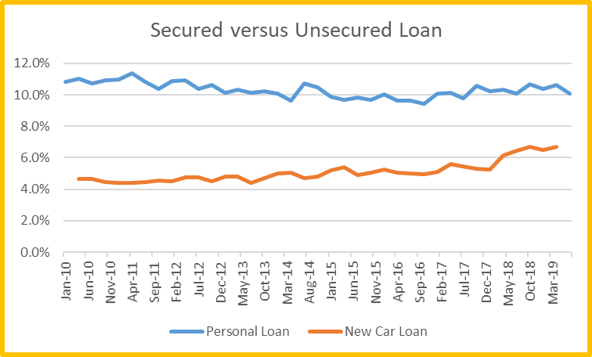
Characteristics (continued)
Security
Secured - Loans are guaranteed by a specific asset, i.e. a home or a car, and typically have lower rates
Unsecured - Loans that require no collateral, are generally offered to only borrowers with excellent credit histories, and have higher rates of interest – 12% to 28% (and higher) annually

Slide 13
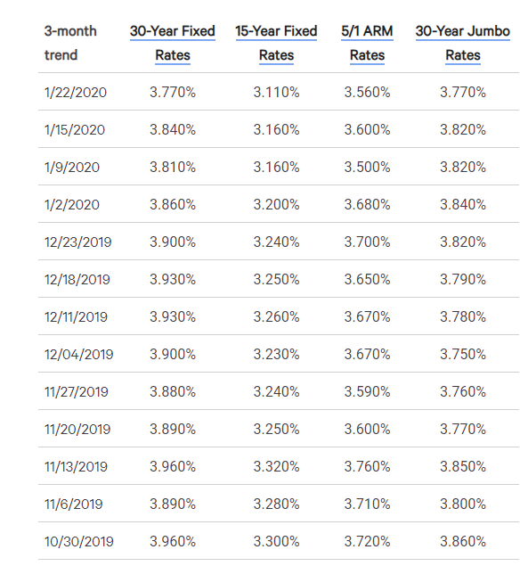
Characteristics (continued)
Rate Type
Fixed-rate loans
Same interest for the duration of the loan with generally a higher interest rate
Variable-rate loans
Interest rate is tied to an index plus some margin, adjusted on different intervals
Convertible loans
Begin as a variable-rate loan and can be locked into a fixed-rate loan at some predetermined future time

Slide 14
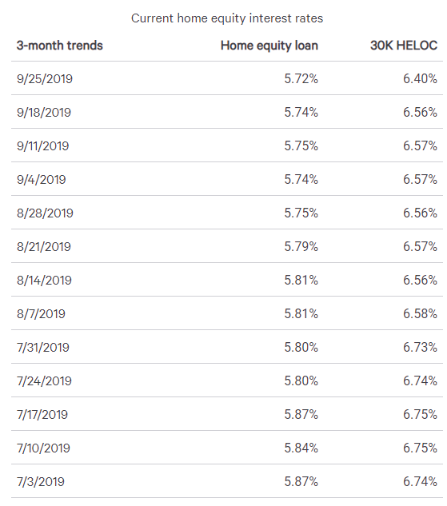
Characteristics (continued)
Home Related
Home equity loans
Second mortgages which use the equity in your home to secure your loan. Normally can borrow up to 80% of your equity and rates are
Home Equity Lines of Credit (HELOC)
A line of credit against your home equity which allows you to draw money from your home’s value and pay it off with interest, with rates normally adjustable

Slide 15
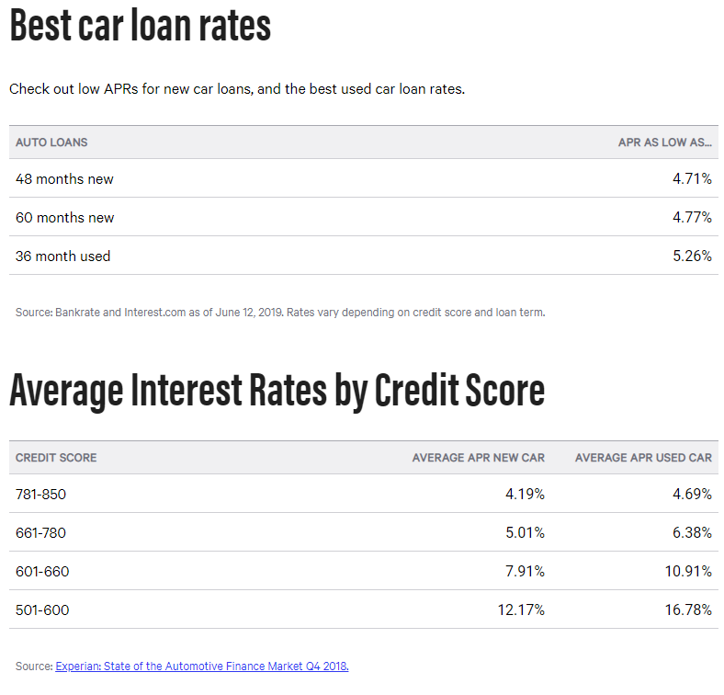
Characteristics (continued)
Specialty
Student loans
Loans to help offset the cost of an education
Auto loans
Loans secured by the vehicle the consumer is purchasing
Payday
Short-term loans of 1-2 week secured by a post-dated check—HUGE interest rates and fees

Slide 16
Costs of Consumer Loans
What are the costs of consumer loans?
Consumer loans are required by Regulation Z of the Truth in Lending Act to state the loan APR in bold on the loan documents
The APR is the simple interest rate paid over the life of the loan. It takes into account all costs, including interest rate, cost of credit reports, and costs of all possible fees
Loans are either single payment, installment or payday

Slide 17
Single Payment Loans
Single payment (or balloon) loans
A loan that is repaid in only one payment, including interest
Generally is short-term lending of one year or less, sometimes called bridge or interim loans
Cost is simple interest
Both principal and interest are due at maturity, with interest is calculated as principal x interest rate x time
APR = [(interest+Fees)/Years]/Avg. borrowed
Calculating Consumer Loan Costs (LT42) may be helpful

Slide 18
Installment Loans
Installment loans
Installment loans are loans which are repaid at regular intervals and where payment includes both principal and interest
Cost is also Simple Interest
Most installment loans today are based on a simple-interest calculation (your calculator)
Repayment is on your outstanding balance, as each month the interest portion of the payment decreases and the principal portion increases

Slide 19
Payday Loans
Payday Loans
Short-term loans of 1-2 weeks secured with a post-dated check which is “held” by the lender and then cashed later with huge rates APR > 520%
Cost is the APR
Interest plus fees divided by years and by average amount borrowed
To get the effective rate, take the APR of the loan in decimal form, divide it by the number of compounding periods, add 1, and take it to the power of the number of periods, and subtract 1

Slide 21
Understand Mortgage Loan Types, Characteristics and Costs
There are a number of different loan options when considering how to finance your house. Your choice of loans should be based on four areas:
1. Your time horizon: How long do you expect to have the mortgage, and how certain are you of that time horizon?
2. Your preference (if any) for low required payments: How important are lower payments in the initial years of the loan?
3. Your tolerance for interest rate risk: Are you willing to assume interest rate risk?
4. Your work status/history: Are you or have you been a member of the armed forces?

Slide 22
Mortgage Loans (continued)
Types of Loans
Conventional loans: neither insured or guaranteed
They are below the maximum amount set by Fannie Mae and Freddy Mac of $510,400 in 2020 (single family)
They require Private Mortgage Insurance (PMI) if the down payment is less than 20%
PMI is insurance to make the lender whole should the borrower fail to make payments
Borrowers can eliminate PMI by having equity greater than 20%

Slide 23
Mortgage Loans (continued)
Jumbo loans
Loans in excess of the conventional loan limits and the maximum eligible for purchase by the two Federal Agencies, Fannie Mae and Freddy Mac of $510,400 in 2020 (some areas have higher amounts)
Some lenders also use the term to refer to programs for even larger loans, e.g., loans in excess of $500,000

Slide 24
Mortgage Loans (continued)
Piggyback loans
Two separate loans, one for 80% of the value of the home and one for 20%
The second loan has a higher interest rate due to its higher risk
The second loan is used to eliminate the need for PM Insurance
With a piggyback loan, PMI is not needed

Slide 25
Mortgage Loans (continued)
There are a number of different types of mortgage loans available. These include:
Fixed rate mortgages (FRMs)
Variable or adjustable rate mortgages (ARMs)
Variable or Fixed Interest Only Option (IO)
Option Adjustable Rate Mortgages (Option ARMs)
Negative Amortization (NegAm)
Balloon Mortgages
Reverse Mortgage
Special Loans: VA or FHA

Slide 26
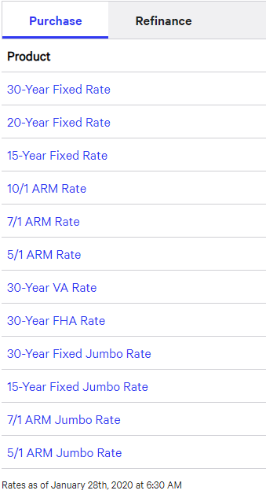
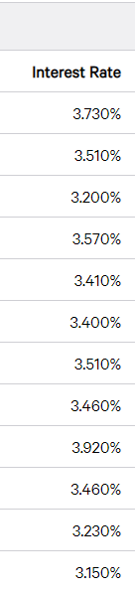
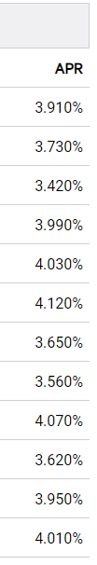
Mortgage Loans (continued)
Fixed rate mortgages (FRMs)
Fixed rate of interest for the life of the loan, and least risky from the borrowers point of view
Benefits
Higher monthly payments, so pay down principle faster
Interest rate risk is transferred to the lender
No risk of negative amortization
Risks
Interest rates are higher as lenders must be compensated for increased interest rate risk

Slide 27
Mortgage Loans (continued)
Variable or ARMs
Mortgage loans with a rate of interest that is pegged to a index that changes periodically, plus
Benefits
Lower monthly payments and rates, as interest rate risk is assumed by the borrower
Risks
Lower monthly payments initially as borrows assume interest rate risk
Possible “payments shock” as rates rise, perhaps beyond what borrowers are able to pay

Slide 28
Mortgage Loans (continued)
Fixed/Variable Loan with Interest only option
FRMs or ARMs with an option for interest only payments for a number of years, and then payments reset to amortize loan over the remaining years – generally not recommended
Benefits
Lower monthly payments and greater flexibility
Borrowers can afford more house
Risks
Once interest-only period passes, payment resets, and the payment increase can be large
A rise in payments when interest period ends

Slide 29
Mortgage Loans (continued)
Option Adjustable Rate Mortgages (Option ARMs)
ARM where rates adjust monthly, and payments annually, with “options” on the payment amount: minimum, interest only, and fully amortizing -- never recommended!!!!!
Benefits
Lower monthly payments and greater flexibility
Risks
The minimum payment option often results in a growing loan balance, termed negative amortization, which has limits and will cause loan to be reset
A huge payments rise when interest period ends

Slide 30
Mortgage Loans (continued)
Negative Amortization Mortgages (NegAm)
Mortgage loans in which scheduled monthly payments are insufficient to amortize, or pay off the loan.
Benefits
Lower payments
Risks
Interest expense that has been incurred, but not paid, is added to the principal amount, which increases the amount of the debt.
NegAm loans have a maximum negative amortization that is allowed. Once that limit is hit, rates adjust automatically

Slide 31
Mortgage Loans (continued)
Balloon Mortgages
Mortgage loans whose interest and principal payment won’t result in the loan being paid in full at the end of the term.
Benefits
Allow smaller interest payments
These loans are often used when the debtor expects to refinance the loan closer to maturity
Risks
The final balloon payment can be huge
You may not be able to refinance at a rate you would like

Slide 32
Mortgage Loans (continued)
Reverse Mortgages
Mortgage loans whose proceeds are made available against the homeowners equity.
Financial institutions in essence purchase the home and allow the seller the option to stay in the home until they die
Benefits
Used by cash-poor but home-rich homeowners who need to access the equity in their homes to supplement their monthly income at retirement
Risks
Once they die, the home is sold and the loan repaid, generally with the proceeds

Slide 33
Mortgage Loans (continued)
Federal Housing Administration (FHA) Insured Loans
Does not originate loans, but insures loans issued by others
Benefits
Lower PMI insurance (.85%), but required for the entire life of the loan (1.75% of the loan)
Risks
While the required down payment is very low, the maximum amount that can be borrowed is also low

Slide 34
Mortgage Loans (continued)
Veterans Administration (VA) Guaranteed Loans
These loans are issued by others and guaranteed by the Veterans Administration
Benefits
For ex-servicemen and women as well as those on active duty
Loans may be for 100% of the home value
Risks
With not down payment, the risk remains of owing more than the house is worth

Slide 36
Questions
Any questions on types of mortgage loans?

Slide 37
C. Understand Key Relationships to Reduce Borrowing Costs
Key to your plans and strategies is reducing your costs for borrowing
1. Understand the Key Relationships on Borrowing:
Total interest cost is related to the interest rate
Keep your interest rate as low as possible
Total interest cost is inversely related to maturity
Keep your loan maturity short
Periodic payment is directly related to both the maturity and interest rate
Keep both short
Parents are cheaper than banks

Slide 38
Relationships and Borrowing Costs (continued)
2. Understand the key clauses for Consumer and Mortgage Loans—none are in your favor!
Note that all clauses are in the lender’s favor
You are putting your future in someone else’s hands when you borrow!
You are committing future earnings to today’s consumption!
Read the documents very carefully and understand them before you sign—know what you are doing!!!

Slide 39
Relationships and Borrowing Costs (continued)
Insurance agreement clause
You must purchase life insurance that will payoff your loan if you die before the loan is paid off
Acceleration clause
Requires the entire loan to be paid-in-full if you miss just one payment
Deficiency payments clause
Requires any amount in excess to be paid if the collateral's value does not satisfy the loan.
Recourse clause
Defines the lender’s ability to collect any outstanding balance via wage attachments and garnishments

Slide 40
Relationships and Borrowing Costs (continued)
3. Know the steps to reduce borrowing costs
a. Don’t get into debt in the first place!
Follow the prophet—rather than your wants!
Distinguish between true needs and wants
Remember your goals
Remember ignorance, carelessness, compulsiveness, pride, and necessity are offset by knowledge, exactness, discipline, humility, and self reliance
Stick to your budget
If you really need it, plan and save for it

Slide 41
Relationships and Borrowing Costs (continued)
b. Compare the after-tax cost of borrowing with the after-tax lost return from using savings
It makes little sense to borrow at a high interest rate when you have savings earning a lower rate. The formula is:
After-tax lost return = nominal interest rate * (1 – tax rate)
Tax rate = Federal + State + Local marginal tax rates
Be careful though, to not put your house at risk!

Slide 42
Relationships and Borrowing Costs (continued)
c. Maintain a strong credit rating
Increase your credit score
Make sure your credit reports have no mistakes
Pay all your bills on-time
Keep balances low, particularly on revolving debt
Keep your oldest accounts, but not too many
Don’t apply for too many new cards
Don’t have too many of the same type of cards
Call and increase your credit limits (if possible)

Slide 43
Relationships and Borrowing Costs (continued)
d. Reduce the lender’s risk
a. Use a variable rate loan
b. Keep the loan term as short as possible
c. Provide collateral for the loan
d. Pay a large down payment on the item to be purchased with financing

Slide 44
Relationships and Borrowing Costs (continued)
Least expensive
Borrowing from parents and family
Home equity loans
Other secured loans
More expensive
Credit unions
Savings and loans
Commercial banks
Most expensive
Credit cards
Retail stores
Finance companies and payday lenders
Isn’t it interesting that those who are in the worst financial situation have to pay the most for credit

Slide 45
Questions
Any questions on the key relationships to reduce borrowing costs?

Slide 46
D. Consumer, Student and Mortgage Loan Plans and Strategies
We have already discussed your Consumer Loans and Debt Plan earlier
However, we can add a few more thoughts to your plans and strategies

Slide 47
Plans and Strategies (continued)
Plans and Strategies
Consumer Loans
We will separate needs from wants
We defer all wants until we can pay cash for them
We pay cash for all consumer purchases
We will pay off all credit cards monthly
We keep our emergency fund at 3 months and rebuild it quickly once it is drawn down
We will never buy toys with debt

Slide 48
Plans and Strategies (continued)
Plans and Strategies
Student Loans
We will seek scholarships as much as possible
We will spend loan money only on education
We defer all wants until we can pay cash for them and after we have paid off our student loans
We will understand our employment options to help pay off our student loan debt
We build our emergency fund to 3 months and then use the 20%+ to pay down non-subsidized and then subsidized loans
We will not buy toys until student loans are paid off

Slide 49
Plans and Strategies (continued)
Plans and Strategies
Mortgage Loans
We will have 20% down payment to eliminate PMI
We ensure all housing payments are within the front- and back-end ratios recommended
We avoid debt like the plague
We keep our emergency fund at 3 months and rebuild it quickly when it is drawn down
We defer all wants until we can pay cash for them, except for student and mortgage loans
We will not borrow against the equity in our home
We will go into retirement out of mortgage debt

Slide 50
Review of Objectives
Do you understand consumer loans, principles, types, characteristics, and costs?
Do you understand mortgage loan types, characteristics, and costs?
Do you understand the key relationships for borrowing?
Do you understand some additional Consumer and Student Loan Plans and Strategies?

Slide 51
Case Study #1
Data
Anne is looking at the mortgage cost of a $300,000 1. traditional fixed rate 6.0%, 30 year amortizing loan versus 2. a fixed rate 7.0%, 30 year loan with an 10 year interest only option.
Calculations
A. What are her monthly payments for each loan for the first 10 years?
B. What is her new monthly payment beginning in year 11 after the interest only period ends?
Application
C. How much did Anne’s monthly payment rise in year 11 in percentage terms for the interest only loan?

Slide 52
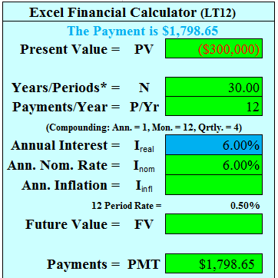
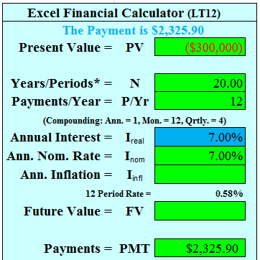
Case Study #1 Answers
A. Anne’s monthly payments are
Traditional: The amortizing loan payment is:
PV=-300,000, I=6.0%, P/Y=12, n=360, PMT = ?
PMT = $1,798.65
Interest only: Payment is $300,000*7.0%/12 = ?
$1,750.00
B. After the 10 year interest only period, her new payment would be (she would have to amortize the 30 year loan over 20 years):
PV = -300,000, I=7.0%, P/Y=12, N= 240, PMT = ?
PMT = $2,325.89
C. The new payment is a 33% increase (LT12)

Slide 53
Case Study #2
Data
Matt is offered a $1,000 single payment loan for 1 year at an interest rate of 12%. He determines there is a mandatory $20 loan processing fee, $20 credit check fee, and $60 insurance fee. The calculation for determining the APR is (annual interest + fees) / average amount borrowed. (LT42)
Calculations
A. What is Matt’s APR for the 1 year loan assuming principle and interest paid at maturity?
B. What is Matt’s APR if this was a 2 year loan assuming principle and interest paid at maturity?

Slide 54
Case Study #2 Answers
Matt’s interest cost is Prin. * Rate * Time
A. The APR for the 1 year loan is:
Interest = $1,000*.12*1 year = $120, Fees: $20+$20+$60=$100
APR = (120 + 100) / 1,000 = 22.0%
B. The APR for the 2 year loan is:
Interest = $1,000*.12*2 = $240
Fees: $20 + $20 + $60 = $100
APR = [(240+100)/2]/1,000= 17.0%
Since this is a single payment loan,
the average amount borrowed is the
same over both years.
Note that Matt’s APR is significantly higher than his stated interest rate. He should be very careful if taking out this loan.

Slide 55
Case Study #3
Data
Matt has other options with the same $1,000 loan at 12% for 2 years. But now he wants to pay it back over 24 months and he has no other fees.
Calculations
Using the simple interest and monthly payments calculate:
A. The monthly payments
B. The total interest paid
C. The APR of this loan
Note: The simple interest method for installment loans is simply using your calculator’s loan amortization function

Slide 56
Case Study #3 Answers
A. To solve for simple interest monthly payments, set your calculator to monthly payments, end mode:
PV=-1,000, I=12%, P/Y= 2, N=24, PMT=?
PMT = $47.074
B. Total Interest = 47.074 x 24 – 1,000 = ?
$129.76
C. APR = [(interest + fees) / 2] / average amount borrowed (which changes each year as you pay it down). (See the following slide to see how to get the average amount borrowed of $540.68.)
($129.76 / 2 years) / $540.68 = 12%

Slide 57
Case Study #4
Data
You are looking to finance a used car for $9,000 for three years at 12% interest.
Calculations
A. What are your monthly payments?
B. How much will you pay in interest over the life of the loan?
C. What percent of the value of the car did you pay in interest?

Slide 58

Case Study #4 Answers
A. To solve for your payments, set:
PV= -9,000, I = 12, N=36, and PMT=?
Your payment is $298.93 per month
B. To get your total interest paid, multiply your payment * 36 months = $10,761.44 – 9,000 = ?
$1,761.46
C. To determine what percent of the car you paid in interest, divide interest by the cars cost of $9,000
= $1,761.46 / 9,000 = 19.6%
You paid nearly 1/5 the value of the car in interest.

Slide 59
Case Study #5
Data
Bill is short on cash for a date. He und he can give a post-dated check to a Payday lender who will give him $100 now for a $125 check which the lender can cash in 2 weeks. The APR is the total fees divided by the annual amount borrowed. The effective annual rate = (1 + APR/periods) ^{periods} -1.
Calculations
A. What is the APR?
B. What is the effective annual interest rate?
Application
C. Should he take out the loan?

Slide 60
Case Study #5 Answers
A. the APR is the amount paid on an annual basis divided by the average amount you borrow
APR = ($25 * 26 two-week periods)/$100 = ?
APR = 650%
B. To solve for your Effective Annual Interest rate, put it into the equation for determining the impact of compounding.
The effective annual interest rate is
(1 +[ 6.5/26 periods])^{26 periods} – 1 =
Effective rate is 32,987%
This is a very expensive loan
C. No. It is just too expensive

Slide 61
Case Study #6
Data
Wayne is concerned about his variable rate mortgage (ARM). Assuming a period of rapidly rising interest rates, how much could his rate increase over the next 4 years if he had a 6 percent variable rate mortgage with a 2 percent annual cap (that he hits each year) and a 6 percent lifetime cap?
Application
How would this affect his monthly payments?

Slide 62
Case Study #6 Answers
Assuming rates increased by the maximum 2% each year, at the end of the 4 years it could have reached its cap of 6%, giving a 12 percent rate. Nearly doubling the interest rate would significantly increase Wayne’s monthly payment.

Slide 63
Case Study #7
Data
Jon took out a $300,000, 30 year Option ARM mortgage for purchasing his home, which had a 7% mortgage. Each month he could make a minimum payment of $1,317 (which didn’t even cover interest), an interest only payment of $1,750, a payment of $1,996 that included both principle and interest, or an additional amount. The loan had a negative amortization maximum of 125% of the value of the loan. Jon was not very financially savvy, and for the first 10 years made the minimum payment only. As a result, at the end of year 10, he was notified that he had hit the negative amortization maximum and that his loan had reset.
Calculations
A. What is Jon’s new monthly payment beginning in year 11 after he hit the negative amortization limit?
B. How much did Jon’s monthly payment rise over the minimum payment he was paying previously?

Slide 64
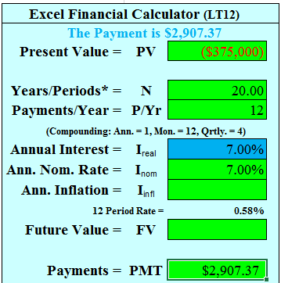
Case Study #7 Answers
A. After the negative amortization limit is hit, he must now amortize the loan over 20 years, instead of 30.
His new loan amount is not $300,000, but $375,000 (300,000 * 125%) :
PV = -375,000, I=7.0%, P/Y=12, N= 240, PMT = ?
PMT = $2,907.37
B. His minimum payment was $1,317, and his new payment is $2,907.
It is a 121% increase over the
minimum payment period.

Slide 65
Notes
Other good sources of information on mortgages are available at:
www.mtgprofessor.com
www.bankrate.com

