Slide 1
Personal Finance: Another Perspective
Credit: Understanding and
Using it Wisely
Updating 2020-05-27

Slide 2
Objectives
A. Understand credit reports, bureaus, scores and the principles of using credit wisely
Understand the correct uses of credit cards
Know how credit cards work and how to manage open credit
D. Understand and Create your Credit Plan

Slide 3
Your Personal Financial Plan
Section VII: Credit Use: Cards, Reports and Scores (use Credit template (LT01-7))
  What is your vision for your Credit Plan?
  What are your goals?
    What type of credit card user are you (credit, convenience, or both)? Include credit card names, rates (see box) and fees
    Get one credit report and one credit score, and give provider, score, and rankings.
      Is your credit report correct?
  What are your credit Plans and Strategies?
  What are your constraints and accountability?

Slide 4
Opt Out for Credit Card Applications
Getting too many credit card applications?
  There is a national credit opt-out number to take your name off the mailing lists of all four major credit reporting agencies either permanently or for five years. This may also help reduce your risk of identity theft. It is easy and (relatively) painless!
    Call 1-888-567-8688 or 1-888-5 OPT OUT or www.optoutprescreen.com
  Answer the questions on the phone or online. It only asks your home phone number, your name, address, and your social security number. Then they send a form for you to fill out and mail in.
    It is worth it (unless you like junk mail).

Slide 5
Opt Out for Telemarketers
Getting too many telephone calls:
  The do not call registry can be accessed by signing on to:
    www.Donotcall.gov
  From here, you will put in up to 3 phone number(s) and your email address.
    You will then receive confirming emails. When you receive them, click on the hyperlink to confirm them, and you will be set up on the Do Not Call list

Slide 6

Credit Case Study
Data:
Bill, a BYU student, was reading about the importance of keeping a high credit score and got his FICO score of 690. He heard a rumor that to improve his FICO score, he needed to reduce the number of cards in his name. Bill cancelled three of his five credit/bank cards which he had not used in a long time. Instead of helping, the next time he purchased his FICO score it had dropped by 40 points.
Analysis:
  A. List three possible reasons why his score may have dropped?
  B. What should he have done to make sure the cancelled cards helped, and not hurt, his score?
  C. What things might he do to improve his score?

Slide 7

A. Understand Credit Reports, Bureaus, Scoring, and the Principles of using Credit Wisely
What is a credit report?
  It is a listing of what credit you have and how you have used and repaid your credit in the past
  Why should I care about my credit report?
    It is the raw data from which your credit score is calculated
      If there are mistakes, your credit score will be lower and so you will pay more for loans and debt

Slide 8

Credit Reports (continued)

Slide 9
Credit Reports (continued)
How do you get your Credit Report?
  You can get 3 free credit reports each year, one from each of the three major reporting agencies
    Go to www.annualcreditreport.com (NOT FREECREDITREPORT.COM
    Click on request credit report, then fill out
    Choose your report supplier (any will do)
    Answer questions—they are very picky!
    Click on “Save as PDF” or “Print” for binder
  Print off your credit report from one provider
    DO NOT PUT IN A CREDIT CARD NUMBER

Slide 10
Credit Reports (continued)
What do you do about mistakes on your credit report?
  1. Contact the creditor (info is at the end of the report)
    Many of the mistakes can be fixed over the phone
  2. Contact the credit reporting agency’s customer service
    Explain inaccuracies in writing with support documents using the “Investigation Form” from the website
    If you cannot get the problem solved, then
  3. Fill out a dispute form with the
    You can put up to 100 words on your credit report explaining a situation and what you have done to try to resolve that situation

Slide 11
Credit Bureaus
What are credit bureaus?
  These are companies that physically keep your credit information
  They are the data suppliers when you get your Credit Report. The 3 major Credit Reporting bureaus are Equifax - www.equifax.com, Experian - www.experian.com, and Trans Union - www.transunion.com
  Be proactive, as you can change things if incorrect
    Review your report and report inaccuracies for investigation

Slide 12
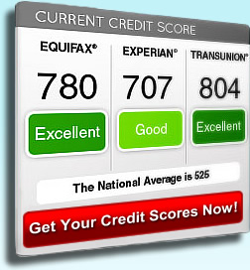
Credit Scores
What is a three-digit number that measures your credit-worthiness?
  Credit score

Slide 13
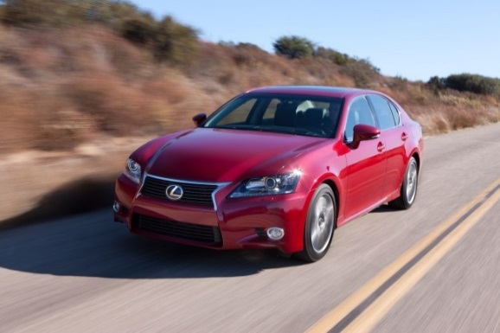
Credit Scores (continued)
What are the benefits of a high credit score
  75% of all mortgage loans are sorted on credit scores, the most common being FICO
  Higher scores allow higher credit limits and lower rates
  Example, a 60-month $40k car loan:
The lowest score paid $16,318 more in interest than the highest score

Slide 14

Credit Scores (continued)
What is a “FICO” Credit Score?
  It is a credit scoring method developed by Fair, Isaac and Company (hence FICO)
    Opened to the public in March 2001
  Ranges from 300 to 850
    Can be purchased from www.myfico.com and other sites or free at www.discover.com/free-credit-score
  One of three major scoring companies, but generally used the most
    Used in credit approval and other areas as well, i.e. insurance, cell phones,
  FICO has 28 credit scores for different users

Slide 15
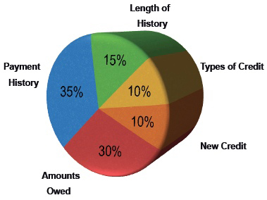

Credit Scores (continued)
What determines your FICO credit score?
  Payment History (35%):
    What is your on-time payment record?
  Amounts Owed (30%):
    How much do you owe? (vs. your credit limits)
  Length of Credit (15%):
    How long have accounts been open?
  New Credit (10%):
    Are you taking on more debt?
  Types of Credit Use (10%):
    Do you have a healthy mix? (avoid finance companies and payday loans)

Slide 16
Credit Scores (continued)
What are credit considerations from marriage?
  New spouse’s credit is not merged with yours, and does not affect your credit score
    When you apply for a mortgage to buy home, both credit scores are considered.
    Your goal is both with good credit scores
  Add your spouse as a joint account holder and/or cosigner on everything
    That way credit is established for both

Slide 17
Credit Scores (continued)
How do you improve your credit use and score?
  Payment History (35%):
    Make all payments on time including mortgage, rent, utilities, insurance, credit cards, tuition
  Amounts Owed as a percent of credit limit (30%):
    Pay down debt, pay off your cards monthly, and eliminate all auto, student and other debt quickly
    Get credit limit increases to increase your credit limit
    Pay off your credit card several times a month as you get closer to getting a home

Slide 18

Credit Scores (continued)
  Length of Credit (15%):
    Keep your oldest accounts, use each card annually
    Keep credit cards active, don’t cancel
  New Credit (10%):
    Don’t open too many cards, and don’t apply for more than one per year.
    If married, include spouse as a joint account holder
  Types of Credit (10%):
    Have a healthy mix
    Do not have too many of the same type of card

Slide 19
Reports and Scores (continued)
Getting your Credit Score
  Your credit scores is your grade for how well you have used credit. The most used credit score is from FICO
    1. FICO Scores
      a. Discover offers your FICO score for free, you can check it often as it is updated monthly. Go to https://www.discover.com/free-credit-score/ and you can sign up and get a free FICO score
    2. Other Credit Scores: Vantage/PLUS Scores
      a. Other free sites can give a non-FICO score
        www.CreditKarma.com (with an app)
        www.Creditsesame.com (with an app)

Slide 20
Reports and Scores (continued)
    3. You may be able to get a copy of your credit score from your bank or credit card provider (it may or may not be a FICO score)
      This is generally free
    4. If you go to Mint.com, you can also get a free copy of your credit score from them
      You need to have already done your budget
  Regardless of how you get your credit score, you will view and print off your credit report and credit score and put them in your PFP binder

Slide 21
Credit Bureaus (continued)
What Should You Do?
  We manage our assets weekly--lets manage our liabilities as well
    Take an active role in managing your credit
    Review the things that go into your credit score
    Review your credit report every year (it is free) and view your credit score (I recommend a FICO score) every two years, or more often if you are planning to take out a loan for a house

Slide 22
Principles of Using Credit Wisely
What are the Principles of using credit wisely?
  1. Know yourself, your vision, goals and budget
  2. Seek, receive and act on the Spirit’s guidance
  3. Understand the key areas of credit and know where you are financially (your budget, assets and liabilities)
  4. Keep current on all bills (and pay off all credit cards and other debt monthly)
  5. Make only planned purchases (that are in your budget and that are planned for, particularly large purchases)
  6. Be wise in your use of credit and debt (and don’t go into debt except for a modest home and education)
  7. Review your credit score and credit reports annually (to ensure correctness and no identity theft)

Slide 23
Principles (continued)
Finding balance
Guiding Principles Doctrines
Know yourself and budget Identity
Seek, receive and act on the Spirit’s guidance Obedience
Know where you are financially Stewardship
Keep current on all bills Accountability
Make only planned purchases Stewardship
Be wise in your use of credit Accountability
Review your score and reports Stewardship

Slide 24
Principles (continued)
From Obedience to Consecration
You are a child of God (identity), striving to be worth of the Spirit (obedience), acting on your ability to choose (agency), who understands the benefits and dangers of credit (stewardship) and who uses credit only for those items recommended (accountability). You understand the credit industry (stewardship), use it to your advantage by keeping your credit score high (accountability), so you can get the lowest cost on needed credit products (stewardship), so you can eliminate your interest costs and save money to accomplish your personal mission and individual and family vision and goals.

Slide 25
Questions
Do you understand credit bureaus, credit reports, and your credit score and the principles of using credit wisely?

Slide 26
B. Understand the Correct Uses of Credit Cards
What are credit cards?
  Credit cards are essentially open lines of credit
    Credit cards can be either:
      The single most destructive financial instrument in the history of the world, or
      A tool to help us reach our personal and family goals
    It depends on us!
      If we use them to borrow money and get further into debt, they are destructive
      If we use them to achieve our personal and family goals, they can be helpful

Slide 27
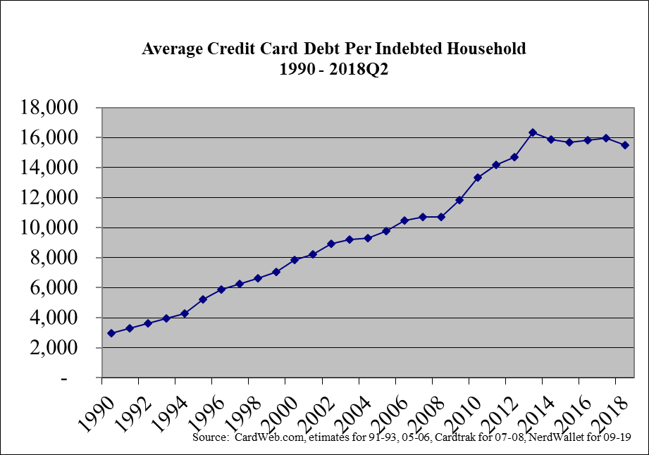
Credit Cards (continued)
Source: http://www.nerdwallet.com/blog/credit-card-data/average-credit-card-debt-household/

Slide 28
Credit Cards (continued)
What are the correct uses of credit/debit cards?
  Guarantee / Emergency Use
    Hotel rooms, rental cars, emergencies, etc.
  Convenience
    Buying things over the internet
  Float/Timing
    Buy things before you pay for them
    Can take advantage of things on sale
  Free services
    Extended warranties, travel insurance, airplane miles, gasoline, etc.

Slide 29
Credit Cards (continued)
What are debit cards?
  Debit cards are like a check in that money is taken from your checking account, and like a credit card in that you use it instead of cash.
    Unless you have overdraft protection, it cannot be used for more than is in your account so you cannot spend borrowed money

Slide 30
Credit Cards (continued)
What are secured credit cards
  Secured credit cards are similar to credit cards except that these cards are generally tied to a checking or savings account
    When this money is gone, the card is worthless until more funds are added
  These cards are convenient, especially to build credit, as credit scoring agencies cannot tell the difference between a secured and unsecured card

Slide 31
Credit Card Summary and Questions

Slide 32
C. Understand How Credit Cards
Work and How to Manage Open Credit
Why do companies like to issue credit cards?
  Large annual fees ($10-$300)
  High interest rates (up to 23% +)
  Large balance transfer fees (3%+)
  Wonderful cash advance fees (4.0%+)
  High penalty rates (25%+) plus late fee
  All of this on top of a 1.5%-5% charge to merchants. What a Business!!!

Slide 33
How Credit Cards Work (continued)
What type of credit card user are you? This will tell you what type of card to look for:
  Credit user - You carry a balance, so look for a low interest rate
  Convenience user - You pay it off each month, so look for a low annual fee, interest-free grace period, and free benefits
  Convenience and credit user - You generally pay it off, but sometimes carry a balance, so balance the interest rate and annual fee

Slide 34
How Credit Cards Work (continued)
What determines the Costs of Open Credit?
  The balance owed
    The more you owe, the higher the costs
  Interest rates
    Rates are stated in terms of an Annual percentage rate (APR) which does not take into account the time value of money!
  Cash advance costs
    Interest begins immediately, may be at a higher rate than for purchases, and usually entails a “cash advance fee” of 2% to 4% of the amount advanced

Slide 35
How Credit Cards Work (continued)
  The grace period
    Normally 20 to 25 days, excluding cash advances and doesn’t apply if you carry a balance. Not all credit cards offer a grace period
  The annual fee
    An annual fee for the privilege of using the card. May range from $0 to $150+
  Additional or penalty fees
    May include annual, activation, usage, or other fees

Slide 36
Managing Open Credit (continued)
In order to manage your credit cards and open credit, there are four steps you need to follow:
1. Reduce your Balance
  Set up your budget and stick to it
    If you are in debt, commit to reducing your balance each month by a specific dollar amount (i.e., $150)
    Do not go into any new debt (i.e., if you find yourself in a hole, stop digging)
    Develop your saving, income and expense plan and have the discipline to stick to it

Slide 37

Managing Open Credit (continued)
2. Protect Against Fraud
  Use wisdom in what you do
    Save your credit receipts to ensure against fraud
      Compare receipts to your credit statement
      Once checked, destroy your old receipts.
    Use caution when giving out your credit card number
    Be aware of where your cards are at all times
      Never leave a store without your card

Slide 38
Managing Open Credit (continued)
3. Know the Trouble Signs
A “Yes” below means you may have a problem:
  Do you only make the minimum payment each month?
  Have you reached your credit limit on any of your cards?
  When with friends, do you pay the entire bill and have them reimburse you with cash?
  Do you wait for your monthly bill to determine how much you have charged?
  Do you get cash advances because you do not have enough in your checking account?
  Have you been turned down for credit or had a card cancelled?
  Have you used some savings to pay off credit card bills?
  Do you know how much of your credit card bill is for interest?

Slide 39
Managing Open Credit (continued)
4. Control Your Spending
  Commit to always live on less than you earn
    Catch your vision, goals and plans for your Credit Plan
    Live on your budget, and only spend for what is planned
    If you have problems with credit, perform plastic surgery, i.e., cut up your credit cards
    If all else fails, use the “envelope method” of budgeting
      Put money for each budget category in an envelope. When it is gone, you have nothing more to spend.

Slide 40

Managing Open Credit (continued)
What do you do if your credit cards are lost or stolen?
  1. Call your credit card company IMMEDIATELY (or sooner)!
    Copy all your cards, front and back, and keep the 800 numbers handy to report any loss or theft.
    Put this information in a safe place in case of theft.
  2. File a police report IMMEDIATELY in the jurisdiction of the loss
    This shows the credit card company that you are diligent and trying to find it.

Slide 41
Managing Open Credit (continued)
  3. Call the 3 national credit reporting organizations and the Social Security Administration to place a fraud alert on your name and social security number:
      Equifax: 800-525-6285
      Experian 888-397-3742
      Trans Union: 800-680-7289
      Social Security Administration
        (fraud line): 800-269-0271

Slide 42
E. Understand and Create Your Credit Plan
Your Credit Plan should include how you will handle credit cards and open credit
  It need not be long, but it needs to be thought out
    Following are a few ideas

Slide 43
Developing a Credit Plan (continued)
Vision:
  This is likely from your Plan for Life
  Other ideas include:
    We will watch Credit Reports and Scores quarterly to ensure no major changes nor fraud
Goals:
  We will not go into debt except for those things specified by the prophets: a modest education and home, and perhaps a first car
  We will not buy cars on debt after the first car
  We will pay off all credit cards monthly
  We will not pay any credit card or auto interest

Slide 44
Developing a Credit Plan (continued)
Plans and Strategies
Overall
  We will live on a budget and save 20% (with 15% saved for retirement)
  We will not buy anything with credit cards unless we have the money to pay it off at the end of the month
  If we have problems, we will perform “plastic surgery” and cut up the cards
  We will save for all auto and toy purchases, and will pay cash for all autos and toys

Slide 45
Developing a Credit Plan (continued)
Plans and Strategies
Credit Cards
  We will use cards credit cards wisely and only for planned items
  We will use debit cards carefully as the risk is higher of loss
  We will not buy anything with credit cards unless we have the money to pay it off at the end of the month

Slide 46
Developing a Credit Plan (continued)
Plans and Strategies
Credit Report
  We will Opt Out of all mailing lists for credit cards
  We will pull one credit report every four months to make sure there are no changes
  We will check each of our Credit Report’s annually to make sure there are no mistakes or fraud
  We will watch our VantageScore monthly via the CreditKarma or CreditSesame app to ensure no major changes. If so, we will immediately check our credit reports

Slide 47
Developing a Credit Plan (continued)
Plans and Strategies
Credit Score
  We will Opt Out of all mailing lists for credit cards
  We will keep our credit score above 760 so we can get the lowest rates for a mortgage and insurance
  We will pull our free FICO Credit Score annually to make sure there are no major changes
  We will watch our VantageScore monthly via the CreditKarma or CreditSesame app to ensure no major changes

Slide 48


Developing a Credit Plan (continued)
Constraints
  Our biggest hurdles to accomplishing this will be:
    Not living on a budget and not saving money
    Being impatient and not saving for our vehicles, toys, and other large purchases
    Losing the Spirit and not keeping an eternal perspective
    Not watching spending on the little things
Accountability
  From your Plan for Life
Success Emails

Slide 49
Questions
Do you know how to develop a credit plan?

Slide 50
Review of Objectives
A. Do you know about credit evaluation, credit reports, and your FICO credit score and the principles of effective credit use?
B. Do you understand the correct uses of credit cards?
C. Do you know how credit cards work and how to manage your credit cards and open credit?
D. Do you understand how to develop your Credit Plan

Slide 51
Case Study #1
Data:
Bill, a BYU student, was reading about the importance of keeping a high credit score, and got his FICO score of 690. He heard a rumor that to improve his FICO score, he needed to reduce the number of cards in his name. Bill cancelled three of his five credit/bank cards which he had not used in a long time. Instead of helping, the next time he purchased his FICO score it had dropped by 40 points.
Analysis:
  A. List three possible reasons why his score may have dropped?
  B. What should he have done to make sure the cancelled cards helped, and not hurt, his score?
  C. What things might he do to improve his score?

Slide 52
Case Study #1 Answers
A. Three possible reasons his score may have dropped:
  1. History. One of the cards cancelled was his card with the longest history. His score may have dropped as his time with credit was lessened.
  2. Available credit. Each of the cancelled cards had a large amount of available credit. When these were cancelled, they decreased his total available credit, and increased his percentage usage each month, resulting in a lower score.
  3. Mix. Perhaps the cards cancelled resulted in a mix of credit that was biased toward one type of card. This may have lowered his score.

Slide 53
Case Study #1 Answers
  B. What should he have done to make sure his score did not drop:
    1. History. Make sure the cards cancelled did not have his longest credit history. He should keep the card with the longest credit history.
    2. Limits. Before dropping the cards, he should go to his existing credit/bank card companies and request an increase in credit limit, at least to match the amount he had previously. If they will not increase the limit, keep the old cards.
    3. Mix. Even though the cards may not be used, if they give a better mix, it may be wise to keep them. Avoid too many of the same types of cards.

Slide 54
Case Study #1 Answers
  C. What other things might he do to improve his credit score (above what has been talked about)?
    1. Payment Record. Tighten his budget and save 20%. Pay bills on time and don’t miss!
    2. Amount Owed. Use that 20% and any additional money to pay down debt (after he has started his Emergency fund). This will reduce his amount owed and his usage of available balances.
    3. Limits. Call his credit card companies and request an increase in credit limits. This will help his use of available balances.

Slide 55
Case Study #1 Answers
    4. Credit History. If he can convince his parents (I am not sure I would do this), have him included on one of his parent’s credit cards. This will increase his credit history (this is called piggybacking and it works only for families, not individuals).
    5. Application History. Do not apply for new cards. Generally, I recommend between 2-4 cards for most individuals. Do not get new cards (just for the store credit)
    Credit Mix. Do not apply for too many of the same type of cards.

Slide 56
Case Study #2
Data
  Adrian Tanner graduated from college and got her first job. Based on her salary of $70,000, the bank pre-qualified her for a home loan and she found the perfect house. However, when she went in to finalize the loan, she was told that she didn’t qualify for the loan due to her low credit scores.
Application
  A. What didn’t she do?
  B. What should she have done? and
  C. What can she do to remedy the situation?

Slide 57
Case Study #2 Answers
Recommendations:
  A. What she didn’t do was determine her credit score before going and getting a loan. Know your credit score before you go. Knowledge is power!
  B. She should have reviewed her credit report and score, and tried to resolve any problem areas of her credit before getting the loan. She also should have gotten her credit score to see how she was looked upon by the financial community.
  C. She can get her free annual credit report from each of the three agencies each year, and then pay to get her credit score (or get a free one), then work to improve that score.

Slide 58
Case Study #3
Data:
  Steve carried an average daily balance of $600 this month. His balance last month was $1,000 and he made a $900 payment on the 15th of this month.
Calculations
  Calculate the monthly interest charges for his credit card accounts charging 10%, 16%, 18%, and 24% interest. Fill in the following chart:
    10% 16% 18% 24%
Average Daily Balance $5.00
Application
  What does this chart say about the need to get a low interest rate?

Slide 59
Case Study #3 Answers
Calculations:
  Average daily balance (ADB) $600
  10% 16% 18% 24%
Average Daily Balance $5 $8 $9 $12
ADB * Interest Rate / 12
Recommendations: If you use credit cards to finance spending (which is not recommended), it is important that you get a low interest rate on your card.

Slide 60
Case Study #4
Data:
Bethany, a BYU student, was reading about the importance of having a high credit score. She went to www.annualcreditreport.com but found she has no credit history. She pays her bills on time, has a checking account and a debit card
Questions:
  A. Why might she not have a credit report?
  B. What can she do to improve her credit history?
  C. Does a debit card help build credit?
  D. If banks will not allow her to get a credit card, what could she do?
  E. How could she get a secured credit card?

Slide 61
Case Study #4 Answers
  A. She may not have credit history because she has not had much credit. Even though she pays her bill on time, the bills may be in other student’s names. She may also be an international student without a social security number.
  B. She could try to get a credit card. This would be helpful to her in improving her credit history.
  C. A debit card does not help build credit.

Slide 62
Case Study #4 Answers
  D. If she cannot get a credit card, she should (carefully) look into a secured credit card. If she can find one with low fees, she will put money into the card and can charge up to the amount of money on the card. Credit reporting agencies cannot tell the difference between a credit card and a secure credit card
  E. She should check with her bank or www.bankrate.com for a card that does not charge an application or insurance fee and that has a low annual fee

Slide 63
Suggestions from Students
Discover offers your credit score for free, you can check it often as it is updated monthly. https://www.discover.com/free-credit-score/
Other banks and credit card companies may also offer you access to your FICO score on a monthly basis
  These services show what you are doing well and what tools may improve your credit. (OB ‘17)
Creditkarma.com and Creditsesame.com offer free credit scores
  Their mobile apps may help you monitor your credit score, but they do not use a FICO score

