Slide 1
Personal Finance: Another Perspective
The Transportation Decision: Making it Wisely
Updated 2020-01-28

Slide 2
Objectives
A. Understand key issues and principles of effective car ownership
B. Understand how to buy or lease a new vehicle
C. Understand the lease versus buy decision
D. Understand how to develop an effective auto and adult toy strategy
Appendix:
Optional: Understand how to buy a used car

Slide 3
Your Personal Financial Plan
Section XV: Your Auto Decision Plan
  What is your vision and goals for your Transportation/Toy Plan? (use Auto Home Mission Strategy template (LT01-15)
    What auto(s) are you currently driving? What expenses and fees are you paying, including gas, maintenance, repair and insurance?
  What are your auto/toy plans and strategy?
    Strategies may include how often to get a new vehicle, new versus used, cash versus debt, negotiation strategies, warranties, etc.
  What are your constraints and accountability?

Slide 4
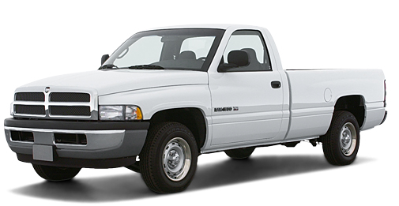
Transportation Case Study
Data
Maxine negotiated the price of a car with a dealer and now wants to decide whether she should lease or buy the car.
  Manufacturers Suggested Price (MSRP) $25,000
  Negotiated cost/Capitalized cost 22,000
  Down Payment 2,000
  Lease Term and residual 3 Years, 55%
  Fees: Acquisition $500, Registration $150, License $35, Documentation $200, Termination $300
  Rent charge and Loan rate (APR) 8.35%
  Sales tax 6.25%
Calculations
  Help her decide based solely on costs. She will pay cash for the down payment, taxes on down payment, and fees but will finance the remainder (including other taxes). Assume the value at term end is the residual value (The Lease versus Buy Analysis (LT22) may be helpful to check your work)

Slide 5
A. Understand Key Areas and Principles of Auto Ownership
There are a number of important topics to understand before we discuss buying or leasing new or used vehicles. These include:
  1. Choosing a vehicle
    a. Goals and Budget
    b. Vehicle Safety
    c. Vehicle Reliability
    d. Insurance and MPG
  2. Before You Go Looking
    a. New/Used Vehicle Prices
    b. Holdback
    c. Warranties
    d. Service Contracts
    e. Lemon Laws
  3. After You Have Found It
    a. Vehicle History
    b. Checked by a Mechanic
    c. Maintenance records

Slide 6
1.a. Choosing a Vehicle:
Know Your Vision, Goals and Budget
Know your vision, goals and budget
  Do you know your auto vision, goals and budget?
    Does your car fit your budget, or your budget fit your car?
      If you are planning to finance the vehicle (not recommended), are there sufficient funds to cover the costs and still attain your other goals
      Are you putting aside money each month to purchase another vehicle in the future

Slide 7
b. Vehicle Safety
Pick a vehicle that is safe for your family
  Where do you find information on vehicle safety and ratings?
    There are a number of good sites. A good place to start is the National Highway Traffic Safety Administration site at www.nhtsa.gov, safer cars at www.safercar.gov, and the Insurance Institute for Highway Safety at www.iihs.org

Slide 8
c. Vehicle Reliability
Pick a vehicle with a good repair record
    If the vehicle has a reliable record, there is a better chance you will not have unforeseen expenses
  Where do you find safety and repair information?
    You can find good information at Consumer Reports on new and used vehicles at www.consumerreports.org.

Slide 9
d. Insurance and MPG
Pick a vehicle inexpensive to insure and drive
  The Insurance Services Office (ISO) rates each vehicle on its loss history, with a number 3-27
    The higher the number, the more expensive the coverage. Sports cars, high performance cars, and SUV’s are expensive to insure
  Which vehicles are more expensive to drive?
    Check the miles per gallon in the city and highway

Slide 10
2. Before You Go Looking: a. New versus Used Prices
Your choice of new versus used vehicles will depend on three areas:
  Goals, preferences, and budget
    New
      Advantages: New vehicle and all that goes with it, lower maintenance costs, fewer miles
      Disadvantages: Higher initial vehicle and insurance costs, and may limit other goals if spend too much
    Used
      Advantages: Lower initial vehicle and insurance costs, and may help with other goals
      Disadvantages: Higher maintenance costs and higher miles

Slide 11
New Vehicle Prices
New: Know the dealer’s invoice price
  There are a number of automobile websites where you can get estimates of what the dealer paid new from the manufacturer, i.e., www.edmunds.com, www.autosite.com, or www.kbb.com.
      Put in the manufacturer, model, and options and you can get the invoice price
  You can generally find the same information on used cars just as you do new cars. Key sources include www.edmunds.com, www.autosite.com, www.kbb.com, www.nada.com or www.vehix.com.
    With used cars, you must include the vehicle condition

Slide 12
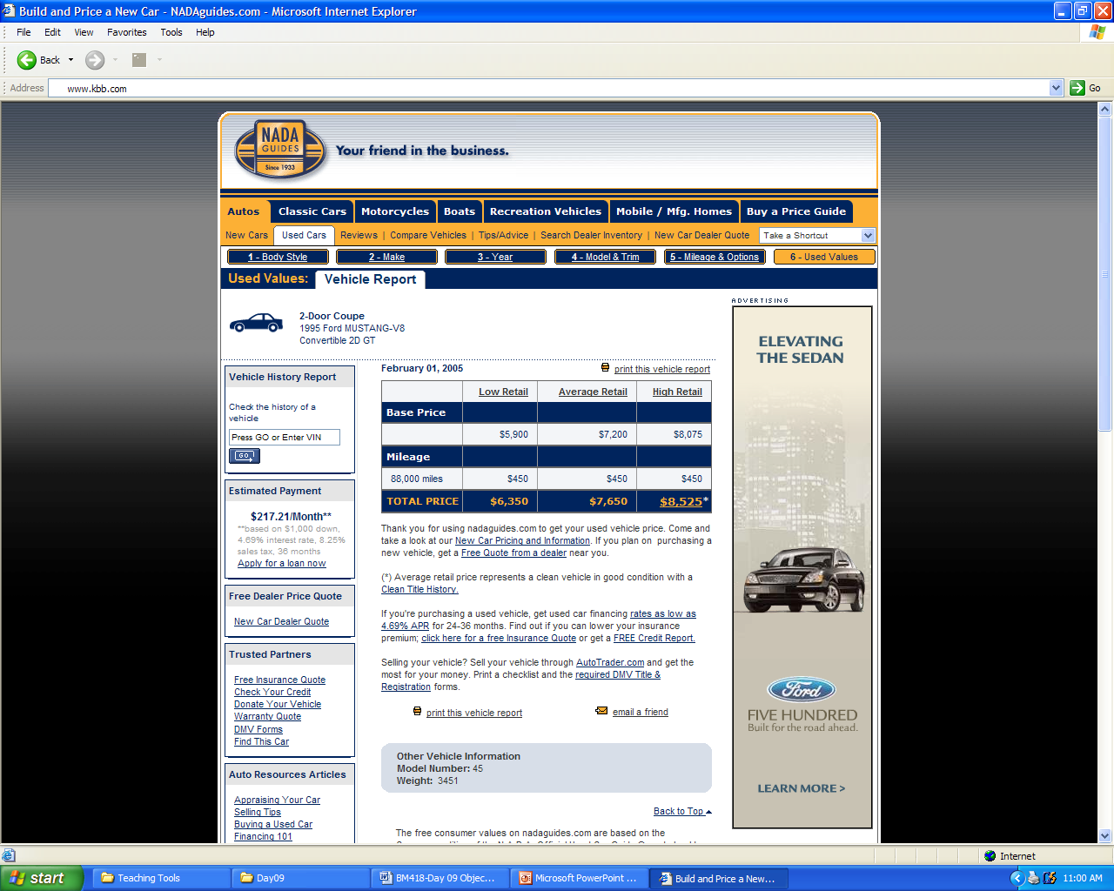
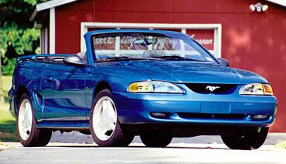

Slide 13
b. Holdback
Know the dealer Holdback
  What is a holdback?
    The holdback is a rebate to the dealer to compensate the dealer for holding the vehicle on his lot. Information on holdback is found at many different sources, including: http://www.edmunds.com/advice/incentives/holdback/
  Why is this important?
    It is important for you to realize that even when the dealer sells a vehicle at this cost, he is still making money

Slide 14
c. Warranties
Know the warranty and period
  What are warranties?
    Warranties are assurances that goods are as promised and that any problems will be resolved
  What are full warranties?
    Full warranties are contracts that require:
      1. Product will be fixed at no cost to the buyer within a specified time
      2. Owner will not have to undertake unreasonable tasks to return the product
      3. Defective product will be replaced or money returned if it cannot be fixed

Slide 15
d. Service Contracts
Know available service contracts and providers
  What are service contracts?
    Agreements between the contract seller (dealer, manufacturer, etc.) to provide free (or with a deductible) repair services to covered components specified length of time or mileage after the original warranties are over.
  What should you be concerned about?
    Contract terms: Items covered (power-train), length of coverage (i.e., 5 years), and mileage Contract seller: Who stands behind it. Generally service contracts from the manufacturer are better as you can get service nation-wide

Slide 16
e. Lemon Laws (Consumer Protection)
Know your rights as a consumer
  What are lemon laws?
    Laws established to protect the consumer in case the vehicle purchased is a “lemon”
  How do you know if you have a lemon?
    You are still having problems, and you have made:
      4 attempts to fix the problem, and
      The car was out of service at least 30 days during the first 12 months or 12,000 miles
    Take the car back and either get another car or your money back

Slide 17
3.After You Have Found It: a. Vehicle History
Get a vehicle history report
  What is a vehicle history report?
    It is a record of each and every time the vehicle was registered with a different owner in the records of the state
  How can you get a copy of a vehicle history?
    You can go to www.carfax.com. By putting in the Vehicle Identification Number (VIN), you can get a report as to the ownership and location of a vehicles history.

Slide 18
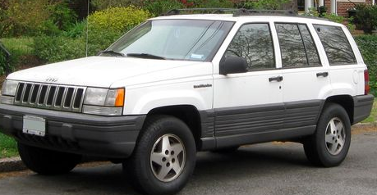
b. Inspection by a Good Mechanic
Get the vehicle checked by a qualified mechanic
  How do you get it checked?
    Take it to a qualified mechanic, preferably from a dealer for a major checkup
      While it may cost between $80-250, it will be worth it if they find problems

Slide 19
c. Service Records
Review the service records of the vehicle
  How do you check service records?
    Sellers should have a copy of all service performed on the vehicle
      Consumers should keep a record of all service performed
      Dealers, oil change places, etc., often have records of when service was performed
  Vehicles which have good service records were likely better taken care of than those without, and as such, command a higher premium

Slide 20
Principles of Effective Auto Ownership
Why is the auto decision so difficult?
  The reality is that this is an extremely complex (not just dollars and sense) decision as it:
    Has lots of options for potential vehicles
    Has much uncertainty over future costs
    Reflects our self-image
    Signals to others how successful we are
    Makes a statement about our lifestyle
  The ideal is a safe and reliable means of transportation that you have saved for and can afford

Slide 21
Areas and Principles (continued)
What happens when the self-image, signals, or statements becomes more important than our personal vision and goals
  We spend more than we should
  The costs get in the way of our more important vision and goals, reducing our chances of achieving them
  It relegates more important goals to a lesser position

Slide 22
Principles of Auto Ownership (continued)
What are the principles of effective ownership?
  1. Understand yourself, your vision and goals
  2. Seek, receive and act on the Spirit’s guidance
  3. Understand the key areas and costs of vehicle ownership
  4. Make your vehicle fit your budget, not your budget fit your vehicle
  5. Understand and minimize all costs, for purchase, fuel, repair, taxes, insurance, depreciation, and resale value over the car’s effective life—keep it running
  6. Be a wise steward over your vehicle

Slide 23
Areas and Principles (continued)
Finding balance
  Guiding Principles Doctrines
  Understand yourself, vision and goals Identity
  Seek, receive and act on Spirit’s guidance Obedience
  Understand key areas & costs of ownership Stewardship
  Make vehicle fit budget, not vice versa Agency
  Minimize all costs over the car’s useful life Stewardship
  Be a wise steward over your vehicle Stewardship

Slide 24
Areas and Principles (continued)
  From obedience to consecration
  I am a child of a loving Father in Heaven (identity), striving to live worthy of the Spirit (obedience), learning to be a wiser steward over the things God has blessed me with (stewardship). I am striving to understand the costs and benefits of my different transportation options (agency), choose good vehicles, minimize costs, maintain them well, and keep them my predetermined amount of time so I can accomplish my personal mission and my individual and family vision and goals.

Slide 25
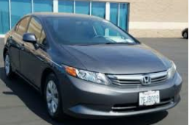


Questions
  Any questions on the key areas and principles of auto ownership?
    Are there better ways to buy a vehicle?
2012 Honda Civic
Wasarut’s Kia
Matt’s email

Slide 26
B. Understand how to Buy/Lease a Vehicle
General Guidelines (the process):
    1. Know the terminology
    2. Narrow your choices and pick your vehicle
    3. Determine your total price and negotiate for it
    4. Determine how to finance the purchase (lease or buy)
    5. Enjoy your purchase and keep it well maintained

Slide 27
1. Know the Terminology
  MSRP
    Manufacturers hoped for price
  Capitalized cost
    Your agreed to or negotiated cost
  Capitalized cost reduction
    Any reductions in cap. cost, such as rebates, down payment, dealer incentives, trade-in, etc.
  Net capitalized cost (also called adjusted capitalized cost)
    Capitalized cost less capitalized cost reduction
  Residual value
    Expected value of the vehicle at term end
  Lease term
    The number of months the vehicle is leased

Slide 28
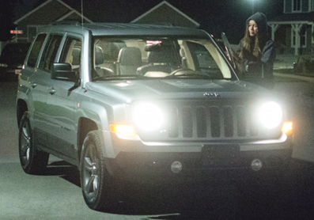
2. Narrow Your Choices and Pick your Vehicle
Comparison shop by price, product features, and quality
  Be informed. Check library and Web sources
Look at the alternatives
  Fit your car to your budget—Include all maintenance, insurance and repair costs
  Calculate your payments if you must finance it
Determine what is available in your price range.
Test-drive the exact vehicle you are considering.

Slide 29
3. Determine your Total Price and Negotiate
Before you begin negotiations, determine how much you can spend
  Identify the car(s) you are interested in
    Do your homework and find the dealer’s cost (including all your options) plus:
        Rebates
        Holdback from manufacturer
        Dealer invoice
    Send out notices to all your dealerships in your area, with their best “out the door” price (have your financing, if needed, secured)

Slide 30
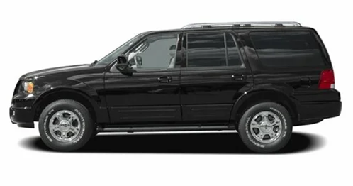
Negotiating Recommendations (continued)
Start negotiations at below dealer’s invoice
  See what they say they paid for the vehicle (invoice) and what price they want “out the door”
    Dealer inventory often impacts difference between invoice and MSRP (demand & supply)
    Date often affects dealers willingness to deal. End of month and end of year are good times
  If their deal is the best, then take it
    If not, show them your best deal from your emails and ask your local dealership to beat it by $100-300. Most of the time they will

Slide 31
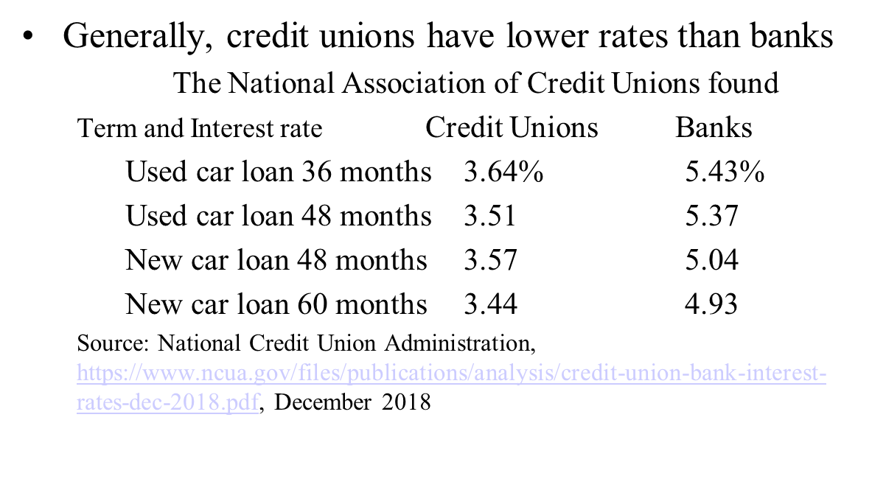
Your Purchase (continued)
If financing the vehicle:
  Ideally, get approved for the financing before you go shopping for the vehicle
  Determine the term of the loan and find the most attractive rate
  Go with dealership financing only if they can beat the best rate other places and you are approved on the spot.

Slide 32
5. Maintain Your Purchase
Read the owner’s manual and perform regular maintenance
  Particularly do oil changes every 3-5,000 miles
  Don’t ignore warning signals.
    You do at your peril!
  Choose a good garage; check training and experience

Slide 33
Questions
Any questions on general guidelines on buying a new vehicle?

Slide 34
C. Understand the Leasing versus Buy and How to Calculate Lease Costs
Leasing Challenges
  There may be a place for leasing, particularly if your business can expense your lease costs. Monthly costs are cheaper; however, for most people:
    It generally costs more due to higher interest costs
    Once in the leasing habit, payments go on forever
    You have fixed mileage, with high costs if go over
    You must maintain vehicle in good condition
    At the end of contract you do not own the car
    There are extra fees and leasing profits are hidden
    There are high early termination penalties and fees if you return it early

Slide 35
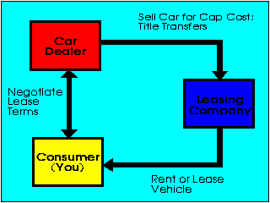
Leasing Costs (continued)
1. Negotiate the price and the lease type first!
  MSRP: $22,000
  Negotiated Price: 20,000
Closed-end (or walk away) lease: As long as vehicle is clean and taken care of, you owe nothing at lease end.
Open-end lease: If lender cannot get the amount estimated, borrower must pay the difference

Slide 36
Leasing Costs (continued)
2. Select the Lease Term (the schedule)
  Select 3 years with 57% residual value

Slide 37
Leasing Costs (continued)
3. Calculate Residual Value
  Auto Residual Guides
    Kelly Blue Book (kbb.com) and Edmunds (edmunds.com)
  Important parameters
    Year, make, model and options of auto
    Term of lease (3 years) and MSRP
    Apply residual % to MSRP for residual value
      $22,000 MSRP
      x .57 Residual ratio (3 year lease)
  $12,540 Residual value

Slide 38
Leasing Costs (continued)
  4. Calculate Lease Costs (4 major costs)
  MSRP: $22,000, Negotiated cost (Net. Cap. Cost) $20,000, Residual Value: 57%, 3 Year Term, Rent Charge 6.0%, Taxes 6.25%, Taxes, tags and license: $250, Acquisition fee: $300, Termination fee: $300
  1. Fees: There are both front- and back-end fees
    Front-end: Taxes and tags: $250
    Acquisition: $300
    Back-end: Termination fee: $300
    These are added to get your Net Capitalized Cost

Slide 39
  MSRP: $22,000, Negotiated cost (Net. Cap. Cost) $20,000, Residual Value: 57%, 3 Year Term, Rent Charge 6.0%, Taxes 6.25%, Taxes, tags and license: $250, Acquisition fee: $300, Termination fee: $300
  2. Usage (or depreciation)
    Usage is the amount of the value of the vehicle that is used over the lease life. It is calculated by taking the net cap cost (NCC) less the residual value (RV)
      $20,000 - $12,540 = $7,460 total
      $7,460 / 36 months = $207.22 per month

Slide 40
  MSRP: $22,000, Negotiated cost (Net. Cap. Cost) $20,000, Residual Value: 57%, 3 Year Term, Rent Charge 6.0%, Taxes 6.25%, Taxes, tags and license: $250, Acquisition fee: $300, Termination fee: $300
  3. Interest (or finance costs)
    (Net capitalized cost+residual)*money factor (APR/24)
      It is the average amount borrowed times the monthly interest rate: (Net cap. cost + residual) / 2 times average interest rates: APR / 12
      ($20,000+$12,540)/2*.06/12)= $81.35 per month
      $81.35 * 36 months = $2,928.60 total
  4. Taxes (or government costs)
    Taxes are (Usage + Interest) * tax rate
      ($7,460 + $2,928.60) * .0625 = $649.29 total
      $649.29 / 36 = $18.04 per month

Slide 41
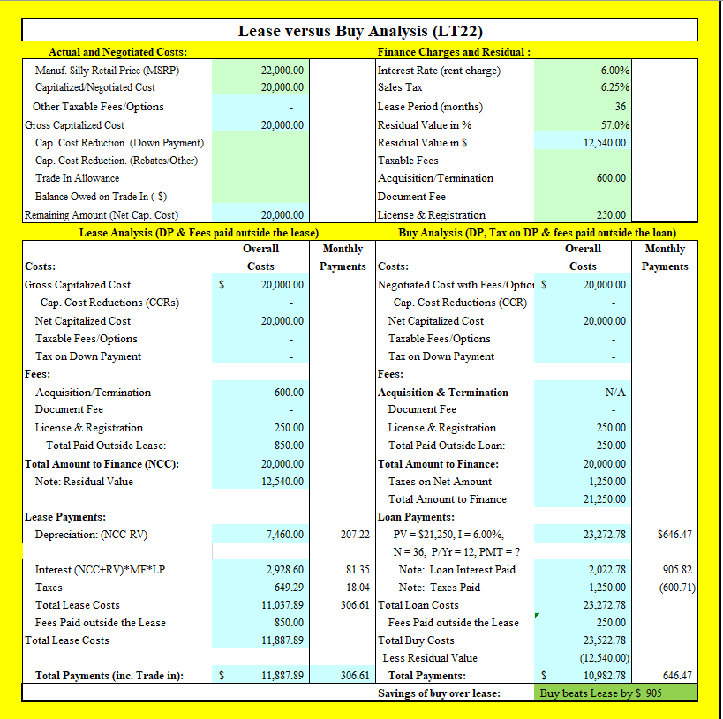
Questions
Any questions on the challenges of leasing and calculating lease costs? (Use LT22 to check your work)
?

Slide 42
E. How to Develop a Transportation/Toy Plan
What happens if you don’t think through the auto decision and have a strategy?
  You borrow, and pay interest instead of earn it
  You get in the habit of buying/leasing a car on credit, so you pay interest and find it difficult to fund your other important goals
  It’s not in your budget or is more than you planned, so it relegates important goals to a lesser position
  You buy a new car too often, and so you pay too much for expensive depreciation, insurance and other costs which limits your other goals

Slide 43
Transportation/Toy Plan (continued)
Vision
  Likely from your Plan for Life
Goals
  Budget: Ensure the auto fits the budget, not the budget fits the auto
  Vehicle age: Keep your cars for 10 years or 200,000 miles whichever comes first
  Maintenance: Be diligent in oil changes every 3-5,000 miles and do the recommended maintenance
  Financing: Pay cash for all vehicles
  New car purchases. We will buy used vehicles until our net worth is >$750,000

Slide 44
Transportation/Toy Plan (continued)
Plans and Strategies
  Before you buy a vehicle, check out the vehicle thoroughly
  Budget for all costs, including purchase, fuel, maintenance, and insurance
  Purchase new vehicles 1-2 years old with less than 24,000 miles, then buy the 100,000 extended warranty at $150 over invoice
  Spouse gets the newer vehicle
  Once you have a vehicle, save a specific amount each month for purchase of your next vehicle when this vehicle dies

Slide 45
Transportation/Toy Plan (continued)
Constraints
  We buy a new vehicle only after we have a $500k in net worth; and spouse gets the newer and safer car.
  The value of all toys and vehicles will not exceed 50% of annual income (Dave Ramsey)
Accountability
  From your Plan for life

Slide 46
Transportation/Toy Plan (continued)
What are toys?
  Toys are adult vehicles that are not necessary for transportation yet still may be important for individual and family recreation and goals
    These include boats, motorcycles, ATVs, SxSs, jet skis, bikes, trailers, RVs, etc.
  What happens without a Toy Plan?
    You can spend significant amounts of resources on things that are not consistent with your personal and family goals and at the wrong time in your financial life

Slide 47
Transportation/Toy Plan (continued)
Vision
  From your Plan for Life
  Other ideas include:
    Toys give experiences to bring family together
Goals
  We will pay cash for all toys only after saving 20%
  Our first toys will be bikes, then tents, camping equipment, then perhaps a small ATV for the kids.
  As net worth increases, we may purchase a trailer and larger ATVs consistent with our budget and savings
  We will purchase good toys with available spare parts

Slide 48
Transportation/Toy Plan (continued)
Plans and Strategies
  We will buy good equipment with available parts so we can keep toys running more than 20 years
  We will keep all toys 20 years, and do all recommended maintenance so they will last
  We will stay within annual budgeted amounts for toys, including fuel, maintenance and insurance
  We will not allow others to use toys unless they take good care of them so they will last our required 20 years

Slide 49
Transportation/Toy Plan (continued)
Constraints
  We will keep close to the Spirit so we are not enticed by the trappings of the world to spend more
  We will buy toys only if we are reaching our savings and budget goals.
  Accountability
  From your Plan for Life

Slide 50
Review of Objectives
A. Do you understand how a car fits into your financial plan and principles?
B. Do you understand the process of how to buy or lease a vehicle?
C. Do you know how to make the lease versus buy decision?
Do you know how to put together your auto/toy strategy?

Slide 51
Case Study #1
Data
Maxine negotiated the price of a car with a dealer and now wants to decide whether she should lease or buy the car.
  Manufacturers Suggested Price (MSRP) $25,000
  Negotiated cost/Capitalized cost 22,000
  Down Payment 2,000
  Lease Term and residual 3 Years, 55%
  Fees: Acquisition $500, Registration $150, License $35, Documentation $200, Termination $300
  Rent charge and Loan rate (APR) 8.35%
  Sales tax 6.25%
Calculations
  Help her decide based solely on costs. She will pay cash for the down payment, taxes on down payment, and fees but will finance the remainder (including other taxes). Assume the value at term end is the residual value (The Lease versus Buy Analysis (LT22) may be useful for this type of problem)

Slide 52
MSRP 25,000, Negotiated/Capitalized Cost 22,000, Down Payment 2,000, Lease Term and residual 3 Years and 55%, Fees: Acquisition $500, Registration $150, License $35, Documentation $200, Termination $300, Rent charge and Loan rate 8.35%, and Sales tax 6.25%.
  Solution: Cost of Leasing
    Down Payment and fees $2,000
      Taxes on Down Payment (2,000*.0625) 125
      Fees (Acq + Reg + Lic + Doc+ Term) 1,185
        Total Paid Outside the Lease $3,310
    Total Lease Payments:
      1. Usage: [20,000 – 13,750 (55% of MSRP)] $6,250
      2. Interest: (Average outstanding * average rate)
      [(Net Cap. Cost + Residual) * Money Factor]
      (20,000 + 13,750) / 2 * .0835/12 * 36 months) 4,227
      3. Taxes: (6,250 + 4,227)*.0625 655
      Total lease payments of $11,132
    Total Cost of Leasing (DPF+LP) $14,442
      Monthly lease cost: 11,132 / 36 = $309.22

Slide 53
MSRP 25,000, Negotiated/Capitalized Cost 22,000, Down Payment 2,000, Lease Term and residual 3 Years and 55%, Fees: Acquisition $500, Registration $150, License $35, Documentation $200, Termination $300, Rent charge and Loan rate 8.35%, and Sales tax 6.25%.
  Solution: Cost of Buying
    Down Payment and fees $2,000
      Taxes on down payment 125
      Upfront Fees (Reg. + License + Doc.) 385
        Total Paid Outside the Loan $2,510
  Remaining Amount $20,000
    Remaining taxes (20,000)*.0625 1,250
    Total Amount to Finance including taxes $21,250
    Total Payments over holding period
    -21,250 PV, 8.35%, 36 N, PMT=669.33*36 24,096
    Total Cost of Vehicle (Financed + DP + fees) $26,606
    Market value of car at end of the loan (residual) (13,750)
    Total Cost of Buying DP+UF+TP+T-MV $12,856
      Monthly Purchase Payment $669.33

Slide 54
MSRP 25,000, Negotiated/Capitalized Cost 22,000, Down Payment 2,000, Lease Term and residual 3 Years and 55%, Fees: Acquisition $500, Registration $150, License $35, Documentation $200, Termination $300, Rent charge and Loan rate 8.35%, and Sales tax 6.25%.
  Maxine makes this decision based solely on costs:
    They are: Lease Buy
    Total Cost $14,442 $12,856
    Monthly Cost 309 669
      Buy versus Lease Savings $1,586**
    **Why the Differences
      Acquisition/Term. $800⁽¹⁾ $0
      Taxes $654⁽²⁾ 1,250
      Interest 4,227 2,846⁽³⁾
      Total $5,682 $4,096 ($1,586)
    ⁽¹⁾ Some fees for leasing but not buying, so the advantage is for buying
    ⁽²⁾ Taxes are paid on borrowed amount, and leases you borrow less, so advantage leasing
    ⁽³⁾ Interest is paid only on unamortized amount, and buying amortizes faster, so advantage buying

Slide 55
  MSRP 25,000, Negotiated/Capitalized Cost 22,000, Down Payment 2,000, Lease Term and residual 3 Years and 55%, Fees: Acquisition $500, Registration $150, License $35, Documentation $200, Termination $300, Rent charge and Loan rate 8.35%, and Sales tax 6.25%.

Slide 56
Case Study #2
Data
Andrea is considering the costs of owning a vehicle valued and sold for $30,000. Auto Loan Amount: $30,000, Duration: 4 years, APR: 8.65%
  Property taxes: 2% of the vehicle value per year
  Sales Taxes: 3% of the sales price
  Title and Tags: $40 per year
  Maintenance and Usage Costs: $1,500 per year
  Insurance: $2,000 per year
Calculations
Calculate the total first year cost of ownership.

Slide 57
Case Study #2 Answer
$30,000 4 years APR 8.65% will have payments of $741.58 x 12 =
  $8,898.91 payments in year 1
  $600 Property Tax
  $900 Sales Tax
  $40 Title/tags
  $1,500 Maintenance/usage
  $2,000 Insurance
  $13,938.91 for the total cost for the first year
  Note: If you include your sales tax in the loan, the payment is $30,000 * (1.03) = PV = $30,900, N = 48, I = 8.65, PMT ? = $763.82 * 12 = $9,165.87

Slide 58
Case Study #3. How to you Buy A Used Auto?
Note: This section was originally in my slides, but I never had time to get to them. I include them here, as a problem for those who are interested. Please talk with me if you have any questions
Key questions to ask on buying a used car:
  1. Can I afford this car?
    Will it fit into my monthly budget? Is it a need?
  2. Does it meet my current driving needs?
    What type of driving you do? Shop for a car that meets your needs and driving patterns
  3. Will it meet my future needs?
    Consider how you will feel about this car a year or two from now? Will your family be growing?
  4. Does it meet my preferences?
    Gas mileage, sedan/SUV/truck, 2-door/4-door, safety?

Slide 59
Getting the Best Deal
The cost of a vehicle is based on its reliability, performance and popularity
  Of course you want a car that is reliable and performs well. But do you want the same used car everyone else wants?
    If so, you will pay a premium for it. In some cases, the only difference is the nameplate
    Check reliability at www.consumerreports.com

Slide 60
If You Must Finance the Car
I do not recommend financing a vehicle!
  This is not a preferred method—don’t borrow
  But if you must:
    Get your financing approved beforehand from a credit union or other financial institution
      Do not use in-house financing unless you get special deals (0% financing) or unless it is very competitive
        Make sure you read the fine print completely!

Slide 61
Getting Used Car Financing
If you must borrow, there are several different lenders available for funding a dealership used car loan
  Banks and credit unions
    This is generally the cheapest form of borrowing (after parents)
    Banks will typically only finance a car that is less than five years old
  Auto Dealerships.
    Dealerships will consistently have the worst interest rates because they are selling you their services

Slide 62
Financing a Used Car (continued)
When looking for a lender, it is also important to consider the maximum length of the loan
  The good news is that most banks have 60-month programs for late used models
  However, the older the vehicle, the less likely it will sustain for a full 60 months
    In general, the older the vehicle, the shorter the loan length. An older vehicle is not good collateral for a loan.
    I recommend loans of 36 months or less

Slide 63
Sources of Used Cars
The three most common places from which you can buy used cars are the following:
  1. Private parties
    Generally the most reasonable prices, but no warranty
  2. New car dealerships
    Some may be backed by warranties
  3. Used car lots
    May be run by rental car agencies.
    Sometimes no haggle buying, competitive prices, and perhaps the factory warranty may still be in effect

Slide 64
Locating Good Used Cars
Do your research -- leave no stone unturned
  Ask friends, relatives (you will know more about history of vehicle)
    Watch for cars with “For Sale” signs
  Watch newspaper classifieds, bulletin boards, etc.
    Generally, closer is better
  Use Internet sites:
    KSLclassified.com
    AutoTrader.com
    Classifieds2000.com
    Usedcars.com

Slide 65
1. Call Before You Go See a Car
Create and use a form when calling-- ask key questions. Verify the:
  The price in the ad (ask again as they may have lowered the price since the date published)
  Number of miles, number of owners
  How often oil was changed (ask for receipts)
  What is the blue book or recommended price
If it doesn’t fit your criteria or the seller seems uneasy answering questions, skip the visit and keep looking!

Slide 66
Ask and Verify Key Information
To verify previous owners
  Use www.Carfax.com
    $20 for a two month subscription
    Check out every potential vehicle as to previous owners and locations via its VIN.
To verify current value
  Use Edmunds.com, KBB.com (Kelley Blue Book), or superpages.com
  Agree as to the quality of the vehicle, i.e. excellent, good, etc. before you come to visit so you can verify a fair price

Slide 67
2. Go see “The Car”
Note your first impressions
  Does the car appear to be well cared for? Examine for rust. Beware of newly painted cars, as this may be a cover-up for more serious damage
  Are there considerable dents, mismatched paint areas, or poorly fitting parts? Make sure there are no ripples in door panels, as this indicates previous accidents
  Check for body filler. Use a refrigerator magnet on suspicious spots to test for auto-body filler
  Look inside the car for wear and tear on the seats and pedals. Make sure it is consistent with the mileage on the odometer

Slide 68
Check Out the Car in Person
Check the underside and tires
  Look underneath for evidence of fluid leaks such as coolant (greenish), oil (black), transmission fluid (pink), or gasoline (identified by smell)
  Take a look at the tires. A tread that’s uneven to one side is a sign of poor alignment or balance
  Check CV joint boots on either end of front axles. These are expensive to replace
  With 4-wheel drive vehicles, make sure all 4 tires are the same brand, size, and type
  Tires must be same size (and same brand if 4 wheel drive). Insist on a spare, jack, and lug wrench with the deal

Slide 69
Check Out the Car (continued)
Check under the hood
  Look for mismatched bolts or offset paint. This may mean a front-end accident
  Look at the underside of the hood. A sprayed black film on the underside usually means oil leaks
  Examine the engine belt for wear. Use judgment as if it breaks, you will have to pay to repair it
  Look for leaks and other things out of place

Slide 70
Check Out the Car (continued)
Perform gauge and listening tests
  Make sure no emergency gauge lights are on when the engine is running
  Does the car start right away? Listen for unusual noises
  Wipe the inner surface of the tailpipe with a rag: white or gray dust is normal. Thick, greasy soot means the car burns a lot of oil—this can be serious
  Most of you are not mechanics, but look for potential problems anyway

Slide 71
Check Out the Car (continued)
Check the oil, brake, and transmission fluid
  Are levels ok?
  Take out the transmission dip stick. Does the fluid smell burned?
  Does it look like they just changed all the fluids? It may indicate that there is a problem
  Check the oil level. A low level may indicate either a leak or an owner who didn’t care much or know much about the car

Slide 72
Check Out the Car (continued)
Check the shock absorbers and lights
  Bounce the car up and down at each corner. (when you release it, you should not feel it bounce back more than twice)
  Test all lights: brake lights, headlights, reverse lights, turn signals, etc.

Slide 73
Check Out the Car (continued)
Check for play (the amount that a part can move before it engages)
  Check for play in the steering wheel, clutch, and brakes
  Hold brake pedal down as far as possible for 45 seconds. If they don’t hold firm, there may be a leak
  Push the top of one rear tire toward the car. If it moves too much, there may be bearing problems

Slide 74
3. Go for a Test Ride
Take it for a drive personally
  How does it feel? How does it fit?
  Evaluate the acceleration from a stop. Does it hesitate or accelerate as it should?
  Check engine noise, passing acceleration, hill-climbing power, braking, cornering, suspension, seat comfort
  Check for rattles and squeaks, interior controls, and the audio system. Play the radio, tape deck, CD player, etc.

Slide 75
4. Take the Car to a Qualified Mechanic
Get a more complete inspection
  Choose a mechanic who regularly works on these cars, generally from the dealer. Other mechanics may be only guessing as to problems
    Dealers may also have the car history on their computers
  Have mechanic do a compression check and check for oil and fluid leaks
  For automatic transmissions, take the car to a transmission specialists to check out the transmission

Slide 76
5. Negotiate the Deal
Notes on negotiating for a used car
  1. Let the sellers know you have the cash in hand. Cash does wonders for an agreement
  2. Know the fair value for the car beforehand from KBB.com or other website
  3. Negotiate politely!
    If the price is too high, have a persuasive argument to support it, KBB.com says____
      a. It needs some work from ________
      b. The body or paint doesn't justify the price of ________
      c. You have seen lower prices elsewhere in the market (and show screen shots)

Slide 77
Negotiate the Deal (continued)
If you just want to test their price:
  a. The car isn't exactly what you are looking for, but for a lower price you might be interested
  b. The car is worth the price, but you can only afford a lower price (budgetary constraints)
Make an opening offer that is low, but in the ballpark
  Expect to spend an hour negotiating
    Don’t be afraid to walk out if you are not getting anywhere
    You don’t have to buy this car!

Slide 78
Tips for Negotiating
Important Tips
1. Pray for guidance and listen to the spirit
2. Only enter into negotiations with a salesperson you feel comfortable with and who can deal
3. Negotiate the “out the door” price if at dealerships
4. Decide ahead of time how high you will go and walk out when you reach this price
5. Leave if you get tired or hungry or feel pressured -- don't be hurried into a decision
6. Don't be distracted by pitches for related items
7. Expect a “closer” to try to sell you more things before you reach a final price—don’t succumb

Slide 79
Closing the Deal: At a Dealership
The financing and insurance person will probably try to sell you a number of additional items.
  Most (if not all) of these you don’t need!
Review the contract thoroughly:
  Ask questions about anything that dramatically increases the price. You will also be asked to provide proof of insurance before you drive away in your used car.
Finally, you should inspect the car before you take possession of it
  If any work is required or promised by the dealer, get it in writing in a "Due Bill."

Slide 80
Closing the Deal: Private Sale
Before money changes hands, make sure you will be able to register the car in your name
  No registration means no deal
Request the title (sometimes called the "pink slip") and have it signed over to you.
  No title means no deal
  One way to deal with the seller still owing money on the car is to conclude the sale at the bank where the title is held
Once all of the paperwork is complete
  Relax and begin enjoying your new purchase: a good used car

Slide 81
6. Finance the Used Car (not recommended)
If necessary, finalize the financing from your bank or credit union
  Make sure you understand exactly what you are getting into before you sign
    Once you sign, you have committed yourself
  Try not to get into the habit of buying cars on credit

Slide 82
7. Take Care of Your Car
Change the oil every 3-5,000 miles
  Wash and clean it often
  Get the recommended tune ups and care
  Rotate the tires every 5,000 miles
  Drive it and take care of it like you want your car to last 200,000 miles—it may!

Slide 83
Addendum
Note: even if you do all the above listed things in buying a used car, there is still the chance that you will have more expenses than you had considered.
  That is one of the risks of buying a used car
However, the closer you adhere to the process explained, the less likely you will have major problems in the future

Slide 84
Useful Auto Websites
Carfax Carfax.com
Intellichoice IntelliChoice.com
Edmunds Edmunds.com
Kelly Blue Book kbb.com
Consumer Reports Consumerreports.org

