Slide 1
Personal Finance: Another Perspective
Cash Management:
Making the Pennies Count
Updated 2020/01/22

Slide 2
Objectives
A. Understand the importance and principles of cash management
B. Understand the different types of financial institutions, and the need to spend the time each week on your finances
C. Understand the different cash management alternatives and how to compare them?
Understand and create your Cash Management Plan

Slide 3

Your Personal Financial Plan
Section VI: Cash Management
  What is your vision and goals for your Cash Management Framework? (use Cash Template TT01-06)
  Include:
    What are you earning on your Savings? What costs/fees are you paying? What are you earning on your Checking? What costs/fees are you paying?
  What Plans and strategies will you use with cash management?
    How many month’s expenses will you have and which assets?
  What are your constraints and accountability?

Slide 4
Case Study
Data
  Bill and Suzy are married, both 25, and will be making a combined $96,000 upon graduation. Bill is in sales, so they consider a 4 month Emergency Fund a priority. They have two priorities:
    1. Ensure they are not loosing too much return to inflation, and
    2. Since Suzy is expecting, they are would like to save for their new child’s education as well.
  Application
    What cash management instruments would you recommend they use given their priorities, and how would you recommend they divide out their Emergency Fund assets?

Slide 5
Understand the Importance and Principles of Cash Management
What is cash management?
  The management of cash and liquid assets to help you meet your personal goals
    It is “a penny saved is a penny earned” as guided by Benjamin Franklin
    It is the process of “we take care of the pennies, and the dollars will take care of themselves” (Anonymous)

Slide 6
Importance and Principles (continued)
How can it help achieve your goals?
  Want to save more money?
    Automate Savings: Pay yourself second and do it through payroll deductions or automatic deposits into your mutual fund accounts
  Want to shorten your time working on finances?
    Use cash management/budgeting software: Use programs such as Intuit’s Quicken or Mint.com
  Want to be a better steward?
    Use electronic record keeping: Perhaps move to an electronic system to keep better records of your finances, i.e., Quicken, Mint, YNAB, etc.

Slide 7
Importance and Principles (continued)
What is an Emergency Fund?
  It is a resource that can be used to meet unexpected needs for cash
  The traditional rule of thumb is for it to be sufficient liquid assets to cover 3-6 months of expenses (I changed it to be the larger of expenses or income to take into account the needs of students)
    You need an emergency fund so you won’t need to tap into long-term money to meet current expenses
Notes:
Is it still wise to have this emergency fund in this world of credit cards and home equity lines of credit?
Yes—perhaps even more so

Slide 8
Importance and Principles (continued)
What are the principles of Cash Management?
  1. Know yourself, your goals, vision and budget
  2. Seek, receive and act on the Spirit’s guidance
  3. Understand the key areas of cash management and develop a plan how you will manage liquid assets
  4. Seek for the highest return in terms of after-tax and equivalent taxable yield, consistent with your safety, interest rate, risk tolerance and liquidity requirements
  5. Monitor and revise your strategy as necessary to meet your changing personal and other conditions

Slide 9
Importance and Principles (continued)
Finding Balance
  Guiding Principles Doctrines
  Know yourself, your vision and goals Identity
  Seek, receive and act on guidance Obedience
  Understand the key areas of C.M. Stewardship
  Seek for highest return (R_{AT} or ETY) Agency
  Monitor and revise as necessary Accountability

Slide 10
Importance and Principles (continued)
From obedience to consecration
I am a child of Heavenly Parents (identity), living as I know how (obedience), using the talents and skills I have been blessed with (stewardship). I have a Plan to be wise stewards over our short-term finances (agency), particularly the small things which can add up over time (accountability), so that I can accomplish my personal mission and my individual and family vision and goals

Slide 11
Questions
Any questions on the importance and principles of Cash Management?

Slide 12
B. Understand Types of Financial Institutions and the Importance of Spending Time with Your Finances
There are two main types of institutions (but the distinction is blurring through deregulation)
    “Banks” or deposit-type financial institutions
    Non-deposit-type financial institutions
  The choice of which one you use depends on which will serve your needs the best

Slide 13
Financial Institutions (continued)
Deposit-type Financial Institutions
  Commercial banks
    Widest variety of services, so generally do not offer the highest rates
  Savings and loan associations
    Slight ownership differences, but essentially similar to commercial banks but higher rates.
  Credit unions
    Similar to above, but since not-for-profit, can offer sometimes higher rates on savings
  Internet or “Net” banks
    Electronic banks with no local network so they have lower costs and can offer higher rates.

Slide 14
Financial Institutions (continued)
Non-deposit Type Financial Institutions
  Mutual fund companies
    You can write checks on your mutual fund account
  Stockbrokerage firms
    You can write checks on your brokerage account
Now both banks and non-banks can offer on-line financial services which allow access to bank balances and some resources 24 hours a day.
  There has been a major blurring of roles between deposit and non-deposit institutions:

Slide 15
Financial Institutions (continued)
Choosing a Financial Institution—the three Cs
  The Cost Factor
    Monthly fees, minimum balance, check charges, balance-dependent scaled fees, rates on savings
  The Convenience Factor
    Location (branches, ATMs), safety deposit boxes, overdraft protection, stop-payment ability
  The Consideration Factor
    Personal attention, advice, attention to detail, FDIC insured, allow Quicken direct-connect
  Note that whatever institution you choose, it is your responsibility to make sure they do what they say

Slide 16
Spending the Time Each Week
Application taxes times
  Realize the importance of spending time each week with your finances
    While technology can help, unless you plan and spend at least 1-2 hours a week planning and evaluating your finances, you will likely not be able to attain with your financial goals.
      Plan the time necessary and use that time wisely

Slide 17
Spending Time (continued)
From the book, the Millionaire Next Door it states:
  People who become wealthy allocate their time. . . in ways consistent with enhancing their net worth. [They] allocate nearly twice the number of hours per week to planning their financial investments as [those who do not become wealthy] do. (Thomas Stanley and William Danko, The Millionaire Next Door, Pocket Books, 1996, p. 71)
Unless you are spending 1-2 hours a week on your financial planning and reporting (i.e., budget, investing, retirement process, etc.), it may be difficult to reach your goals
  Make the decision now to spend the time!

Slide 18
Questions
  Any questions on financial institutions and the importance of spending time each week on your finances?

Slide 19
C. Understand Your
Cash Management Alternatives
There are lots of alternatives, each of which has their benefits and costs
  Traditional cash management assets
    Checking accounts
    Savings accounts
    Money market accounts
    Certificates of deposit
  Less traditional assets
    Money Market and short-term bond Mutual Funds
    U.S. Treasury bills
    U.S. Savings bonds (Series EE/I)
    Note: Graphs are from FRED.org as of 2020/01/20

Slide 20
Cash Management (continued)
Traditional Cash Management Instruments
  Checking accounts (interest bearing)
    Liquidity: Very liquid, daily
    Required minimum balances: low
    Interest rates: Fixed, but minimal, currently .05% to 1.0%
    Safety and Taxes: FDIC insured, all taxable
    Penalties for early withdrawal: No
    Source of information: Bloomberg, banks and credit unions, bankrate.com
    How to invest: contact a bank or other financial institution to set up an account

Slide 21
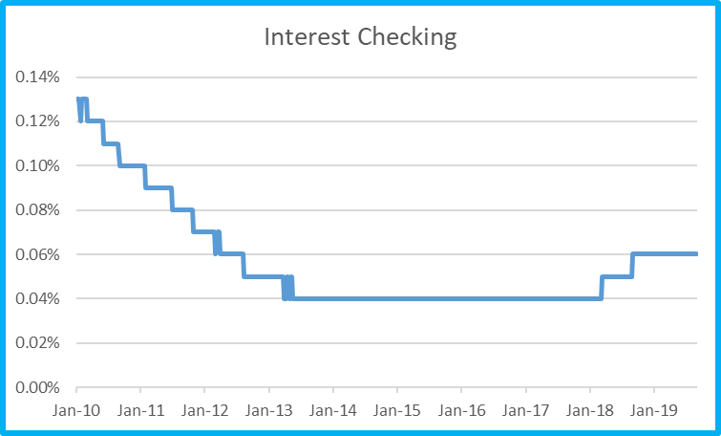
Source: St. Louis Federal Reserve at Fred.org 2020/01/22

Slide 22
Cash Management (continued)
  Savings accounts
    Liquidity: Very liquid, daily
    Required minimum balances: Low
    Interest rates: Fixed, but minimal, currently 0.05% to 2.0%
    Safety and Taxes: FDIC insured, all taxable
    Penalties for early withdrawal: No
    Source of information: traditional and internet banks, savingsaccounts.com
    How to invest: Contact a bank or other financial institution to set up an account

Slide 23
Cash Management (continued)
Money Market Accounts (MMA)
    An alternative to a bank’s savings account
      Liquidity: Very liquid, daily
      Required minimum balances: Higher
      Interest rates: Variable, but higher than savings, 0.25% - .60%
      Safety: Very – FDIC insured
      Safety and Taxes: FDIC insured, all taxable
      Other features: Limited check writing
      Penalties for early withdrawal: No
      Source of information: WSJ, Credit Markets
      How to invest: contact a financial institution

Slide 24
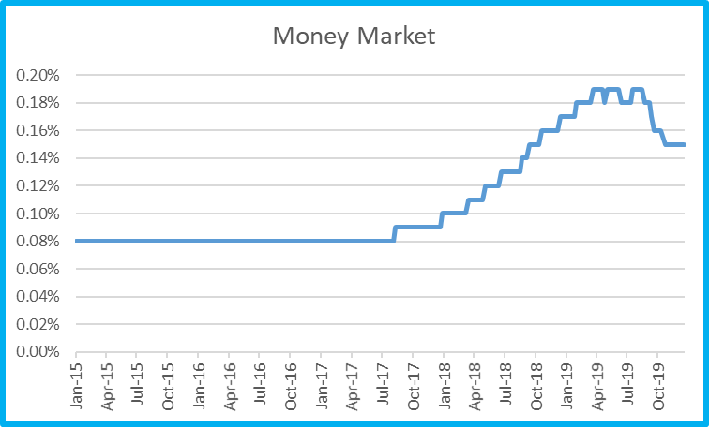
Source: Fred 2020/01/22

Slide 25
Cash Management (continued)
Certificates of Deposits (CDs)
  Pays a fixed rate of interest for a fixed period of time
    Liquidity: Less liquid, generally monthly, depending on maturity
    Required minimum balances: Higher
    Interest rates: Higher rates, 1m 0.10%, 3m 0.19%, 6m 0.34%, 1 year 0.49%, 5 year 0.95%
    Safety: Very – FDIC insured
    Other features: None
    Penalties for early withdrawal: Yes
    Source of information: WSJ Bankrate.com, FRED.org
    How to invest: Contact a financial institution to purchase a CD

Slide 26
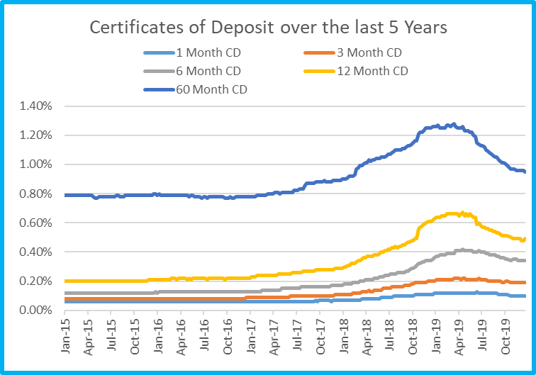
Source: Fred.org 2020/01/22

Slide 27
Cash Management (continued)
Money Market Mutual Funds (MMMFs),
  Pool funds from many investors to buy higher yielding debt securities
    Liquidity: Very, daily
    Required minimum balances: Much higher
    Interest rates: Slightly higher than MMAs
    Safety and Taxes: Not FDIC insured, all taxable
    Other features: Limited check writing, charge administrative fees, bought by the share
    Penalties for early withdrawal: No
    Source of information: Brokers, bankrate.com
    How to invest: contact a mutual fund company to set up an account and purchase a fund

Slide 28
Cash Management (continued)
Short-term Bond Mutual Funds
  Pool funds from many investors to buy higher yielding debt securities, less than 1 year maturity
    Liquidity: Very, daily
    Required minimum balances: Much higher
    Interest rates: Slightly higher than MMMFs
    Safety and Taxes: Not FDIC insured, all taxable
    Other features: Limited check writing, charge administrative fees, bought by the share
    Penalties for early withdrawal: No
    Source of information: Brokers, bankrate.com
    How to invest: contact a mutual fund company to set up an account and purchase a fund

Slide 29
Cash Management (continued)
Note that MM/Short-term Bond Mutual Fund returns may be either taxable or tax-free depending on the type of securities and location of the securities the mutual fund (MF) invests in.
  If the MF invests in only government securities, the interest (not capital gains) is state tax free
  If the MF invests in only municipal securities, the interest is federal tax free
  If the MF invests only in municipal securities from your state, the interest may be both federal and state tax free as well (for states that have state taxes)

Slide 30
Cash Management (continued)
U.S. Treasury Bills
  Short-term, less-than 12 months, government debt
    Liquidity: Somewhat, monthly
    Required minimum balances: Much higher
    Interest rates: 4W 1.52%; 13W 1.54%, 26W 1.56%, 1Y 1.54%, 5Y 1.64%, 10Y 1.84%
    Safety: Very, guaranteed
    Other features: state and local income tax exempt on interest, and purchased at a discount, but don’t accrue periodic interest payments
    Penalties for early withdrawal: Yes
    Source of information: FRED database 2020/01/20 http://www.wsj.com/public/page/news-fixed-income-bonds.html
    How to invest: 3 or 6 month bills can be purchased from www.treasurydirect.gov, banks and brokers

Slide 31
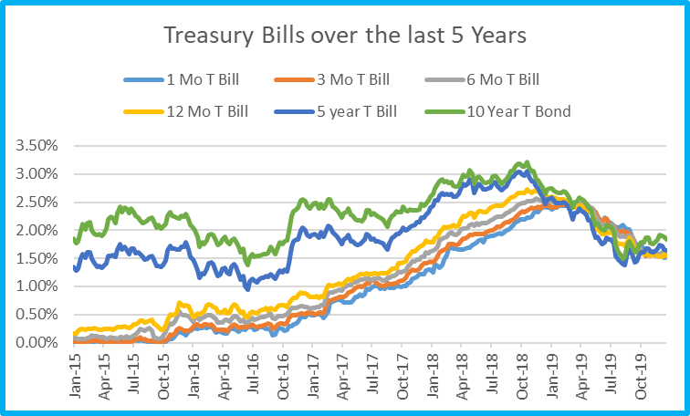
Source: Fred.org 2020/01/22

Slide 32
Cash Management (continued)
U.S. Series EE Savings Bonds
  US government savings bonds
    Liquidity: Only after 5 years. Must hold 1 year
    Required minimum balances: Higher
    Interest rates: Previous rates were variable. Now they are fixed at 0.1% through April 2020
    Safety: Very
    Other features: State and local income tax exempt, interest tax-free if spent on eligible college tuition, sold in $25 to $10,000 bonds
    Penalties for early withdrawal: 3 month before 5 years
    Source of information: www.savingsbonds.gov
    How to invest: Purchase via website, $10,000/ year plus $5,000/year paper bonds from your IRS tax refund

Slide 33
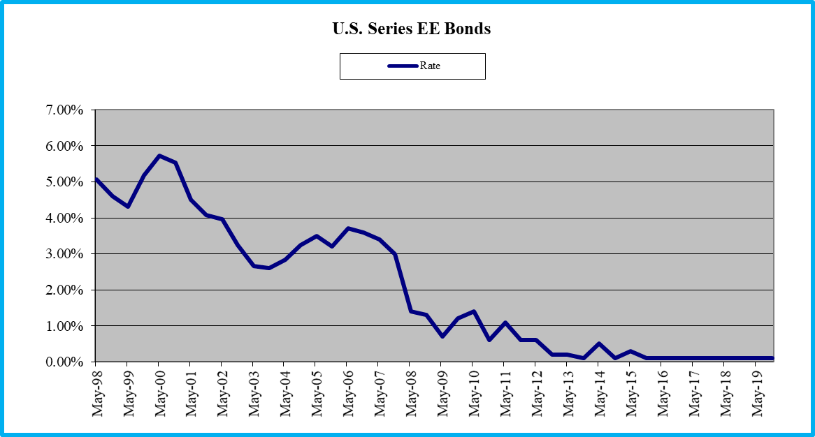
Source: Treasurydirect.org 2020/01/22

Slide 34
Cash Management (continued)
U.S. Series I Savings Bonds (inflation linked)
  US government savings bonds
    Liquidity: Very, after 5 years. Must hold at least 1 year
    Required minimum balances: Minimal ($25)
    Interest rates: inflation linked, 2.22% until April 2020
    Safety: Very, guaranteed
    Other features: Taxed only in year cashed, interest tax-free if spent on eligible college tuition, interest income free from state and local taxation, sold in $25 to $10,000 bonds
    Penalties: Yes, 3 month penalty before 5 years
    Source of information: www.treasurydirect.gov
    How to invest: Purchase via website, $10,000/ year plus $5,000/ year in paper bonds from your IRS tax refund

Slide 35
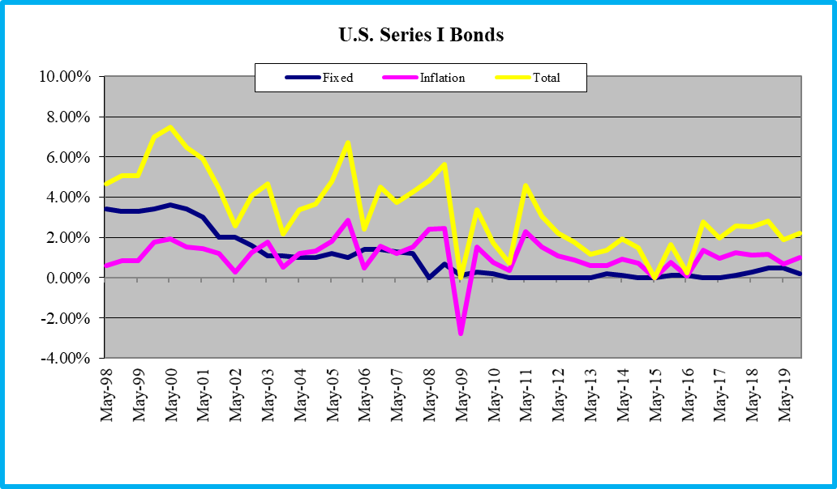
Source: Treasurydirect.org 2020/01/22

Slide 36
US Series EE/I Bond Income Limits
If your Modified Adjusted Gross Income is above specified limits in the year bonds are cashed, you cannot exclude the interest income from your income taxes. The limits are:
Year Filing Single Married Filing Jointly
2016 $77,550-92,550 $116,300-146,300
2017 $78,150-93,150 $117,250-147,250
2018 $79,700-94,700 $119,550-149,550
2019 $81,100-96,100 $121,600-151,600
2020 $82,350- 97,350 $123,350-153,550
Your modified Adjusted Gross Income is your adjusted gross income adding back certain items such as foreign income, foreign-housing deductions, student-loan deductions, IRA-contribution deductions and deductions for higher-education costs (see IRS Form 8815)

Slide 37
Sources of Cash
Management Information
Graphs:
  Bankrate.com (Firefox browser works best)
  http://www.bankrate.com/brm/graphs/graph_trend.asp?
Interest Rate Data:
  Wall Street Journal: Money Rates, Consumer Rates
U.S. Savings Bonds:
  www.treasurydirect.gov
Other Financial Websites
  CNN Money, Yahoo Finance
  BYU Libraries
  Bloomberg

Slide 39
Comparing Cash Management Alternatives
How do you compare different cash management alternatives?
  1. Use comparable interest rates
    Look at the Annual Percentage Yield (APY)
      The APY (similar to the APR), is the yield or return number you should use when comparing different cash management alternatives. It takes into account the effect of compounding
        APY = (1+[APR/Periods])^^{Periods}-1
    Financial institutions are required by law to state the APY which converts the different interest rates into similar compounding periods

Slide 40
Comparing Alternatives (continued)
2. Calculate after-tax returns and Equivalent Taxable Yields (ETY)
  a. Calculate the after-tax return for taxable assets
    After tax return = taxable return * (1- tax rate)
      Tax rate = Marginal (Federal + State + Local) tax rate
  b. Calculate the equivalent taxable yield (ETY) for tax-advantaged assets
    The ETY is the yield that is offered on a comparable taxable bond to give the same after-tax yield as a tax-advantaged security.
      ETY = return after tax / (1 – (marginal tax rate))
  For help, see After Tax ETY (LT26)

Slide 41
Comparing Alternatives (continued)
3. Calculate real returns, i.e., returns after inflation
  Calculate your return after the impact of inflation
    Use the correct formula for calculating real or after-inflation returns
      Real return = (1 + nominal return) - 1
      (1 + inflation)
    If you are calculating after-tax after-inflation returns, your nominal return above would be your after-tax return
    Remember, inflation linked bonds, such as Series I bonds, take into account changes in inflation when determining yields

Slide 42
Comparing Alternatives (continued)
4. Consider safety
  Some alternatives are explicitly or implicitly guaranteed by the government up to $250,000
    Others have no guarantee
5. Consider maturity and interest rate adjustment periods
    Consider the maturity of the instrument
    Consider how often the interest rate could change and the potential impact of those rate changes

Slide 43
Comparing Alternatives (continued)
  Your choice of cash management asset depends on:
    1. Your goals and risk tolerance
      What is the purpose for this money?
    2. The type of asset preferred
      CDs, MMA, MMMF, Savings bonds?
    3. Your tax situation
      What is your marginal tax rate?
    4. The location of the financial assets
      Muni’s from your state?
    5. Your use of the funds
      Used for tuition at a qualified school?

Slide 44
Questions
Do you understand cash management alternatives and how to compare them?

Slide 45
D. Understand and Create Your Cash Management Plan
How to develop a Cash Management Plan?
  1. Decide how many months of expenses you want
    Generally, 3 to 6 months is recommended (which is the time it takes to get another job)
  2. Decide how you will divide your investments between the various cash management assets
    Using a month’s expenses is a good guide
  3. Diversify your cash management assets based on risk and return
    Try to get the highest return at your level of liquidity, safety, and risk
    Using additional assets discussed can help

Slide 46
Your Cash Management Plan (continued)
Vision
  Likely from your Plan for Life
  Other ideas include:
    Have liquidity for short-term needs, and keep additional funds invested for higher returns
Goals
  Always keep a 4 month Emergency Fund, and replenish it immediately back to target levels
  Pay off all credit cards monthly and pay no interest
  Strive for the highest interest rates consistent with my level of risk
  Keep up with inflation with short-term funds

Slide 47
Cash Management Plan (continued)
Plans and Strategies
  Auto pay a specific amount monthly into saving/investing
  Diversify short-term instruments in checking, saving, CDs, US Savings Bonds, and short-term bond funds
  Have 3 months expenses in my Emergency fund, with 1 month in checking, 1 month in savings/CD (for higher interest), and 1 month in a no-load short-term bond fund (for better than MMMF rates)
  Have 4 months expenses in my Emergency fund, 1 month expenses in checking, 1 month in savings/CD, 1 month in a short-term bond fund, and 1 month in I bonds (which you have held for one year and which can be used for educational expenses for your children as well)

Slide 48
Cash Management Plan (continued)
Plans and Strategies (continued)
  Since my income is volatile, I will have 6 months expenses in my Emergency fund, 1 month in checking, 1 month in a MMMF, 2 months in a short-term bond fund, and 2 months in I bonds
  Re-evaluate my cash management holdings annually to make sure I am getting the best tax-adjusted interest rates
  Watch requirements of high-yield savings accounts carefully so I do not lose return from additional fees
  Use I bonds for cash management, which after 1 year, become education vehicles as well

Slide 49
Cash Management Plan (continued)
Constraints
  Laziness will keep me from good record keeping
  Not living on a budget will make it difficult to save
  Getting caught up in sin and the things of the world will make it difficult to save
Accountability
  From your Plan for Life

Slide 50
Review of Objectives
A. Do you understand the importance and of good cash management and how it can help you achieve your goals?
B. Do you understand the different types of financial institutions, and the need to spend the time each week on your finances?
C. Do you understand the different cash management alternatives and how to compare them?
D. Do you understand and can you create your Cash Management Plan?

Slide 51
Case Study #1
Data
  Bill and Suzy are married, both 25, and will be making a combined $96,000 upon graduation. Bill is in sales, so they consider a 4 month Emergency Fund a priority. They have two priorities:
    1. Ensure they are not losing too much return to inflation, and
    2. Since Suzy is expecting, they are would like to save for their new child’s education as well.
  Application
    What cash management instruments would you recommend they use given their priorities, and how would you recommend they divide out their Emergency Fund?

Slide 52
Case Study #1 Answers
A. What cash management instruments would you recommend they use given their priorities?
  If their priority is return, I would recommend they keep some liquidity with their checking account, but would have a majority in savings, a short-term bond mutual fund, and possibly an I bond.
  If their priority is education, I would recommend the I bond as it is state and federal tax free, and the returns, although volatile, are still good (1.90%)

Slide 53
Case Study #1 Answers
B. How would you recommend they divide out their Emergency Fund?
  I would do one month ($8,000) in checking, one month in an internet high-yield savings, one month in an I bond, and 1 month in a short-term bond mutual fund. This would accomplish both priorities

Slide 54
Case Study #2
Data
  Bill is in the 22% Federal and 5% state tax brackets. Suzie is an investor in the 35% Federal and 5% state tax bracket. They are each considering purchasing one of the following bonds for their investment portfolios:
    1. A 4.00% corporate bond (all taxable)
    2. A 2.75% municipal bond (federal tax-free)
    3. A 3.00% treasury bond (state tax-free)
Calculations
  Calculate the after-tax returns and ETY (for tax-advantaged securities) for each bonds for Bill and Suzie.
Recommendations
  Which bond should Bill and Suzy purchase and why?
Note: After-tax, ETY, and After-inflation Returns (LT26) may be helpful in the problems following

Slide 55
Bill is an investor in the 22% federal marginal tax bracket and 5% state tax bracket. Suzie is an investor in the 35% Federal tax bracket and 5% state tax bracket. They are each considering purchasing one of the following bonds for their investment portfolios: 1. A 4.0% corporate bond (all taxable); 2. A 2.75% municipal bond (federal tax-free); or 3. A 3.0% treasury bond (state tax-free). Calculate the after-tax returns and ETY. Recommend a bond for purchase for both Bill and Suzy.
  Bill (After-tax return = taxable return * (1- tax rate))
    Corporate Bond 4.0%:
      AT: 4.0% * (1 - (.22 + .05)) = 2.92%
      ETY = before tax yield = 4.00%
    Municipal Bond 2.75%:
      AT: 2.75% * (1 - .05) = 2.61%
      ETY: 2.61 / (1- (.22+.05)) = 3.58%
    Treasury Bill 3.0%:
      AT: 3.0% * (1 - .22) = 2.34%
      ETY: 2.34% / (1-(.22+.05)) = 3.21%
Recommendations:
  The corporate bond is the best asset for Bill
    Highest after-tax (2.92%) and ETY yields (4.0%)

Slide 56
Bill is an investor in the 22% federal marginal tax bracket and 5% state tax bracket. Suzie is an investor in the 35% Federal tax bracket and 5% state tax bracket. They are each considering purchasing one of the following bonds for their investment portfolios: 1. A 4.0% corporate bond (all taxable); 2. A 2.75% municipal bond (federal tax-free); or 3. A 3.0% treasury bond (state tax-free). Calculate the after-tax returns and ETY. Recommend a bond for purchase for both Bill and Suzy.
  Suzie (After-tax return = taxable return * (1- tax rate))
    Corporate Bond 4.0%:
      AT: 4.0% * (1 - (.35 + .05)) = 2.40%
      ETY = before tax yield = 4.00%
    Municipal Bond 2.75%:
      AT: 2.75% * (1 - .05) = 2.61%
      ETY: 2.61 / (1- (.35+.05)) = 4.35%
    Treasury Bill 3.0%:
      AT: 3.0% * (1 - .35) = 1.95%
      ETY: 1.95% / (1-(.22+.05)) = 3.25%
Recommendations:
  The municipal bond is the best asset for Suzie
  Highest after-tax (2.61%) and ETY yields (4.35%)

Slide 57
Case Study #3
Data:
  Your buddy Paul asks you about real returns. After showing him the correct method of calculating real returns, he wants to know what his real return is on his money market account. He shows you his brokerage statement, where he is earning a 0.5% yield. He also estimates that inflation will be 1.5% this year. Paul is in the 35% federal and 7% state marginal tax brackets.
Calculations:
  What is his after-tax and after-tax after-inflation return?
Recommendations:
  What are the implications of this result for cash management decisions?

Slide 58
Your buddy Paul asks you about real returns. After showing him the correct method of calculating real returns, he wants to know what his real return is on his money market account. He shows you his brokerage statement, where he is earning a 0.5% yield. He also estimates that inflation will be 1.5% this year. Paul is in the 35% federal and 7% state marginal tax brackets. What is his after-tax after-inflation return? What are the implications of this result for cash management decisions?
Calculations:
  AT: After-tax return = before-tax return * (1 – (federal + state marginal tax rate))
    0.5% * (1 – ( .35 + .07 ) ) = ?
      0.29%
  After-tax Real Return = (1+ after-tax return) -1
  (1 + inflation)
  The after tax, after-inflation return is:
  (1.0029/1.015) –1 = ?
      -1.19%
  Note: You must take out taxes first, before you take out the impact of inflation

Slide 59
Case Study #3 Answer
Implications
  It is very difficult to do much more than keep up with taxes and inflation with liquid assets.
  Only the amount needed to meet immediate emergency needs and short-term goals should be here.
  You should diversify your cash management assets as well as other assets
  The final returns are even lower when you factor in the fact that you pay tithes on your increase, i.e. charitable giving.

Slide 60
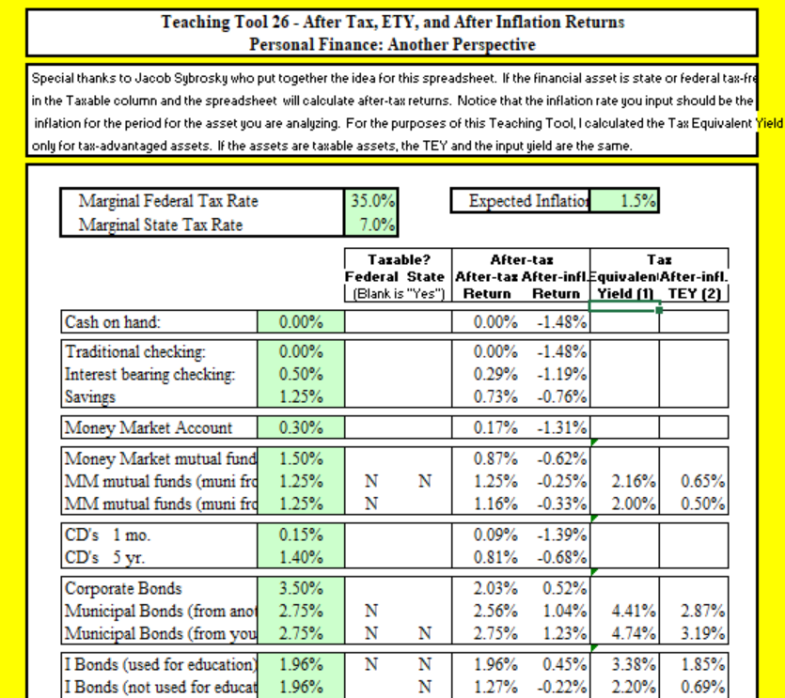
Additional Help: After Tax, ETY, and after Inflation Returns (LT26) may be useful

Slide 61
Case Study #4
Data
  Natalie heard you have taken Personal Finance at BYU. She just got married two months ago, and they were given $3,000 as a wedding present. Natalie and Taylor will both be graduating in two years. She wants either a. Save the money for law school tuition when she graduates or b. Use it to go on a vacation before law school. They are in the 22% federal and 5% state tax bracket.
Calculations
  If they invest the $3,000 in a U.S. Series I bond that earns 2.52%, what is her after-tax return and ETY for each decision.

Slide 62
Natalie and Taylor are in the 22% federal and 5% state tax bracket. They have a $3,000 wedding gift that they will either invest for school tuition or for a vacation. Calculations: If they invest the $3,000 in a U.S. Series I bond that earns 2.52%, what is the after tax and equivalent taxable yield (ETY) where the principle and interest are: A. Planned to be used to pay for law school tuition? or B. Planned to be used to save for a family vacation?
Calculations:
  A. AT: If Natalie and Taylor use the principle and interest for tuition, the bond is both federal and state tax exempt. The formula is:
    Return _{after tax} = return _{before tax} * (1 – tax rate) or:
    2.52%
  ETY: Since this asset is federal and state tax-free, the equivalent yield on a taxable bond would be the tax-free return divided by 1 minus the tax rate or
    2.52% /(1 – (.22 + .05)) = 2.52% / .73 =
    3.45%

Slide 63
Natalie and Taylor are in the 22% federal and 5% state tax bracket. They have a $3,000 wedding gift that they will either invest for school tuition or for a vacation. Calculations: If they invest the $3,000 in a U.S. Series I bond that earns 2.52%, what is the equivalent taxable yield (ETY) where the principle and interest are: A. Planned to be used to pay for law school tuition? or B. Planned to be used to save for a family vacation?
Calculations:
  B. AT: If Natalie and Taylor use the principle and interest for a family vacation, it is only state tax free. The after-tax rate is:
      After-tax rate = 2.52% * (1 - .22)
      1.97%
    ETY: The Equivalent Taxable Yield is
      ETY = 1.97% / (1 – (.22 + .07))
      2.69%
Implications:
  How they choose to spend the money can have a significant impact on their returns

Slide 64
Suggestions from Students
To get better rates:
  The Wall Street Journal under “Consumer Rates” has selected rates in various consumer categories. Sometimes this is an internet bank or S&L with a high interest rate. These may be interesting
    Be aware of the conditions and requirements for these rates as they may be onerous
    These may require a minimum balance
  Do a Google search on highest savings rates. Go down below the Ads, and it may give a few ideas
  Bankrate.com, nerdwallet.com and many others can give ideas of places to look for higher rates
  http://www.bankrate.com/brm/graphs/graph_trend.asp?

