Slide 1
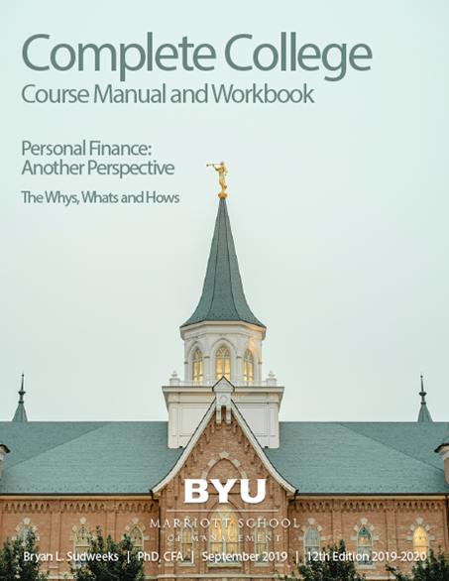
Personal Finance: Another Perspective
Building a Strong Foundation:
Another Perspective on Wealth
Updated 2020/01/06

Slide 2
Objectives
A. Understand how to bring Christ more into your finances
B. Understand our framework for learning:
Course structure and design
The importance of perspective
A different learning framework
C. Understand the implications of that learning framework
D. Remember that “Life is Good”

Slide 3
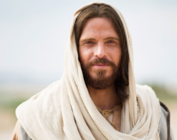
A. Understand How to Bring Christ Into our Finances
How do we bring Christ into our finances?
1. We increase our love for and faith in the Savior and His atonement
2. We strive to change daily and become more converted disciple
3. We learn to apply His words and create our lives and values more closely with Him
4. We always remember and reach up to Him

Slide 4
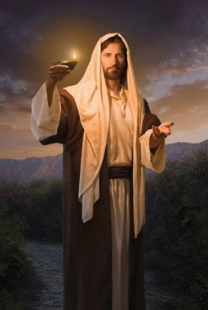
Bringing Christ into our Finances (continued)
1. We increase our knowledge of and faith in the Savior and His atonement
He knows and loves us perfectly, and has designed a detailed, individual, and customized curriculum (called life) exactly tailored to our needs, mission and destiny
Personal finance is simply one of the pieces of that curriculum and is part of His plan for His children

Slide 5
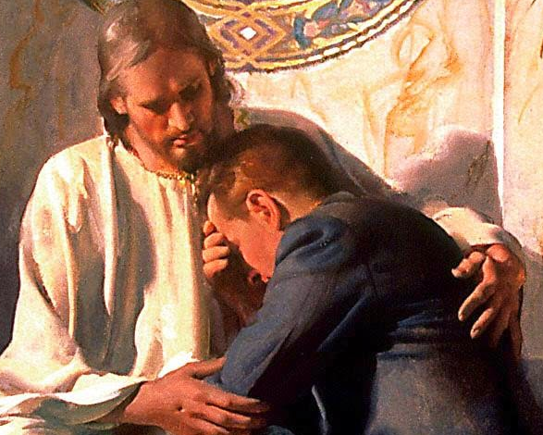
Bringing Christ Into our Finances (continued)
2. We strive to change daily and become a more converted disciple
God’s grace, repentance and the atonement of Jesus Christ are perfect tools to help us change and to become more like our Savior
Doctrines and principles, confirmed by the Spirit, can help us change our behavior
“The answers are always in the doctrines and principles, and the doctrines and principles need to be in us” (Bednar, Increase in Learning, p. 172)

Slide 6
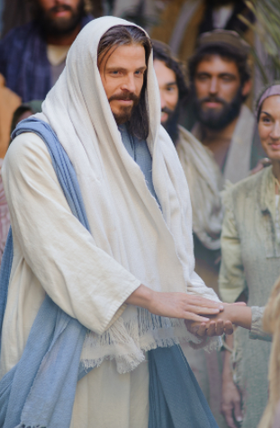
Bringing Christ Into our Finances (continued)
3. We apply His words and create our lives and values more closely with Him
Application is an invitation to learn and create
We are all creators, and can learn best from the Master
We learn important lessons from the creation
“Creation is a spiritual gift” (Sharon Eubank, “Turn on your Light,” Ensign, Nov. 2017)
We likely had our first lessons in creation in the pre-existence (Abraham 3:24.)

Slide 7
Bringing Christ Into our Finances (continued)
4. We always remember and reach up to Him
We need Christ’s inspiration and guidance daily if we are to return with our families to His presence
We remember:
His death and atonement save us
All things, including ourselves, are His
We are His stewards
We all are unprofitable servants
Our conduct on our journey is as important as our destination

Slide 8
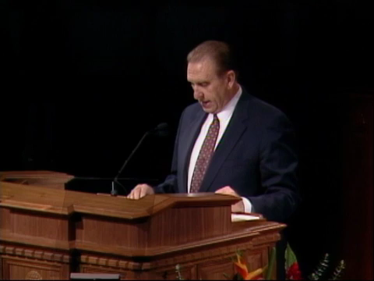
B. Our Framework for Learning
What is the purpose of this class?
To help you plan our financial future early

Slide 9

Course Structure and Design
What is our course structure and design?
It is “LEARN, DO, BECOME”
After 30 days, we retain:
10% of what we hear
30% of what we see
50% of what we see and hear
70% of what we do, and
90% of what we see, say and do
It is high learning and low stress class. You LEARN as you hear the discussions, share ideas and read the materials; DO as you ask questions, prepare the assignments and experiences, and BECOME as you create your Personal Financial Plan (see Serey and Verderber, 1989).

Slide 10

Course Structure and Design (continued)
LEARN
Classroom, materials and speakers
Book
Personal Finance: Another Perspective, Sudweeks, 12th Edition, 2019-2020, Sep. 2019
Link to a Zip file with materials
Costs for the class:
Class Packet CD $0.00
PFP Binder & Tabs 12.00
Online materials at www.Perrsonalfinance.byu.edu

Slide 11
Course Structure and Design (continued)
DO
1. Quizzes (40%). One quiz every 4 class periods, open book and notes but not open neighbor
2. Attendance and participation (15%). You will learn more from each other than from me. Consistent, on-time attendance is the mark of a professional.
3. Service teaching and experiences (5%). You will teach or do experiences and will write up each session. You will have 5 total teaching or PF experiences
4. Final Exam (15%). This will be a timed take home exam and will be likewise be open book and notes

Slide 12
Course Structure and Design (continued)
BECOME
You create your Personal Financial Plan 25%
This will help follow a prophet who said “plan your financial future early then live your plan”
Many of the 16 sections are due throughout the semester so check LearningSuite for dates
The final Personal Financial Plan (PFP) binder) and will handed back the last day of class will be submitted on Day 26 (the third to last day of class)

Slide 13
Course Structure and Design (continued)
When you have questions, we can help
My office hours are (666 TNRB):
Monday and Wednesday
9:30 -10:30 a.m.
2:00 – 3:00 p.m.
My TA is Hunter Christensen
He will post his office hours
He will respond to questions within 2 hours
It is “low stress, high impact learning”

Slide 14
The Importance of Perspective and Choice
What is the importance of perspective?
The historian Will Durant wrote of the human need “to seize the value and perspective of passing things. … We want to know that the little things are little, and the big things big, before it is too late; we want to see things now as they will seem forever—‘in the light of eternity’ ” (The Story of Philosophy, New York: Simon and Schuster, 1927, p. 1).
How do we see things “as they are, were, and are to come?” (D&C 93:24)

Slide 15
Perspective and Choice (continued)
The key is to have a correct perspective
Russell M. Nelson said,
“Understand who you are in God’s plan” (Robert C. Oaks, “Understand Who You Are,” BYU Speeches, Mar, 21, 2006).
Remember Simba and his departed father Mufasa from the Lion King
“Look inside yourself. You are more that what you have become. Remember who you are”
Likewise from the “Star Wards: Rise of Skywalker”
“Don’t be afraid of the real you”

Slide 16
Perspective and Choice (continued)
Our perspective for this course is simple:
Personal Finance is simply part of living the gospel of Jesus Christ
Christ taught that money, when anchored in His teachings, is part of His plan for His children as it allows us to use His resources wisely to exercise our stewardship, agency and accountability as we strive to follow and eventually become like Him
Notes:
“But seek ye first the kingdom of God, and his righteousness; and all these things shall be added unto you” (Matt. 6:33).
It is the temporal application of eternal principles

Slide 17
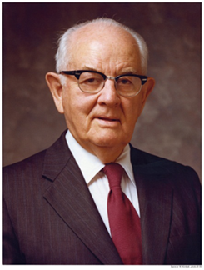
Perspective and Choice (continued)
What about choice?
Spencer W. Kimball said:
We hope we can help our young men and young women to realize, even sooner than they do now, that they need to make certain decisions only once. . . We can make a single decision about certain things that we will incorporate in our lives and then make them ours—without having to brood and re-decide a hundred times what it is we will do and what we will not do.… My young brothers [and sisters], if you have not done so yet, decide to decide! (“Boys Need Heroes Close By,” Ensign, May 1976, 46).

Slide 18
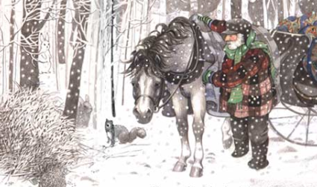


Perspective and Choice (continued)

Slide 19

A Different Learning Framework
Our learning framework is different
It is that doctrines and principles, confirmed by the Spirit, change behavior
“Personal finance is more personal than it is finance: it is more behavior than it is math” (Dave Ramsey)
How we spend our money is not just math, but an extremely complex decision-making process of deciding between current and future consumption—it is our behavior
Notes:
He calls it, “A flexible tool that can be used to enhance our gospel learning and can be a useful aid as we apply the principles of prayerful inquiry and the pattern of asking, seeking, and knocking” (Increase in Learning, p. 157).

Slide 20
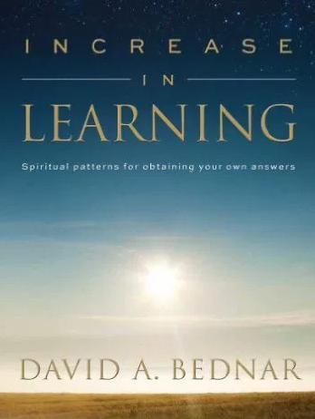
Learning Framework (continued)
We use Bednar’s framework for learning
It is ”a” pattern for learning, and not the “only” one
It is unique as it addresses behavior and change, and is detailed in his book Increase in Learning
It is based on not just doing, but understanding why we should do the things we should do
It is based on:
Doctrines (the why’s”)
Principles (the “what’s”), and
Application (the “how’s”).
It is finding balance in the things we do.
Notes:
He calls it, “A flexible tool that can be used to enhance our gospel learning and can be a useful aid as we apply the principles of prayerful inquiry and the pattern of asking, seeking, and knocking” (Increase in Learning, p. 157).

Slide 21
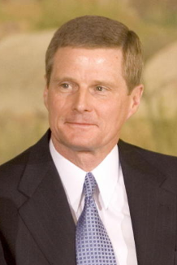
Learning Framework (continued)
David A. Bednar writes,
Somehow we seem to be drawn to application as the primary way to ‘fix” things, to make life better. . . And far too often we emphasize application without the necessary understanding and divorced from the doctrinal content. . . Whatever the reasons, emphasizing applications to the exclusion of fundamental doctrines and principles does not produce spiritual power, protection, and direction. . . Appropriate applications are necessary but can never stand alone. What is needed is a balance among doctrines, principles and application. . . The answers always are in the doctrines and principles. And the doctrines and principles need to be in us (ibid. italics added, p. 170-172).

Slide 22
Doctrines, Principles and Application (continued)
It is a learning framework
It asks three critical questions that lead to learning
1. Why should we [learn and become better at personal finance]? (this is “why” or a doctrine)
2. What are the principles on which how we [learn and become better at personal finance are based]? (this is “what” or a principle)
3. How do we [learn and become better at personal finance]? (this is “how” or an application)

Slide 23
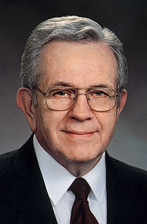
Doctrines or “Whys”
What are the “why’s” of personal finance?
Doctrines are the truth about ourselves, our lives, our history, and our relationship to our Father in Heaven and his Son Jesus Christ.
Boyd K. Packer said,
True doctrine, understood, changes attitudes and behavior. The study of the doctrines of the gospel will improve behavior quicker than a study of behavior will improve behavior (“Little Children,” Ensign, Nov. 1986, 17).

Slide 24
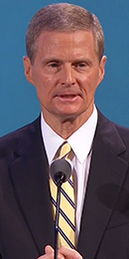
Doctrines or “Whys”
Bednar writes,
President Packer did not teach that simply knowing true doctrine changes us. Rather, doctrine must be understood. . .The word understanding in the scriptures frequently is linked to and associated with the heart and refers to a revealed result or conclusion. Thus, true doctrine confirmed in the heart as true by the witness of the Holy Ghost changes attitudes and behavior. Knowing true doctrine is necessary but is not sufficient. Understanding true doctrine both in our minds and in our hearts is essential to a righteous attitude and actions (Ibid, p. 153).

Slide 25
Doctrines or “Whys” (continued)
Why learn doctrines?
Question 1: “Why should we learn and become better at family finance?”
Doctrines are critical as they give us the motivation and strength to do the right things even when they are difficult

Slide 26
Doctrines or “Whys” (continued)
Spiritual
To bring us to Christ, who then brings us to Heavenly Father
Because God’s work and glory is to bring to pass the “immortality and eternal life of man” (Moses 1:39) and the only way we can have eternal life is through Jesus Christ (see John 14:6), then the purpose of all mortal experience is to bring us to Christ, who brings us to Heavenly Father
Notes:
Learning to live life and manage our finances according to gospel principles will help us to become more like our Savior

Slide 27
Doctrines or “Whys” (continued)
Temporal
To become wiser stewards
Joe J. Christensen reminds us:
Our resources are a stewardship, not our possessions. I am confident that we will literally be called upon to make an accounting before God concerning how we have used them to bless lives and build the kingdom (“Greed, Selfishness, and Overindulgence,” Ensign, May 1999).
Notes:
Managing resources is a skill that Heavenly Father wants us to develop during mortality so he can trust us with the greater gifts, even eternal life

Slide 28
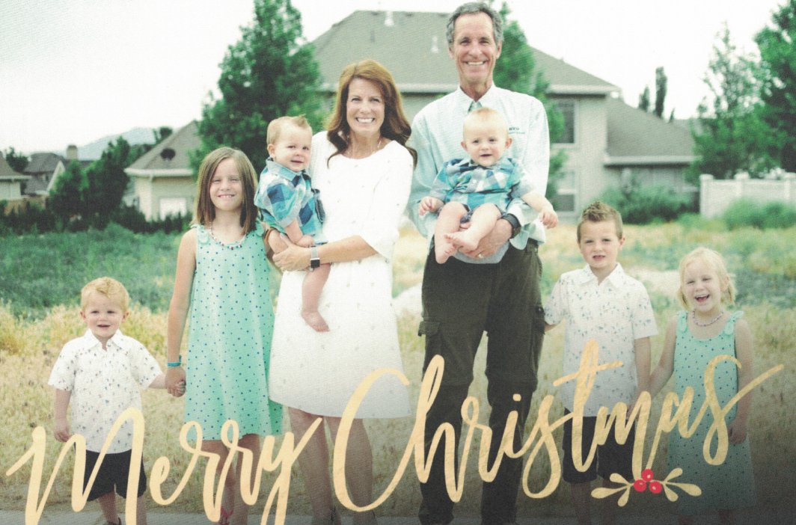
Doctrines or “Whys” (continued)
Family
To return with our families back to Heavenly Father’s presence
David O. McKay reminded us,
“No other success can compensate for failure in the home” (Conference Report, Apr. 1935).
Notes:
An eternal perspective on finances can prepare us for eternal marriage, strengthen existing marriages, and be a conduit for positive parenting

Slide 29
Doctrines or “Whys” (continued)
Individual
To prepare for and accomplish our divine missions
We all have sacred missions to perform here on earth as part of our “divine nature and destiny” (Proclamation on the Family, Ensign, November 1995)
Notes:
Many of our missions will require material resources. As we are faithful in managing our finances, we can acquire resources that we can then consecrate to the work God has for us to do

Slide 30
Principles or “What’s”
Why learn principles?
Question 2: What are the principles on which how we ‘learn and become better at family finance’ are based?
Principles are “doctrinally based guideline for the righteous exercise of moral agency. Principles are subsets or components of broader gospel truth. Principles provide direction” (Bednar, p. 154)

Slide 31

Principles or “What’s) ” (continued
Ownership
We do not own the things we have and are
The scriptures remind us
“The earth is the Lord’s, and the fullness thereof; the world, and they that dwell therein (Psalms 24:1). The Lord is the creator of the earth (1 Nephi 17:36), the creator of worlds, men, and all things (D&C 93:10) and the preserver of our life and supplier of our breath (Mosiah 2:21)

Slide 32
Principles or “What’s”(continued)
^{i]}
Stewardship
We are stewards over all the Lord has given us
The Lord said:
Thou shalt be diligent in preserving what thou hast, that thou mayest be a wise steward; for it is the free gift of the Lord thy God, and thou art his steward. (D&C 136:27)

Slide 33
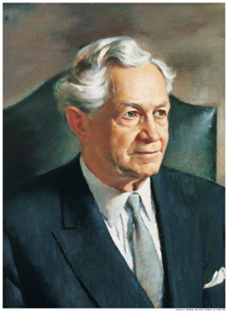
Principles or “What’s”(continued)
Agency
We are agents to act and not be acted upon
David O. McKay wrote,
Next to the bestowal of life itself, the right to direct that life is God’s greatest gift to man.… Freedom of choice is more to be treasured than any possession earth can give (Conference Report, Apr. 1950, p. 32; italics added).

Slide 34
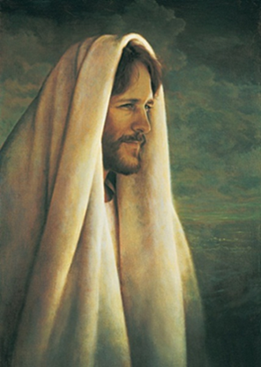
Principles or “What’s”(continued)
Accountability
We are accountable for our choices and actions
The Lord counseled,
For it is required of the Lord, at the hand of every steward, to render an account of his stewardship, both in time and in eternity. (D&C 72:3)

Slide 35
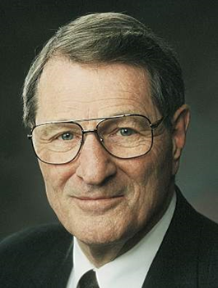
Principles or “What’s” (continued)
Neal A. Maxwell put “things” into a correct perspective when he taught:
The submission of one’s will is really the only uniquely personal thing we have to place on God’s altar. The many other things we “give,” brothers and sisters, are actually the things He has already given or loaned to us. However, when you and I finally submit ourselves, by letting our individual wills be swallowed up in God’s will, then we are really giving something to Him! It is the only possession which is truly ours to give! (italics added, “Swallowed Up in the Will of the Father,” Ensign, Nov. 1995, 22).

Slide 36
Application or “How’s”
Why learn application?
Question 3. “How do we learn about and become better at family finance?”
It is how we accomplish what we need to do, i.e., how we go from the spiritual creation to the physical creation
Application is an invitation to learn and create
Remember, “innovation and creation are spiritual gifts” (Sharon Eubank, “Turn on Your Light,” Ensign, Nov. 2017)

Slide 37
Application or “How’s” (continued)
What lessons can we learn from the creation to help us with application?
1. God is creative
We are in His image so we should be creative too
2. Christ worked under the direction of the Father
We should work under Father’s direction as well
3. Creation is a two-step process
We create spiritually first, then physically
4. There was an order in creation
We have order in our creations as well.

Slide 38
Application or “How’s” (continued)
5. The earth was created from existing matter
We create with our skills, talents, abilities and vision with the materials that are around us
6. Creation takes time
Our creations will take time as well.
7. Creation was a planned event
Likewise our lives should be a planned event
8. We create every day
We create through prayer, family, vision and goals, finances, and every day of our lives
Through this class and creating your PFP may help make your life a planned event!

Slide 39
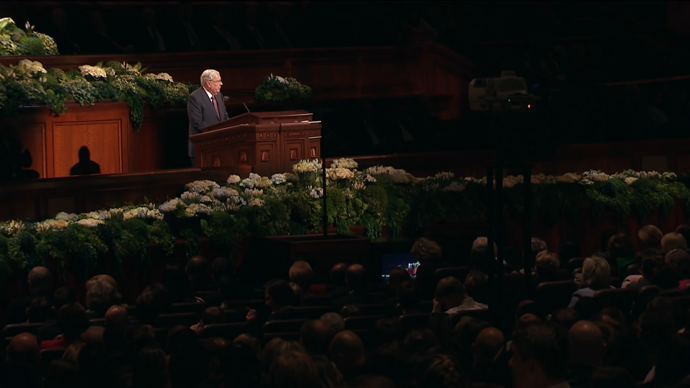
Application or “How’s” (continued)
How do we apply these things? Let me share a “pattern” that is helpful

Slide 40
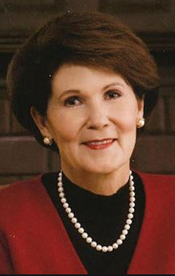
Application or “How’s” (continued)
Vision: We Catch our Vision
“Where there is no vision, the people perish” (Proverbs 29:18). Vision is critical effective goals
Patricia T. Holland said,
“Our prayers ought to be to see as God sees, to adjust our minds so we may see things from an eternal perspective. If we listen too often to the voices of the world, we will become confused and tainted. We must anchor ourselves in the spirit and that requires daily vigilance.” (“A Women’s Perspective on the Priesthood,” Liahona, June 1982.).

Slide 41
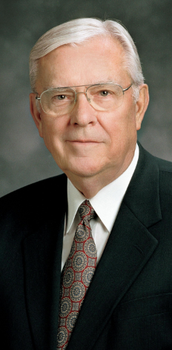
Application or “How’s” (continued)
Goals: We Develop our Goals
Goals are tools to help us keep us focused on our vision. M. Russell Ballard said:
Over the years, I have observed that those who accomplish the most in this world are those with a vision for their lives, with goals to keep them focused on their vision and tactical plans for how to achieve them. Knowing where you are going and how you expect to get there can bring meaning, purpose, and accomplishment to life (“Return and Receive,” Ensign, May 2017.).

Slide 42

Application or “How’s” (continued)
Plans and Strategies: We make our tactical plans and strategies
M. Russell Ballard said,
“Making these goals is not enough; we must make a plan to carry them out” (Ibid.)
Goals are the destination, where we want to be, and our plans are the process by which we will get from where we are now to where we want to be

Slide 43
Application or “How’s” (continued)
Constraints: We Determine our Constraints
Constraints are given conditions or circumstances that your solution must satisfy.
They must be taken into account as they can have a major impact on your ability to accomplish your goals and vision
These are planning for and avoiding things that could keep you from accomplishing your vision and goals

Slide 44
Application or “How’s” (continued)
Accountability: We share our vision with others
Accountability is the process by which we make known our vision, goals and plans to others
a. We need the moral or personal help of family, friends, and others to accomplish our goals and vision
b. Mentors and friends can help when we fall short to know what to do to improve
c. As we share, we give others permission to catch their own vision as well

Slide 45
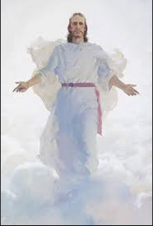
Application or “How’s” (continued)
An example
Heavenly Father’s vision is the exaltation of his children. His goal is to “bring to pass the immortality and eternal life of man” (Moses 1:39). His plan is the Plan of Salvation or the Plan of Happiness. He has no constraints as his plan is for all people, although He will not violate the agency of His children. And He communicates his plan with children through His Son, accountability partners, parents, leaders, prophets, apostles and scriptures. Just as He has a vision, goal, plans, constraints, and accountability, so we should too.

Slide 46
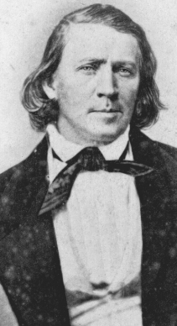
Application or “How’s” (continued)
Finally, Our conduct on our journey is as important as our destination
Some have assumed that the revelation (D&C 136) is a simple how-to guide for organizing pioneer companies and have underestimated the role it played in refocusing Brigham Young and the Church. By helping the Saints remember that their conduct on the journey was as important as their destination, the revelation helped transform the westward migration from an unfortunate necessity into an important shared spiritual experience (Chad M. Orton, Revelations in Context, “This Shall Be Our Covenant,” Intellectual Reserve, USA, 2016.)

Slide 47
Application or “How’s” (continued)
As we remember the importance of our daily conduct, it:
Helps us to keep focused on our ultimate long-term vision and goals, to returning to Father’s presence
Helps us keep our priorities in order and reminds us of the importance of being worthy of the guidance of the Holy Spirit
Changes personal finance from being an unfortunate necessity into an important shared spiritual experience as we make the journey with our spouse and family

Slide 48
C. Implications of This Framework
Why is this learning framework important?
1. This framework helps us ask the important questions about our lives and our finances, such as
“What doctrines and principles, if understood, would help me:
“Change my attitudes and behaviors toward my finances to become better at them?”
“Teach my children the place of money in our lives, instead of just the world’s ways?”
“Better live the commandments to live on a budget, spend less than I earn, and be more exact in my record keeping?”

Slide 49
Implications (continued)
2. This framework reminds us where the answers are
Bednar reminds us,
Appropriate applications are necessary but can never stand alone. What is needed is a balance among doctrines, principles and application. . . The answers always are in the doctrines and principles. And the doctrines and principles need to be in us (Italics added, David A. Bednar, Increase in Learning, p. 170-172.)

Slide 50
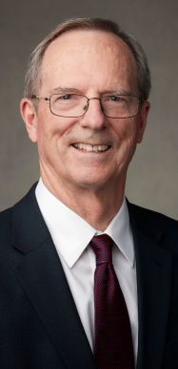
Implications (continued)
3. This framework allows us to lift our perspective and vision, which can help us gain greater motivation
By finding our higher purpose (or doctrines) in what we are doing, we gain greater motivation to do the things that we need to do
Tad R. Callister shared “With increased vision comes increased motivation” (“The Power in the Priesthood in the Boy,” Ensign, May 2013).

Slide 51
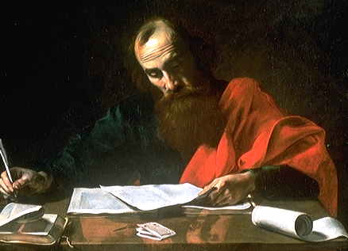
Implications (continued)
4. This framework encourages a long-term “eternal” perspective rather than a “checklist” approach
Paul declared “In the dispensation of the fullness of times [God] might gather together in one all things in Christ” (Ephesians 1:10).
David A. Bednar said,
The principle of gathering together in one can aid us in changing the conventional checklist [of family finance] into a unified, integrated, and complete whole in receiving the transforming power of the gospel of Jesus Christ in our lives (Bednar, p. 163)

Slide 52
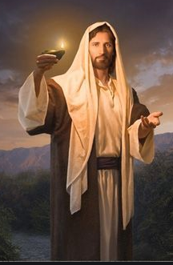
Implications (continued)
5. This framework reminds us of the importance of Christ and of our daily conduct
Its not enough to know these things and even to have a testimony of their truthfulness, we must do them everyday
It is crucial that we daily stay on the covenant path daily and we WILL achieve our destination

Slide 53
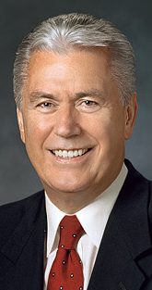
Implications (continued)
6. This framework helps change our thinking
While principles and application keep us on the right track, understanding the doctrines and principles allows us to transform those hourly and daily mundane acts of obedience we must do in our finances into the majestic purposes that our Heavenly Father has planned for us.
Dieter F. Uchtdorf says,
It magnifies our small acts of obedience into holy acts of consecration (“Forget Me Not,” Ensign, Nov. 2011.)

Slide 54
D. Remember that Life is Good
“Life is Good:” is a three word acronym for what I want you to get out of this class
L Love the Lord, and always put and pay Him first
I Invest your money wisely, build a reserve and save
F Find happiness in your spouse, family and service
E Enjoy the journey and give back
I Invest in yourself and family, save for educ. & missions
S Save 20% of all earnings, with 15% for retirement
G Get and stay out of debt, be debt free except to God
O Organize your life, and know vision, goals and plans
O Operate on a budget, and protect yourself with insurance
D Do good, be good, and strive to be more like Christ

Slide 55
Summary
We must bring Christ more into our lives and finances
We increase our learning and love for the Savior and His atonement
We strive to change daily and become more like Christ
We learn to apply His words and create our lives more closely with Him, and
We always remember Him

Slide 56
Summary
Our learning framework addresses each of those key areas. It asks three questions:
Question 1: “Why should we learn and become better at family finance?”
Doctrines are truths about ourselves, our lives, and our relationship with God
Question 2: What are the principles on how we ‘learn and become better at finance’ are based?
Principles are guidelines for the use of agency
Question 3. “How do we learn about and become better at family finance?”
Application is how we accomplish what we need

Slide 57
Summary (continued)
C. Implications of this framework
1. It helps us ask the important questions about ourselves and our finances
2. It reminds us where the answers really are
3. It allows us to lift our perspective and our purpose which brings greater motivation
4. It encourages us to take the long-term (eternal) perspective, which is the one that really matters
5. This framework reminds us of the importance of Christ and of our daily conduct
6. It changes our thinking from “small acts of obedience into holy acts of consecration” (Deiter F. Uchtdorf, “Forget Me Not,” Ensign, Nov. 2011).

Slide 58
Review of Objectives
A. Do you understand how to bring Christ more into our finances?
B. Do you understand our framework for learning:
Course structure and design
The importance of perspective
Doctrines, principles and application?
C. Do you understand the implications of that learning framework?
D. Do you remember that “Life is Good?”

Slide 59
Case Study #1
Data
Brenda came from a family that had little of the world’s goods, but there was a lot of love in the home. The parents loved their children and the children loved their parents. She respects you for the wonderful example you have set.
Application
She asks you:
1. What is the purpose of wealth in our lives?
2. What scriptures support that purpose?

Slide 60
Case Study #1 Answers
You have lots of good ideas, but you might share the following:
The Nephite Prophet Jacob shared with us one view of the purpose of wealth in our lives. He counseled us that if we seek wealth, we should do it for the right reasons:
“After ye have obtained a hope in Christ ye shall obtain riches, if ye seek them; and ye will seek them for the intent to do good-to clothe the naked, and to feed the hungry, and to liberate the captive, and administer relief to the sick and the afflicted.“ (Jacob 2:18-19)

Slide 61
Case Study #1 Answers
2. Again, there are many different answers from scripture. You could respond:
Riches are to help us to fulfill our missions here on earth, to help us become like Christ, to raise righteous families, to move the kingdom forward, and to help and serve others. Remember D&C 14:7 and 11:7:
Seek not for riches but for wisdom; and, behold, the mysteries of God shall be unfolded unto you, and then shall you be made rich. Behold, he that hath eternal life is rich.

Slide 62
Case Study #2
Data
Brenda continues to ask you questions regarding your perspective and guiding principles for understanding and using wealth wisely.
Application
She asks:
What are the four key guiding principles for using wealth wisely? Why is each principle important? What can we do now to incorporate each principle into our lives now?

Slide 63
Case Study #2 Answers
There are a lot of good answers for these questions. You might respond with: The key principles for understanding and using wealth wisely are:
1. Ownership: Everything we have or are is a gift from God.
It is important as the things we have are not ours, but are on loan from a loving Father in Heaven
We can incorporate this principles into our lives by learning that when we share with others, we are only giving back to God what was His in the first place, and what He has loaned to us.

Slide 64
Case Study #2 Answers
2. Stewardship: We are stewards over the things the Lord has blessed us with.
It is important as we must learn to be better stewards over our blessings as we will be held accountable for what we do with these blessings.
We can incorporate this into our lives by learning as much as we can about the things we need to do so that we can become the best stewards we can over the blessings our Heavenly Father shares with us.

Slide 65
Case Study #2 Answers
3. Agency: The gift of “choice” is man’s most precious inheritance
It is important as we need to use this gift wisely so we can return and live with God eternally.
We can incorporate this in our lives by studying all areas of our decisions and decision making processes so we can have the information needed to make the best decisions possible.

Slide 66
Case Study #2 Answers
4. Accountability: We are accountable for our choices
We are the final decision makers in life.
It is important as we must learn to choose wisely.
We can incorporate this into our lives by setting good goals and then by making wise choices to help us attain those goals—goals that our Heavenly Father would have us seek for.

Slide 67
Case Study #3
Data
Brenda was concerned as one of her friends was blessed with material riches, and made poor choices which caused him to lose his testimony. She asks: “If wealth is so bad, should we seek for riches?”
Application
What did the prophet Jacob in Jacob 2:18-19 say about this question? What should we seek for first?

Slide 68
Case Study #3 Answers
The prophet Jacob said seeking for riches is OK “if” we first seek the Kingdom of God, and if we seek riches for the right intent--for righteous purposes.
But before ye seek for riches, seek ye for the kingdom of God. "And after ye have obtained a hope in Christ ye shall obtain riches, if ye seek them; and ye will seek them for the intent to do good-to clothe the naked, and to feed the hungry, and to liberate the captive, and administer relief to the sick and the afflicted (Jacob 2:18-19).
First, we should seek for the Kingdom of God and doing His will. Then we can seek for riches—but with the intent to do good

Slide 69
Case Study #3 Answers
Gordon B. Hinckley said:
The Lord will love us, I think, to the degree to which we lift and bless those in distress. I believe that with all my heart, mind, and soul. The accumulation of means is not a bad endeavor when those means are used to bless the needy of the earth (Discourses of President Gordon B. Hinckley, Volume 2, Intellectual Reserve, 2005, p. 593.)

